Slide 1



EPOCH-2017 Project Overview
&
NCAR/EOL Dropsonde Data Archive
Kate Young
04/24/2018

Slide 2
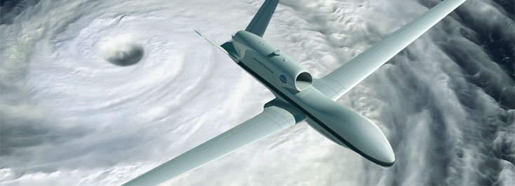
Project Overview
The East Pacific Origins and Characteristics of Hurricanes (EPOCH) NASA funded research campaign aimed at studying tropical storms in the Northern Hemisphere
Notes:
in order to learn more about conditions that drive changes in intensity, and to use the data to improve forecasting models that predict tropical storm impacts on coastal communities.
The project planned six research flights of the NASA Global Hawk conducted between August 1 and August 30, 2017 with 50% of the flights supported through a partnership with the NOAA UAS Program Office, based from NASA Armstrong Flight Research Facility. Only three research flights were flown during the field campaign.

Slide 3
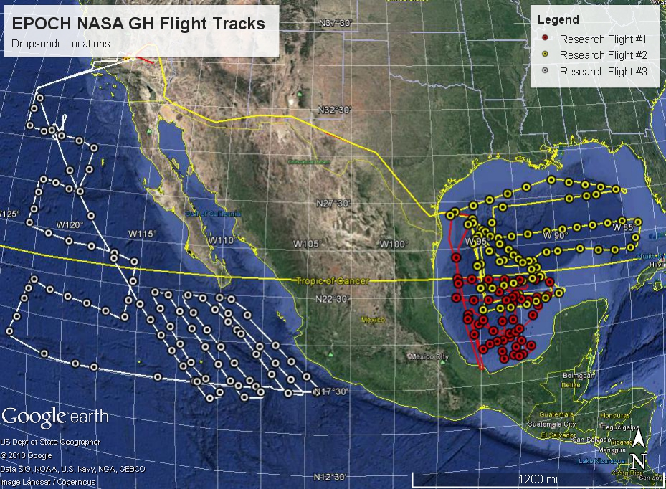
Research Flight | Dates | NRD94 | NRD41 | Sondes deployed
RF01 | 08/09/2017 | 48 |  | 48
RF02 | 08/23/2017 - 08/24/2017 | 65 | 13 | 78
RF03 | 08/30/2017 - 08/31/2017 | 79 | 11 | 90
Total |  |  |  | 216
Notes:
RD41 dropsondes use a next generation PTU module manufactured by Vaisala that has a faster temperature response sensor and improved RH sensor, all the dropsonde electronics were updated including a new 400 MHz transmitters and next generation GPS receiver for the computation of winds.

Slide 4
Corrections Applied
Dry bias correction, by AVAPS, in the relative humidity measurements of the NRD94 dropsondes (TDDryBiasCorrApplied)
Pressure calibration correction is applied to each profile P = P_{DS} + (P0_{REF} - P0_{DS}⁾
GPS altitude measurements have been improved (NRD94 only) by removing an existing real-time geoid correction and replacing it with a more accurate geoid height from the Earth Gravitational Model 1996 (EGM96)
Filtering of the GPS latitude, longitude and altitude is performed to remove spikes introduced by telemetry errors
ASPEN
  Dynamic correction
  Performs smoothing
  Removes suspect data points
Notes:
This bias was discovered, in the spring of 2016. All sounding files have been corrected for this error and contain the flag,
The pressure correction value is unique for each dropsonde and is determined in the final testing of the dropsonde, during production, at which time an independent reference pressure sensor is used to determine a constant pressure offset correction
pressure correction is on average -0.98 for the NRD41 dropsondes and -1.1 hPa for the NRD94

Slide 5
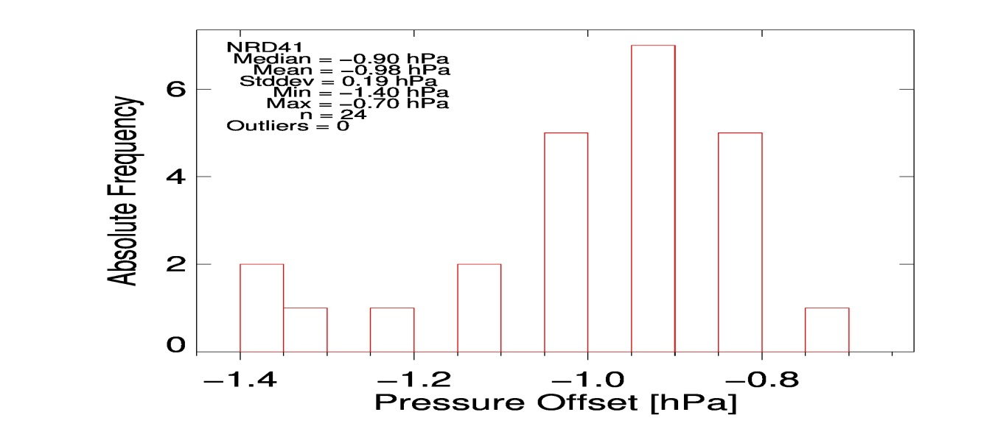
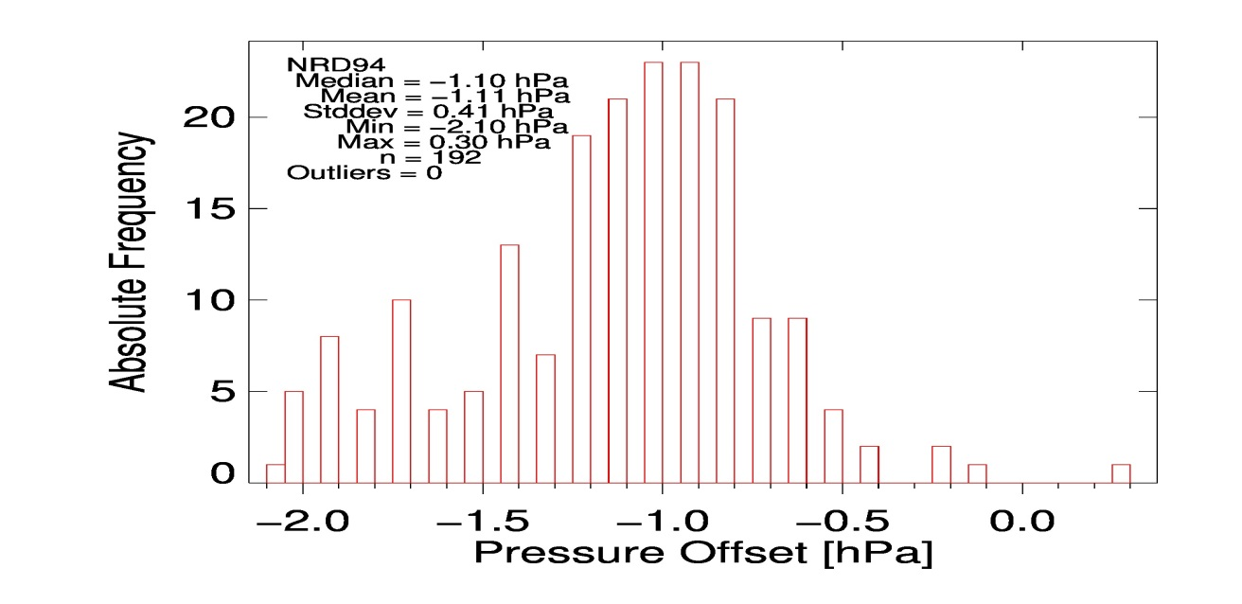
Pressure Correction

Slide 6
Results
PTU and GPS Success Rate = 99.9%
Data Quality Issue | # of soundings
Data Not to Surface | 3
Broken RH Sensor | 2
Early Launch Detect | 1
Bad T/ RH | 1
Missing RH through Saturated Layers | 3

Slide 7
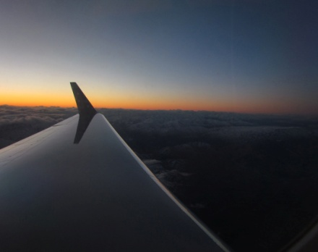
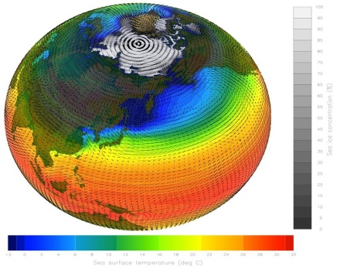
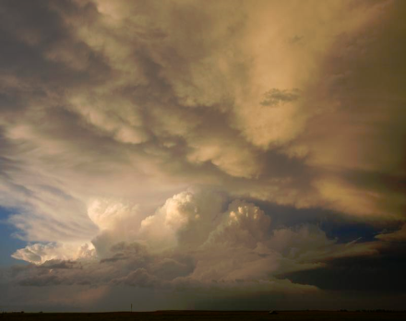
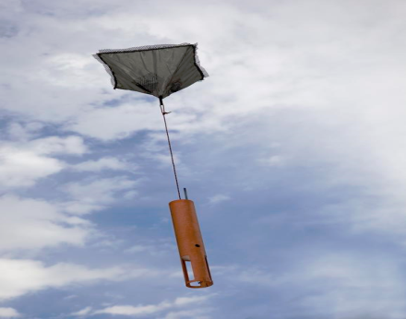
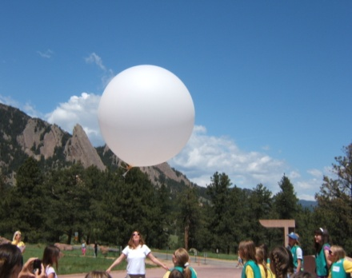
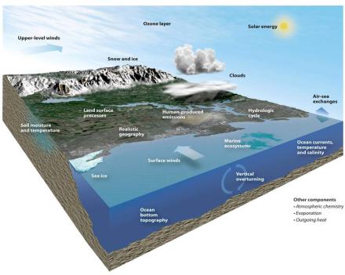


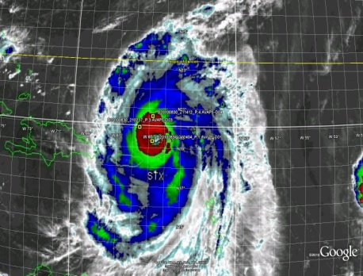
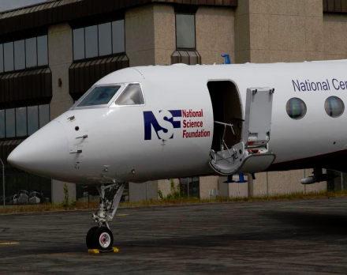
NCAR/EOL Data Archive

Slide 8
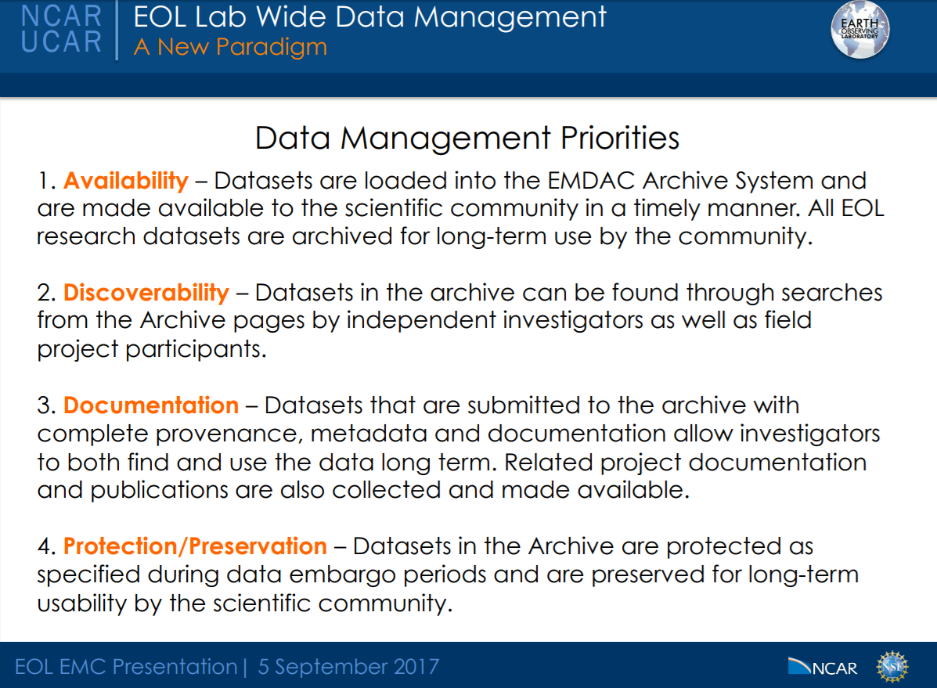

Slide 9
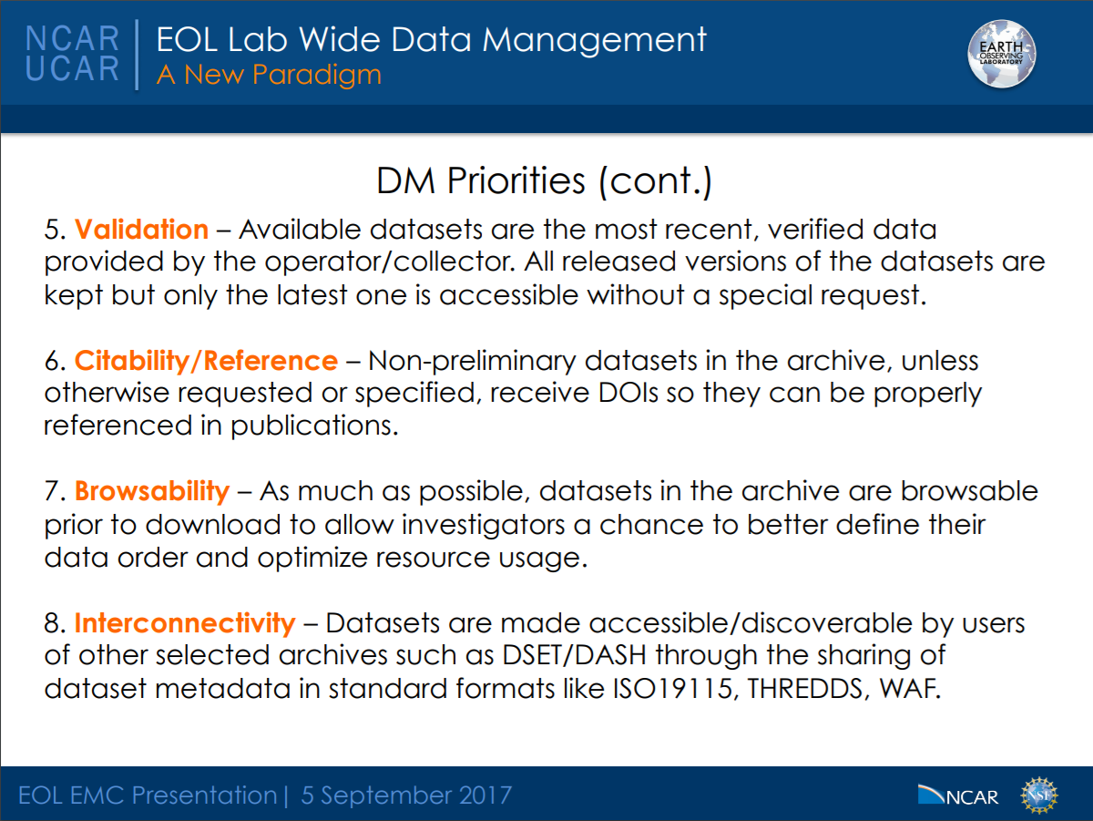
Dropsonde Data Archive

Slide 11
EOL Data Archive
  Online Tool : https://data.eol.ucar.edu/
      Mysql database w/ interface that is easily browsable (project/instrument)
        Project Information
          Summary with Scientific Objectives
          Location & Dates
          Internal Contact Information
        Quality Controlled Data & Data Quality Reports
        Enables Versioning
        Assignment of Digital Objective Identifiers
        Assignment of GCMD Keywords
        Tracking Capability and Metrics

Slide 12
Digital Object Identifiers
A unique identifier assigned to data sets, instruments or software
Track use of EOL-hosted Lower Atmosphere Observing Facilities (LAOFs) and EOL-provided/hosted datasets to obtain reliable metrics
Provide users with a simple, standard way to reference EOL LAOF and datasets
Provide recognition to authors whose creativity and work created the dataset
Lead EOL community in following modern data citation practices

Slide 13
GCMD Keywords
GCMD – Global Change Master Directory
  Governed by NASA
  Includes scientific keywords used for searchability and discoverability
  Keywords can describe instrumentation, platform, topics (ie ocean, atmosphere) and each has a unique universal ID

Slide 14
UCAR/NCAR - Earth Observing Laboratory. 2018. EPOCH 2017 Global Hawk QC Dropsonde Data. Version 1.0. UCAR/NCAR - Earth Observing Laboratory. https://doi.org/10.5065/D60G3HX6. Accessed 28 Feb 2018.

