Slide 1
Update on the RD41 measurements
NCAR |
EOL
Holger Vömel, T. Hock, M. Goodstein, K. Young, I. Suhr NCAR EOL
J. Smith
NOAA/AOC
20th AVAPS Users Group Meeting 25 April 2018
Notes:
Acknowledge NOAA AOC for their effort

Slide 2
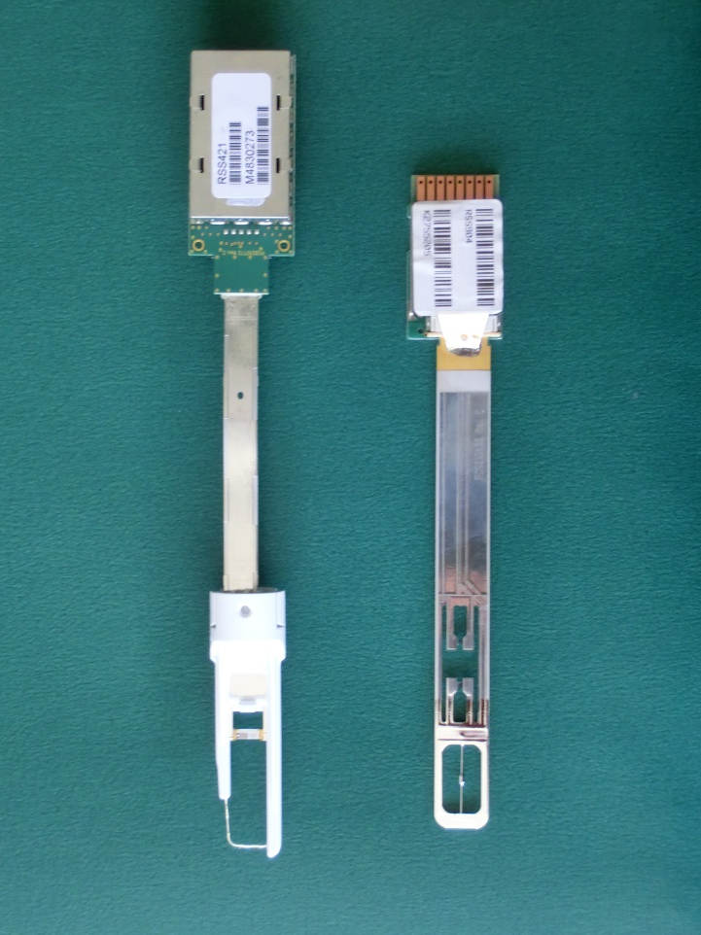
New Vaisala RS41 PTU Module
New PTU Sensors module based on RS41 radiosonde → RD41 dropsonde
New resistive platinum temperature sensor and support structure
One RH sensor
Humidity sensor has a built-in heater & temperature sensor
Same pressure sensor technology
RD41
RD94
RH2
RH1
Temp
RH
Temp
Notes:
the humidity sensor has a built-in temperature sensor which continuously monitors the temperature of the humidity sensor. This temperature is factored in humidity measurements to ensure accuracy in all conditions.

Slide 3
Temperature

Slide 4
Faster temperature measurements
RD41 temperature time constant about 4 times faster
Notes:
Time lag correction makes a difference of about 0.2 K near the surface to about 0.7 K in upper troposphere

Slide 5
Difference between RD41 and RD94 temperature
Aspen time lag corrected

Slide 6
RD41 Temperature Repeatability
17 Sondes

Slide 7
Comparison to Buoy

Slide 8
Relative humidity

Slide 9
RD94 and RD41 relative humidity

Slide 10
RD41 relative humidity variability
17 Sondes

Slide 11
NOAA RD41/RD94 intercomparison October 2017

Slide 12
NOAA RD41/RD94 intercomparison October 2017

Slide 13
Comparison to Buoy

Slide 14
Pressure

Slide 15
NOAA RD41/RD94 intercomparison October 2017

Slide 16
RD41 pressure variability
17 Sondes

Slide 17
Comparison to Buoy

Slide 18
Winds

Slide 19
RD41 wind variability
17 Sondes

Slide 20
Near surface vertical fall velocity

Slide 21
Summary
NCAR dropsonde PTU sensor module updated: RD41
Faster temperature measurement Systematic error to RD94 < 0.2 K Systematic error to buoy < -0.5 K Repeatability < 0.3 K
Better relative humidity measurement RD94 dry bias eliminated Systematic error to RD94 ~ 3% (due to high range) Systematic error to buoy < -3% Repeatability ~ 2% (in lowest km)
No change in pressure measurements Better offset correction Repeatability < 1 hPa Systematic error to buoy < -0.5 hPa
Update in GPS eliminated near surface wind spikes Repeatability ~ 1 – 2 m/s

