Slide 1
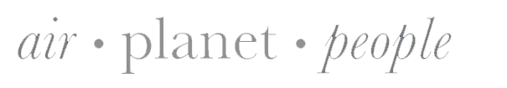
Discussion:
Dropsonde pressure measurements
NCAR |
EOL
Holger Vömel
20th AVAPS Users Group Meeting
25 April 2018
Notes:
Acknowledge NOAA AOC for their effort

Slide 2
Issue
The dropsonde pressure sensor has a small systematic offset, which should be corrected before a sounding:
Current status:
NOAA/AOC: In-aircraft pressure reference sensor
NCAR campaigns: post-processing based on reference comparison during production
Air Force and others: No correction
Future status with RD41
Pressure correction built into firmware
Notes:
Time lag correction makes a difference of about 0.2 K near the surface to about 0.7 K in upper troposphere

Slide 3
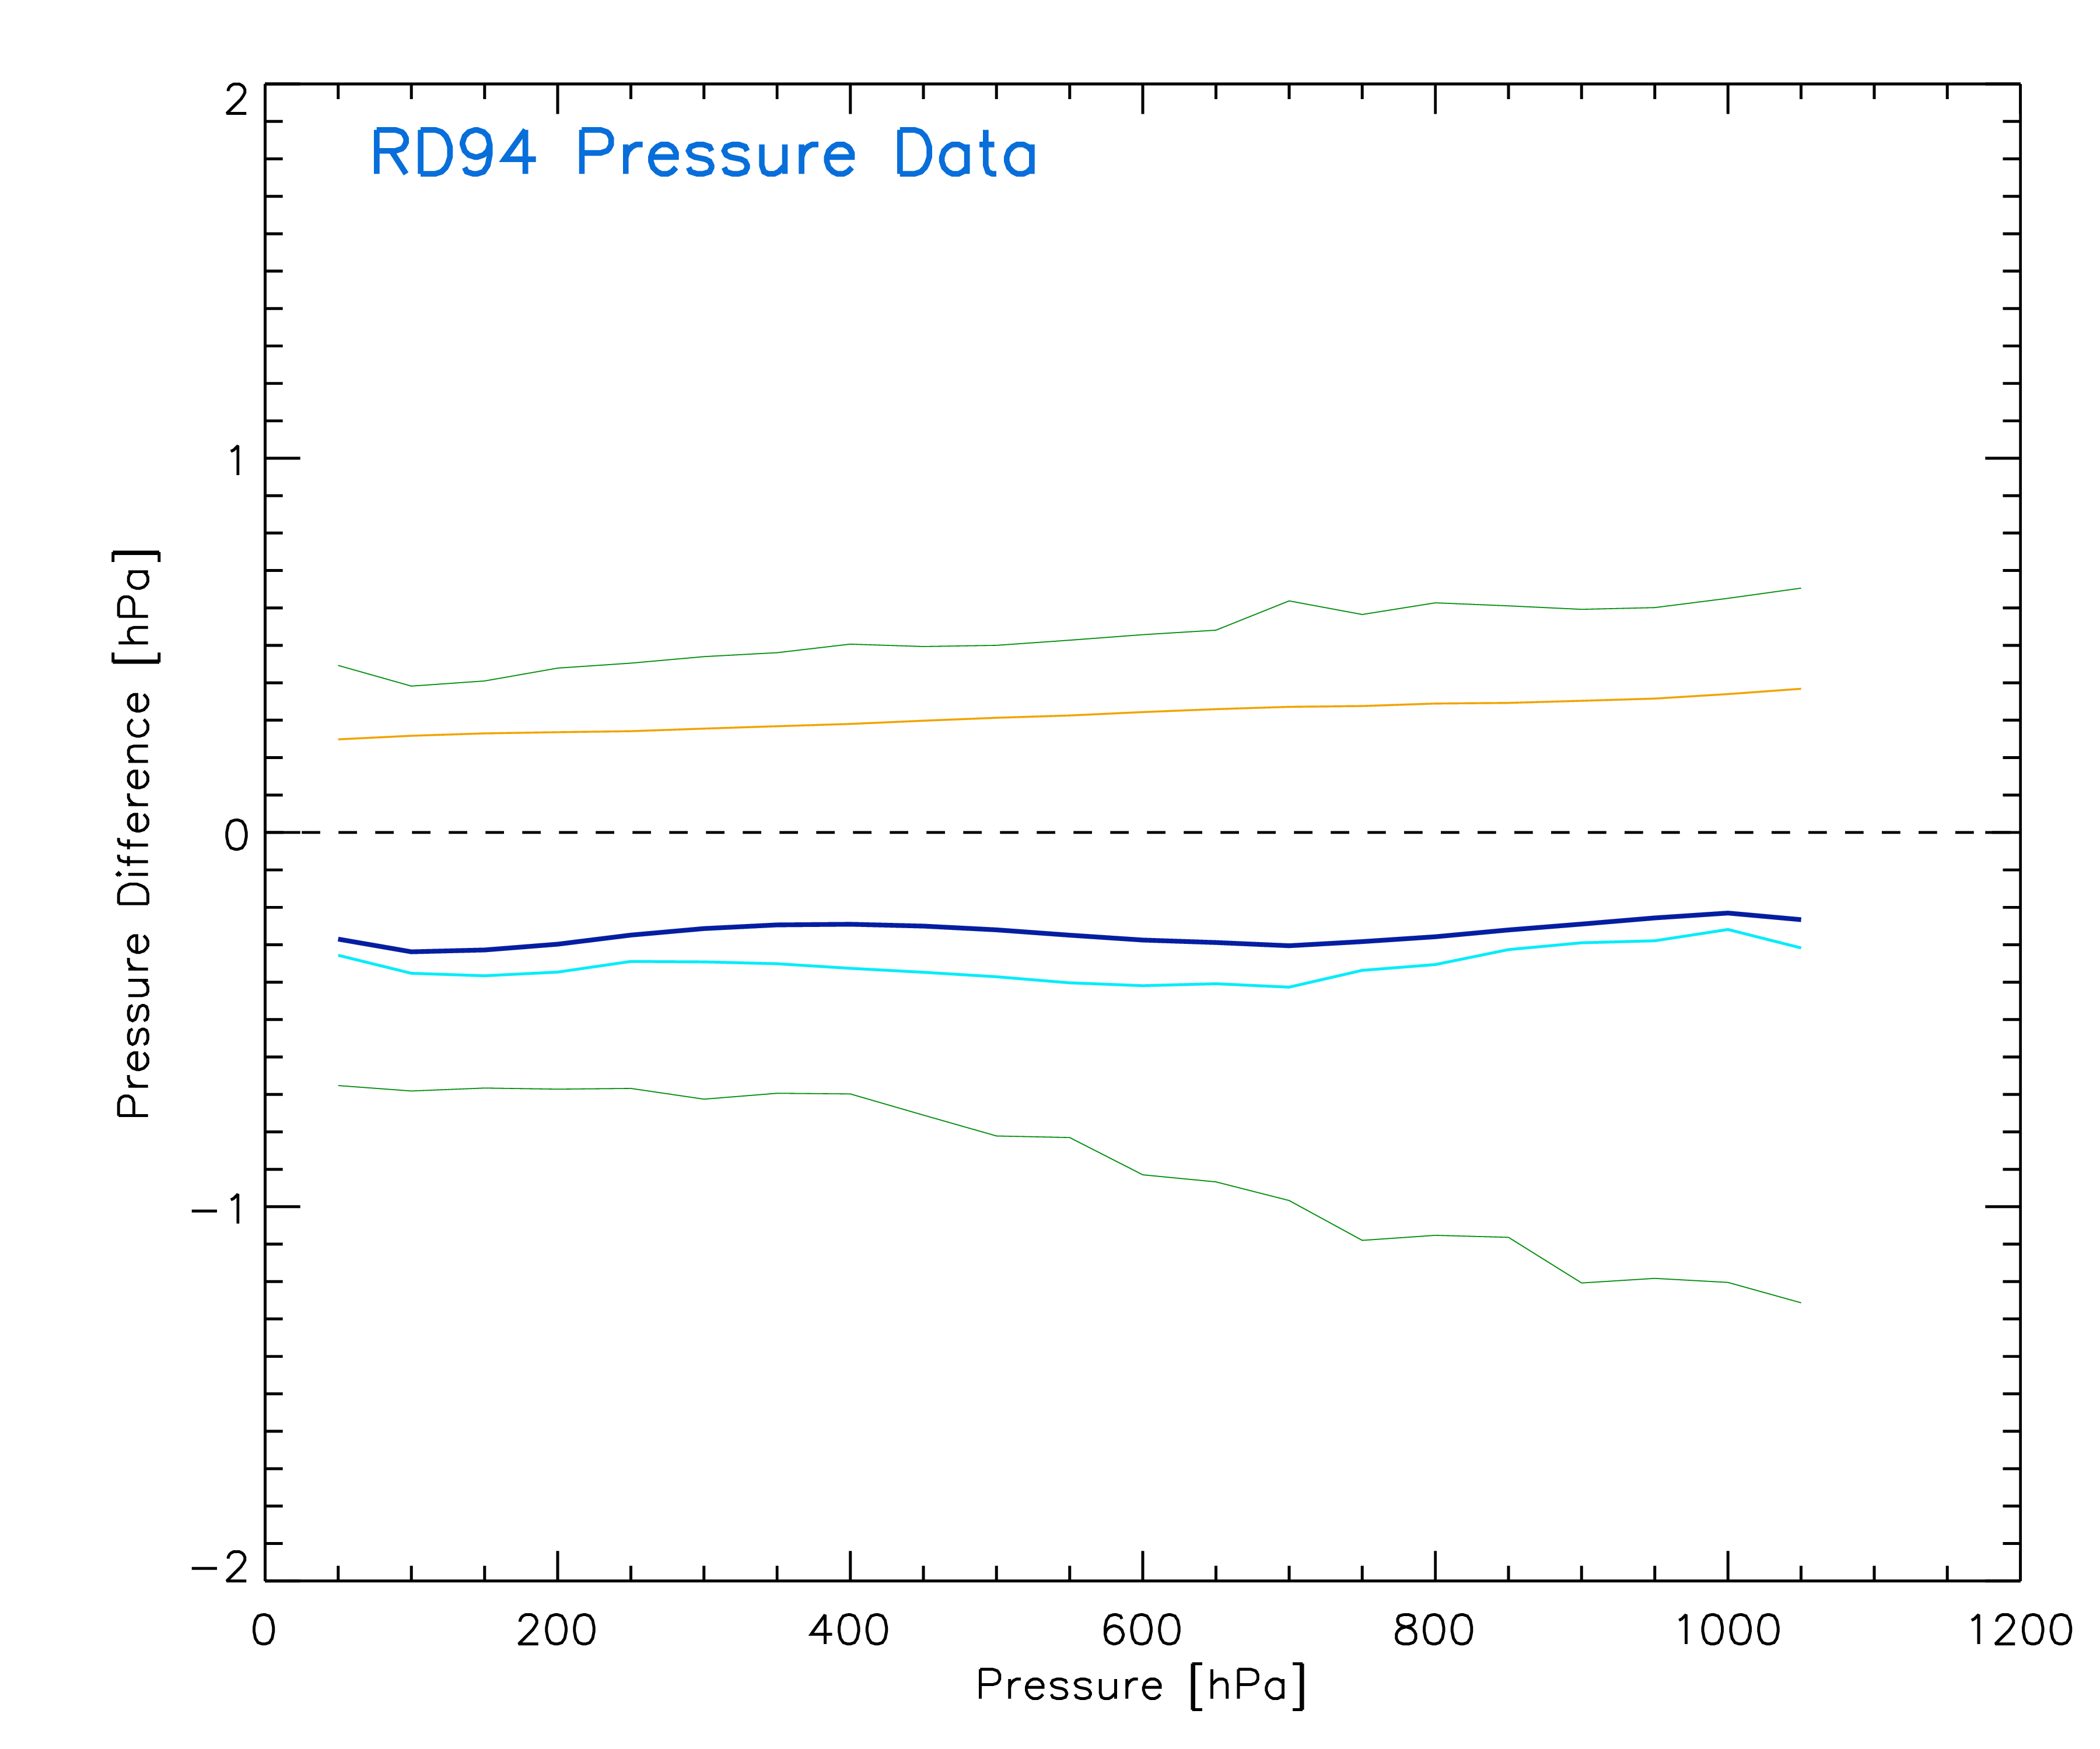
Constant pressure is a good approach
Laboratory offset measurement
Max
Standard Deviation
Mean
Median
Min

Slide 4
Last years recommendation
Recommend application of production pressure correction in AVAPS
Recommend removing dynamic pressure correction
Recommend adjusting extrapolation time in Aspen (see Dean’s talk)
Surface pressure readings to within <0.4 hPa can be demonstrated!

Slide 5
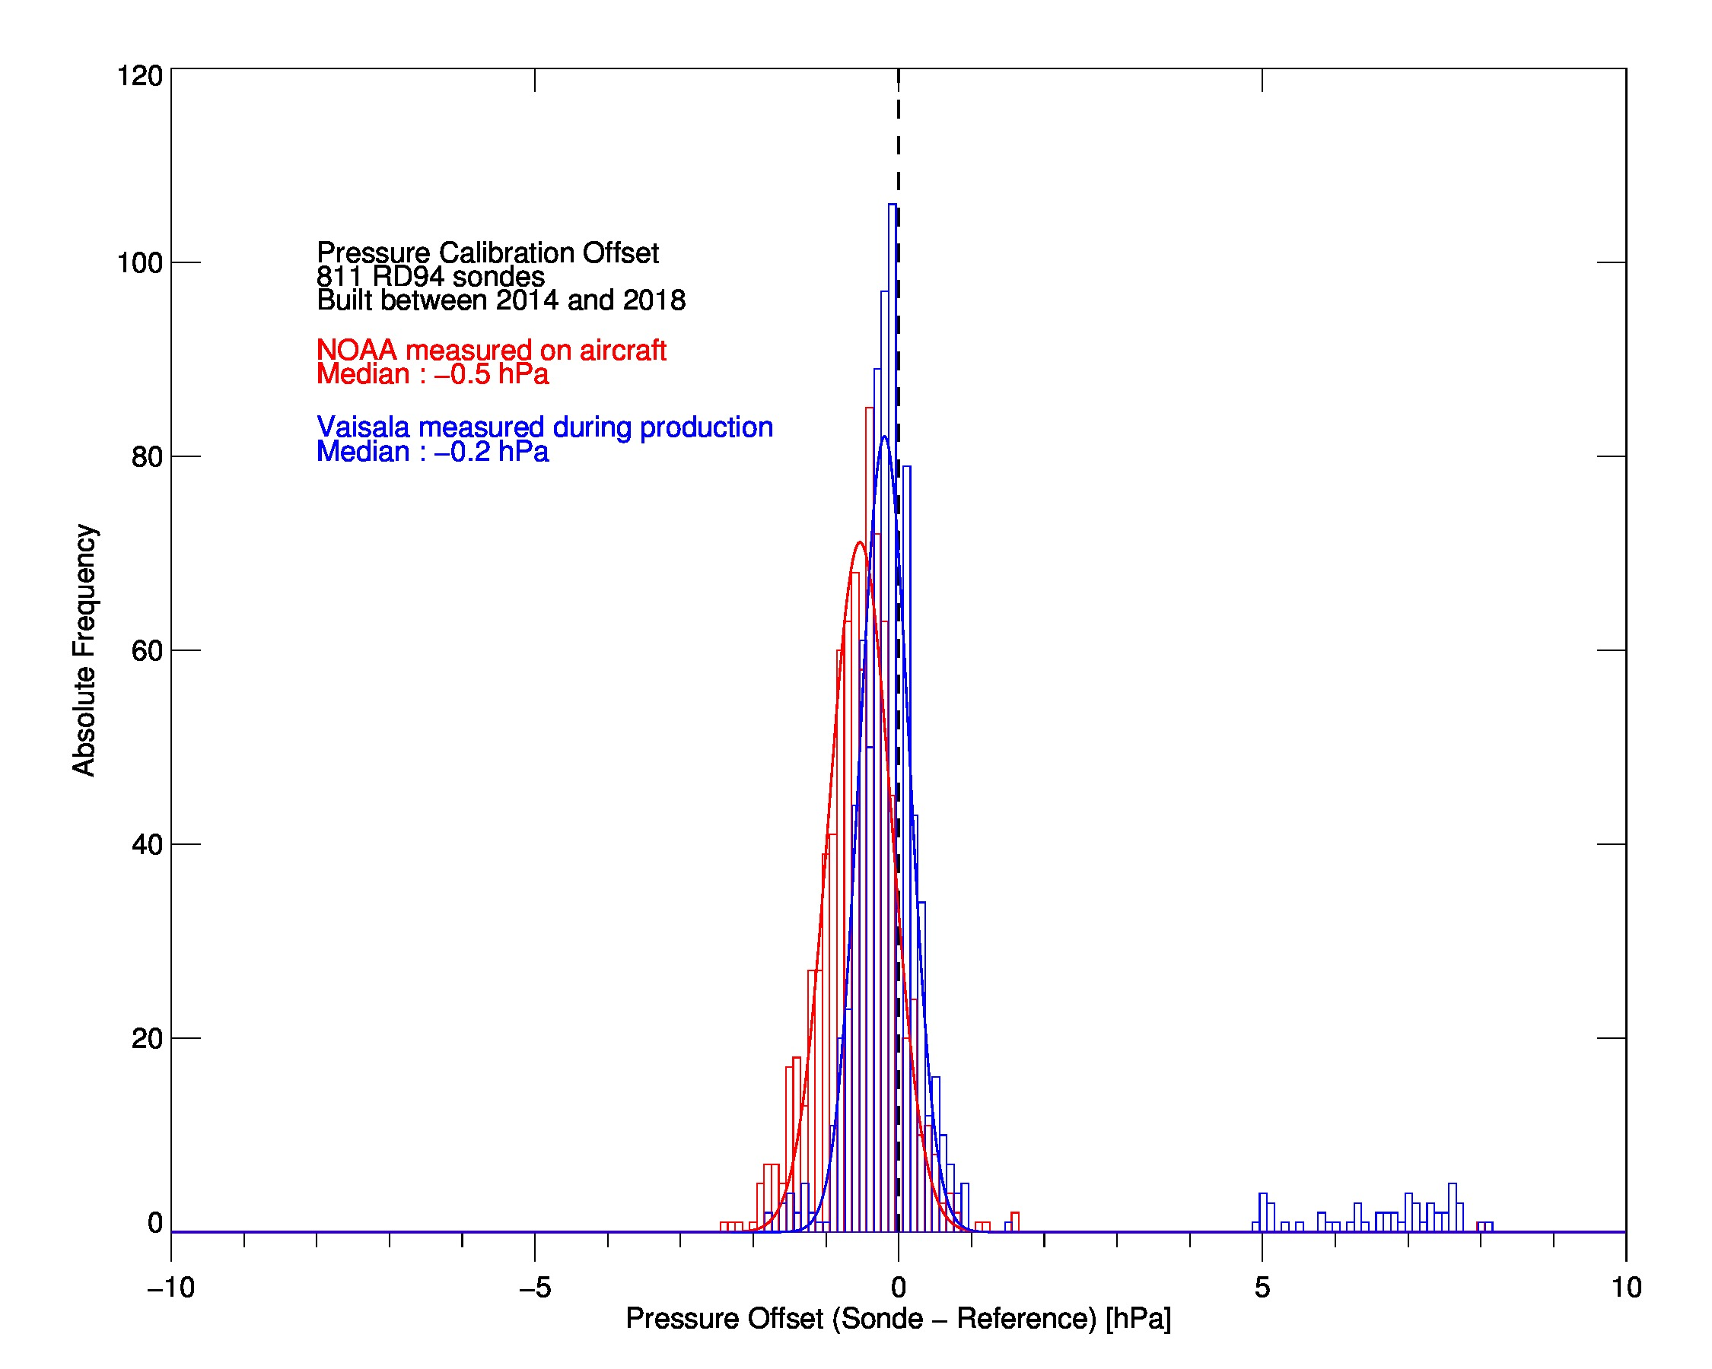
Production problem
Now fixed

Slide 6
Last years recommendation
Recommend application of production pressure correction in AVAPS
Recommend removing dynamic pressure correction
Recommend adjusting extrapolation time in Aspen (see Dean’s talk)
Surface pressure readings to within <0.4 hPa can be demonstrated!

Slide 7
Last years recommendation
Recommend application of production pressure correction in AVAPS
Recommend removing dynamic pressure correction
Recommend adjusting extrapolation time in Aspen (see Dean’s talk)
Surface pressure readings to within <0.4 hPa can be demonstrated!

Slide 8
Last years recommendation
Recommend application of production pressure correction in AVAPS
Recommend removing dynamic pressure correction
Recommend adjusting extrapolation time in Aspen (see Dean’s talk)
Surface pressure readings to within <0.4 hPa can be demonstrated!
0.5 hPa

Slide 9
Updated recommendations
RD94:
NOAA continue with in-aircraft pressure reference
Air Force update AVAPS to allow range checked production based pressure offset correction
Air Force install reference pressure sensors in their AVAPS systems to monitor long term stability (longer term project)
RD41:
Pressure offset correction built into firm-ware.
NOAA and Air Force monitor long term stability
Surface pressure extrapolation:
Need more buoy comparisons to evaluate extrapolation time
Change may need to be implemented.

