Slide 1
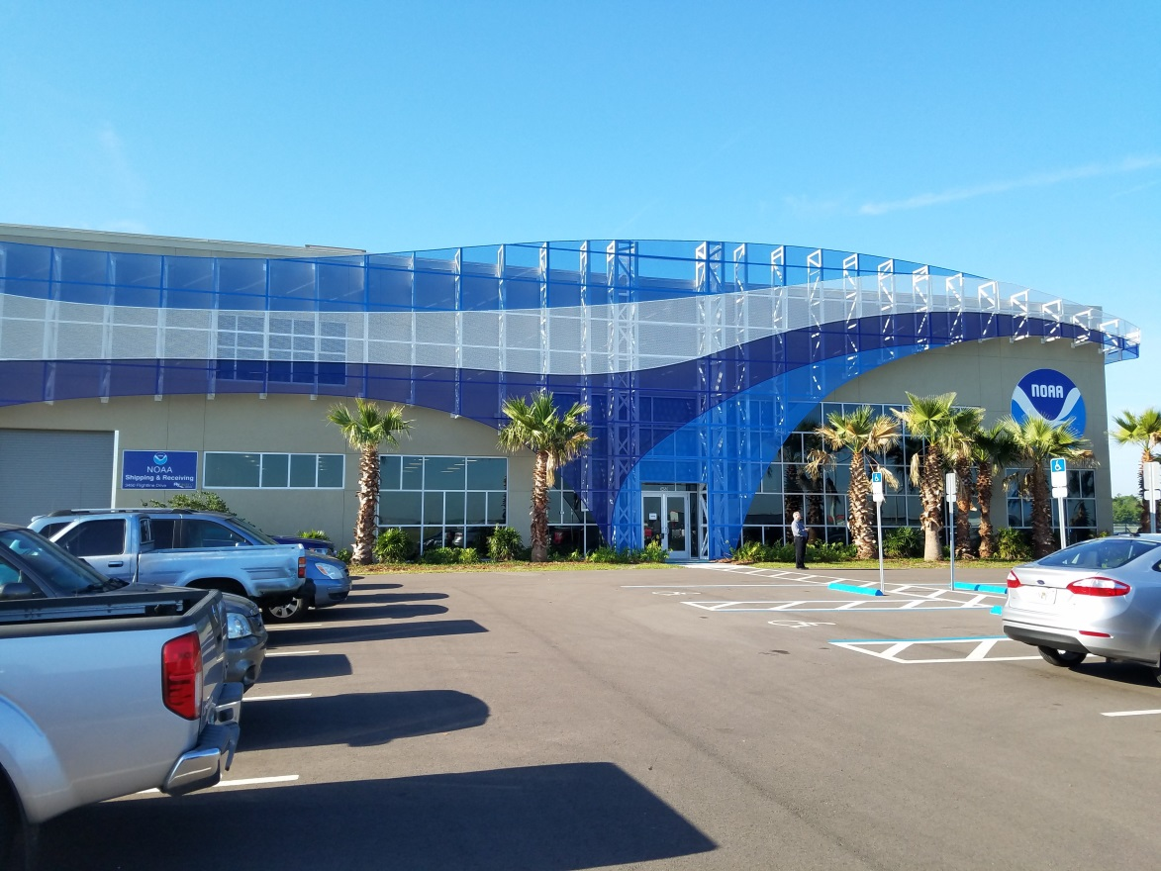
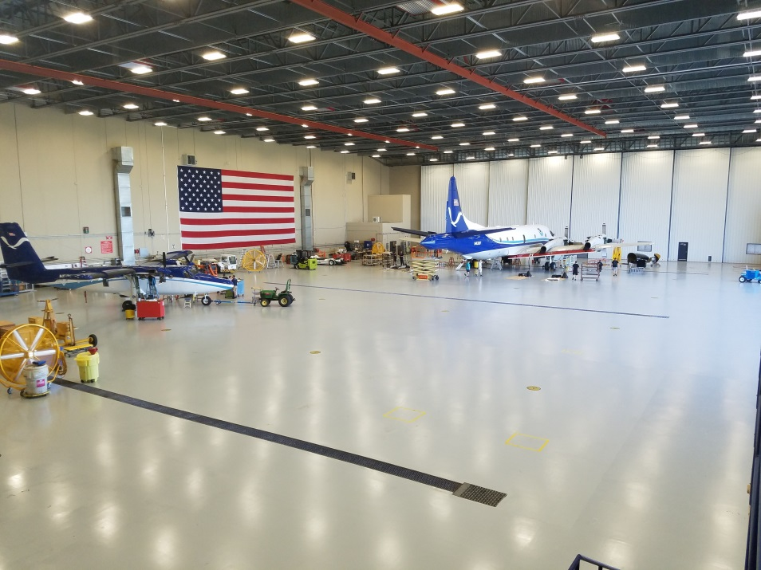
AVAPS at NOAA’s Aircraft Operations Center
Jeff Smith Electronics Engineer
Rich Henning Meteorologist

Slide 2
Projects Involving AVAPS Past 12 Months
Engineering & test 85 Sondes
Hurricane Missions 962
Ocean Winds satellite verification 70
Arctic Heat 3
Atmospheric Rivers 115
Total 1,235
“Average” annual sonde usage about 1,450
Total AVAPS I /II NOAA dropped 29,740

Slide 3


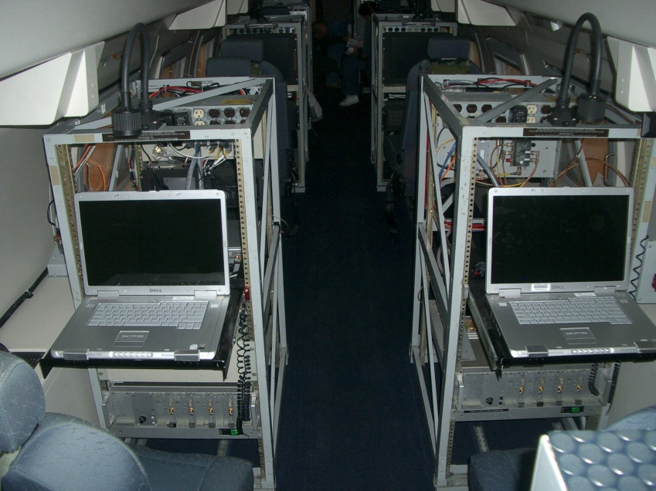
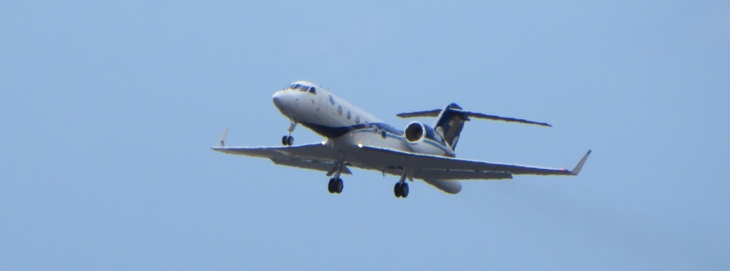
NOAA G-IVSP N49RF
Hurricane Surveillance missions (Synoptic Flow missions) require flying data void areas away from the core of the storm, using dropsondes to map the environment.
Tail doppler radar research missions are closer to the storm core.
US West Coast Atmospheric Rivers project
27 Missions
808 Drops 94% Successful
NOAA Aircraft Operations Center

Slide 4
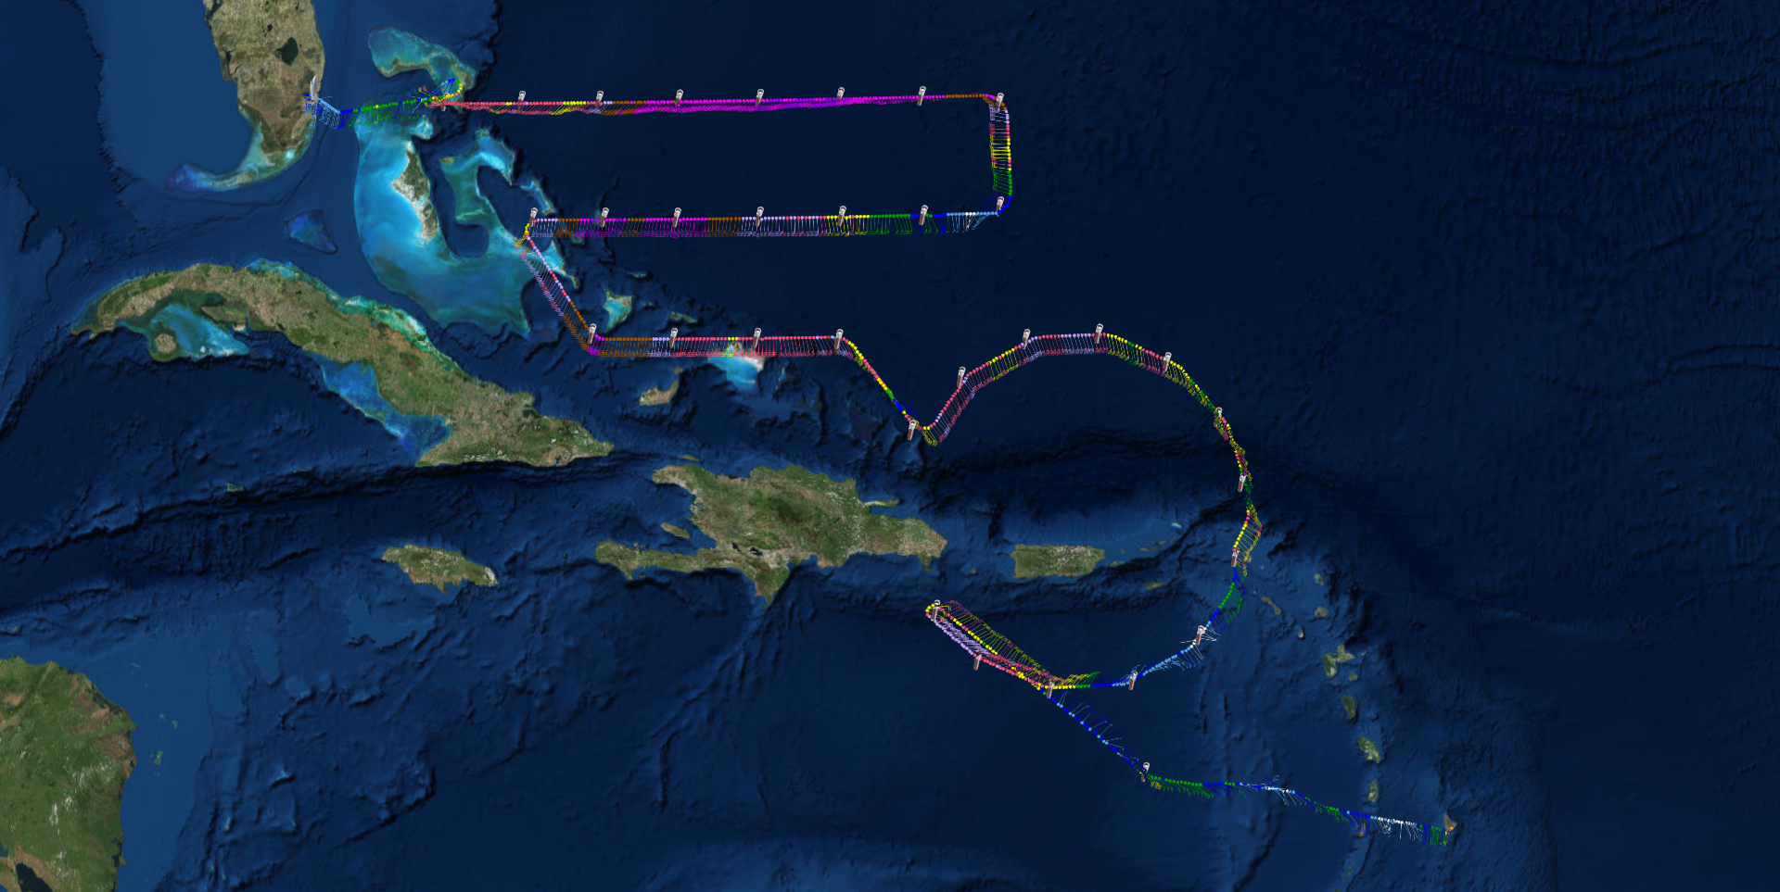
NOAA G-IVSP N49RF
HURRICANE IRMA MISSION
NOAA Aircraft Operations Center

Slide 5
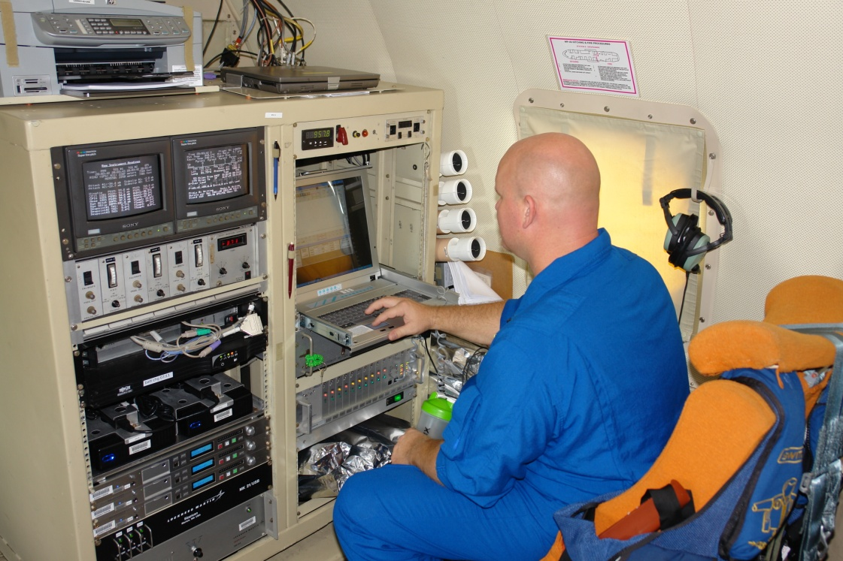

NOAA WP-3D N42RF & N43RF
Tropical cyclone research missions and satellite sensor validation missions.
40 Missions
424 Drops 98% Successful

Slide 6
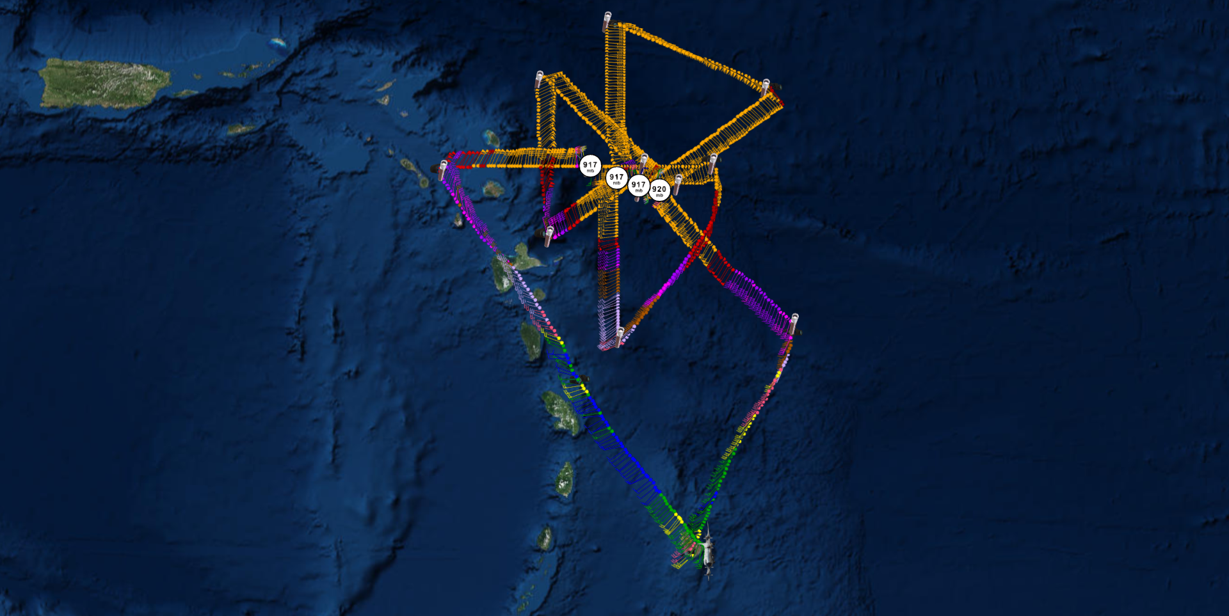
NOAA WP-3D N42RF & N43RF

Slide 7
AVAPS II Failure Modes
14 GPS Performance issues
9 Fast Falls, normal launch detect, some normalized later
6 Telemetry failed abruptly sometime before splash
7 No launch detect, good data (sonde reset at launch)
4 No Launch Detect, no chute deployment
2 Telemetry lost upon launch

Slide 8

KEY EVENTS IN PAST YEAR
NOAA began performing RH Regeneration on all sondes prior to launch
Launched the last of the older revision sondes, and began using existing inventory of Revision A9 sondes, and found these issues:
  GPS antenna cable routing could result in poor GPS/Winds performance
  AVAPS Software update to automatically insert pressure offset measured at time of manufacture did not catch erroneous offsets
  Many sondes exceeded the allowable +/- 0.5 pressure error
Corrective actions taken with help of NCAR and Vaisala:
  All revision A9 sondes opened and the GPS antenna cable routing was corrected
  A new release of AVAPS software was installed which did not automatically insert pressure corrections
  AVAPS Operators utilized onboard precision cabin pressure sensors to correct for pressure offset during sonde initialization
NOAA Aircraft Operations Center

Slide 9
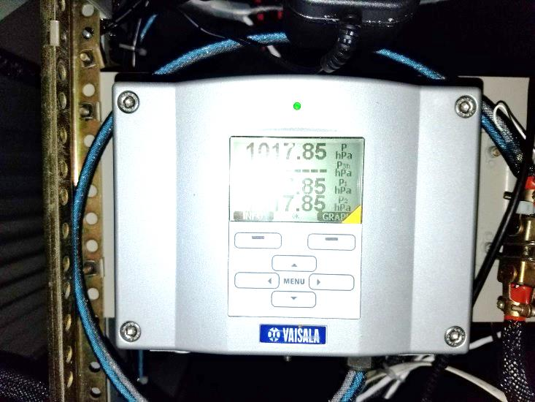
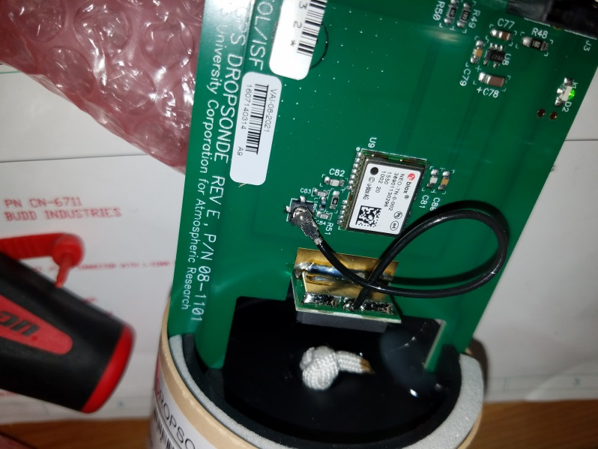
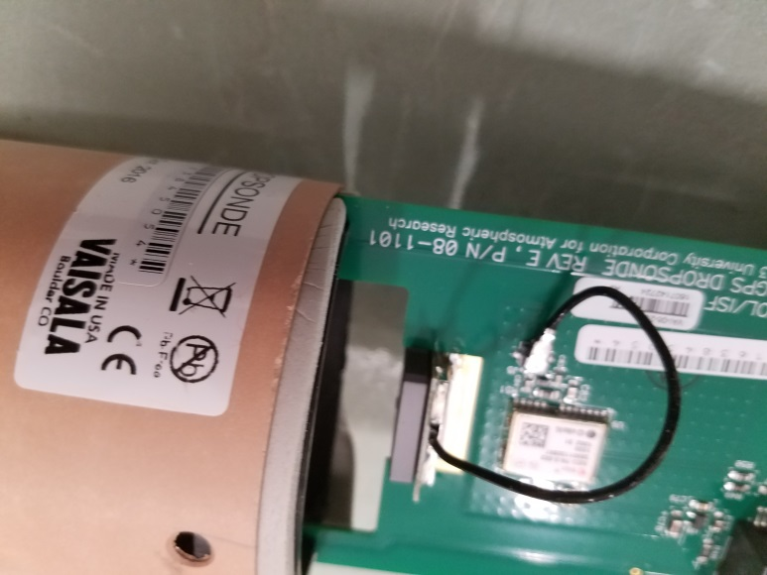
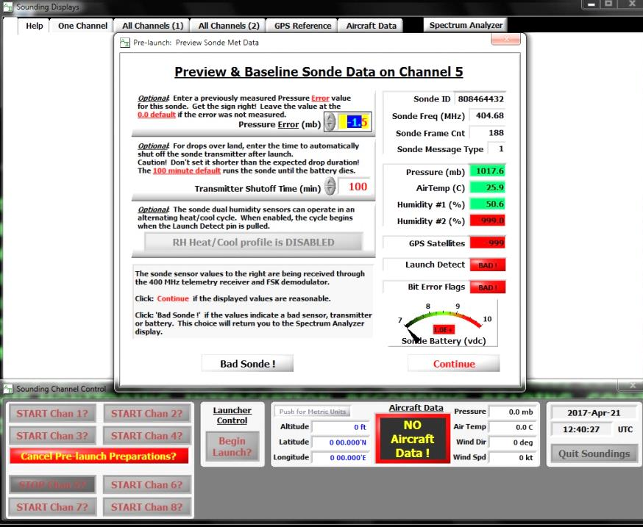
KEY EVENTS IN PAST YEAR (CONT)
BAD
Aircraft cabin pressure sensor
GOOD

Slide 10
KEY EVENTS IN PAST YEAR (CONT)
About one year ago, Vaisala announced the end-of-life was near for the RSS904 PTU sensor used in the RD94 sondes. NOAA asked Vaisala and NCAR to accelerate design and transition to the next generation of the AVAPS dropsonde, the RD41.
  While NCAR was refining the RD41 design, Vaisala accepted the challenge to build 50 pre-production sondes for testing during the 2017 Hurricane season
  The first batch of sondes were launched from NOAA aircraft in various storm environments and over weather buoys with excellent results
  A few design refinements were made, and Vaisala was again challenged to rapidly build another 50 pre-production sondes. These 50 were launched from NOAA and W53rd platforms, again with excellent results
  A couple weeks ago, NOAA formally requested Vaisala transition future US Government sonde orders to model RD41 sondes

Slide 11
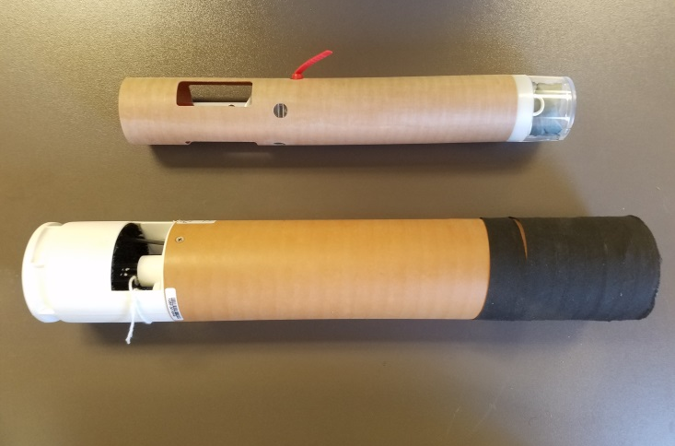
Items for Discussion
Transition to mini-sonde design?

Slide 12
The Wish List
Smooth transition to the RD41
Improved inspection procedures during sonde manufacturing to ensure all performance requirements are met

Slide 13

What about our new jet?
AVAPS / Flight Level Data capability needs to…at minimum…equal current G-IV standards (accuracy of static pressure, winds, temp, geopotential heights)
Possible opportunity for better dew point sensors (upgrade from current chilled mirror systems that do not work adequately at operational altitudes)

Slide 14
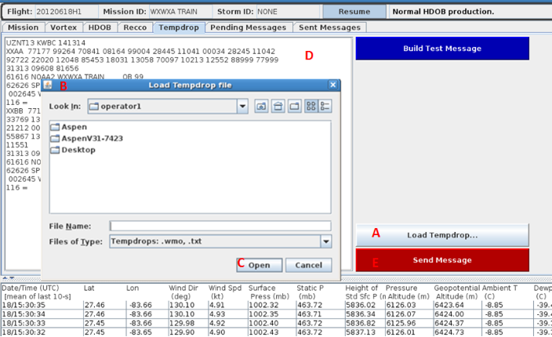
Add capability to transmit BUFR format dropsonde messages into NWS Gateway using AOC Weather Message Module (WMM)

Slide 15
Maintain the same aspect ratio of manually zoomed Skew Ts using QC AutoSave
AutoSaved SkewT from G-IV mission with drop from 180 mb
AutoSaved SkewT from P-3 mission at 700 mb

Slide 16
Using the manual zoom function under the SkewT tab
The sounding can be viewed in greater resolution
However, it will not be saved like this automatically using QC AutoSave unless the Default Options are changed by operator

Slide 17
Under “Other Options” the SkewT output by QC AutoSave can be altered by trial and error (through changes in the the vertical scale and temperature range)

Slide 18
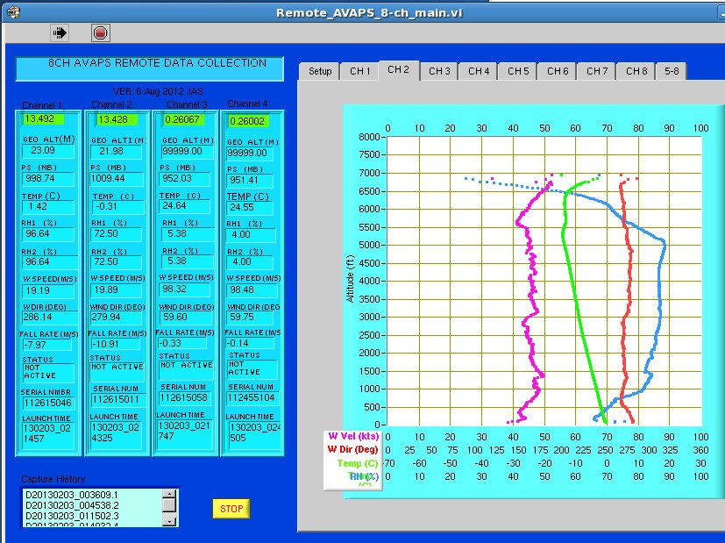
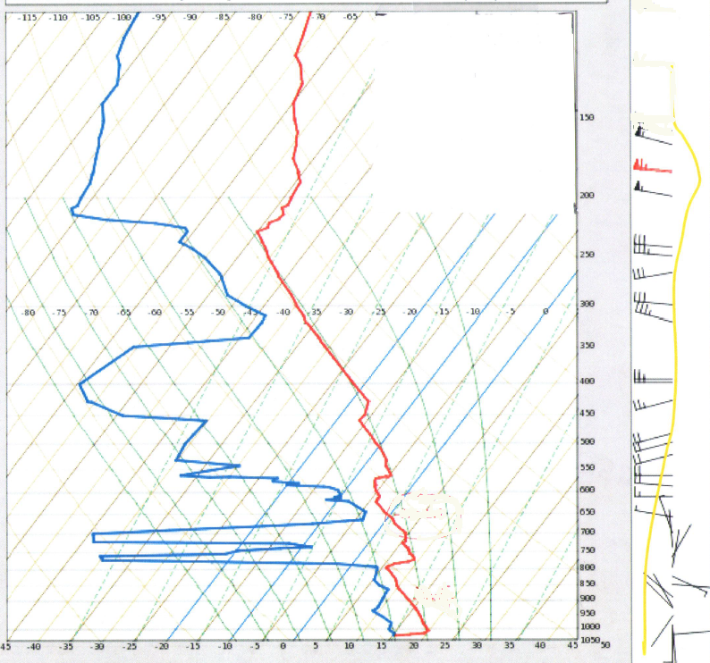
Desired Remote AVAPS Capability
Add Skew-T style as an additional option to display Temp, Dew Point and Winds

Slide 19
QUESTIONS?
NOAA / AOC DATA ARCHIVES, INCLUDING ALL AVAPS DATA AVAILABLE AT:
http://seb.noaa.gov/pub/acdata/<mission>

Slide 20


