Slide 1
Airborne Measurement Campaigns using the KMA/NIMS Atmospheric Research Aircraft in Korea
Presented by Chulkyu Lee
Soohyun Kwon, Jaeil Lee, Jonghwan Youn, Sangwon Joo
National Institute of Meteorological Sciences (NIMS)
Korea Meteorological Administration (KMA)

Slide 2
Main objectives of aircraft operations
Investigate scientific researches on
Severe weather
Environmental monitoring
Greenhouse gases monitoring
Cloud physics and Cloud Seeding

Slide 3
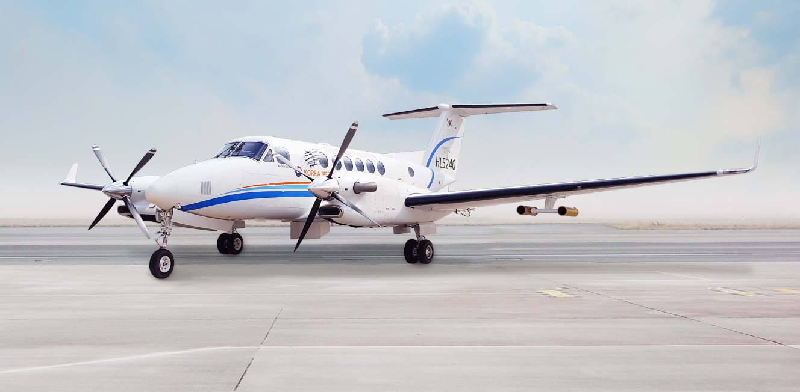
Aircraft Specifications
Identification
Type: King Air 350HW
Manufacturer: Beechcraft (USA)
Engine category: Turbo-prop
Flying performance
Size (L/W/H) : 14.22/ 17.65/ 4.37 m
Max ceiling(altitude)
35,000ft (~10.7 km)
32,000ft (~10 km) with maximum take-off payload
Maximum take-off payload: 16,500 lbs (7,425 kg)
Scientific payload: 3,410 lbs (1,534 kg)
Maximum speed : 312 KTAS (578 km/h at no payload)
Range: 1,550 nmile (2,871 km at maximum payload)
Endurance (Max): 5.5 hrs with maximum payload (with 45 min. reserve fuel)
Crew and scientist on board
Pilot (2), Operator (1), Engineer(1), Scientist (1)
Notes:
KTAS: Knots-True AirSpeed, 비행고도에서의 공기질량을 감안한 실제비행속도
Maximum payload = max scientific payload + max fuel
(대주SPEC 입찰제안서.pdf)
5.1.4.4. Flight Range, with maximum payload of 3611 pounds, is 1550 nm.
This range allows for start, taxi, and run-up, cruise climb and descent, and
for 45 minutes reserve fuel.
5.1.4.5. Flight Endurance at maximum-endurance airspeed is 7.2 hours with 45
minutes reserve fuel.6 This is calculated under the following conditions:
Page 42 of 94
9,400 lb Empty weight, 190 lb pilot, 3410 pound mission payload, 3,500
pounds initial fuel, 16,500 lb takeoff weight, ISA+15, and 20,000 ft.
mission altitude.

Slide 4
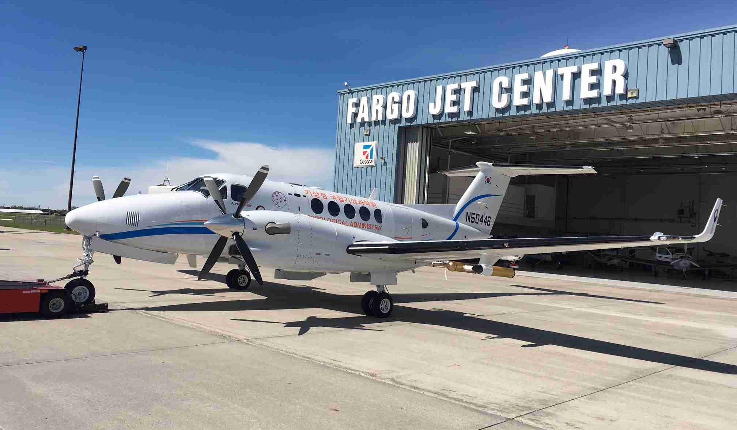
Deployment of scientific instruments
Scientific instruments (25)
AVAPS-II
RSX-3
CCN-200
Nephelometer
SP2
Sky-OPC
Thermo-43i
(back-inside)
CRDS
Thermo-42i
Thermo-42i-Y
Thermo-49i
(front-inside)
Icing Detector
Dew point hygrometer
(tail wing)
Inlet(ISO)
Inlet(Gas)
PIP
CCP(CIP+CDP+LWC)
WCM2000
Temperature sensor
(right wing)
AIMMS-20
GVR
(left wing)
Flare rack
(upper wing)
SFMR
Camera
Ejectable Flare Rack
(bottom)

Slide 5
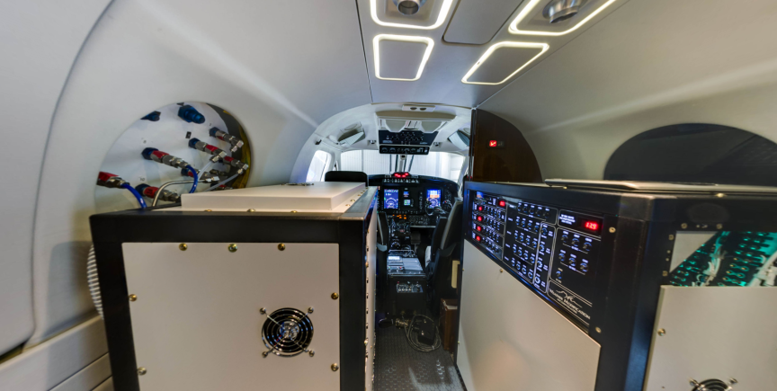
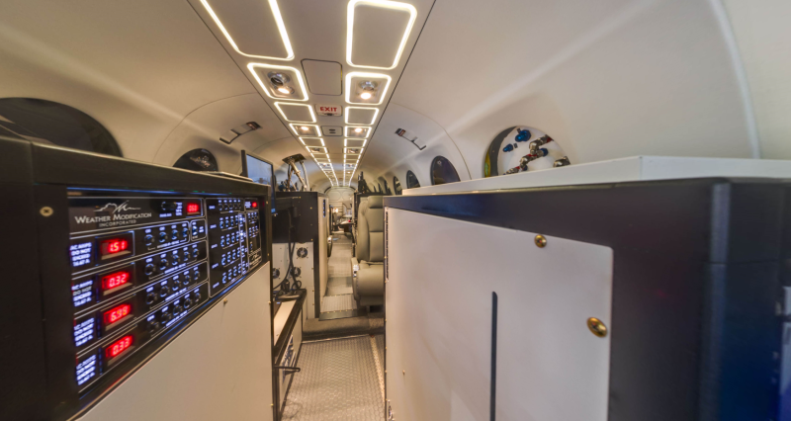
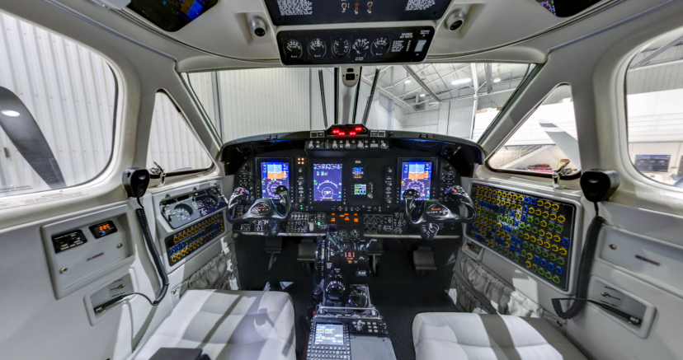
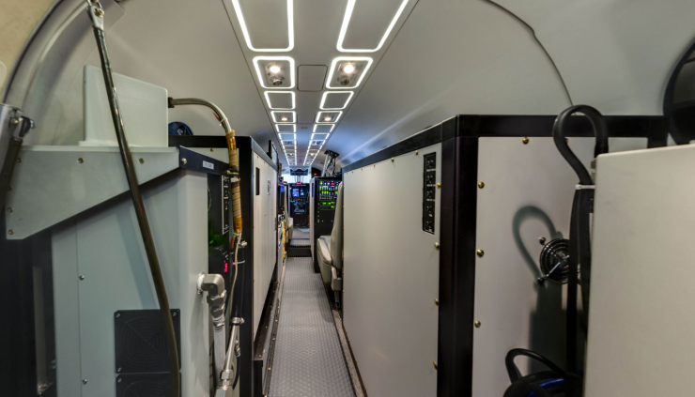
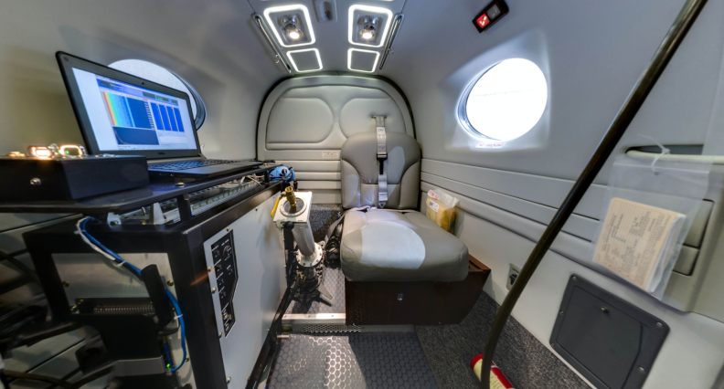
Inside Configuration

Slide 6
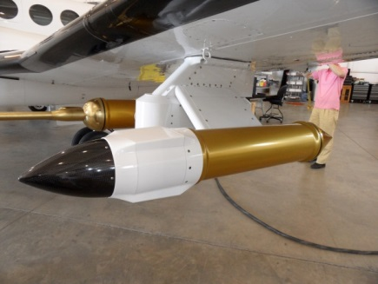
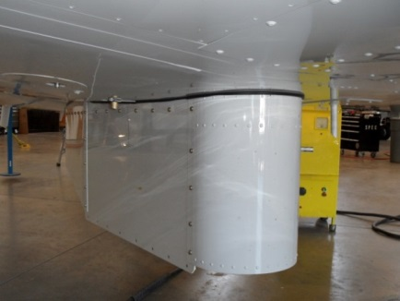
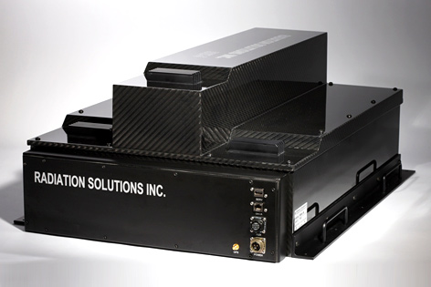
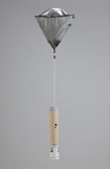
Instruments for Severe Weather
AVAPS-II (RD94)
T, P, RH, WS/WD
4 channels
GVR (radiometer)
PWV (0~20mm)
LWC (0~500g/m²)
Freq. (8 channels)
: 183.31 ±1, ±3, ± 7, ±14 GHz
left wing
Bottom
rear-side
rear-side
SFMR (radiometer)
Sea surface wind
Rain rate
RSX-3 (spectrometer)
Gamma ray detector
Descent speed.: ~11m/s at SL
Descent time: ~8min from 7.5km
Send data in real-time using IRIDIUM
225 channels (0 ∼ 3,000 keV)
Freq.: 4 to 6 GHz (6 channels)
More reliable when SSW>15m/s
Potassium, Uranium, Thorium
Notes:
RSX-3: Gamma ray

Slide 7
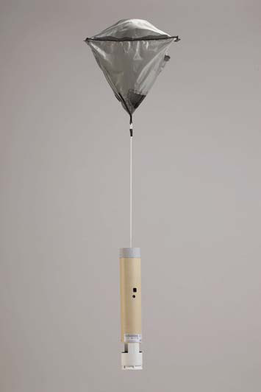
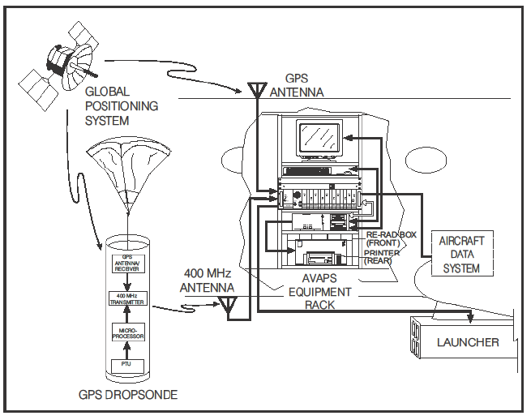
Severe Weather: AVAPS-II
Dropsonde system with 4-channels
4 dropsondes can be deployed simultaneously
Measures temperature, humidity, air pressure from sensors with 0.5 sec. resol., and wind components from GPS with 0.25 sec resol.
Observation data is transferred to the ground using IRIDIUM satellite communication system
Maximum deployment airspeed: 250 kt IAS (450 km/h IAS)
Descent speed: ~11 m/s at sea level
Descent time
From 14 km: ~15 mins
From 7.5 km: ~8 mins
Notes:
(K)IAS : Knots-Indicated AirSpeed, 항공기 속도계에서 직접 산출되는 값

Slide 8
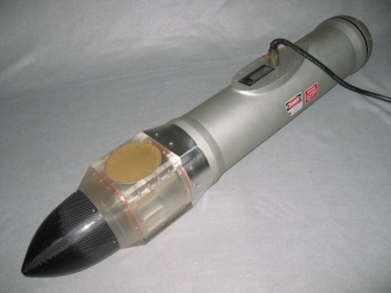
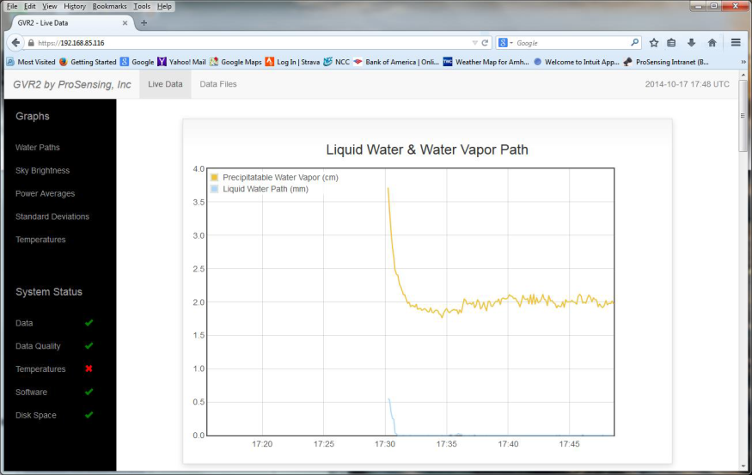
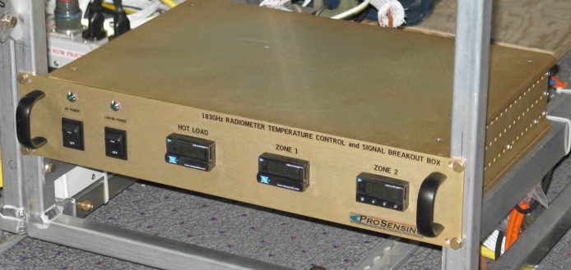
Severe Weather: GVR
G-band (183 GHz) water Vapor Radiometer
Measures the brightness temperature and retrieve Precipitable Water Vapor (PWV) and Liquid Water Contents (LWC) above flying altitude
Target: clouds at high and middle altitude with no rainfall droplet
Consisted by Pod Canister (22 lb) at left wing, Control Box (8.5 lb) and Computer (12 lb) in cabin rack
Frequency (8 Channels): 183.31 ±1, ±3, ± 7 and ±14 GHz Measurement rate: ~10 Hz with 1 sec calibration

Slide 9
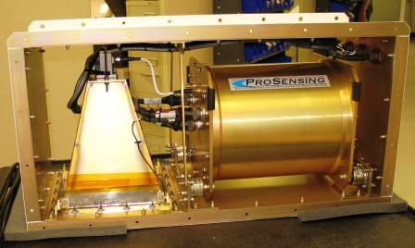
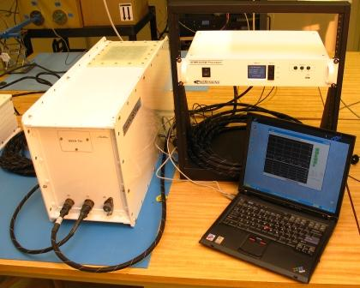
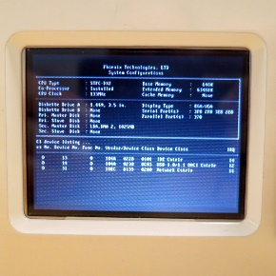
Severe Weather: SFMR
Stepped Frequency Microwave Radiometer
Measures the brightness temperature at six frequencies (4-6 GHz), and retrieves wind speed and rain rate above the ocean
Requirement: Ocean Salinity and Sea Surface Temperature (SST) as constant values and airplane information (Altitude, Air temperature)
Measurement rate: 1 Hz rate

Slide 10
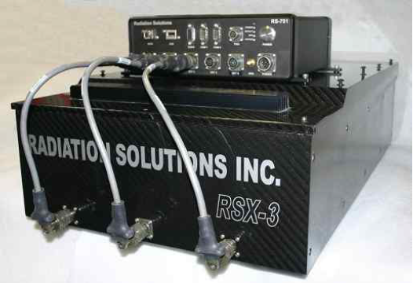
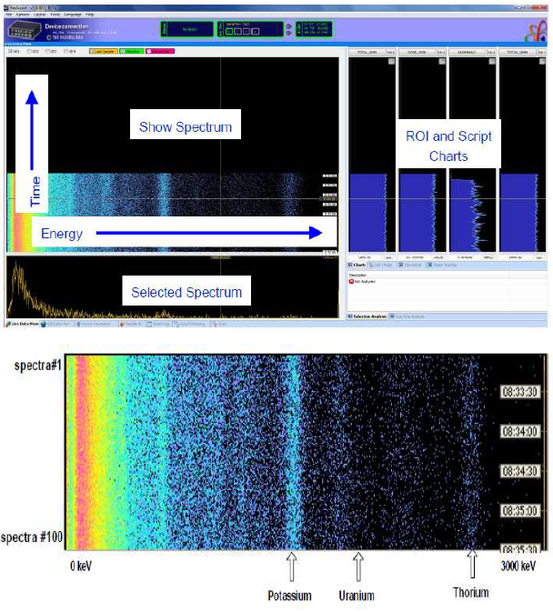
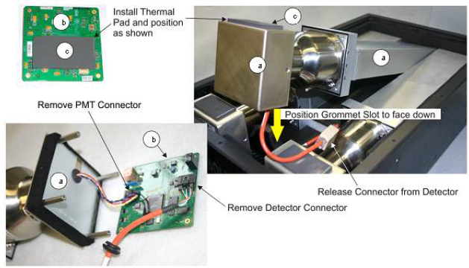
Severe Weather: RSX-3
Gamma ray detector: RS-701(TOP), RSX-3(Base)
Scintillation Detector
Spectrum
Notes:
RSI (Radiation Solution Inc.)

Slide 11
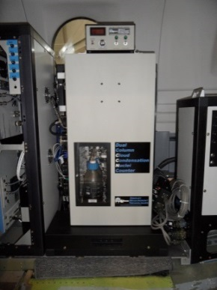
Cloud Physics and Cloud Seeding
CCN-200
Number conc. of
cloud condensation nuclei
0.75~10μm (20bins)
CPC (to-be)
Total # conc. of CN
0.01 ~ 3 μm
Flares
24 burn-in-place hygroscopic
flares for AgI
Super sat. range: 0.07~2%
CCN-200
Flare rack
PIP
CCP
Ejectable flare rack
102 ejectable glaciogenic flares
CaCl₂
CCP
Size distribution of cloud & ice particles
CIP : 7.5 ~ 930 μm
CDP : 2 ~ 50 μm
PIP
SD of large-size cloud particles & precipitation drops
100 ~ 6,200 μm
Channels | Size Range | Res.
CIP | 12.5∼1,550 ㎛ | 25 ㎛
 | 7.5~930 ㎛ | 15 ㎛
CDP | 2∼50 ㎛
LWC | 0∼3 g/m3
rain, snow, graupel and hail

Slide 12
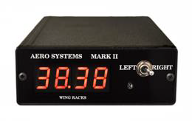
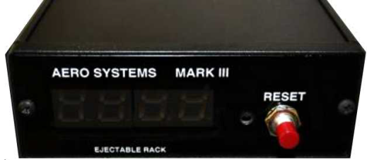
Cloud Seeding: Flare Racks
Wing/Fuselage Flare Racks System
Places seeding materials into the clouds and modify their physical properties
The end burning flare rack system is mounted on the wings of the aircraft, and the ejectable flare rack system is mounted on the belly of the aircraft
- End burning flare rack holds 24 burn-in-place hygroscopic flares (CaCO₃)
- Ejectable flare rack holds 102 ejectable glaciogenic flares (AgI)
The system is controlled by a flare controller which is installed in the cabin and consists of a left/right toggle switch, a power switch, a fire button, and displays.
Notes:
(K)IAS : Knots-Indicated AirSpeed, 항공기 속도계에서 직접 산출되는 값

Slide 13
Cloud Physics: CCP
DMT Cloud Combination Probe
CCP consists of 3 instruments; the Cloud Imaging Probe (CIP), the Cloud Droplet Probe (CDP), the Hotwire Liquid Water Content Sensor (LWC)
- CIP records shadow images of larger particles passing through a collimated laser beam.
- CDP measures smaller particles, relies on light-scattering rather than imaging techniques
- LWC estimates liquid water content using a heated sensing coil
Generates 2-dimentional images of particles from 25-1,550 ㎛
Instrument | Size Range | Resolution
CIP | 12.5∼1,550 ㎛ | 25 ㎛
 | 7.5~930 ㎛ | 15 ㎛
CDP | 2∼50 ㎛
LWC | 0∼3 g/m3
* Airspeed and altitude provided from the heated Pitot tube
* Calibration using standardized water droplets or glass beads

Slide 14
Cloud Physics : PIP
DMT Precipitation Imaging Probe
PIP is a state-of-the-art probe that
- measures size distribution of particles in the 100 – 6,200 ㎛ range
(including rain, snow, graupel and hail), and
- shadow images of particles passing through a collimated laser beam,
which were projected onto a linear array of 64 photodetectors
Environmental operating conditions: Temp. -40~+40℃, RH 0~100%, Altitude 0~50,000 ft
On maintenance: Conduct basic instrument performance checks, including inspection of the PIP optical windows before a flight

Slide 15
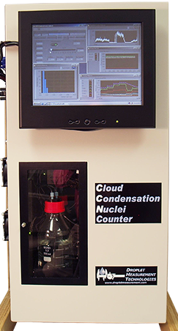
Cloud Physics : CCN-200
DMT Dual Column Cloud Condensation Nuclei Counter
The CCN counter is a continuous-flow thermal-gradient diffusion chamber for measuring aerosols that can act as cloud condensation nuclei
Inside two aerosol sample columns, a thermodynamically unstable, supersaturated water vapor condition is created by the difference in diffusion rates between water vapor and heat
User can modify the temperature gradient and flow rate and obtain the CCN spectra
Supersaturation range : 0.07~2%
Size channel and range : 20 bins, 0.75~10 um
Correction of pressure : ± 0.028% / 100 mb
> 5000#/cm³ particle concentration
: diluting with filtered air
Notes:
** Routine Maintenance
Every 2 days : Refill supply water bottle and empty drain bottle
Every month : Check filters on air inlets, if dirty clean and replace them, Check calibration on sheath and sample flows
Every year : Replace nafion humidifier membrane, Calibrate absolute pressure transducer, OPC and Temperature gradient VS. SS% recalibration

Slide 16
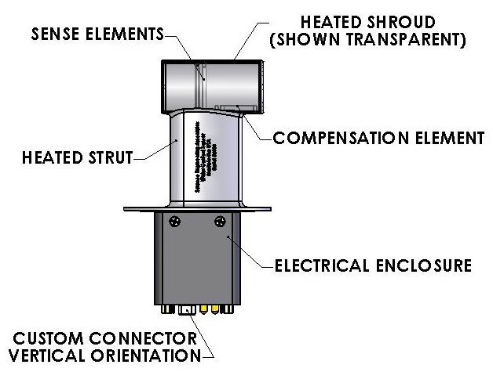
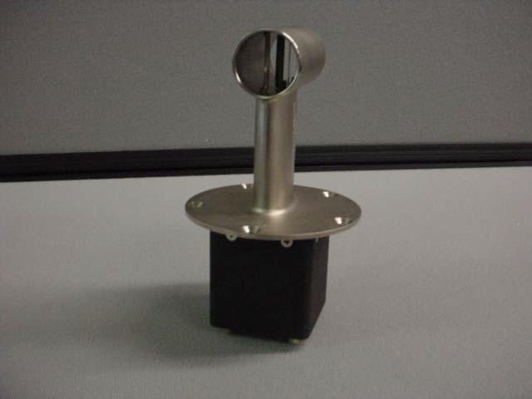
Cloud Physics : WCM2000
WCM-2000 Multi-Element Water Content System
The WCM-2000 is designed to provide users with a single, rugged sensor to simultaneously measure Liquid Water Content (LWC), and Total Water Content (TWC).
Sensitivity: approximately 0.01 - 5 g/m³

Slide 17
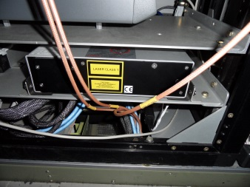
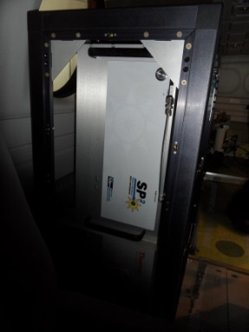
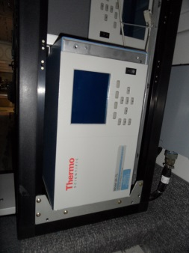
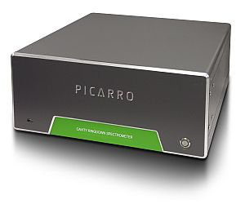
Aerosols and Gases
Inlet for aerosol measurements,
0.01~6μm (90% efficiency)
Inlet for gas measurements
Inside
Sky OPC
Aerosol mass & number conc.
- 0.25-32 μm (31 bins)
- PM₁₀, PM_{2.5}, PM₁
SP2
BC mass &
aerosol number conc. -200∼400 nm
Nephelometer
Scattering coefficients of particles
450 nm (blue), 550 nm (green), 700 nm (red/infrared)
Gas Analyzer
- Thermo 42i-TL: NO, NO₂, No_{x}
- Thermo 42i-Y: NO_{y}
- Thermo 43i-TLE: SO₂
- Thermo 49i: O₃
CRDS
Conc. of CO, CO₂, CH₄, H₂O
Range: CO₂ (0-1000 ppm), CH₄ (0-20 ppm),
CO (0-5 ppm), H₂O (0-7 %v)
Range: NO_{x,y} (200 ppb), SO₂ (20 ppb),
O₃ (200 ppb)

Slide 18
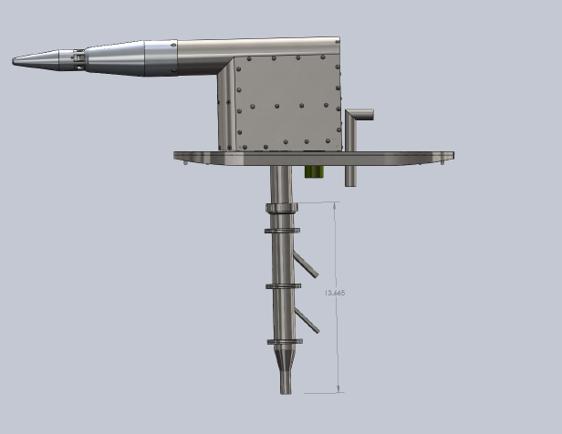
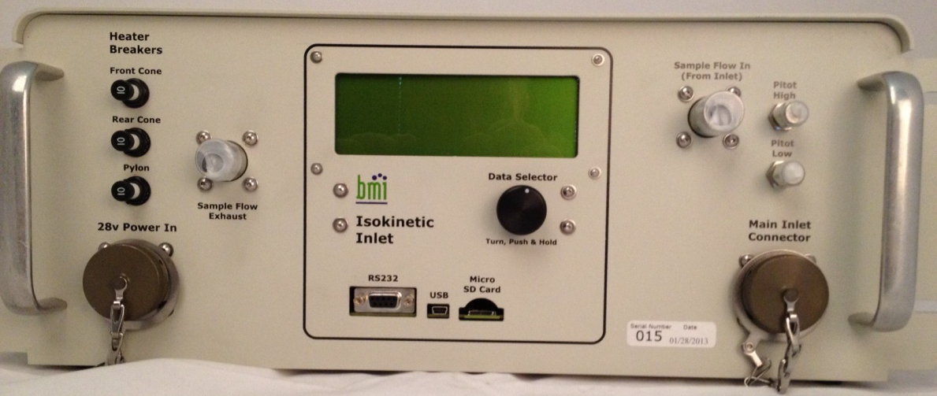
Aerosols: Inlet
Model 1200 Isokinetic Aerosol Inlet System
Used for deployment on aircraft for sampling ambient particles,
- delivering 150 LPM of sample flow for 100 m/s air speeds, and
- transmitting particles of diameters of 0.01-6 μm with > 90% efficiency
Two-stage diffuser assembly decelerates the ambient flow to allow proper sampling.
De-icing heaters prevent building up ices on the inlet
Sample mass flow rate: 1.0 ~ 75 LPM

Slide 19
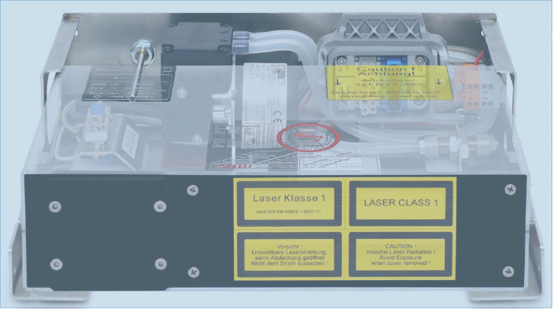
Aerosols: Sky-OPC
Aerosol Spectrometer (or Optical Particle Counter)
Measure concentrations and particle size distribution of aerosol particles irrespective of the ambient air pressure
The 90º light scatter is directed via mirror onto a receiving diode, which is being classified in 31 size channels of 0.25-32 μm.
- 31 channels: 0.25, 0.28, 0.3, 0.35, 0.4, 0.45, 0.5, 0.58, 0.65, 0.7, 0.8, 1.0, 1.3,
1.6, 2, 2.5, 3, 3.5, 4, 5, 6.5, 7.5, 8.5, 10, 12.5, 15, 17.5, 20, 25, 30, 32
Sample volume flow: 1.2 LPM
Measurement time interval: 6 sec
Storage interval: 6 sec or 1-60 min
Pressure range of sample air: >120 mbar
Notes:
(K)IAS : Knots-Indicated AirSpeed, 항공기 속도계에서 직접 산출되는 값

Slide 20
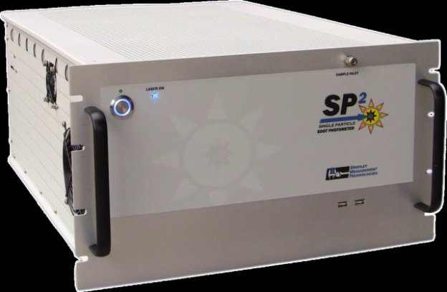
Aerosol : SP2
Single Particle Soot Photometer
Derive the BC mass distribution as function of particle diameters and their number distribution as a function of particle size
Light-absorbing particles absorb energy and heat to the point of incandescence which determines the BC mass concentrations.
All particles scatter light, and the scattering signal can be used to indicate the BC mixing state and aerosol number and mass concentrations.
Particle size range:
- 200-400 nm for scattering signal,
- 70-500 nm mass equivalent diameter for
incandescent signal
Sample flow: 30-180 volumetric cm³/min (typically 120)
Measurement rate: 1 sec to a few minutes
Altitude: 0~40,000 ft

Slide 21
Aerosol : Nephelometer
TSI Integrating Nephelometer (Model 3563)
Monitor the light scattering coefficients of airborne particles continuously
Light scattered by aerosol is directed into the three bandpass filters, blue, green, and red, and yields the quantity called the scattering coefficient to calculate total light extinction
Wavelengths: 450 nm (blue), 550 nm (green), and 700 nm (red/infrared)
Recommended flow rate: 20 to 200 LPM
Averaging time: 1 to 4096 sec
Altitude: 0~6500 ft

Slide 22
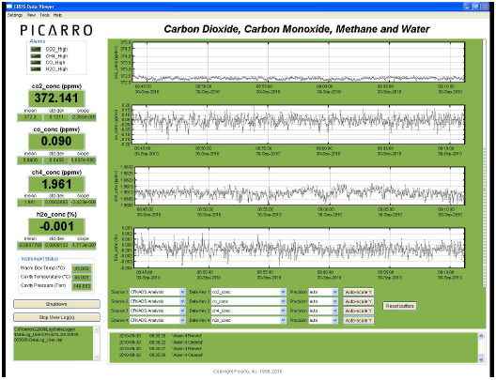
Greenhouse Gas: CRDS
Cavity Ring-Down Spectroscopy
Generate precise, aircraft-based measurements of greenhouse gases (CO, CO₂, CH₄, and H₂O)
Nearly every small gas-phase molecules has a unique near-infrared absorption spectrum. So the concentration of any species can be determined by measuring the strength of this absorption, i.e. the height of a specific absorption peak
Range: CO₂ (0-1,000 ppm), CH₄ (0-20 ppm),
CO (0-5 ppm), H₂O (0-7 %v)
Sample flow rate: <0.6 SLM
Measurement interval: 3.5 sec
Altitude: 250 Torr (1,000 m/min)

Slide 23
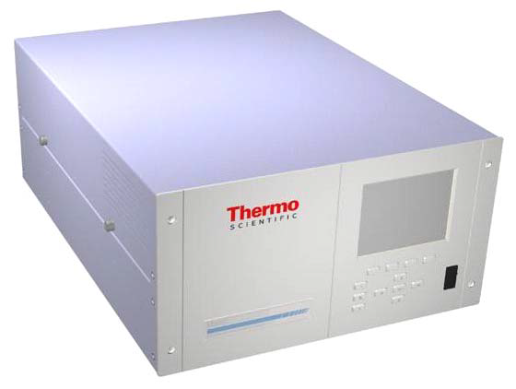
Reactive Gas : Gas Analyzers
Chemiluminescent Gas Aanlyzers for Nitrogen Oxides,
Pulsed Fluorescence SO₂ Analyzer,
UV Photometric O₃ Analyzer
Measure the amount of NOx (NO, NO₂), NOy, SO₂, O₃ in air
NO and O₃ react to produce a characteristic luminescence with an intensity linearly proportional to the NO concentration
SO₂ molecules absorb UV light and become excited at one wavelength, then decay to a lower energy state emitting UV light at a different wavelength
O₃ molecules absorb UV light at a wavelength of 254 nm. The degree to which the UV light is absorbed is directly related to ozone concentration
Range: NO_{x,y} (<200 ppb), SO₂ (<20 ppb),
O₃ (<200 ppb)
Sample flow rate: 1 LPM
Response time: 60 sec

Slide 24
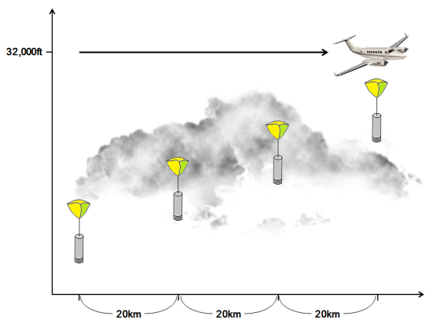
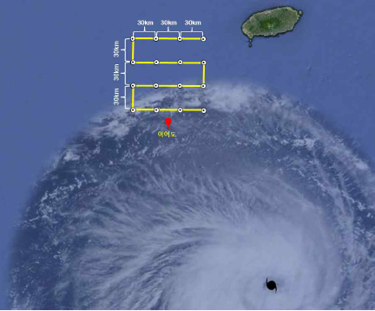
Mission 1: Observation of Severe Weather
Improvement of NWP (numerical weather prediction) model
Improvement of model initial state and verification of model forecast
Area of interest: over Yellow Sea, South Sea
Instrument: dropsonde (RD-94),
SFMR

Slide 25
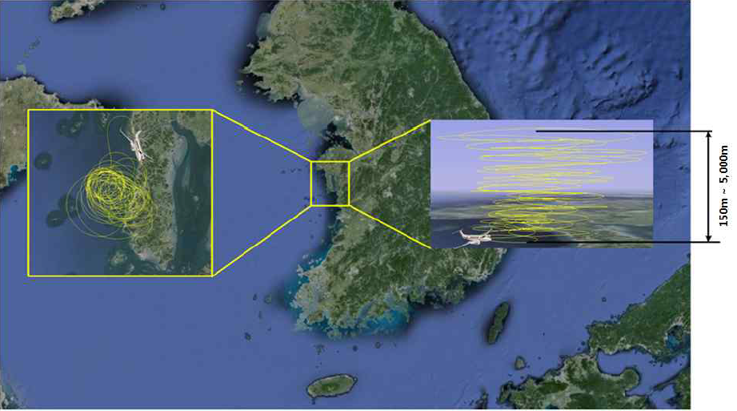
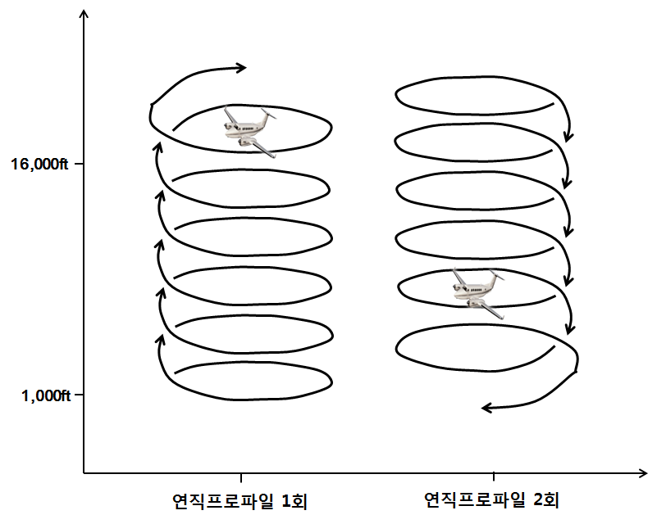
Mission 2: Monitoring of Environmental Meteorology
Improvement of a numerical model of aerosols and Validation of satellite observations
Analysis of aerosol and greenhouse gas profiles
Area: Tae-An peninsula, Yellow Sea
Instruments: Aerosol and gas instruments including CRDS

Slide 26
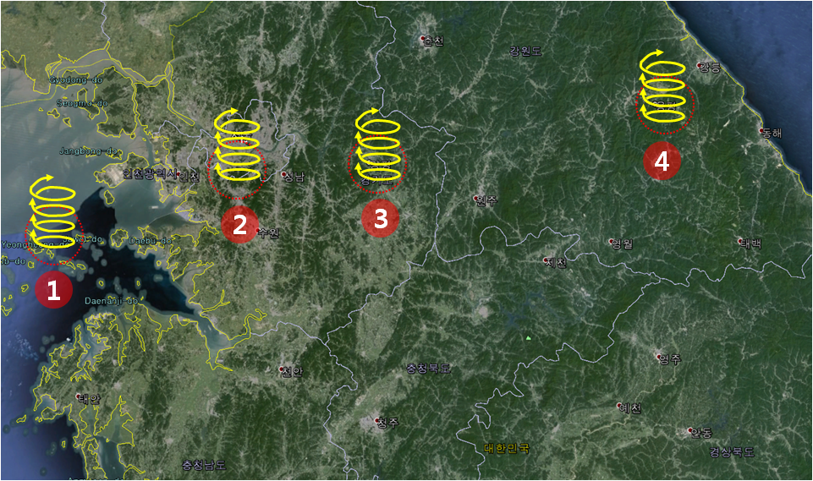
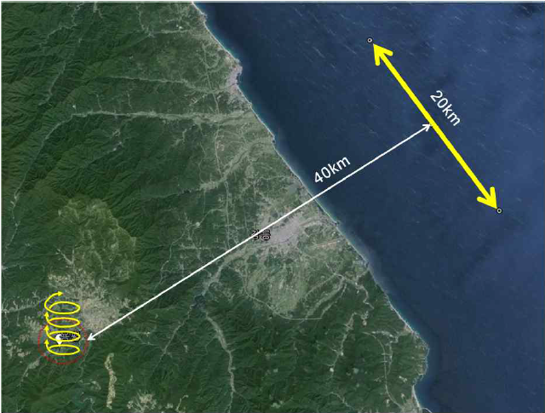
Mission 3: Cloud Physic & Cloud Seeding
Improvement of information on clouds and development of cloud seeding techniques
Observation of cloud droplet, precipitation particle and experiments for cloud seeding
Area: metropolitan upwind and downwind area, mountain area
Instruments: cloud physics and seeding instruments

Slide 27
Flight plans for 2018
Purpose
Train researchers for acquiring skills to observe and analysis data, pilots for mission flights in adverse weather conditions (Dress rehearsal, en-route tests)
Flight hours: 400hrs/year
2018 (350 hrs, Mission FL), 2019~ (400 hrs, Mission FL)
Preliminary schedule for 2018
 | mission | hours | Jan | Feb | Mar | Apr | May | Jun | Jul | Aug | Sep | Oct | Nov | Dec
regular observation | GHGs/ Air quality | 100
 | Cloud physics | 40
Irregular observation | Cloud seeding | 38
 | Asian dust | 49
 | ICE-POP 2018 | 28
 | Heavy rainfall | 35
 | Typhoon | 49
 | Radioactive rays | 11
Total |  | 350

Slide 28
Future Plan
Improvement of detailed flight plans for the experiments
- Severe Weather
- Environmental monitoring
- Greenhouse gas monitoring
- Cloud physics, cloud seeding
Build-up of capability for operation
- flight tests enough for reliable observation
- secure the human resources of the research with aircraft
- establish the expertise of the aircraft operation
International cooperation
- Participate in international atmospheric measurement campaigns

Slide 29
Thank you

