Slide 1
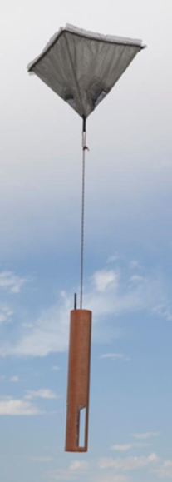
Future NRD41 Mini Dropsonde
Same PTH sensor module Vaisala RSS421
Same u-blox GPS receiver for winds
Same parachute design for stable descent
Same functionality RD41 – umbilical cable, fall rate, telemetry
Several inter-comparisons between RD94 vs NRD94

Slide 2
NRD41 Mini Dropsonde Advantages
Reliable launch detect, two different system
Hall effect sensors
Direct command via automatic launcher
Elimination of umbilical cable with wireless Infrared communication
Add-in to launch tube
Sonde storage
Can be used in automatic launcher or manual launch tube
Storage- Volume reduction 70% NRD41: 28.9 in³ vs RD41: 95.0 in³
Same functionality RD41 – umbilical cable, fall rate, telemetry.
Smaller mass 60% reduction: 140 grams versus 350 grams –
NCAR aircraft releases dropsondes overland.
High reliability 95+% success during NASA HS3, NOAA SHOUT, NSF DEEPWAVE, NSF CSET, NASA/NOAA EPOCH (Launch detect, Fast falls)
Higher production quantity due to NSF/NCAR aircraft (G-V, C-130, U of Wyo. King Air) and NASA Global Hawk
Cost under investigation NCAR-Vaisala
NCAR continue to use NRD41 for all NSF field campaigns and Global Hawk.

