Slide 1
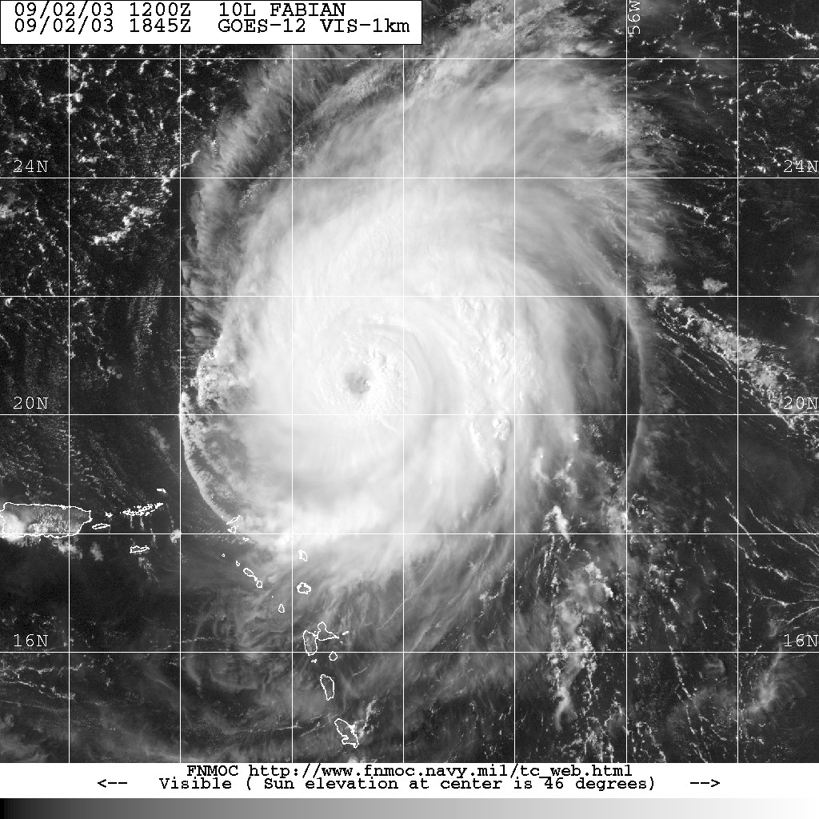


In Search of the Elusive Eyewall Mesovortex
Sim D. Aberson¹, Sarah D. Ditchek¹², K. J. Sellwood¹², J. Gamache¹, and A. Aksoy¹²
¹NOAA/Atlantic Oceanographic and Meteorological Laboratory/Hurricane Research Division
²University of Miami/Cooperative Institute for Marine and Atmospheric Studies

Slide 2
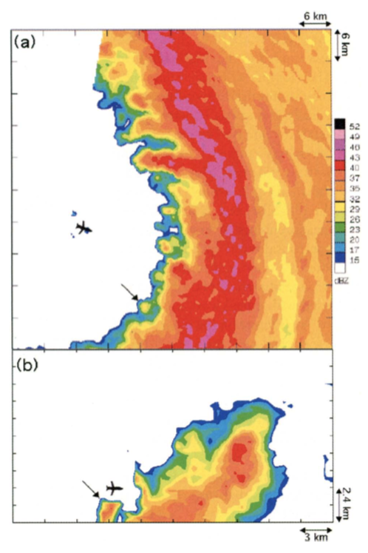
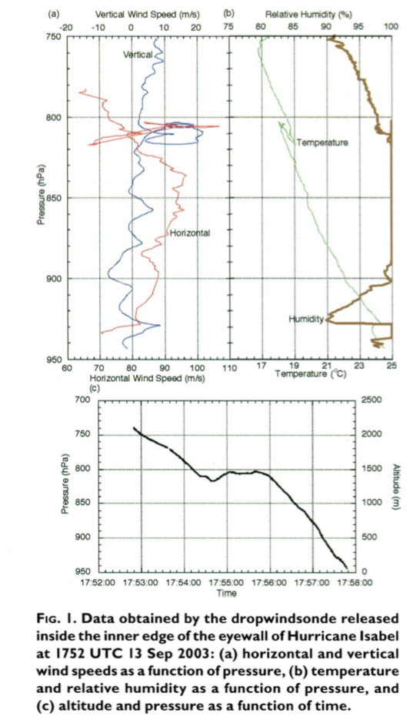
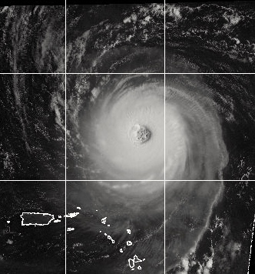
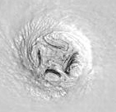
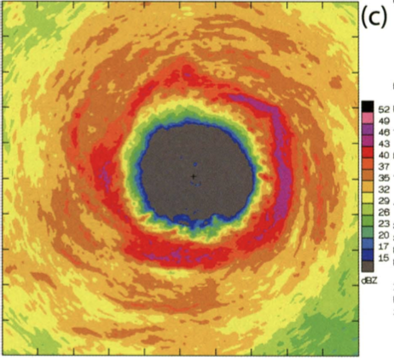
Hurricane Isabel
Meso-scale - having a horizontal scale of a few to several hundred km.
Miso-scale - having a horizontal scale of 40 m to 4 km.
Vortex: a flow with closed streamlines.
Cyclone: a cyclonic circulation, a closed
circulation.
http://glossary.ametsoc.org/
Orlanski, I., 1975: A rational subdivision of scales for atmospheric processes". Bull. Amer. Met. Soc.. 56, 527–530.
Fujita, T. T., 1981: Tornadoes and downbursts in the context of generalized planetary scales. J. Atmos. Sci., 38, 1511–1534.

Slide 3
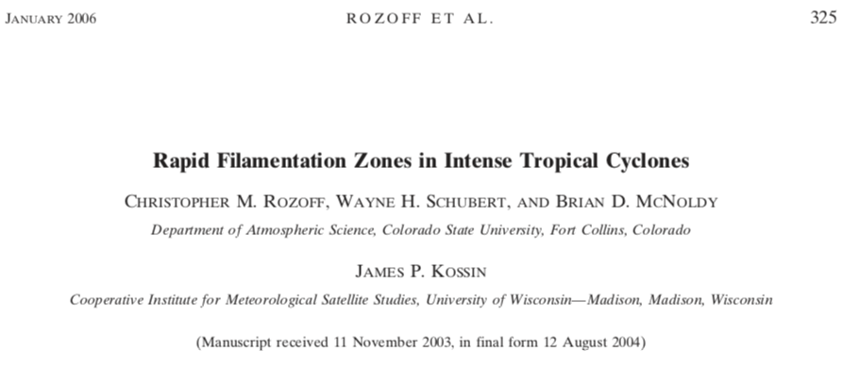
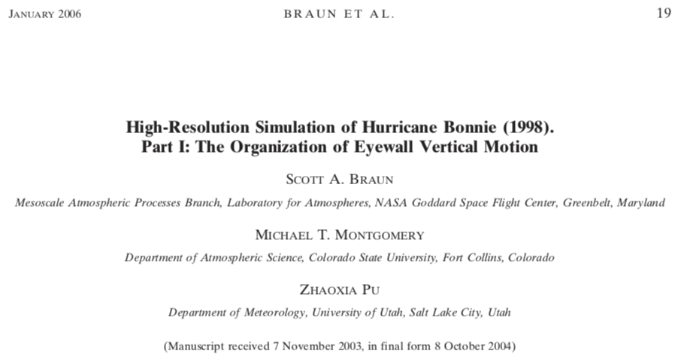
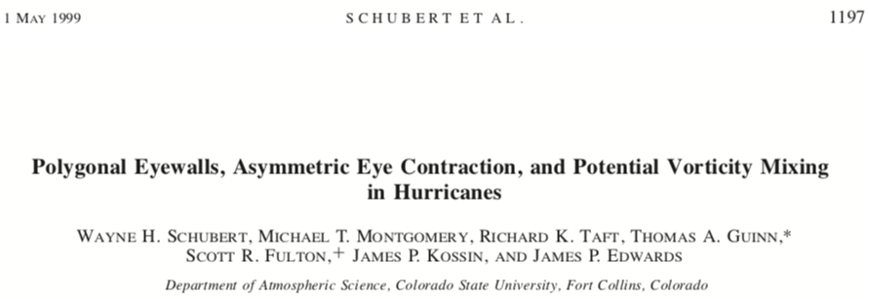
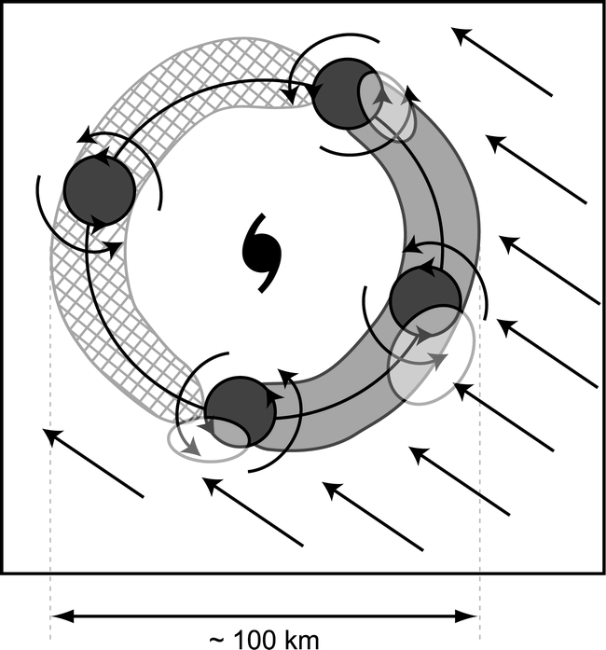
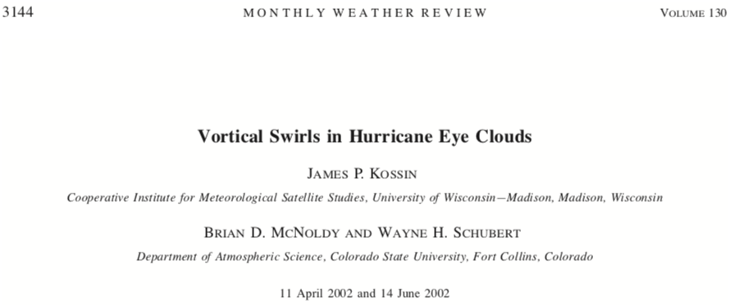
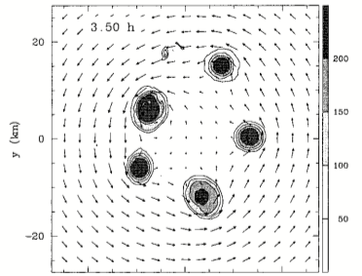
Model experiments show breakdown of the vortex on the inner edge of the eyewall, and closed wind centers (zero tangential wind). Wind and pressure centers are not in the same locations.
Schematic diagram summarizing the interaction between eyewall mesovortices and the low-level inflow associated with the environmental wind shear. The elongated semicircular areas indicate where shear effects favor upward (light shading) and downward (cross hatching) motion. The relative flow associated with the environmental shear is indicated by the straight arrows, while the mesovortices and their local cyclonic circulations are indicated by darkly shaded circles and curved arrows. The semitransparent, lightly shaded ovals represent areas of enhanced low-level convergence and upward motion.

Slide 4
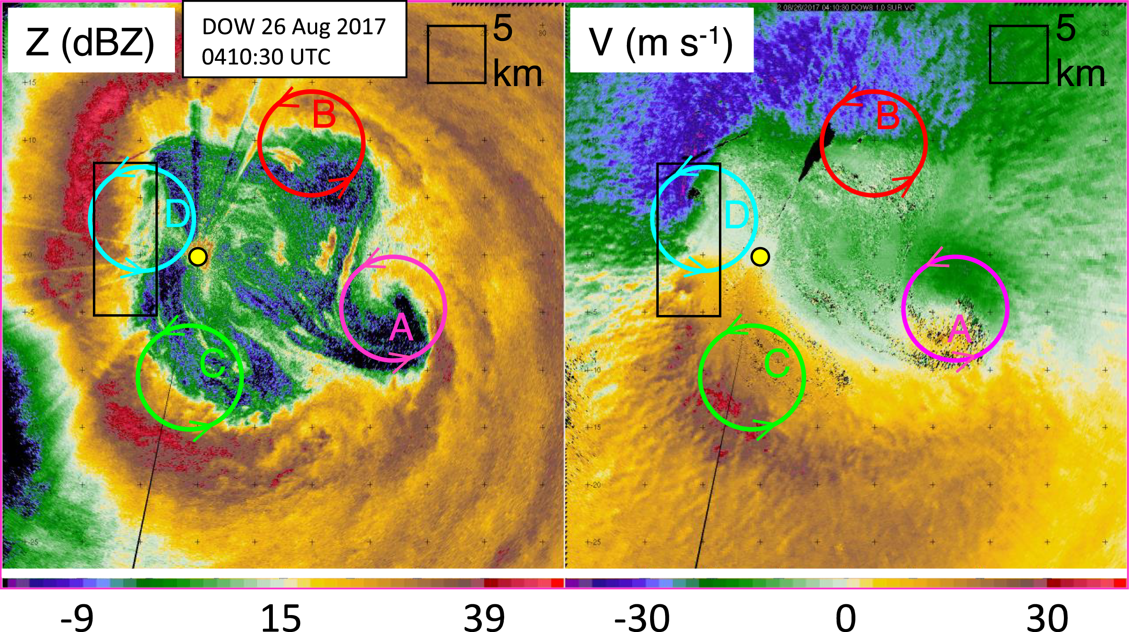
“first direct evidence of MVs” and their role in enhancing surface winds
Finescale DOW radar imagery of hurricane eye and eyewall, including four MVs. (left) Radar reflectivity and (right) Doppler velocity measured from inside eye (DOW location indicated with yellow dot) at 0410:30 UTC 26 Aug 2017. Four MVs revolving about the eye are highlighted schematically with colored circles. Black rectangle is zoomed-in area shown in Fig. 6.
Wurman, J., and K. Kosiba, 2018: The Role of Small-Scale Vortices in Enhancing Surface Winds and Damage in Hurricane Harvey (2017). Mon. Wea. Rev., 146, 713–722, https://doi.org/10.1175/MWR-D-17-0327.1.

Slide 5
So:
Polygonal eyewalls are very common in intense tropical cyclones.
Low-level cloud lines and other patterns are common in intense tropical cyclones.
It has been hypothesized that:
Polygonal eyewalls and low-level cloud liners are signatures of eyewall mesovortices.
Eyewall mesovortices play a role in bringing high-entropy air from the eye into the eyewall increasing buoyancy. Thus, they play a role in intensity change.
Why don’t we see eyewall mesovortices when we cross the eyes of intense tropical cyclones in the P-3 (nor do the C-130s)? Are these solely low-level features?

Slide 6
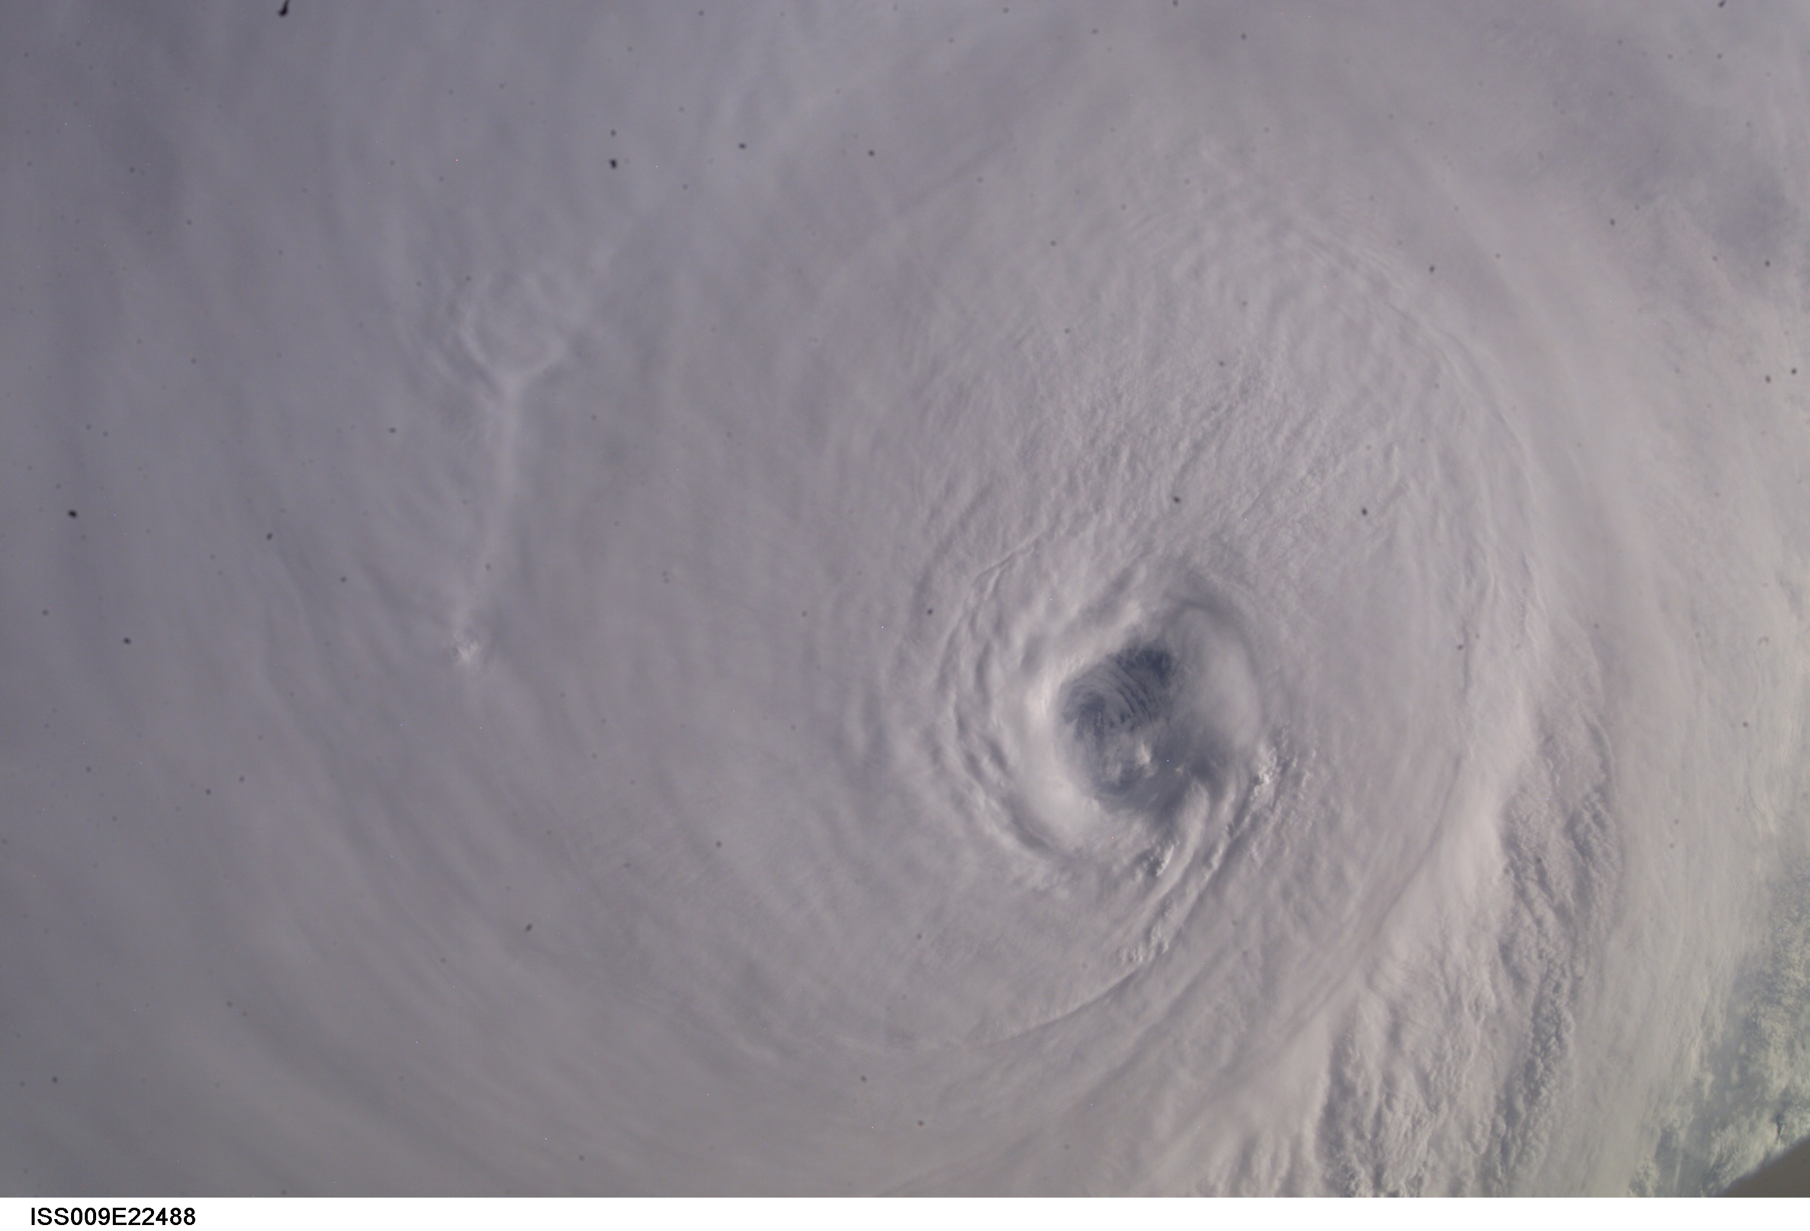
Hurricane Ivan
13 September 2004
223837 UTC
140 kt 912 hPa

Slide 8
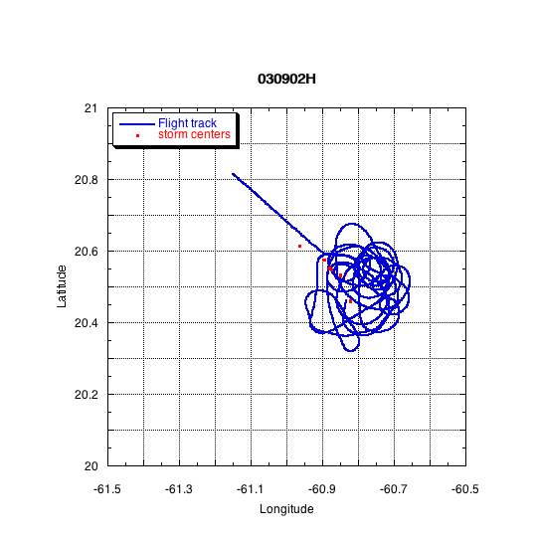
Hurricane Fabian (02 September 2003) 120 kt
Both NOAA P-3 aircraft circled in the eye for up to two hours

Slide 9
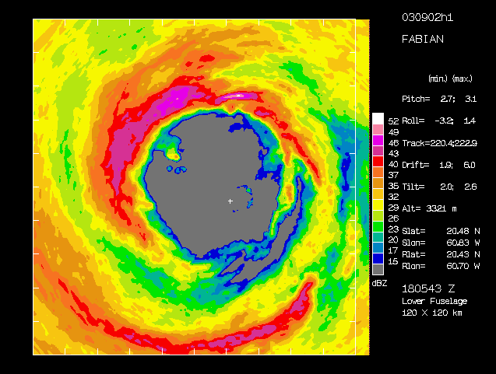
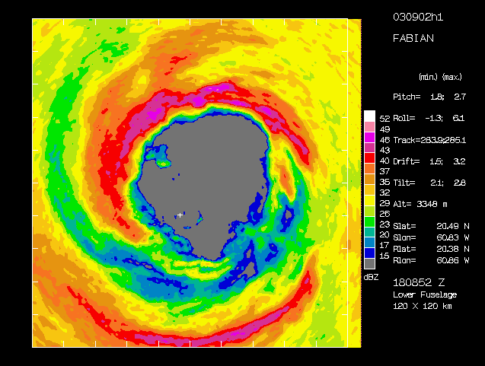
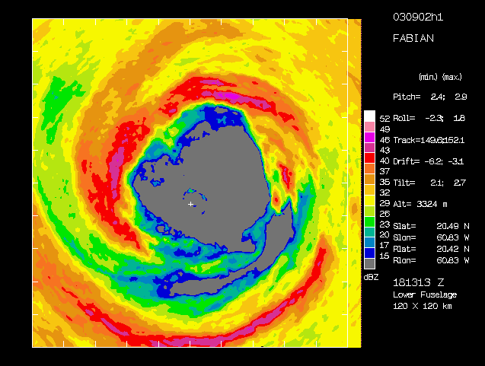
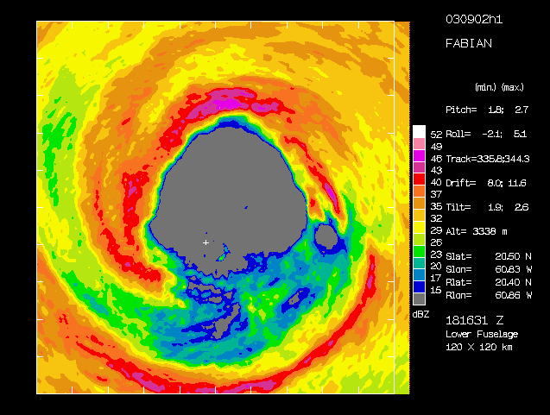
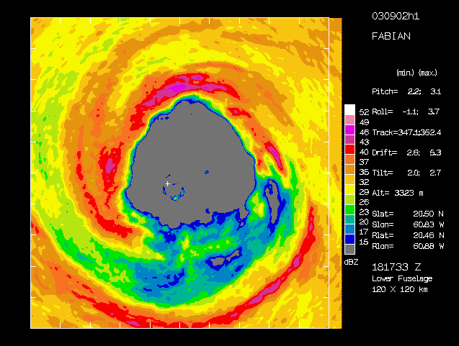
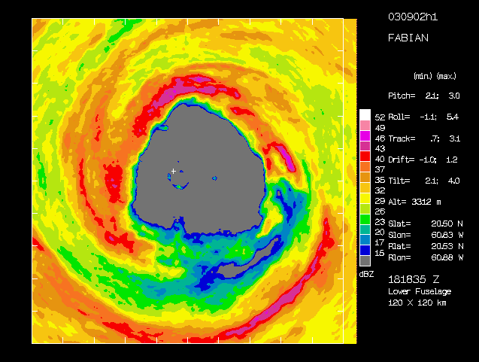
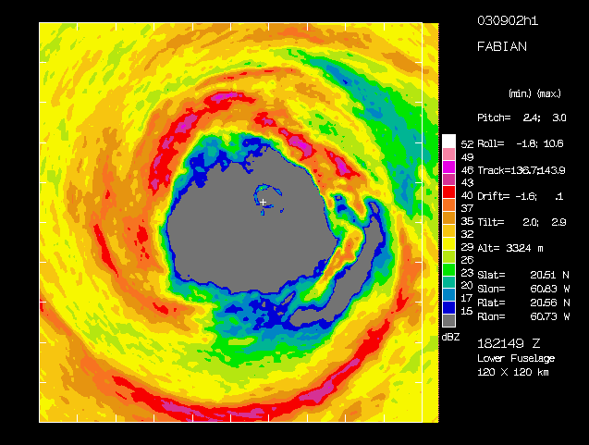
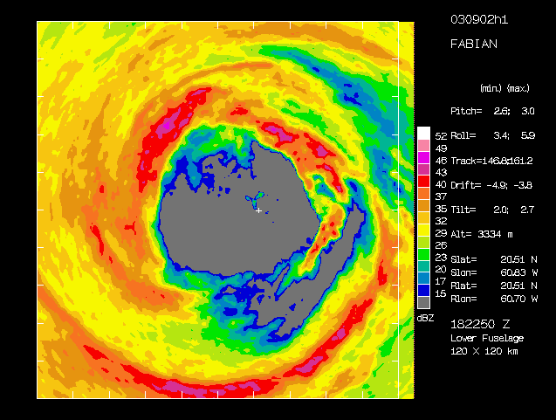
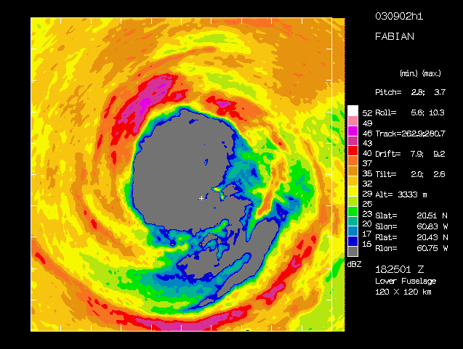
During this time, the eyewall shape changed from circular to triangular (1813 UTC) and back (1823 UTC). The P-3s made three circles in the eye during that time, allowing for unprecedented coverage of the eyewall on short timescales with Doppler radar.
NV
WV
EV
NV
NV
NV
WV
WV
WV
EV
EV
EV
NV
NV
EV
EV
WV
WV

Slide 10
The vertices rotated along the eyewall at ~4.5 degrees per minute, or a rotation period of about 80 minutes.
The theoretical speed of waves c is given by
c=vmax(1-1/m)
where vmax is the tangential speed of the mean flow, and m is the wavenumber (Thomson 1880, Lamb 1932 and by Guinn and Schubert 1993).
At the approximate altitude of the radar observations (~ 3 km), the mean flow was about 57 ms⁻¹, giving a theoretical speed of 37 ms⁻¹, corresponding to a rotation period of 76 minutes.

Slide 11
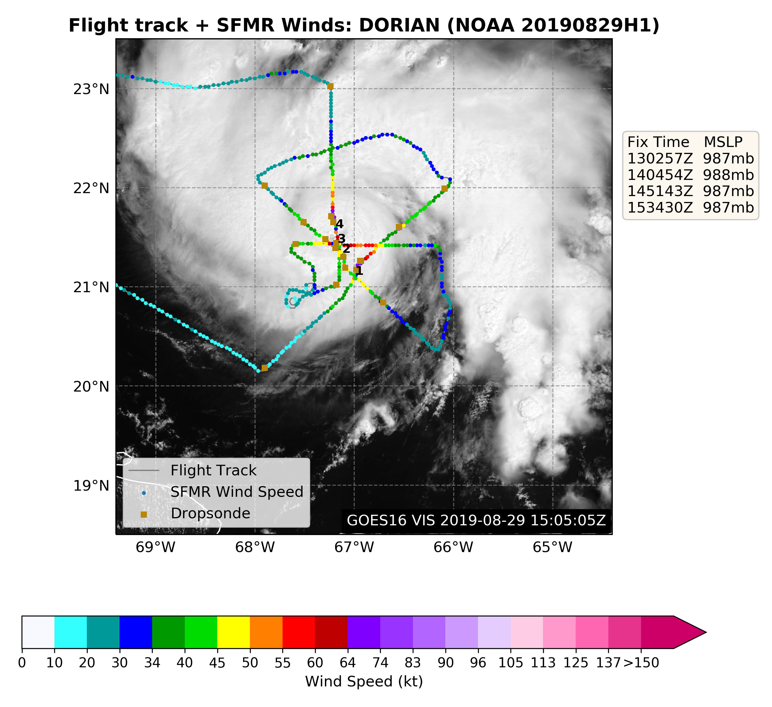
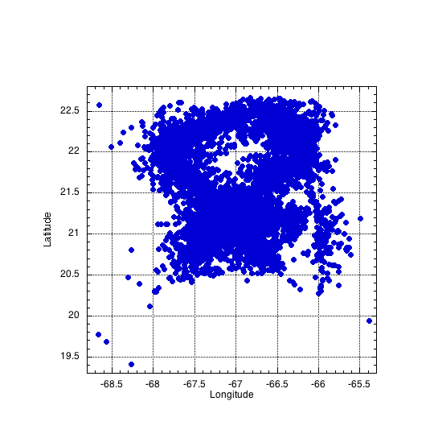
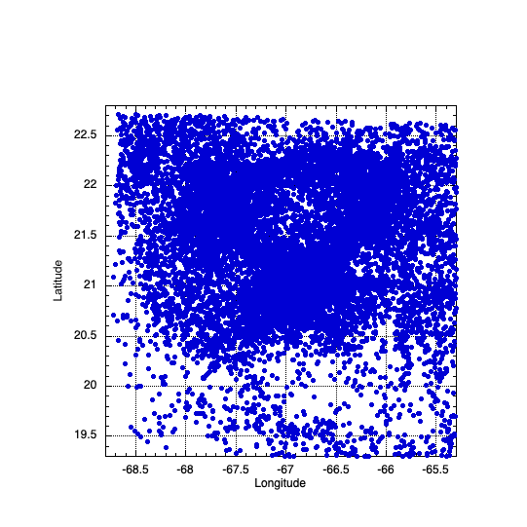
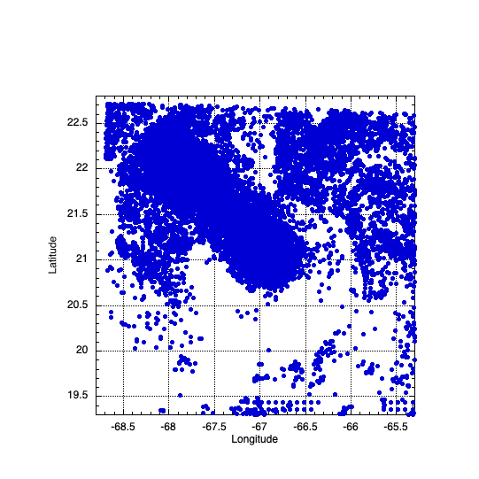
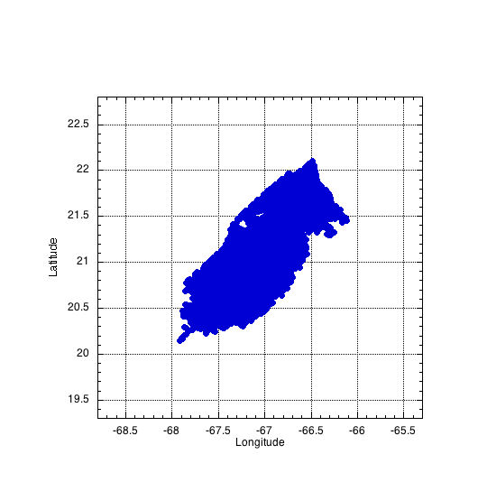
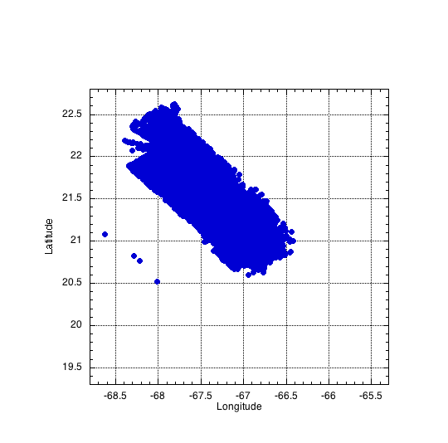
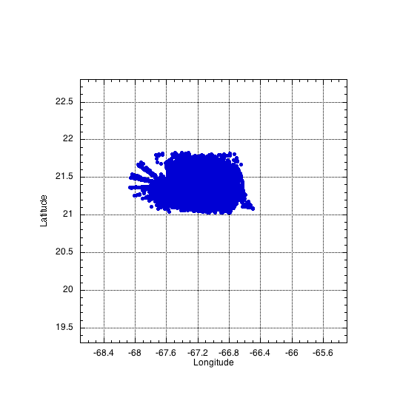
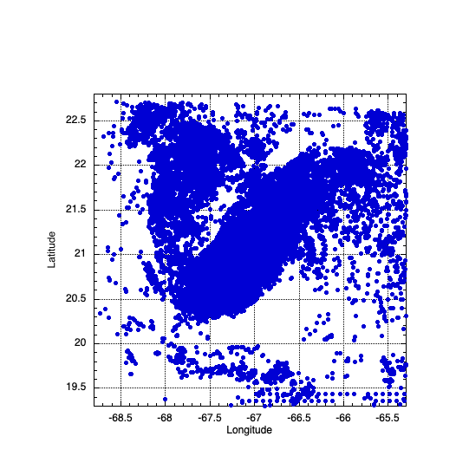
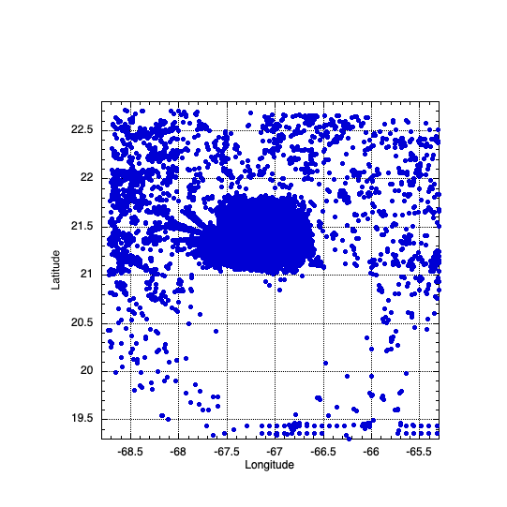
0600 UTC
29 August 2019
0900 UTC
0930 UTC
1000 UTC
1030 UTC
1100 UTC
1130 UTC
1200 UTC
1230 UTC
1300 UTC
1330 UTC
1400 UTC
1430 UTC
1500 UTC
1
2
3
.
.
.
30
1
2
3
.
.
.
30
1
2
3
.
.
.
30
1
2
3
.
.
.
30
1
2
3
.
.
.
30
1
2
3
.
.
.
30
1
2
3
.
.
.
30
1
2
3
.
.
.
30
1
2
3
.
.
.
30
1
2
3
.
.
.
30
1
2
3
.
.
.
30
1
2
3
.
.
.
30
1
2
3
.
.
.
30
1
2
3
.
.
.
30
Ensemble spin up
Storm-relative data
Ensemble mean analyses

Slide 12
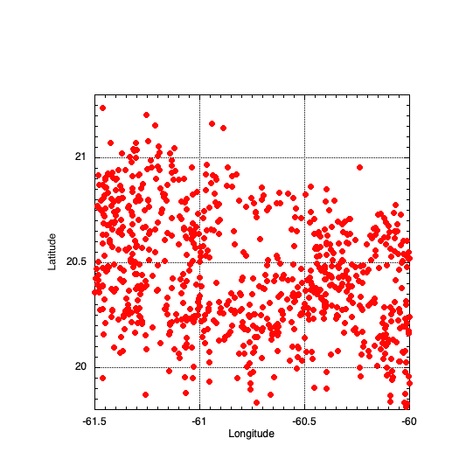
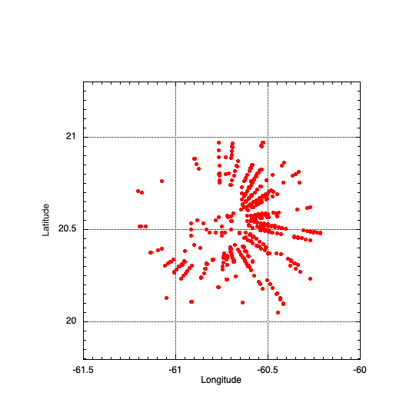
Storm-relative
Earth-relative

Slide 13
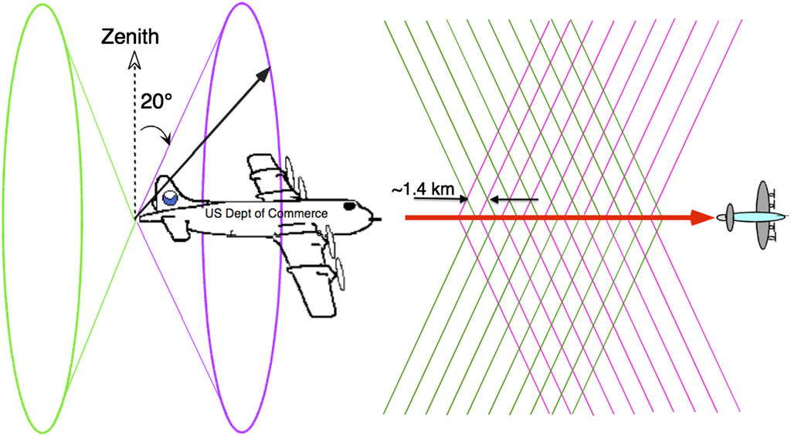
Can we see these small-scale features with airborne Doppler radar?
moving 75 kt
During one circle in the eye, each feature will be sampled four times (fore and aft from left and right sides of aircraft) as it moves around the eyewall.
For every 10 n mi distance the P3 flies from a vortical feature, radar pulses will cross the same location about 1 min apart, and the feature moves 1.25 n mi.
10 n mi
10 n mi

Slide 14
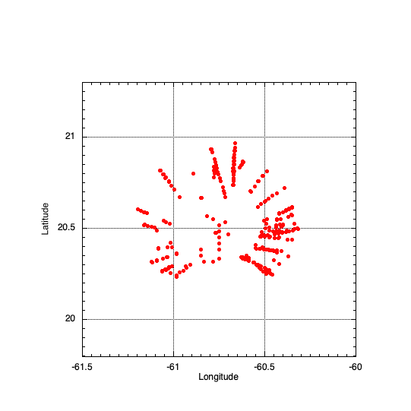

In an attempt to alleviate this problem, we limit the eyewall to be sampled once every time the aircraft circles the eye (every ~5 min) and using data only to the side of the aircraft closest to the eyewall, and only either fore or aft scans.
Eyewall/radius of maximum wind speed
Data assimilated for 1830 UTC analysis
(1827-1833 UTC)
fore scans only
t=0 min, 6 min
t=0 min
~27$°$
t=3 min
t=6 min
fore scans only
2464 observations

Slide 15
Features of HEDAS analyses:
Analyses center location, maximum wind speed, radius of maximum wind speed, etc., largely match best track and center fixes.
Maximum reflectivity just outside location of maximum low-level radial convergence.
Leading edge of convection of west/southwest side of eyewall forms and retreats with location of maximum low-level inflow.
All O-A and O-F statistics are available.

Slide 16
1812 UTC 1818 UTC 1824 UTC

Slide 17
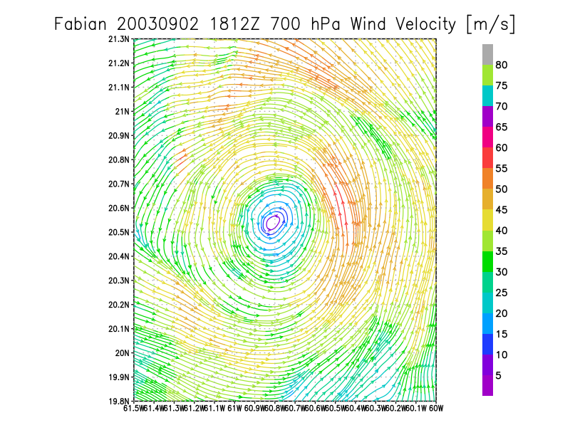
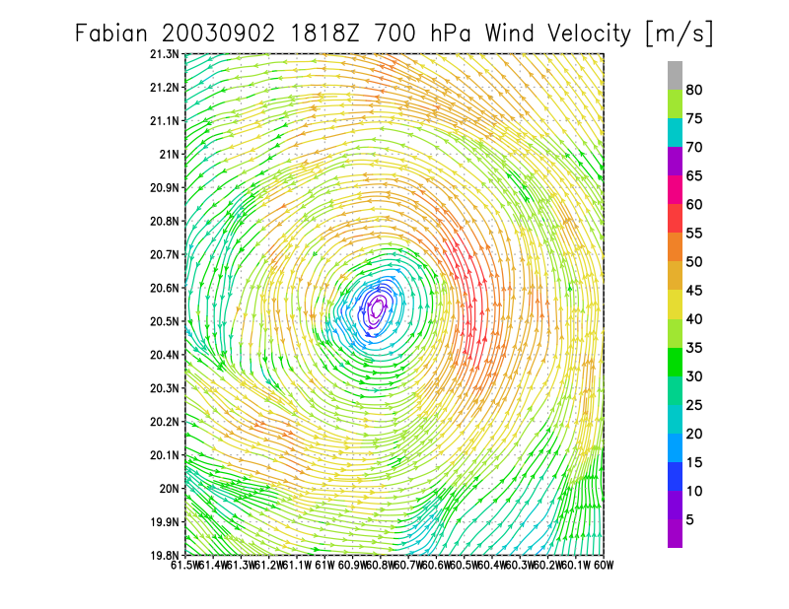
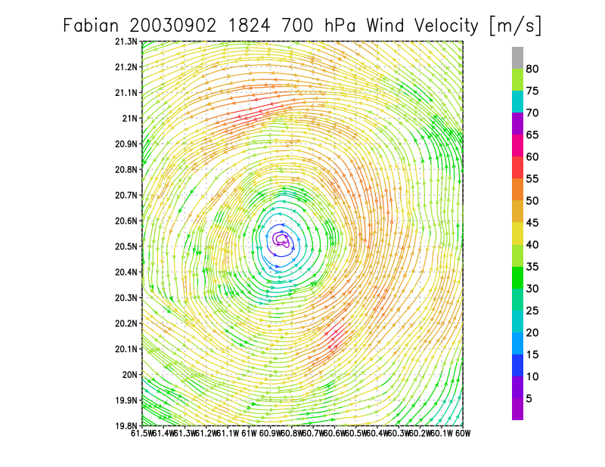
Black circle corresponds to approximate radius of maximum reflectivity, black square to region in reflectivity image.
No small-scale vortices

Slide 18
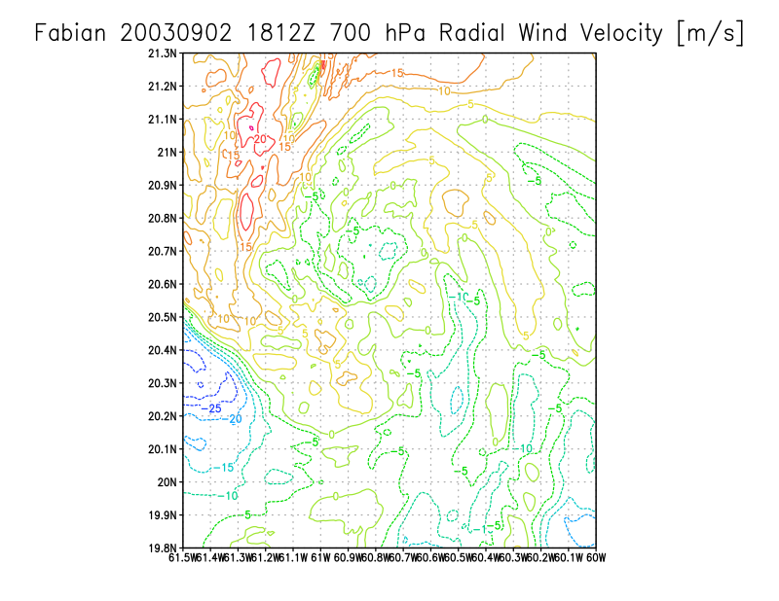
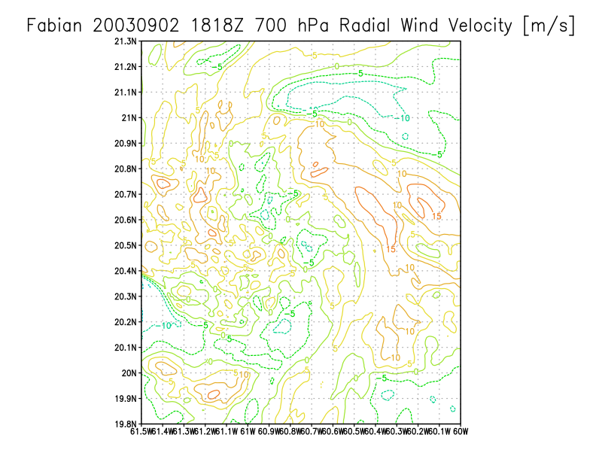
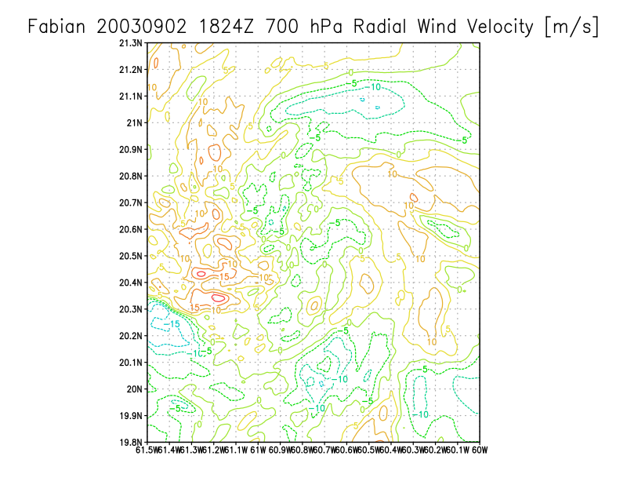

Slide 19
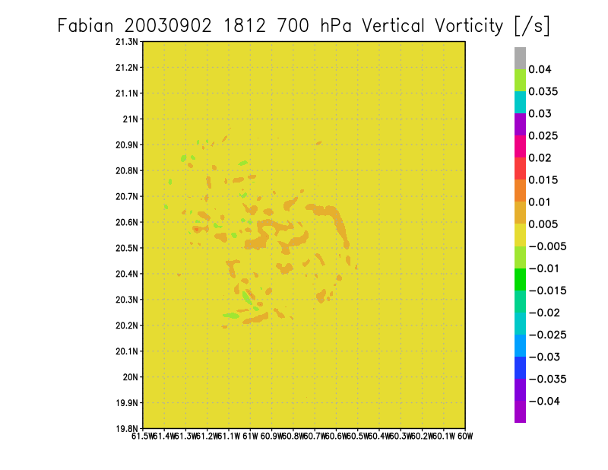

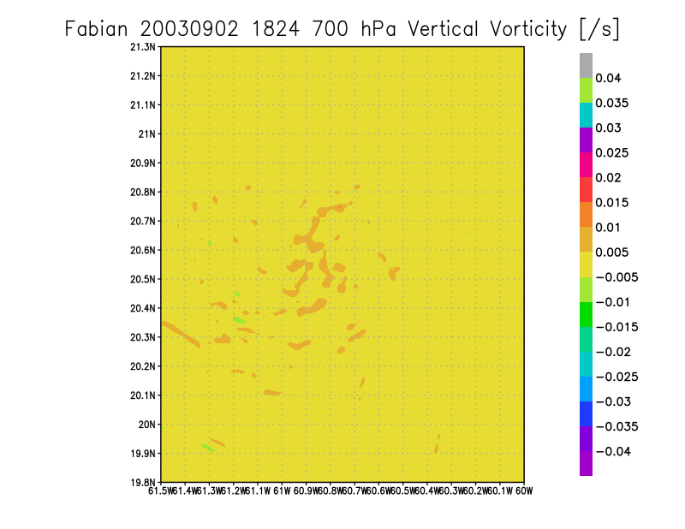
No large vorticity maxima suggesting vortices

Slide 20
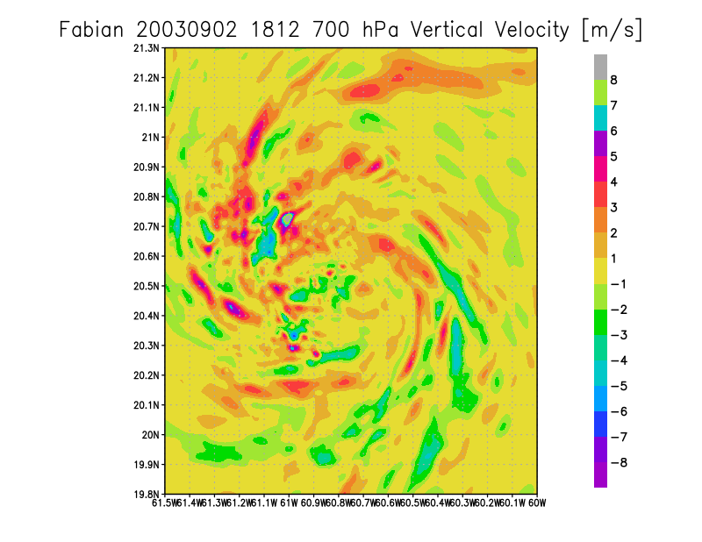
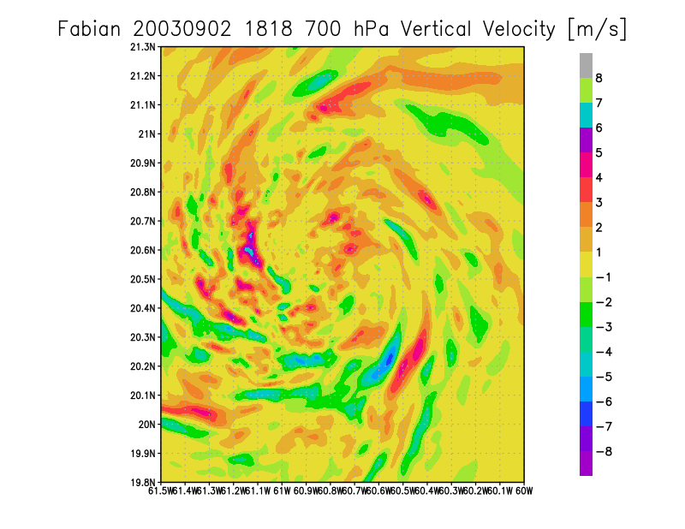
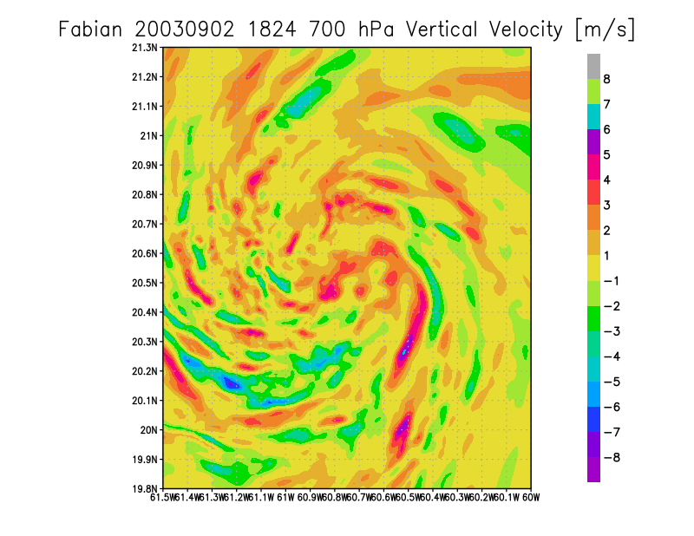

Slide 21
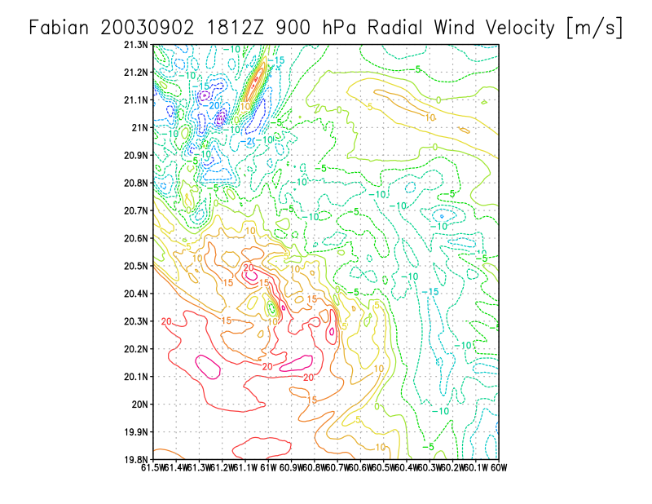
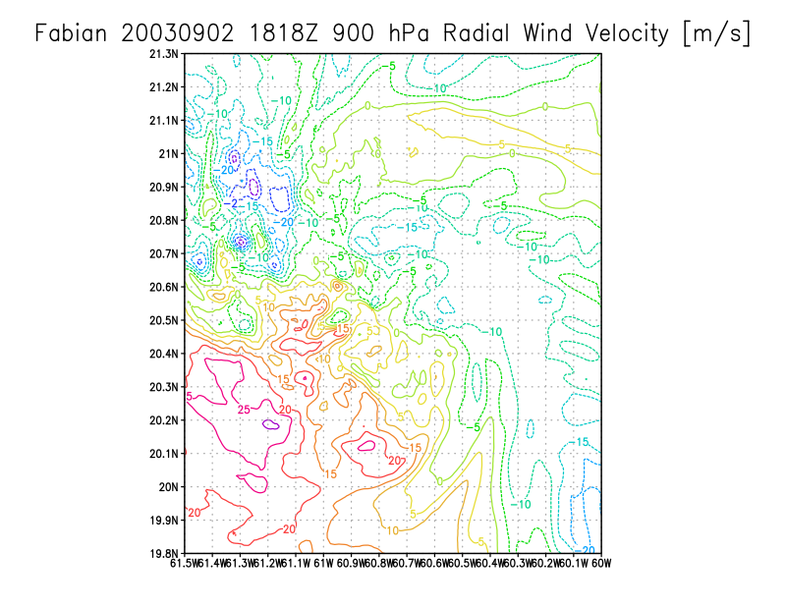


Slide 22




There do not seem to be any feature in the thermodynamic fields, but there are very few temperature or moisture observations, so take that with a grain of salt

Slide 23






Slide 24
Conclusions:
A wavenumber-3 pattern is clearly visible in the reflectivity field that rotates around the center at approximately the same rate as predicted by theory.
This reflectivity pattern does not seem to be related to anything in the wind-velocity analyses.
The reflectivity pattern does seem to be related to shallow, low-level radial-wind dipoles that also rotate around the center near the two southern triangle vertices.
There do not appear to be any meso-vortices in Fabian’s eyewall during this time.
More cases in which the P-3 circled in the eye need to be analyzed to come to any conclusions.

Slide 26





Vortex: a flow with closed streamlines.
Cyclone: a cyclonic circulation, a closed
circulation.
Low: an area of low pressure
What do we call them?
Numerous intense hurricanes exhibit polygonal eyewalls, like Typhoon 8019, attributed to horizontally propagating internal gravity waves.
Typhoon Ida (1958): First photographic evidence of small-scale features in the eye and eyewall.
Fletcher, R. D., J. R. Smith, and R. C. Bundgaard, 1961: Superior photographic reconnaissance of tropical cyclones. Weatherwise, 14, 102-109.
Numerous intense hurricanes exhibit polygonal eyewalls, like Hurricane Betsy (1965), attributed to horizontally propagating internal gravity waves.

Slide 27








Small-scale features seen in eyes of intense tropical cyclones. Study “assumes that the cloud lines are approximately parallel to local streamlines.
Hurricane Debby (1982): Doppler radar analysis shows small-scale circulation in developing eyewall of weak hurricane.
Photograph of a wavenumber-2 pattern in Hurricane Erin (2011), but there was no evidence of vortices in the wind field.
Study suggests that mesovortices may have been responsible for the outward advection of high-θe air into the eyewall. However, no mesovortices are seen in the data.
As in Fig. 12 but (a) at ∼4.2 km in Hurricane Georges at 0041 UTC on 20 Sep 1998, and (b) for GPS sondes deployed in Hurricane Georges between 1900 UTC on 19 Sep and 0100 UTC on 20 Sep. Core average equivalent potential temperature θ_{e} values are only shown for eyewall updraft cores encountered at ∼4.2-km altitude by the second aircraft between 2300 and 0100 UTC.
Photograph taken by the lead author from the right window of the NOAA WP-3D aircraft while circling inside the eye of Hurricane Erin at a flight level of about 4500 m at 1822 UTC 10 Sep 2001.

Slide 28






Pattern resembles mesovortices, but they did not look at the Doppler data to confirm circulations.
Study describes mesovortices, but no closed circulations are found.
A look at the low-wavenumber structure of Hurricane Guillermo. Mesovortices are mentioned in the paper in relation to past studies, but not in relation to Guillermo. Wind-field figures too small to find circulations.
Radar reflectivity (shading), low-wavenumber (n = 0–4) vertical velocity (contours), and low-wavenumber horizontal winds (vectors) in the 9–11-km layer: pass 1–10. Only the highest values of reflectivity (>15 dBZ) have been shaded for clarity. The vertical velocity contour interval is 2 m s⁻¹. Negative values are indicated by the dashed contours. The domain is 120 km on a side with tick marks every 20 km. Regions with substantial wind coverage gaps are omitted from the analysis. Locations of convective clusters–bursts discussed in the text are labeled A–H.
Detailed temporal evolution of the eyewall of Hurricane Dolly. The first panel is at 0503 UTC 23 Jul, and each subsequent panel is approximately 30 min after the previous panel. Panels increase in time in the horizontal. The last panel is at 1433 UTC 23 Jul. The approximate diameter of the eyewall is 45–50 km.

Slide 29








Small- (miso?-) scale features
Distinct vorticity maximum ~6 km across. Wavenumber-1 wind-speed and pressure minima are tracked around the eye, though it is not a closed circulation. They are described as roll vortices or vortex tubes.
Event similar to Hugo in Hurricane Felix
Kelvin-Helmholtz instability on the inner edge of the eyewall in Hurricane Erin (2001).
Sloping striations seen on the inner edge of the eyewall in Hurricane Diana (1984).
(a) Time–height cross section of vertical incidence tail radar reflectivity (dBZ) from LA for 1721–1728 UTC. The LA flight track was at 450 m. Solid and dashed lines denote vertical velocity, and radar reflectivity is denoted by colors using the color scale on the right. (b) Time series plots of w, horizontal wind speed, P_{s}, and θ_{e} for the period 1721–1730 UTC. Updrafts labeled 1, 2, 3, and 4 and wind speed peaks I and II are described in the text. The thick dashed lines in (b) approximately delineate the outer and inner radii of strong eyewall reflectivity maxima in the lower troposphere (1 < z < 5-km altitude).
Photograph of the eyewall of Hurricane Erin with Kelvin–Helmholtz waves at approximately 1815 UTC 10 Sep 2001. The image was taken from the NOAA P3 aircraft from an altitude of approximately 4500 m. The inset shows the entire photograph, with the approximate region of the close-up marked by the rectangle.
Flight-level and surface wind data during the inbound leg into Hurricane Felix: (a) flight-level horizontal wind speed, vertical wind velocity, and surface wind speed; and (b) flight-level horizontal wind speed and direction. The black vertical line corresponds to the time of the release of a dropwindsonde.

