Slide 1
‘Omics: New Technologies to Address NOAA Mission
Kelly D. Goodwin, PhD
AOML Review November 20, 2019

Slide 2
‘Omics
‘Omics at NOAA
A suite of advanced biological tools to analyze organisms at the molecular level
Revolutionize the ability to monitor and understand
oceans and Great Lakes
biological communities
Genetics
Proteomics
Genomics
Metabolomics
Metagenomics
Metatranscriptomics
Epigenetics

Slide 3
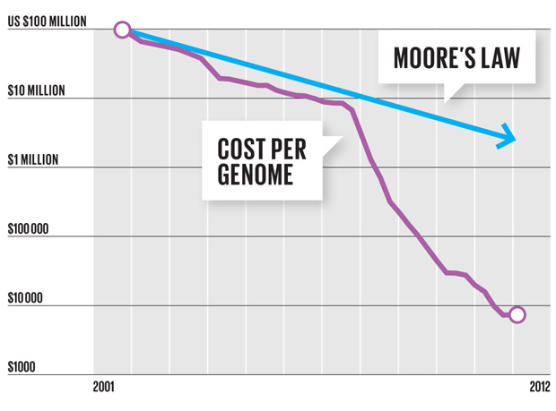
Sequencing Technology: Fast, Cheap, Massive
DNA sequencing reveals unanticipated complexity, diversity, and relationships
Transforming medical, food and environmental science; creating new treatments and economic markets

Slide 4
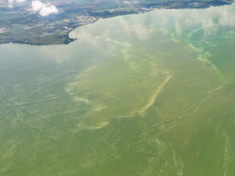
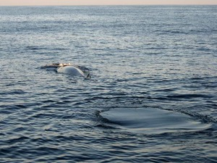
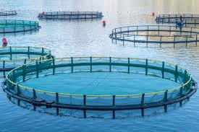
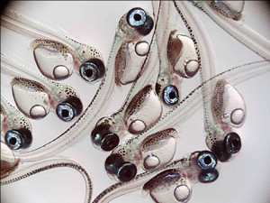
‘Omics Applications
Protect | Sustain | Promote | Improve
from harmful algae, bacteria, invasive | Fish, coral, marine mammals & turtles | Aquaculture, fishing, bioprospecting | Labor & ship costs, time to data products

Slide 5
‘Omics for the Blue Economy
The US Blue Economy Adds
The US Blue Economy Provides
Ocean Value Worldwide
$304
Billion
3.3
Million
$3
trillion
to the Gross Domestic Product
Jobs Annually
by the year 2020
Notes:
https://coast.noaa.gov/digitalcoast/data/
3 Trillion Est. Value- The Ocean Economy in 2030. Organization for Economic Co-operation and Development (2016) DOI:10.1787/9789264251724-en

Slide 6
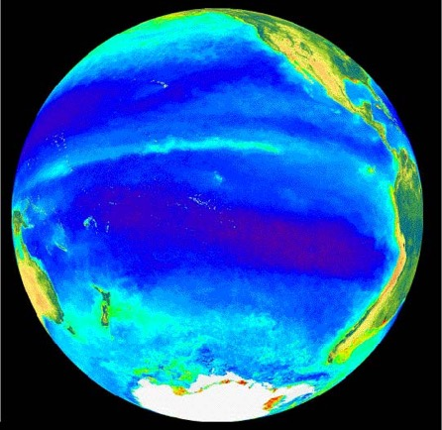
The Ocean is the Earth’s Largest Microbiome
Discovery Awaits
Accounts for 70% of marine biomass
Maintains ecosystem function
Notes:
“The marine environment is primarily occupied by microbes, mainly bacteria and protists, which account for ~70% of the total marine biomass.” Bar-on et al. 2018 https://www.pnas.org/content/pnas/115/25/6506.full.pdf
Microbiomes form the base of the marine food web and perform essential ecosystem functions

Slide 7
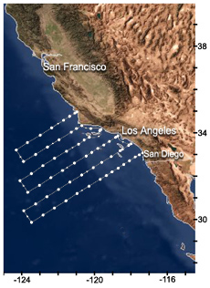
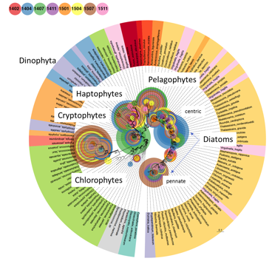
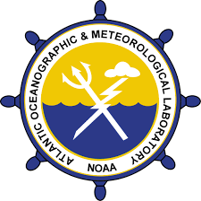
Integration into Marine Monitoring
California Cooperative Fisheries Investigations
‘Omics integrated into this historical program to assess food web dynamics and ecosystem response
SIO/JCVI – A. Allen, L. Ziegler;
NOAA AOML – K. Goodwin

Slide 8
Comprehensive Analysis
18S rDNA, V9 sequences
DNA sequence data reveals community structure compared to single-value chlorophyll measurements
Chlorophyll values
Goodwin et al. 2019, ISBN: 9780128052044

Slide 9
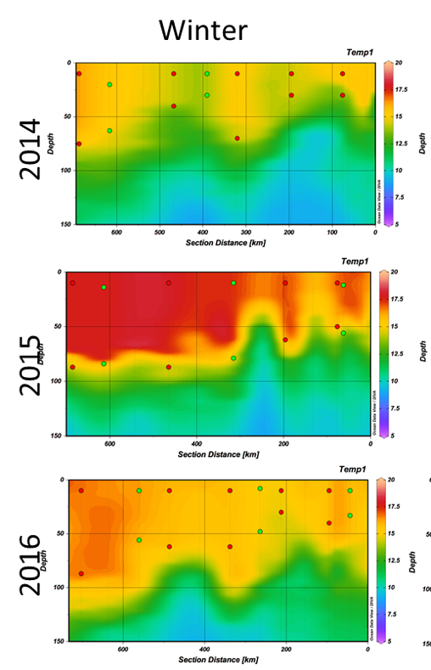
Measure Microbiome Response
Microbiome species related to fish species richness
Develop indices and test trophic interactions under changing conditions
NOAA AOML – C. Kelble, K. Goodwin
NOAA SWFSC – E. Hazen, A. Thompson, J. Santora, E. Satterthwaite
SIO/JCVI – A. Allen, L. Ziegler
“The blob” heat anomaly
Figure credit: Erin Satterthwaite

Slide 10
eDNA and Metabarcoding
Benefits:
Sensitive
Less invasive (no tissue, no trawls)
Extended sampling reach (deep, poles, protected)
Detect multiple trophic levels from single sample (“microbes to mammals”)
Amenable to autonomous platforms
Expanding the microbiome
The microbiome and higher trophic levels, such as fish or marine mammals, can be gleaned from seawater – from the DNA in sloughed or excreted cells
eDNA = environmental DNA
Notes:
eDNA = tissue free
Metabarcoding – used here refers to tissue, in this case larval fish or eggs

Slide 11
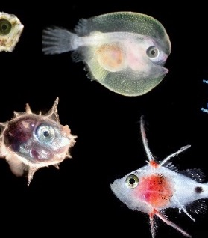
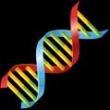
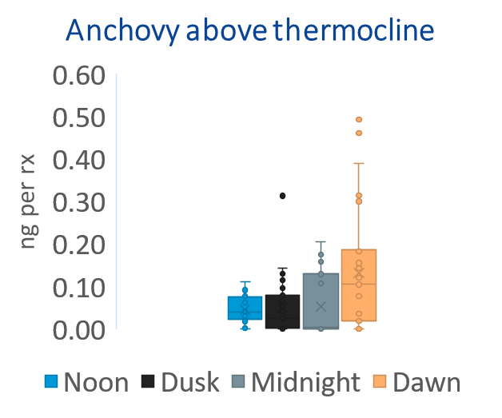
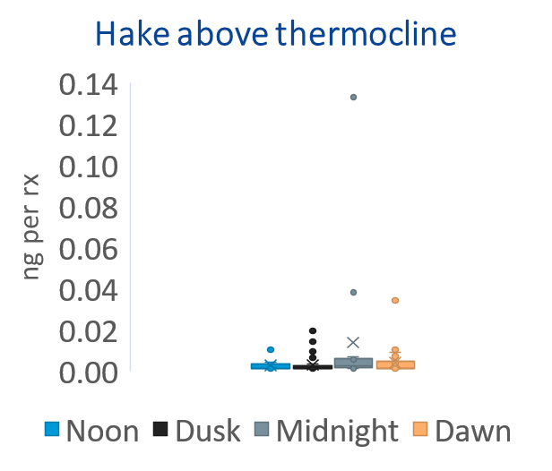
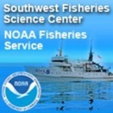
eDNA and Metabarcoding
for fisheries applications
Ichthyoplankton Metabarcoding to Improve Monitoring Efficiency
A. Thompson, Z. Gold, D. Kacev, K. Goodwin, L. Thompson
SWFSC, AOML, UCLA
eDNA for Observations of Key Fish Species
K. Harper, K. Goodwin AOML

Slide 12
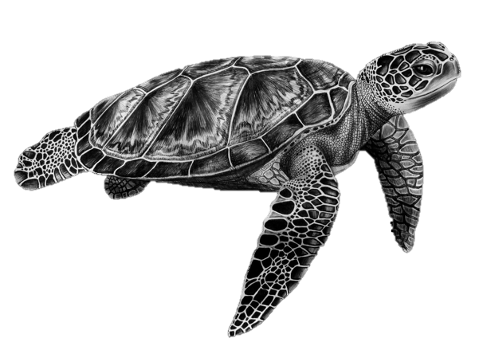
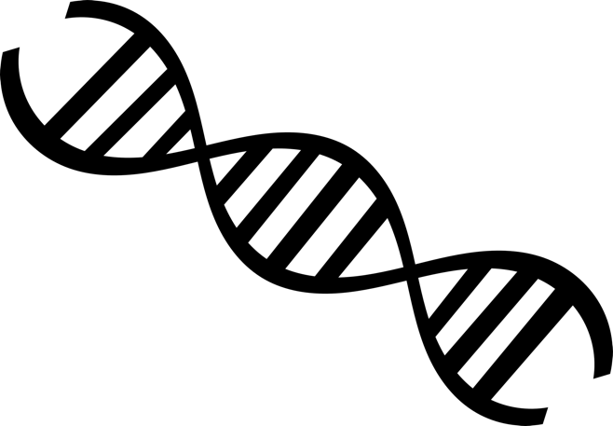
eDNA for Protected Resources
Marine Turtles
Mandated monitoring
Surveys are laborious, expensive, stressful to animal
Suitability of eDNA for marine amphibians unknown
Despite carapace, eDNA detected and consistent with animal presence
Kirsten Harper, Peter Dutton, Kelly Goodwin AOML, SWFSC

Slide 13
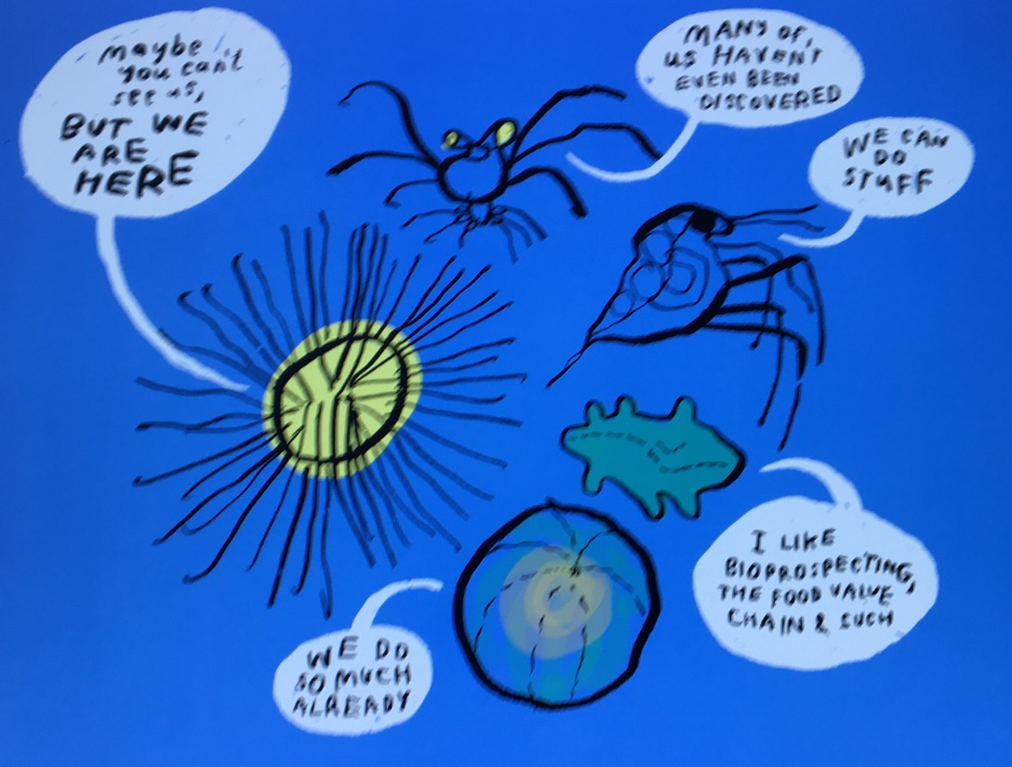
International Collaboration
“Expand Partnerships to Advance ‘Omics Research and Application Across the Agency
Marine Microbiome

Slide 14
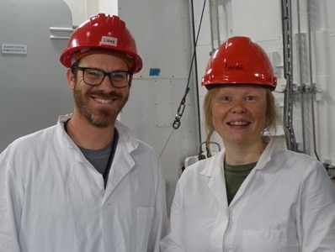
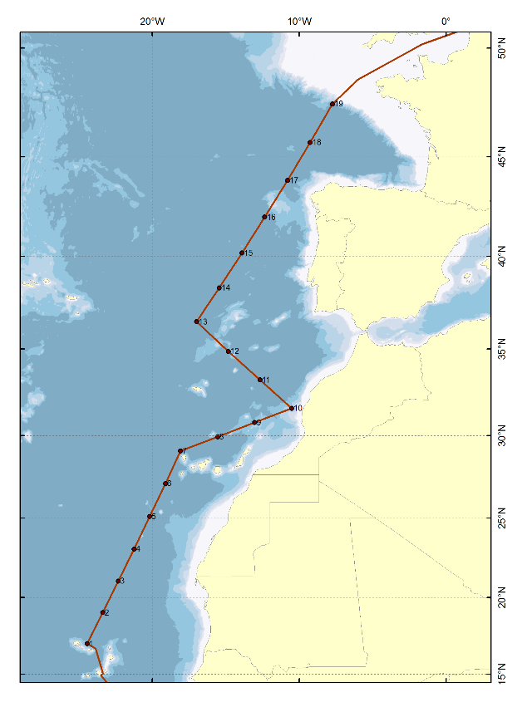
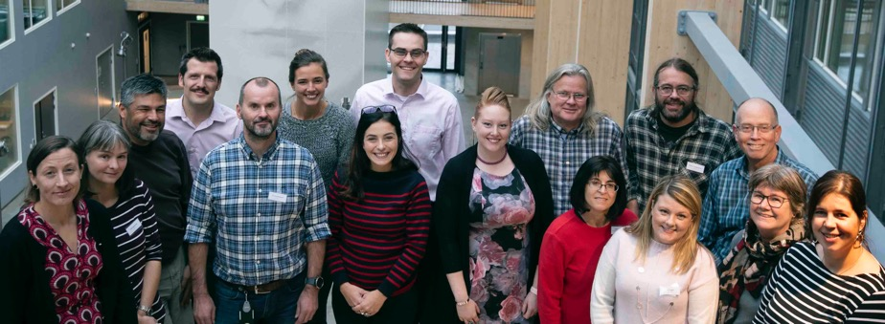
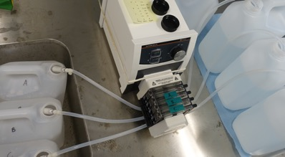
International Collaboration
Joint mission May 2019, cruise from Cape Verde to France. Focus on eDNA investigation of potential mesopelagic fisheries
US-Norway Bilateral on eDNA
Three bilateral meetings since 2018
Pending white paper on eDNA for fisheries stock assessments
United States: L. Thompson, K. Goodwin - AOML,
Norway: J-I Westgaard, T Johansen – IMR; K. Praebel, O. Wangensteen UiT

Slide 15
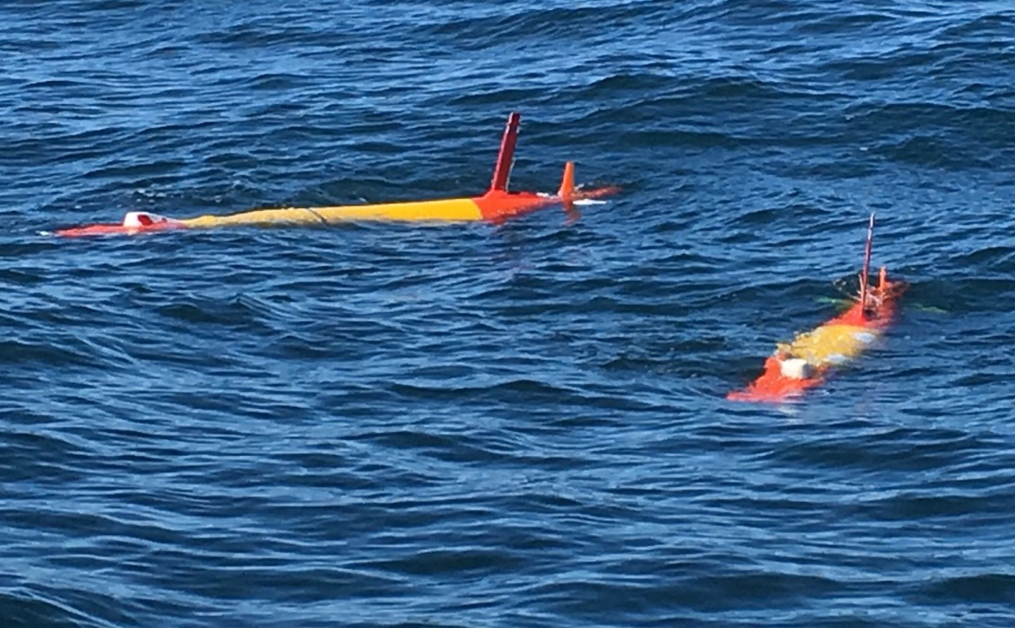
Autonomous ‘Omics
“Accelerate transition of ‘omics research into operations” – NOAA ‘Omics Strategy
eDNA is amenable to integration into autonomous platforms
Augment spatial and temporal sampling to improve models while combating costs

Slide 16
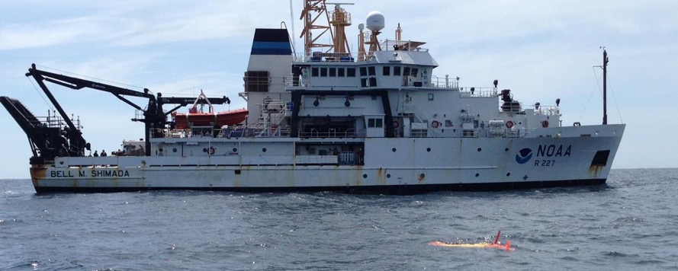
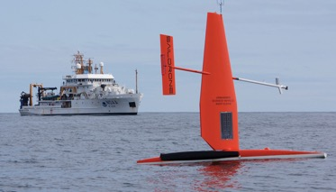
Engineering Advancement
CA Current Missions
Demonstrated equivalency to hand sampling
Increase in readiness level (~RL4 → RL5)
2017: 5-sample capacity
2018: 60-sample capacity
2019: combined with acoustics
Team Leads:
MBARI ESP – J. Birch
MBARI MBON Lead – F. Chavez
NOAA AOML – K. Goodwin
MBARI = Monterey Bay Aquarium Research Institute
Yamhara et al. 2019, 10.3389/fmars.2019.00373

Slide 17
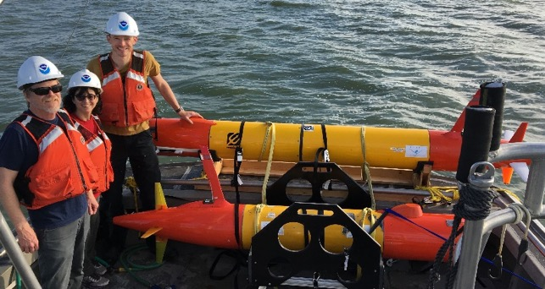
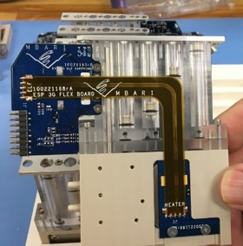
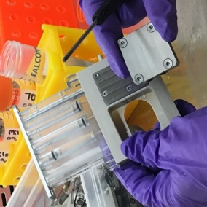
Great Lakes Missions
Protecting Drinking Water from Harmful Algae Toxins
Transition from open ocean to shallow freshwater
2 cartridges:
On-board detection of HAB toxin
eDNA archival
MBARI TEAM – J. Birch, B. Ussler, C. Scholin et al.;
NOAA TEAM – K. Goodwin (AOML), G. Doucette (NCCOS/ CCEHBR), S. Ruberg (GLERL), P. DeUnyl (CIGLR); L. Thompson (NGI/AOML); Tim Davis (Bowling Green)

Slide 18
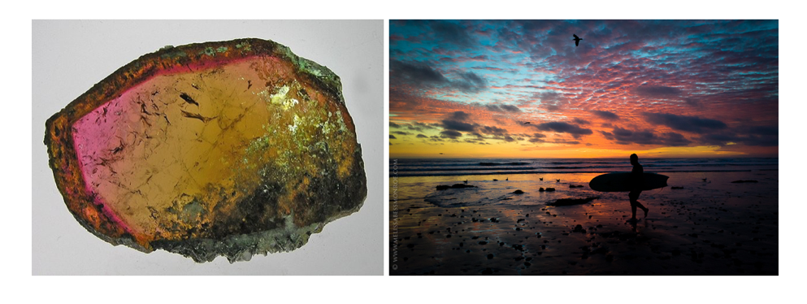
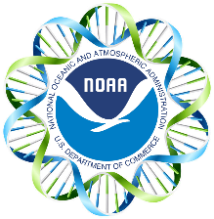
Bioinformatics
Tourmaline
Workforce and Infrastructure Enhancement
Bioinformatics expertise and computing capacity remain primary needs
Bioinformatic workflow “tourmaline” for amplicon sequences
Available on GitHub
See Luke Thompson poster for more information

Slide 19
THANK YOU

