Slide 1
Design and testing of a MOC monitoring array in the South Atlantic
Renellys C. Perez¹², Silvia L. Garzoli²,
Ricardo P. Matano³, Christopher S. Meinen²
¹UM/CIMAS, ²NOAA/AOML, ³OSU/COAS

Slide 2
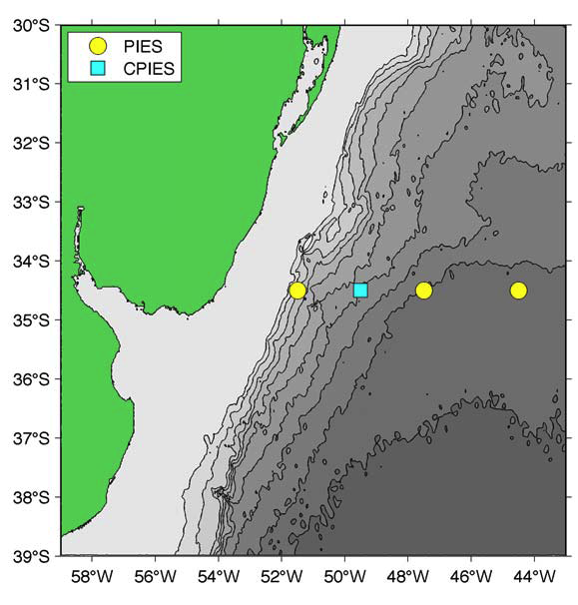
South Atlantic MOC (SAM) array
Deployed 3 PIES/1 CPIES in March 2009
PIES (CPIES) = inverted echo sounder with bottom pressure sensor (and current meter)
As part of BONUS-GOODHOPE project 2 CPIES were deployed near South African coast in February 2008 (Chief Scientist: Sabrina Speich)
Figure from SAM Cruise report (Chief Scientist: Chris Meinen)

Slide 3
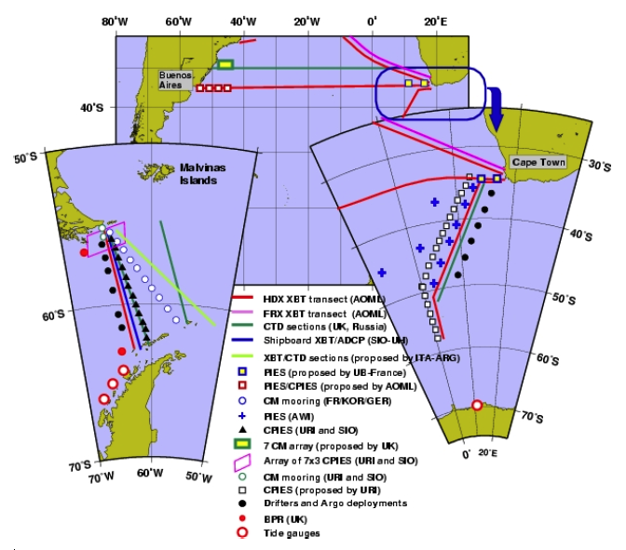
Existing observations in the South Atlantic
To better resolve the western boundary currents along the northern boundary of the SAMOC box, a pilot array was started along 34.5°S
Infrastructure considerations largely determined the latitude
Figure obtained from http://www.aoml.noaa.gov/phod/SAMOC/

Slide 4
Questions:
What do Observing System Experiments (OSEs) tell us about where a MOC monitoring array should be located?
Can a PIES/CPIES array be used to monitor the MOC?
Can the SAM and Bonus-Goodhope arrays be incorporated into a MOC monitoring array?

Slide 5
Motivation
There is only one quasi-comprehensive MOC monitoring system in North Atlantic: the RAPID/MOCHA array at 26.5°N (Cunningham et al. 2007; Kanzow et al. 2007)
Given global extent of the MOC, it is important to take into account changes in other basins
Otherwise, we cannot determine the causality of changes observed by the RAPID/MOCHA array
Heat and salt fluxes from the SA to NA are important for North Atlantic Deep Water (NADW) formation
From XBT measurements we know that there is strong connection between the MOC and heat transport in the SA (Dong et al. 2009)
Garzoli and Matano 2010

Slide 6
Observed connection between NHT and MOC
Signals are positively correlated (r=0.76)
1 Sv increase in MOC = 0.05 ± 0.01 PW increase in NHT
Dong et al. 2009

Slide 7
Array development
Deploy virtual arrays into two high-resolution ocean models
Evaluate the ability of the arrays to reproduce the MOC and NHT
Perfect array of T, S profiles
Perfect array of CPIES*
SAM array + Bonus-Goodhope array (+ additional)
At each time step, velocity estimated as v_{g} + v_{b} + v_{e}+ v_{c}
Velocity adjusted by v_{c} to give zero net volume transport
MOC(t) = maximum northward volume transport at each time step (integrate from velocity surface to ~1000 m)
Focus on five latitudes: 15°S, 20°S, 25°S, 30°S, 34.5°S
* IES travel times are combined with model T, S to produce time series of dynamic height and geostrophic velocity (similar to Gravest Empirical Mode methodology, e.g., Meinen et al. 2006)

Slide 8
Models
POCM: Parallel Ocean Circulation Model (Tokmakian and Challenor 1999)
Bryan (1969) primitive equation, hydrostatic, z-level model
ECMWF/ERA40 reanalysis fluxes
Horizontal resolution is 0.4° longitude x 1/4° latitude*
20 z-levels
OFES: OGCM For the Earth Simulator (JAMSTEC)
Based on MOM3
NCEP/NCAR reanalysis fluxes
Horizontal resolution is 0.1° longitude x 0.1° latitude
54 z-levels

Slide 9
Models
POCM¹
Well studied, but has coarser resolution and older numerics
Successfully simulates vertically integrated flow and diapycnal overturning in Southern Ocean, low-frequency variability of ACC and Malvinas Current
Does not reproduce correct location of Malvinas Confluence nor Zapiola Eddy, only sheds 2 Agulhas rings/year, overestimates ACC transport through Drake Passage
OFES²
High resolution and advanced numerics, but needs further validation
Reproduces large scale SSHA variability in Southern Ocean
Underestimates increasing tendency of SSHA in South Atlantic, Agulhas rings propagate too far north
¹Matano & Beier (2003),Schouten & Matano (2006),Baringer & Garzoli (2007),Fetter & Matano (2008)
²Sasaki et al. (2007), Giarolla & Matano (Ocean Sciences 2010)

Slide 10
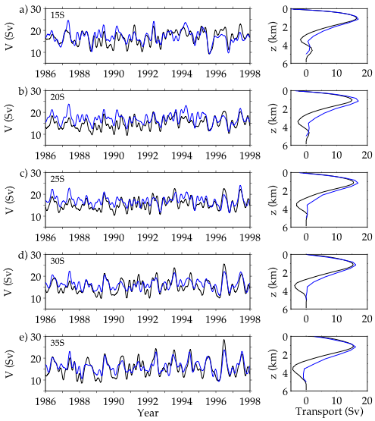
MOC computed using perfect v array “Truth”
Black = OFES
Blue = POCM
Left: MOC time series
Right: Mean vertical structure

Slide 11
MOC computed using perfect v array “Truth”
Lumpkin and Speer (2007)
11°S 16.2 ± 3.0 Sv
32°S 12.4 ± 2.6 Sv
Dong et al. (2009)
35°S 17.9 ± 2.2 Sv

Slide 12
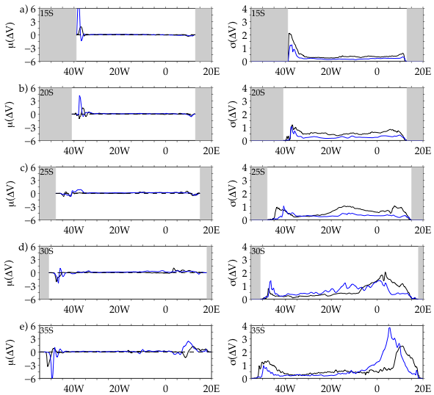
High correlation, but zonal structure different
Black = OFES
Blue = POCM
Left: Mean
Right: Standard Deviation

Slide 13
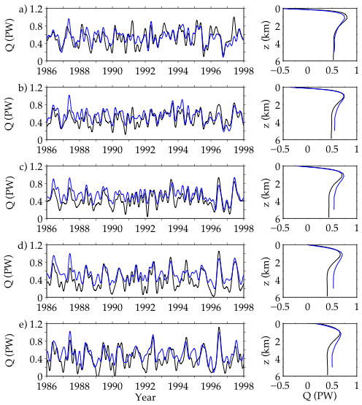
NHT computed using perfect v array “Truth”
Correlation between NHT and MOC exceeds 0.85 for all latitudes and both models (consistent with Dong et al. 2009)

Slide 14
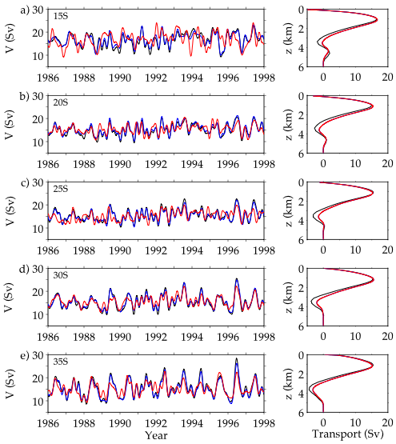
Can a perfect T,S or CPIES array reconstruct the MOC in OFES?
Black = “Truth” array
Blue = Perfect T,S array
Red = Perfect CPIES array
Left: MOC time series
Right: Mean vertical structure

Slide 15
Can a perfect T,S or CPIES array reconstruct the MOC in OFES?
Less than 0.4 Sv bias at all latitudes
High RMSE at 15°S
Perfect T, S: high correlation at all latitudes
Perfect CPIES: high correlation at 20°S, 30°S, 35°S

Slide 16
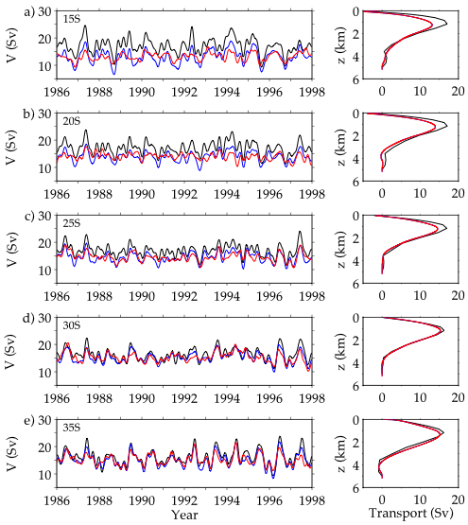
Can a perfect T,S or CPIES array reconstruct the MOC in POCM?
Black = “Truth” array
Blue = Perfect T,S array
Red = Perfect CPIES array
Left: MOC time series
Right: Mean vertical structure

Slide 17
Can a perfect T,S or CPIES array reconstruct the MOC in POCM?
Bias exceeds 1 Sv at low latitudes
High RMSE at low latitudes
Perfect T, S: high correlation at all latitudes
Perfect CPIES: high correlation at 25°S, 30°S, 35°S

Slide 18
Summary of perfect arrays
In general, better reconstructions are achieved
in OFES compared with POCM
at higher latitudes compared with lower latitudes
with a perfect T, S array compared with a perfect CPIES array
for volume transport (MOC) compared with heat transport (NHT)
Recommendation: higher latitudes (25°S to 35°S) better for placement of the SAMOC array, especially if array consists of PIES/CPIES

Slide 19
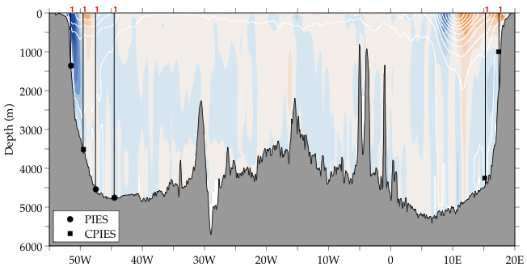
What happens if we degrade the array at 34.5°S in OFES?
Color contours: Mean v
White contours: Std v

Slide 20
What happens if we degrade the array at 34.5°S in OFES?
Color contours: Mean v
White contours: Std v

Slide 21
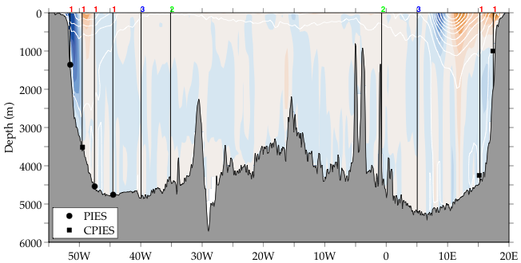
What happens if we degrade the array at 34.5°S in OFES?
Color contours: Mean v
White contours: Std v

Slide 22
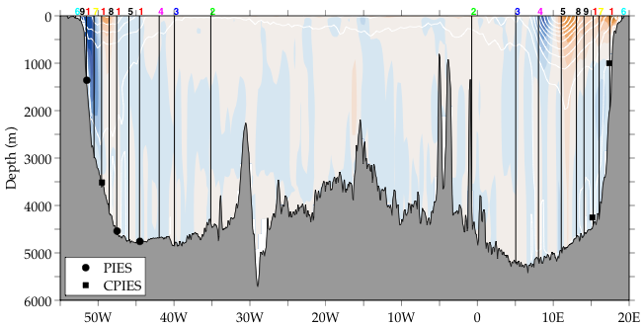
What happens if we degrade the array at 34.5°S in OFES?
Color contours: Mean v
White contours: Std v

Slide 23
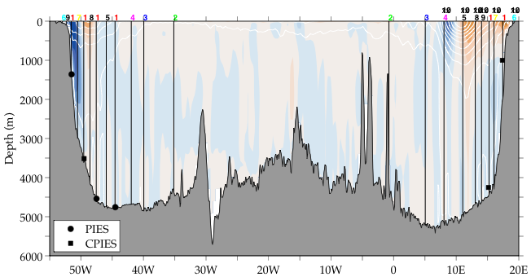
What happens if we degrade the array at 34.5°S in OFES?
Color contours: Mean v
White contours: Std v

Slide 24
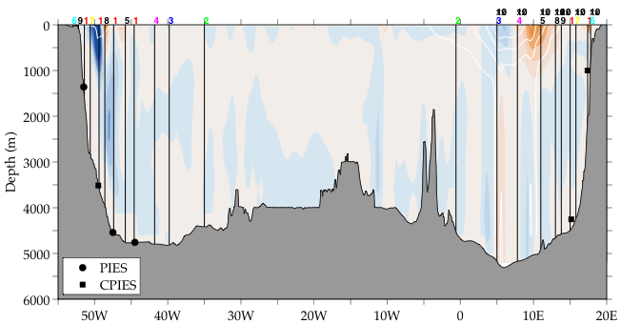
What happens if we degrade the array at 34.5°S in POCM?
Color contours: Mean v
White contours: Std v

Slide 25
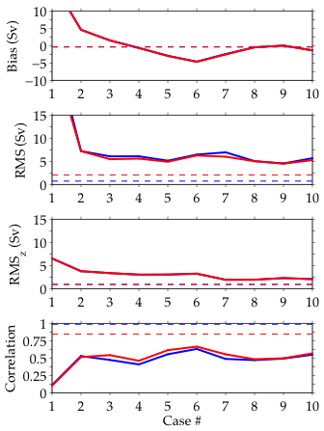
OFES 34.5°S POCM 34.5°S in OFES?
Blue = Degraded T,S array
Red = Degraded CPIES array

Slide 26
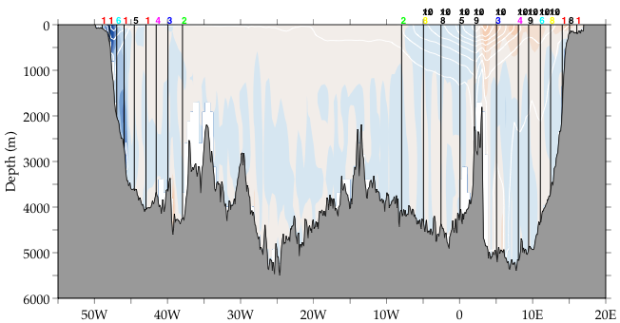
What happens if we degrade the array at 30°S in OFES?
Color contours: Mean v
White contours: Std v

Slide 27
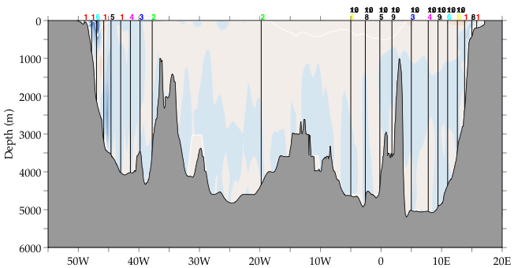
What happens if we degrade the array at 30°S in POCM?
Color contours: Mean v
White contours: Std v

Slide 28
OFES 30°S POCM 30°S
Blue = Degraded T,S array
Red = Degraded CPIES array

Slide 29
Why do less instruments do a better job?
Large meso-scale variability east of Walvis Ridge poorly represented by a handful of moorings [Need to filter out meso-scale variability]
MOC is strongly correlated with Ekman transport at high latitudes
POCM: 0.66 at 25°S, 0.75 at 30°S, 0.85 at 35°S
OFES: 0.51 at 25°S, 0.82 at 30°S, 0.88 at 35°S
RAPID/MOCHA array correlation is ~0.6*
Questions:
Can altimetric data be used to resolve regions of large meso-scale variability and set geographic limits for a SAMOC array?
How many moorings are needed to reconstruct heat and salt transport by Agulhas rings?
*2004-2008 RAPID/MOCHA data obtained from http://www.noc.soton.ac.uk/rapidmoc/

Slide 30
Summary of degraded arrays
For reconstructions of the MOC, it is important to have interior measurements
Present arrays + 2 interior points perform surprisingly well
Energetic Agulhas eddy region must be treated carefully
Degraded CPIES array and T, S array are comparable for MOC reconstructions
Need ~15 measurements to reproduce mean vertical structure of the MOC and have low biases in the OFES model
Degrading the array is less successful in the POCM model

Slide 32
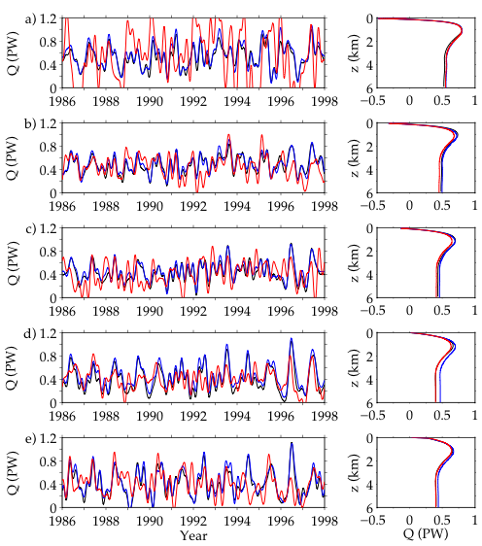
Can a perfect T,S or CPIES array reconstruct the NHT in OFES?
Black = “Truth” array
Blue = Perfect T,S array
Red = Perfect CPIES array plus mean T,S relationship
Left: NHT time series
Right: Mean vertical structure

Slide 33
Can a perfect T,S or CPIES array reconstruct the NHT in OFES?
Less than 0.07 PW bias at all latitudes
High RMSE at 15°S
Perfect T, S: high correlation at all latitudes
Perfect CPIES: modest correlation 20°S, 30°S, 35°S

Slide 34
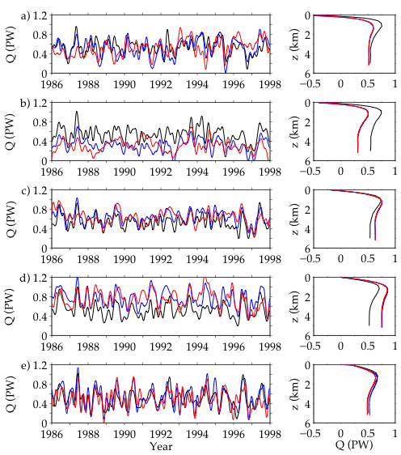
Can a perfect T,S or CPIES array reconstruct the NHT in POCM?
Black = “Truth” array
Blue = Perfect T,S array
Red = Perfect CPIES array plus mean T,S relationship
Left: NHT time series
Right: Mean vertical structure

Slide 35
Can a perfect T,S or CPIES array reconstruct the NHT in POCM?
Large biases at 20°S, 25°S, 30°S
High RMSE at 20°S, 30°S
Perfect T, S: high correlation at all latitudes
Perfect CPIES: modest correlation 25°S, 35°S

Slide 36
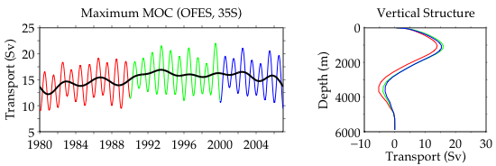
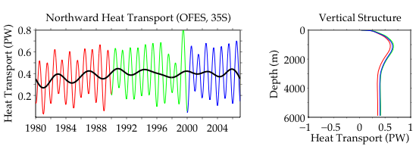
OFES 34.5°S longer term trend

Slide 37
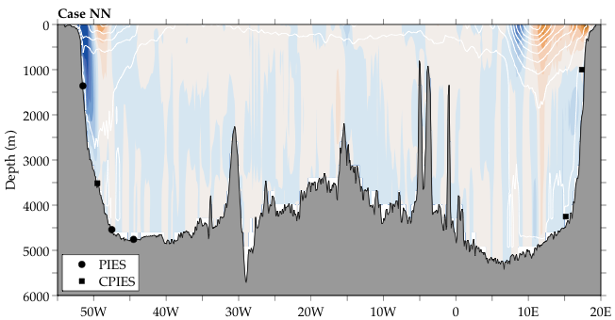
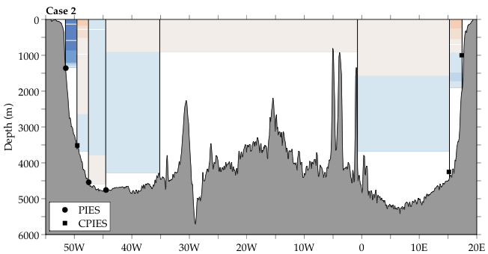
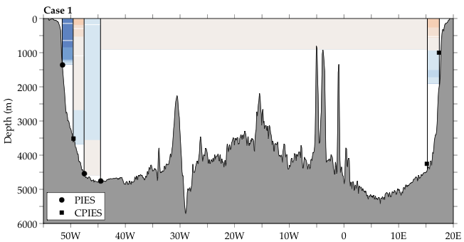
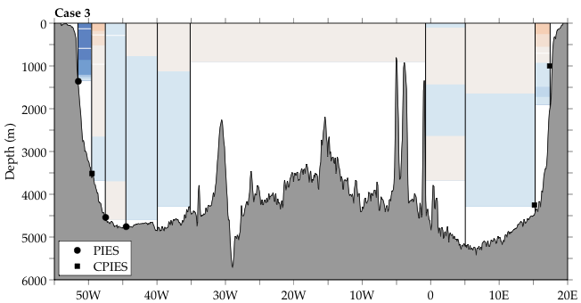
Example of v_{g} reconstruction: OFES 34.5°S

Slide 38
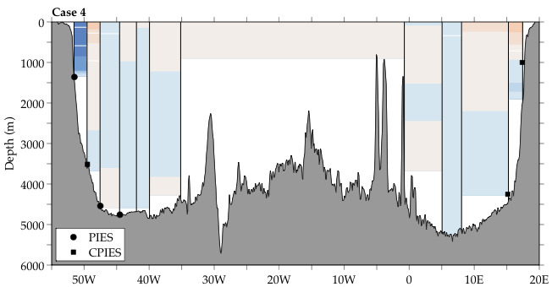
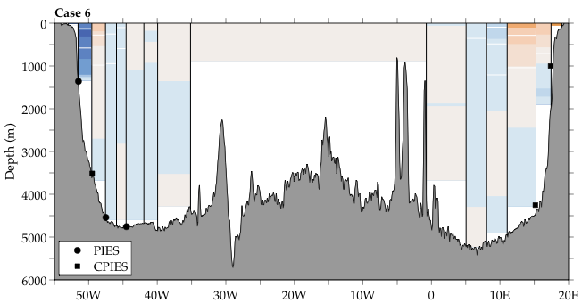
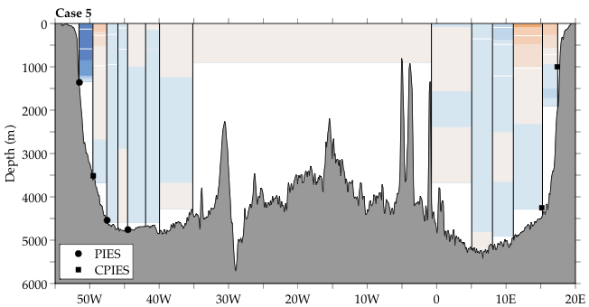
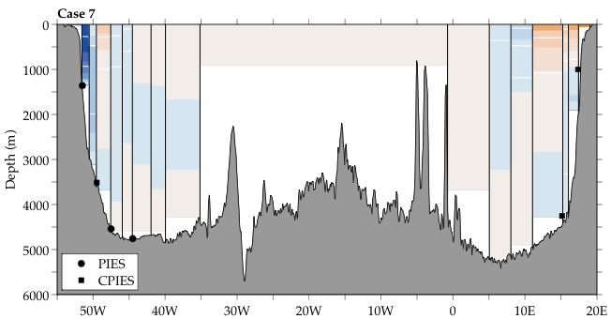
Example of v_{g} reconstruction: OFES 34.5°S

Slide 39
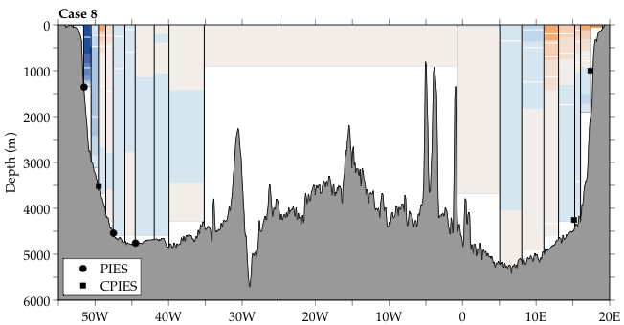
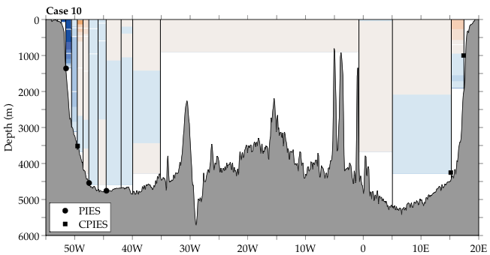
Example of v_{g} reconstruction: OFES 34.5°S

Slide 40
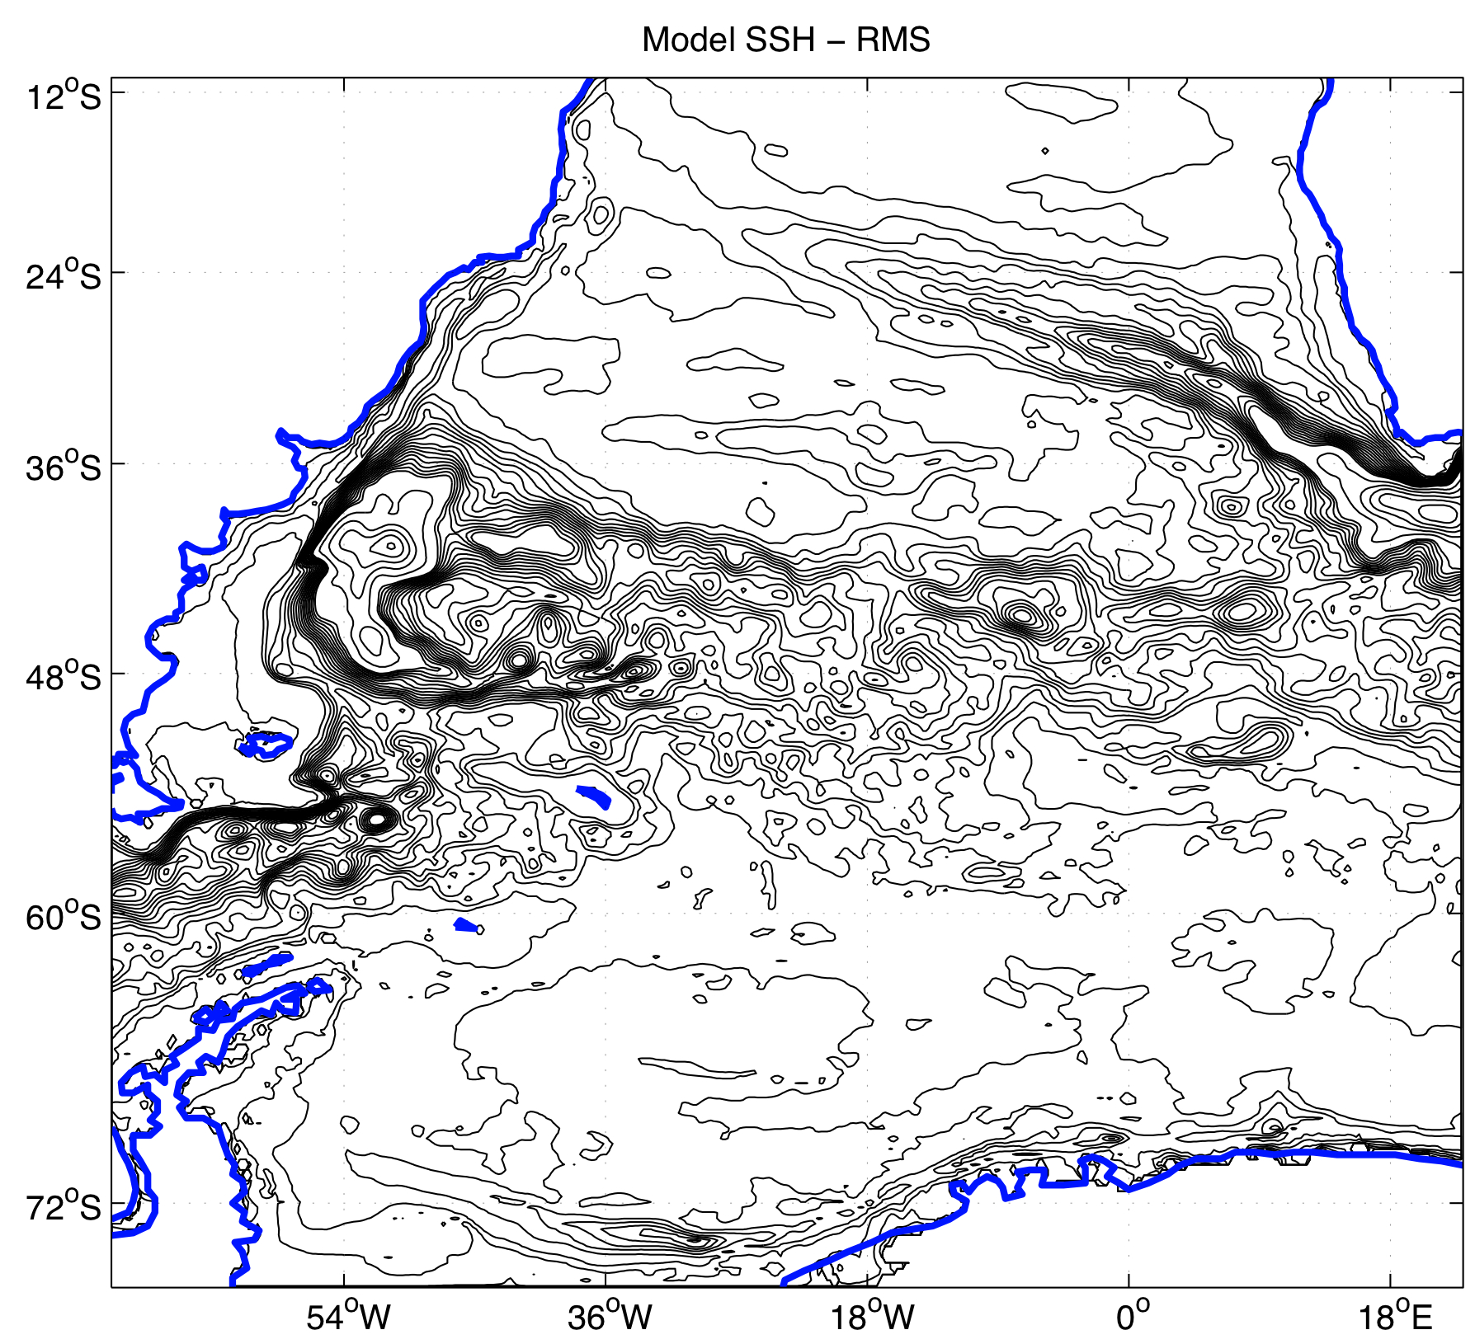
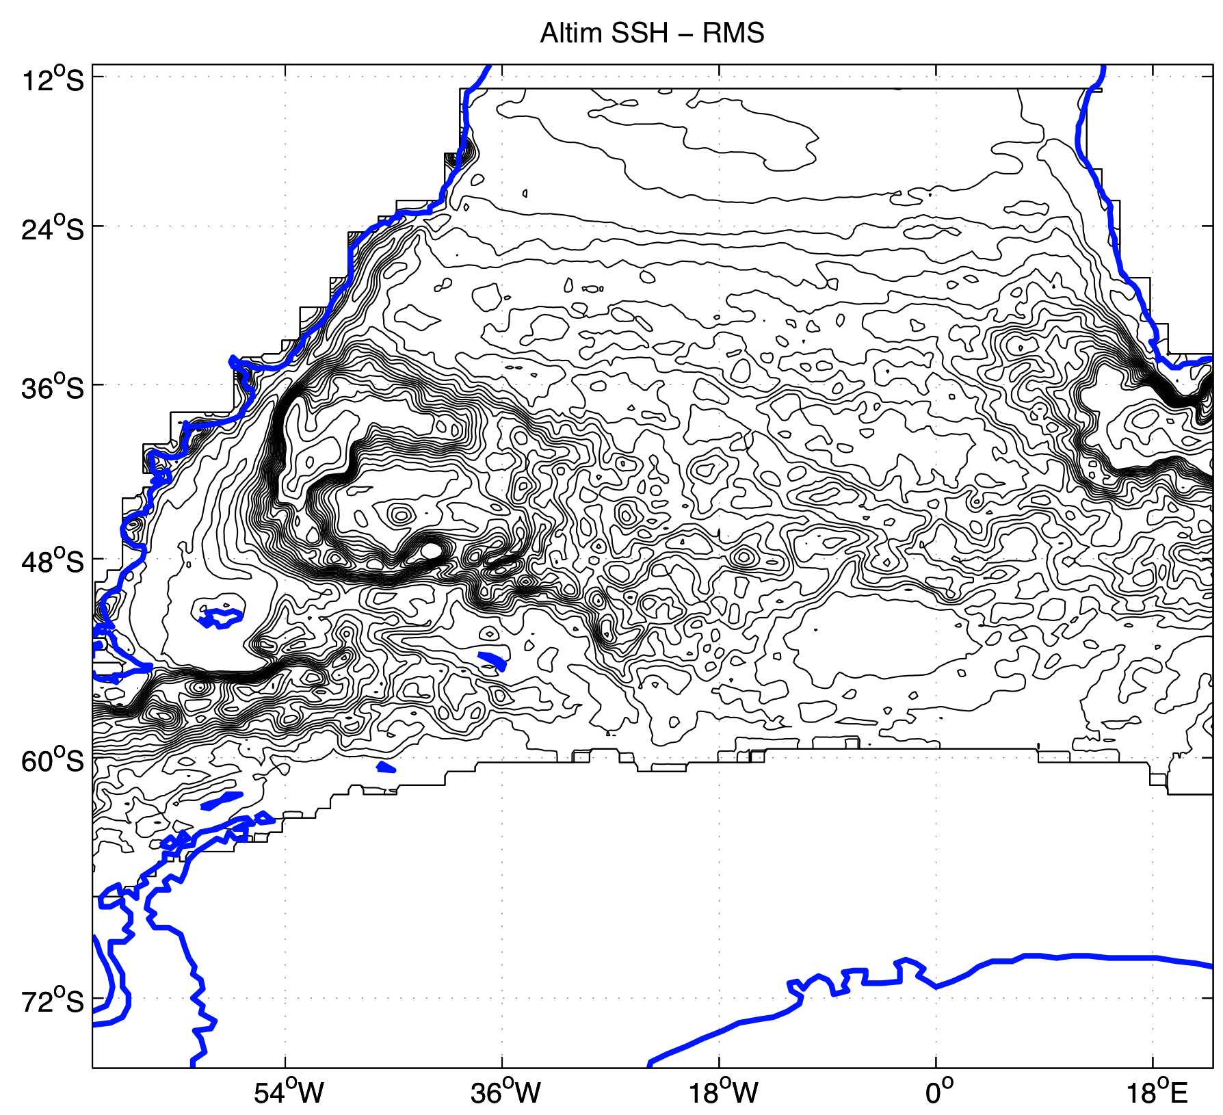
Agulhas rings go to far north in the OFES
Giarolla & Matano (Ocean Sciences 2010)

