Slide 1
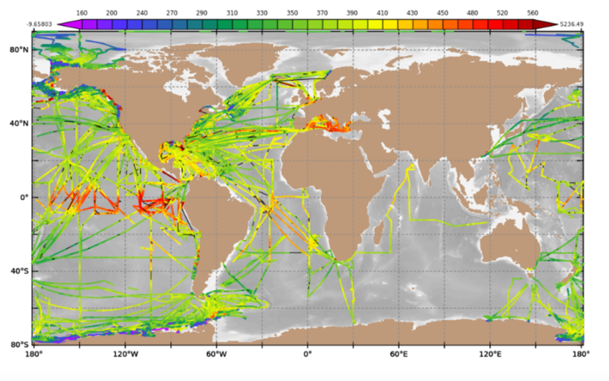
Largest Network of Surface pCO₂ data
In the world.
FY 2021
HIGHLIGHTS
~ 8.8 M data points since 2005. Represents ¼ of world wide data.
2020 and 2021 had a 40% data loss compared to previous years
Contributes to the GCB-2021 estimate of the still increasing Ocean sink of 2.8 +/- 0.4 GtC/year.

Slide 2
Atmospheric measurements from ships used in atmospheric studies
FY 2021
HIGHLIGHTS
Measurements from ships quality comparable to Surface Monitoring Stations and Aircraft Campaigns.
Ship measurements from the ARSV Laurence M. Gould, funded by GOMO.
Ship-based measurements extend back to 2005 and are utilized due to extensive temporal coverage.
This analysis estimates a net uptake of CO₂ south of 45°S. Consistent with ship-based estimates but stronger than recent estimates based on profiling-float observations.
From Long, M., et al. (2021), Strong Southern Ocean Carbon Uptake Evident in Airborne Observations, Science.
Notes:
Recreated from Fig. S15 from Long et al. (2021). Compilation of mean CO₂ observed at surface monitoring stations and as sampled from ships minus the NOAA in situ record at the South Pole Observatory (SPO) over 2012-2017 for (A) winter (DJF) and (B) summer (JJA). The black line is a spline fit provided simply as a visual guide. Blue shading denotes the latitude band in which we designate “Southern Ocean stations.” This record includes shipboard in situ measurements from the ARSV Laurence M. Gould (LMG), from the NOAA equilibrator pCO₂ system (cyan circles with black outlines) and from the NCAR atmospheric O₂ system (cyan diamonds with black outlines). The NOAA LMG data are available from 2005 to the present. The NOAA DRP flask record is collected from this same ship. The NOAA shipboard in situ atmospheric CO₂ data are available in the ObsPack GV+ v7.0 product (http://doi.org/10.25925/20210801).

