Slide 1

Oceans and Climate
Molly Baringer, presenter
Studies of large-scale ocean circulation processes that impact climate. This includes climate data as well as climate science, e.g. the global ocean observing system as well as long-lead time, large spatial scale studies of circulation, sea-level and climate related trends.

Slide 2
How is our climate changing?

Slide 3
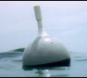
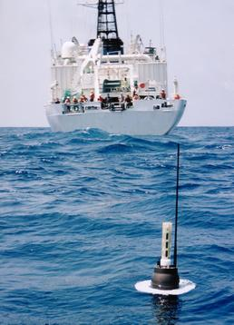
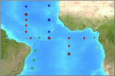
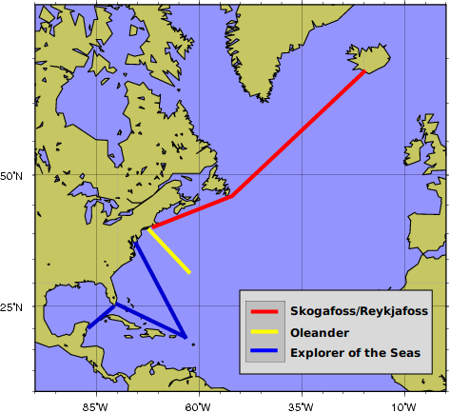
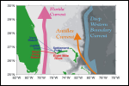
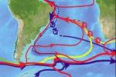
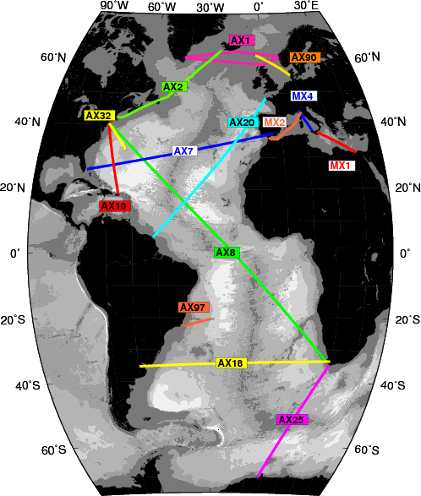
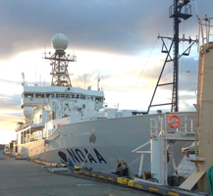

Drifters
TSG
Argo
PNE
WBTS
SAMOC
GO-SHIP Repeat Hydrography
Gliders
XBTs

Slide 4
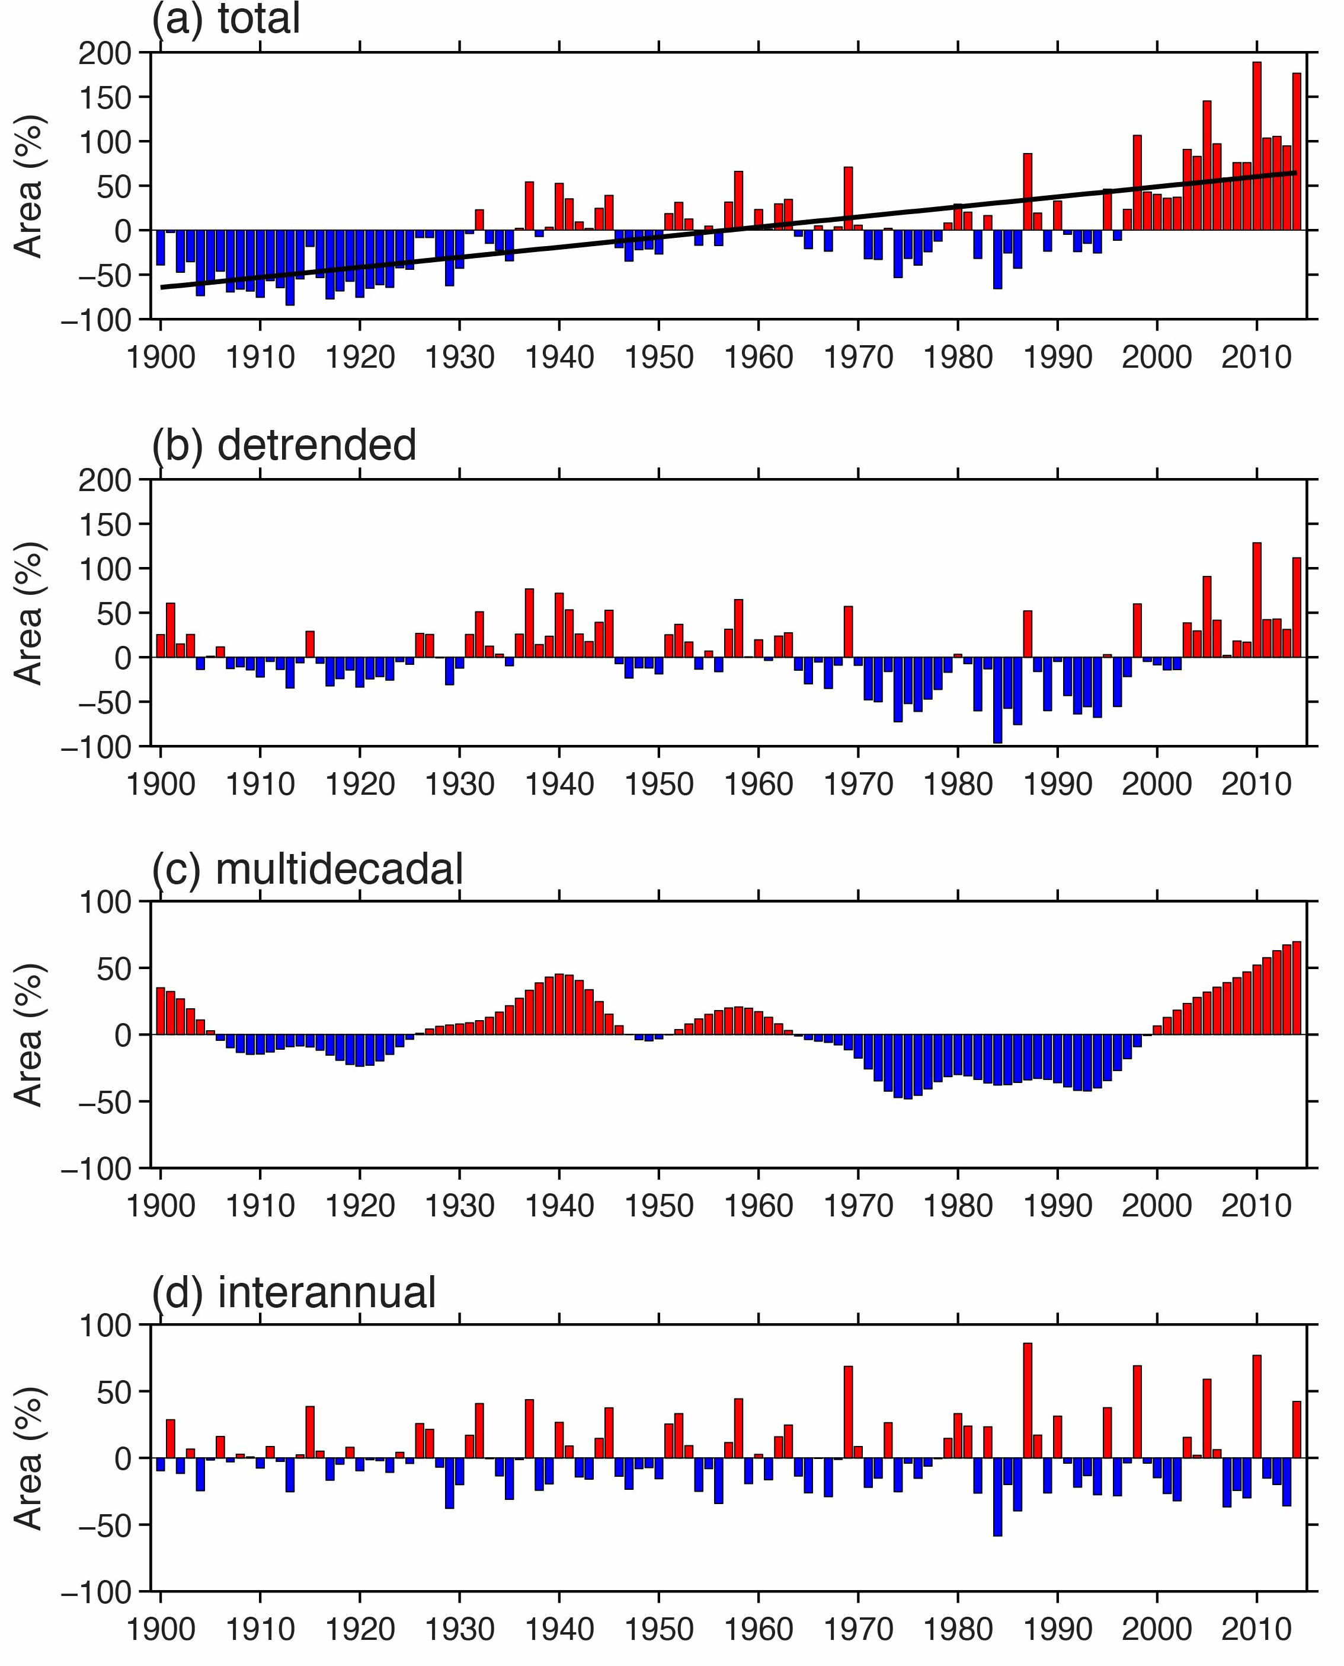
Atlantic warm pool (AWP) area anomaly indices from 1900 to 2014
Wang (2015; BAMS)

Slide 5
South Atlantic Subtropical Gyre
Upper Ocean Heat Content Variability
NASA project: Perez, Msadek, + Collaborators (in prep.)
Notes:
The objective of this project is to improve our understanding of the South Atlantic (SAtl) subtropical gyre over the past few decades and its connection to the Atlantic Meridional Overturning Circulation (AMOC).
As part of this study, the time-variability of the SAtl subtropical gyre (water mass and current changes) will be investigated through analysis and interpretation of satellite and in situ data, synthesis products, OFES ocean-only model simulations, and state-of-the-art eddy-permitting and eddy-resolving NOAA/GFDL climate coupled climate simulations.
This is a preliminary result. Not published yet.
Shown here is how temperature has changed within the South Atlantic subtropical gyre between 1955 – 2013 from the World Ocean Database. Note error bars have not yet been added.
Panels a-c are averages in meridional bands: a) 30S to 20S, b) 40S to 30S, and c) 50S to 40 S
Panel d is the integrated heat content in the upper 700 m in those 3 regions. Note an offset is applied between A, B, C for easier viewing.
Increasing temperatures/heat content from 1955-2013 are observed, with largest long-term trends in regions A and B.
During 2000’s more heat stored in upper 700m in regions A and B.

Slide 6
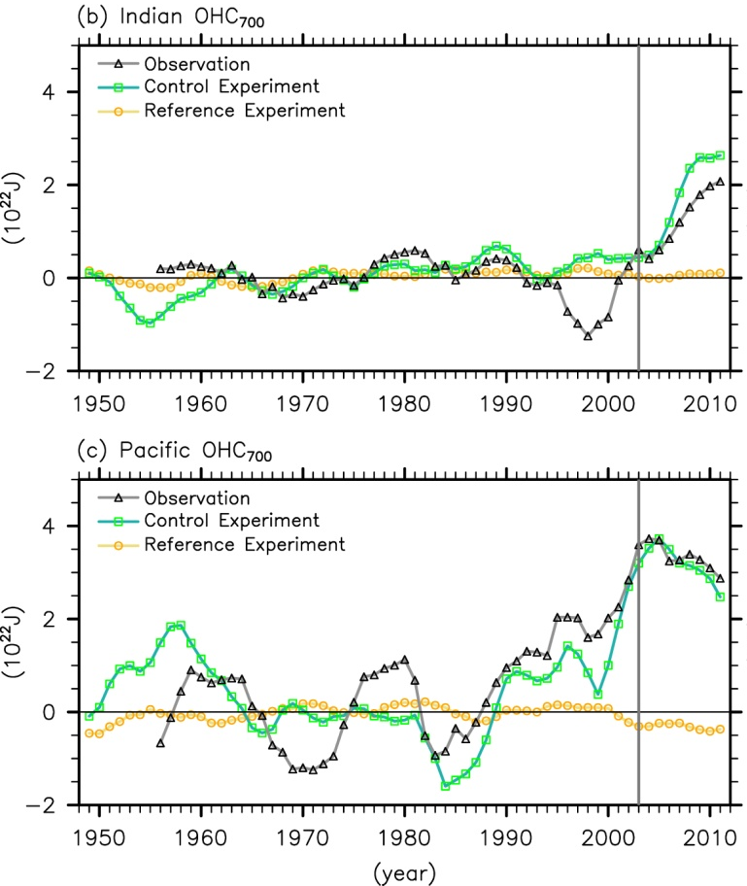
Inter-ocean exchanges of heat, salt & carbon under changing climate
OHC₇₀₀ for the Indian and Pacific Oceans
Funding: NOAA CPO
Personnel: S.-K. Lee, M. Baringer and Y. Liu
Collaborations: GEOMAR & LDEO
Highlights (Lee et al., 2015, in-press):
La-Niña-like conditions during the past decade increased the surface heat uptake over the Pacific Ocean.
However, the enhanced heat uptake has been completely compensated by increased inter-ocean transport carried by the Indonesian throughflow.
Pacific Ocean heat content has slightly decreased, while Indian ocean heat content has increased abruptly during the past decade
Indian Ocean has become increasing important for modulating global climate variability

Slide 7
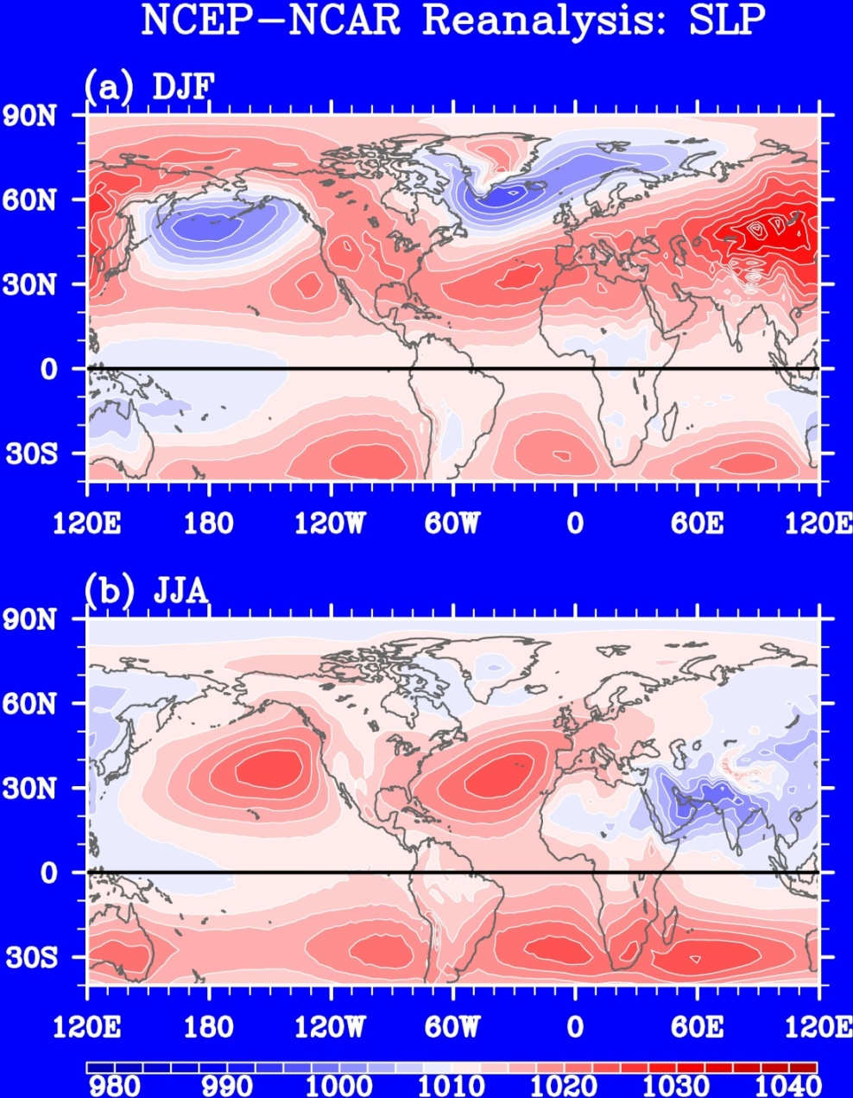
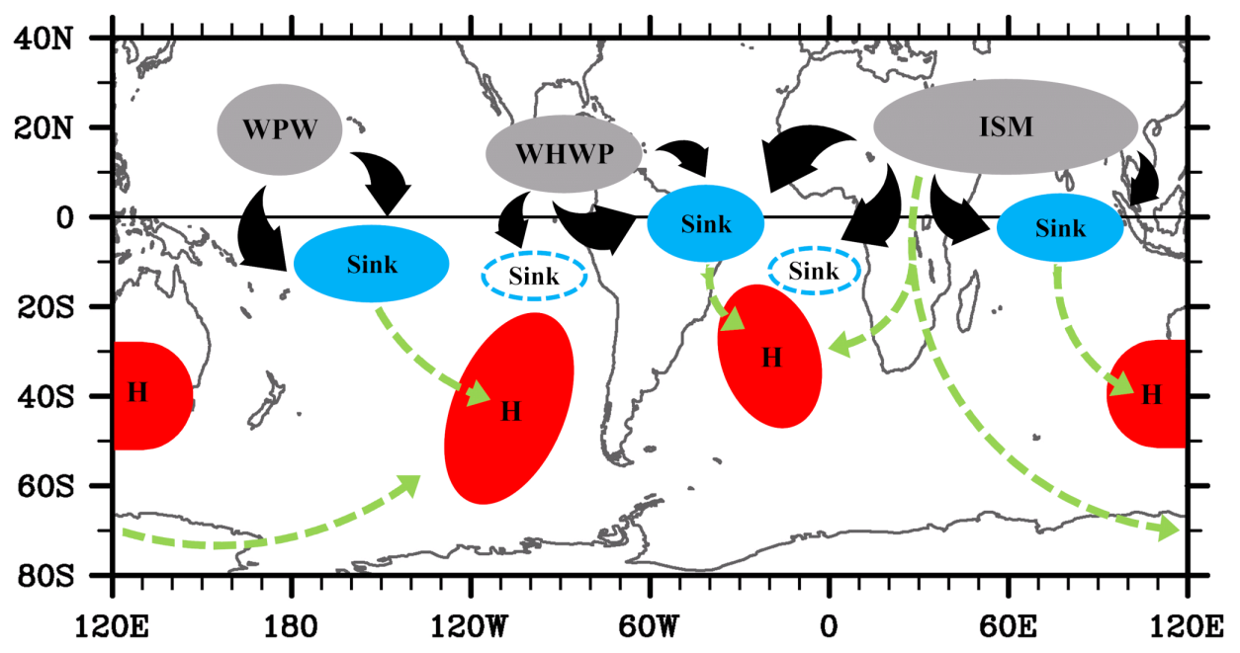
What drives the Southern Subtropical Anticyclones in Winter?
(a) SLP in December - February
Funding: NSF
Personnel: S.-K. Lee & C. Wang
Collaborations: UCLA
Highlights (Lee et al. 2013) :
Northern subtropical anticyclones stronger & better defined in boreal summer consistent with “monsoon heating” paradigm (Rodwell & Hoskins, 2001)
However, the southern subtropical anticyclones remain strong in austral winter
Key processes identified: NH summer heating  equatorial & tropical SH convection suppressed  poleward propagation of stationary waves  SH subtropical highs strengthened
(b) SLP in June - August
(c) Summary of Inter-hemispheric Teleconnection

Slide 8
Wentz et al. (2005) found an increase in satellite-derived global mean surface wind
speed during 1987-2006 that they interpreted as evidence against a muted response
of precipitation to global warming (climate models predict ~2% K⁻¹ increase in precip.
even though water vapor will increase 7% K⁻¹).
Predicted 21st century changes in SST and surface winds
We reconcile the observed and
predicted changes, showing that
surface wind speed can increase
while the Walker circulation slows
down and mutes the precipitation
increase.
Surface wind speed and divergence
Foltz
Ma, J., G. R. Foltz, B. J. Soden, J. He, L. Liu, and C. Dong,
2015: Will surface winds weaken in response to global
warming? Nat. Geosci., submitted.

Slide 9
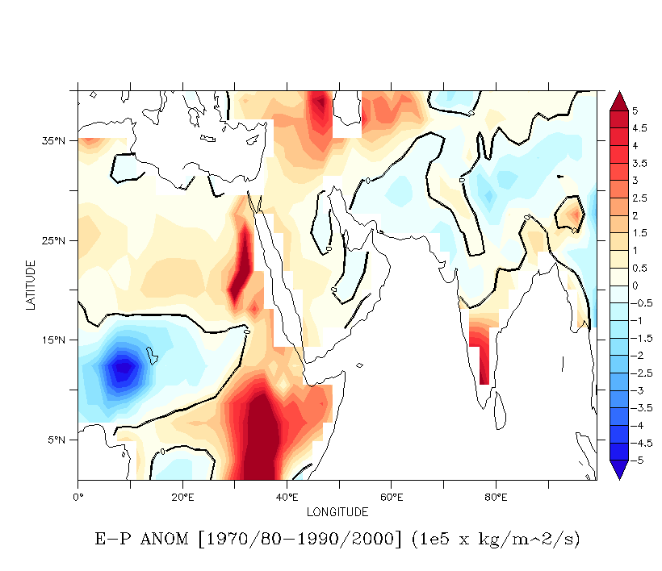
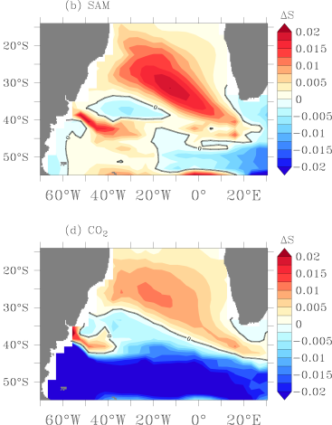
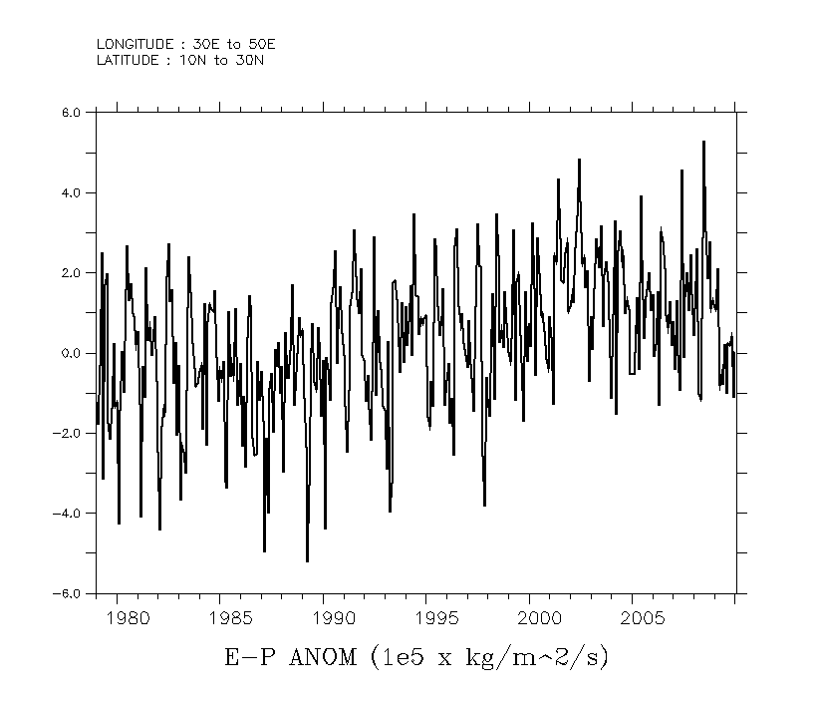
What drives the South Atlantic salinity minimum trends?
Gyre spinup and expansion are driven by wind stress changes in the South Atlantic.
Salinity minimum surface experiences salinity increase, with potential role in the future AMOC state.
In addition, the CO2 effect on the hydrological cycle (dry in the tropic, wet in the extratropics) impacts the water mass properties in the formation regions, such as the Red Sea Water.
What are the impacts of the hidrological cycle changes in the South Atlantic water masses?
Goes et al. (2014)
E-P changes in the Indian Ocean

Slide 10
Arctic Ocean Mass and Sea Level (D. Volkov)
EOF-1 of the non-seasonal OcM (68.2% exp. var.)
Spatial patterns of coupled EOF-1 between the altimetry sea level anomaly (SLA) and ERA-Interim sea level pressure (SLP) and their temporal evolution
Regression map of ERA-Interim winds projected on the nonseasonal cPC-1 of SLP (similar for interannual)
Main results:
Satellites have observed coherent, basin-uniform oscillations of the mass component of the Arctic Ocean sea level; oscillations in the Nordic Seas monitored by altimetry satellites are largely barotropic and coherent with the Arctic interior
We find that these oscillations are mainly induced the meridional Ekman transport anomalies in the northeastern North Atlantic (south of 65°N)
This processes is also relevant for the interannual changes, which needs to be accounted for when interpreting the long-term changes of the Arctic Ocean sea level
SSH and ocean mass averaged over the Nordic Seas

Slide 11
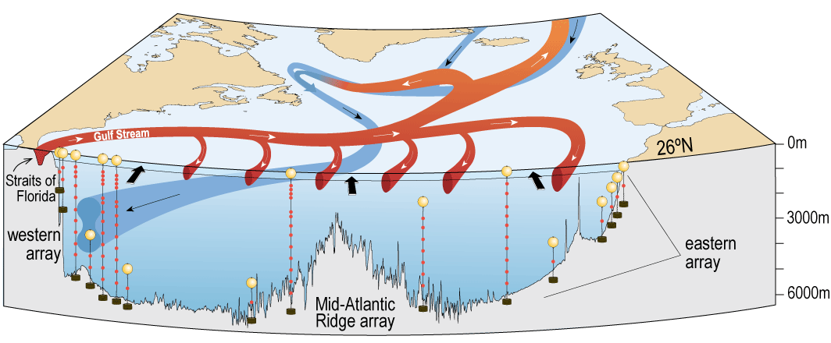
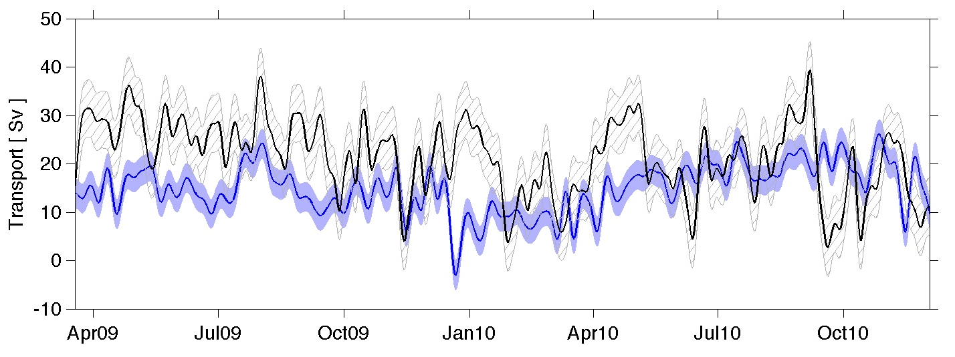
Observations of the MOC
Goals: NOAA partners with the National Science Foundation and the National Environmental Research Council to measure the MOC at 26°N, with Brazil, France, Argentina and South Africa at 34.5°S
Our goals support NOAA’s mission to assess the state of the climate system and improve scientific understanding of a changing climate and its impacts. This leverages a long term NOAA program and a key strength in PHOD.
Baringer et al. (2015);
Smeed et al. (2014);
Meinen et al (2013)
Notes:
The MOC variability at 34.5°S appears to be somewhat more energetic, particularly at short time scales (i.e. < 30 days). This may be due as much to the small differences the methods used to calculate the MOC at the two latitudes as due to ocean differences. The longer and better resolving records that will come in the next few years will allow us to be more definitive.
MOC time series
(10-day lowpass filtered)
At 26.5°N
Mean = 17.0 Sv
STD = 4.6 Sv
Integral time scale ~ 30 days
Trend = -4.2 +/- 4.4 Sv/decade
(95% confidence limits assuming two 30-day integral time scales per degree of freedom)
At 34.5°S
Mean = 21.3 Sv
STD = 7.6 Sv
Integral time scale ~ 10 days
Trend = -54.6 +/- 55.1 Sv/decade
(95% confidence limits assuming two 10-day integral time scales per degree of freedom)
The MOC array at 26.5°N has now collected 10 years of data, which clearly shows variations that are large and may reflect crucial climate system changes, however the record is too short to definitively demonstrate that these changes are not common-place interannual variability. It will be crucial to continue collecting data for several more years (at least) to try and answer this question.
The MOC array at 34.5°S has identified similar levels of variability over a shorter record, and these variations are uncorrelated with the variations at 26.5°N. This illustrates the need for long-term observations of the MOC at multiple latitudes to understand how these latitudinal variations impact and/or control the role of the MOC in the broader climate system.
Continued evaluation of multiple systems (e.g. moored instruments, ship section data, satellite observations) is critical for determining both what these systems can bring to the analysis of the MOC and how cost efficiencies can be found to save funds in the future.
The accuracy/quality/value of the MOC estimates at all of these latitudes will be greatly improved by ongoing improvements/enhancements/expansions of the MOC time series arrays, while the continuing global arrays (e.g. Argo) and ship sections (CTD, XBT) will provide invaluable data throughout the basins. This is a good time to be studying the MOC!

Slide 12
Observations of the MHT

Slide 13
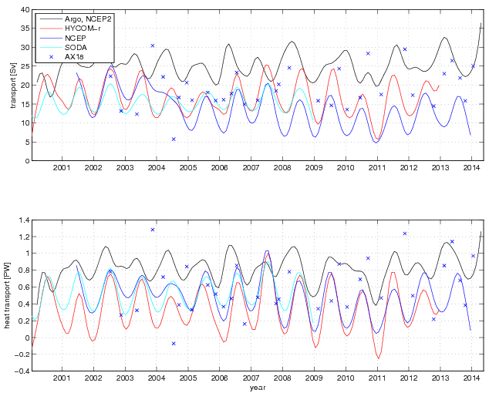
MOC volume and heat transport (VT, HT) estimates from Argo and AX18 (with NCEP2 wind) and 3 models
Argo and the models reveal a seasonal cycle of HT and VT with maxima typically in the austral winter months.
Heat transports from Argo are frequently on the high end due to an underestimation of the southward heat transport in the Brazil Current.
HYCOM-r frequently has relatively low heat transports due to an underestimation of the northward heat transport in the Benguela Current region.
AX18 and SODA are mostly in good agreement.
Notes:
Latitude = 35S
PIs: Claudia Schmid & George Halliwell
Proposal: Transport in the upper branch of the South Atlantic
Meridional Overturning Circulation.

Slide 14
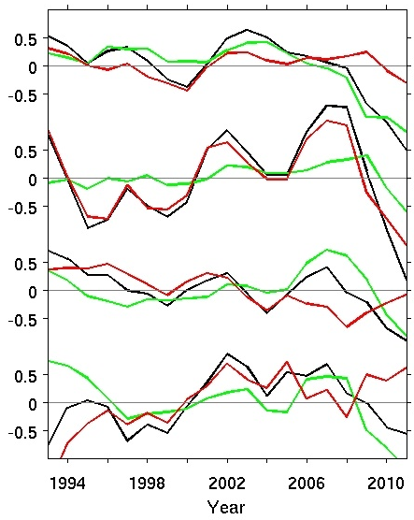
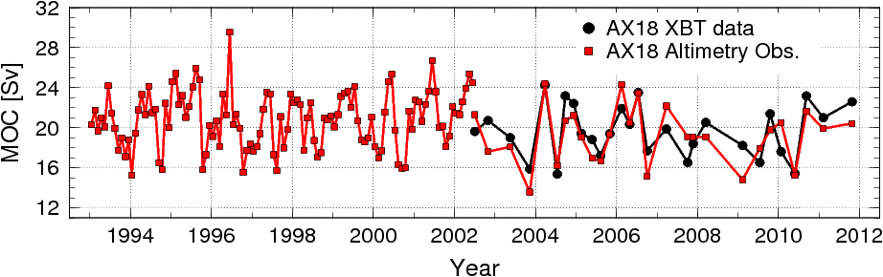
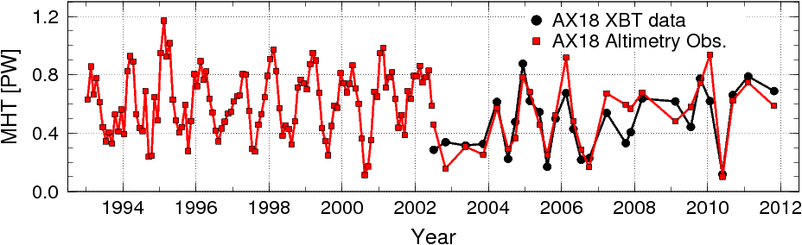
South Atlantic altimetry-derived MOC temporal and spatial variability
South Atlantic MOC and heat transport (MHT) estimates based on altimetry shows different leading contributors at different times
20°S
MOC total
25°S
Geostrophic
30°S
Largely dominated by geostrophic component before 2006.
Largely dominated by Ekman component after 2006 (except 25°S).
At 34.5°S, long period variability with high in mid 2000’s and low in mid 1990s.
Ekman
34.5°S

Slide 15
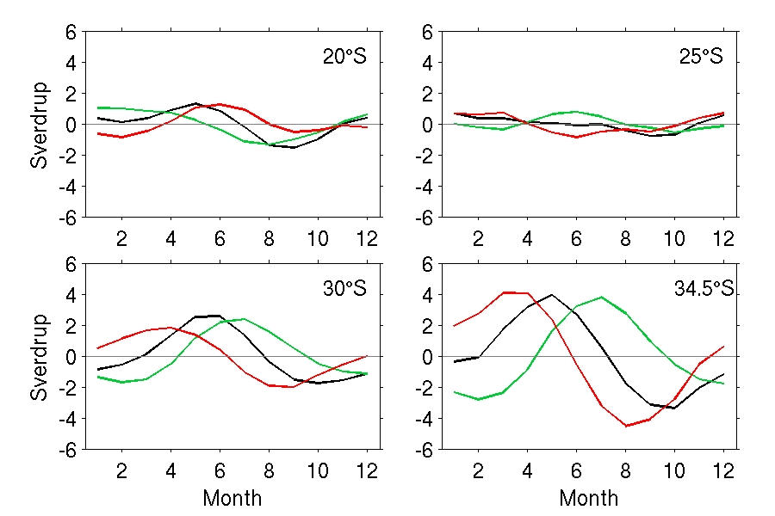
Altimtery-derived meridional changes
seasonal cycle of SAMOC
Total
Geostrophic
Ekman
Amplitude is smaller at 25S, crossing the ST gyre
Geostrophic and Ekman have similar amplitudes
Amplitude is larger at 34.5S, the Confluence region.
Dong, Goni, and Bringas, 2015
Notes:
XBTST to increase visibility and show benefits.

Slide 16
How do these changes affect us?

Slide 17
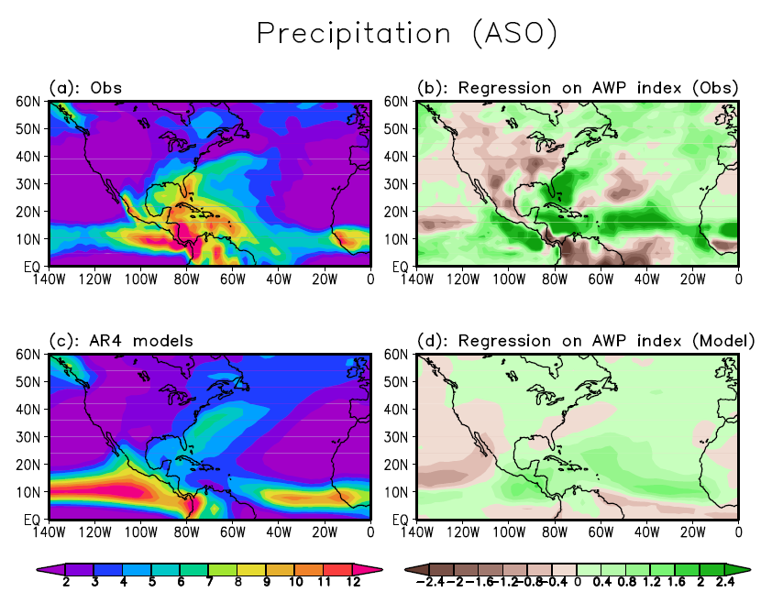
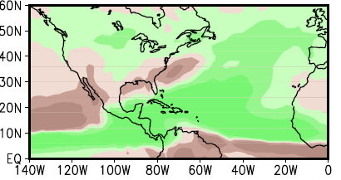
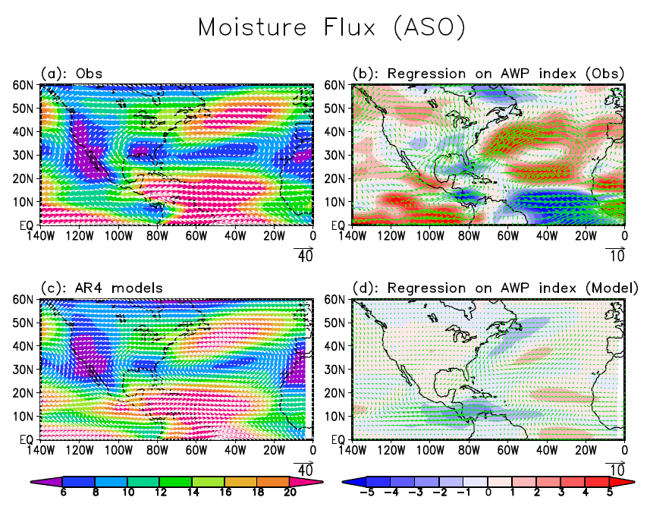
Impact of Atlantic warm pool (AWP) on United States Drought
Regression of rainfall onto AWP index
19 IPCC-AR5 climate models fail to simulate the decreased rainfall in U. S.
Regression of moisture flux onto AWP index
A large (small) AWP is associated with reduced (enhanced) rainfall in the U. S. during summer and fall. The mechanism is that a large (small) AWP decreases (increases) the moisture transport to the U. S. from the AWP. A decreased rainfall can cause drought in the U. S. when the large AWP persists for a long time.
Wang

Slide 18
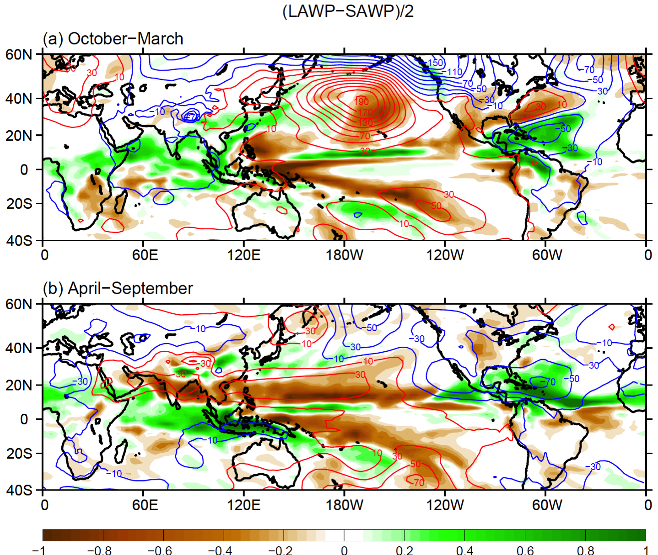
Model rainfall (color) and SLP (contour) response to the AWP: (LAWP – SAWP)/2 runs
Dry
Dry
Wang

Slide 19
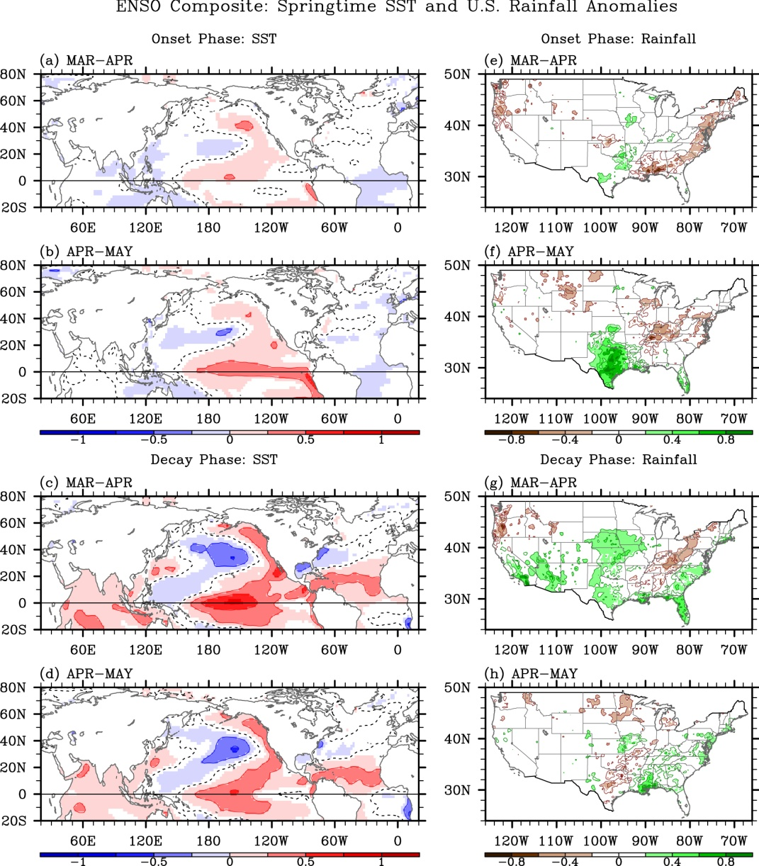
Springtime ENSO phase evolution and its relation to rainfall in the U.S.
SST Anomalies
Rainfall Anomalies
Funding: NOAA CPO
Personnel: Lee, Wang & Enfield
Collaborations: RSMAS & CPC
Highlights (Lee et al., 2014):
ENSO SST anomalies weaker & less coherent in spring compared to those in winter.
Showed unique and significant patterns of U.S. rainfall anomalies frequently appearing during the onset and decay phases of ENSO.
In late spring of a developing El Niño: wet in the South U.S. and dry over the Ohio Valley.
In early spring of a decaying El Niño: wet across the southern U.S. and dry over the Ohio River.
Onset Phase
SST Anomalies
Rainfall Anomalies
Decay Phase

Slide 20
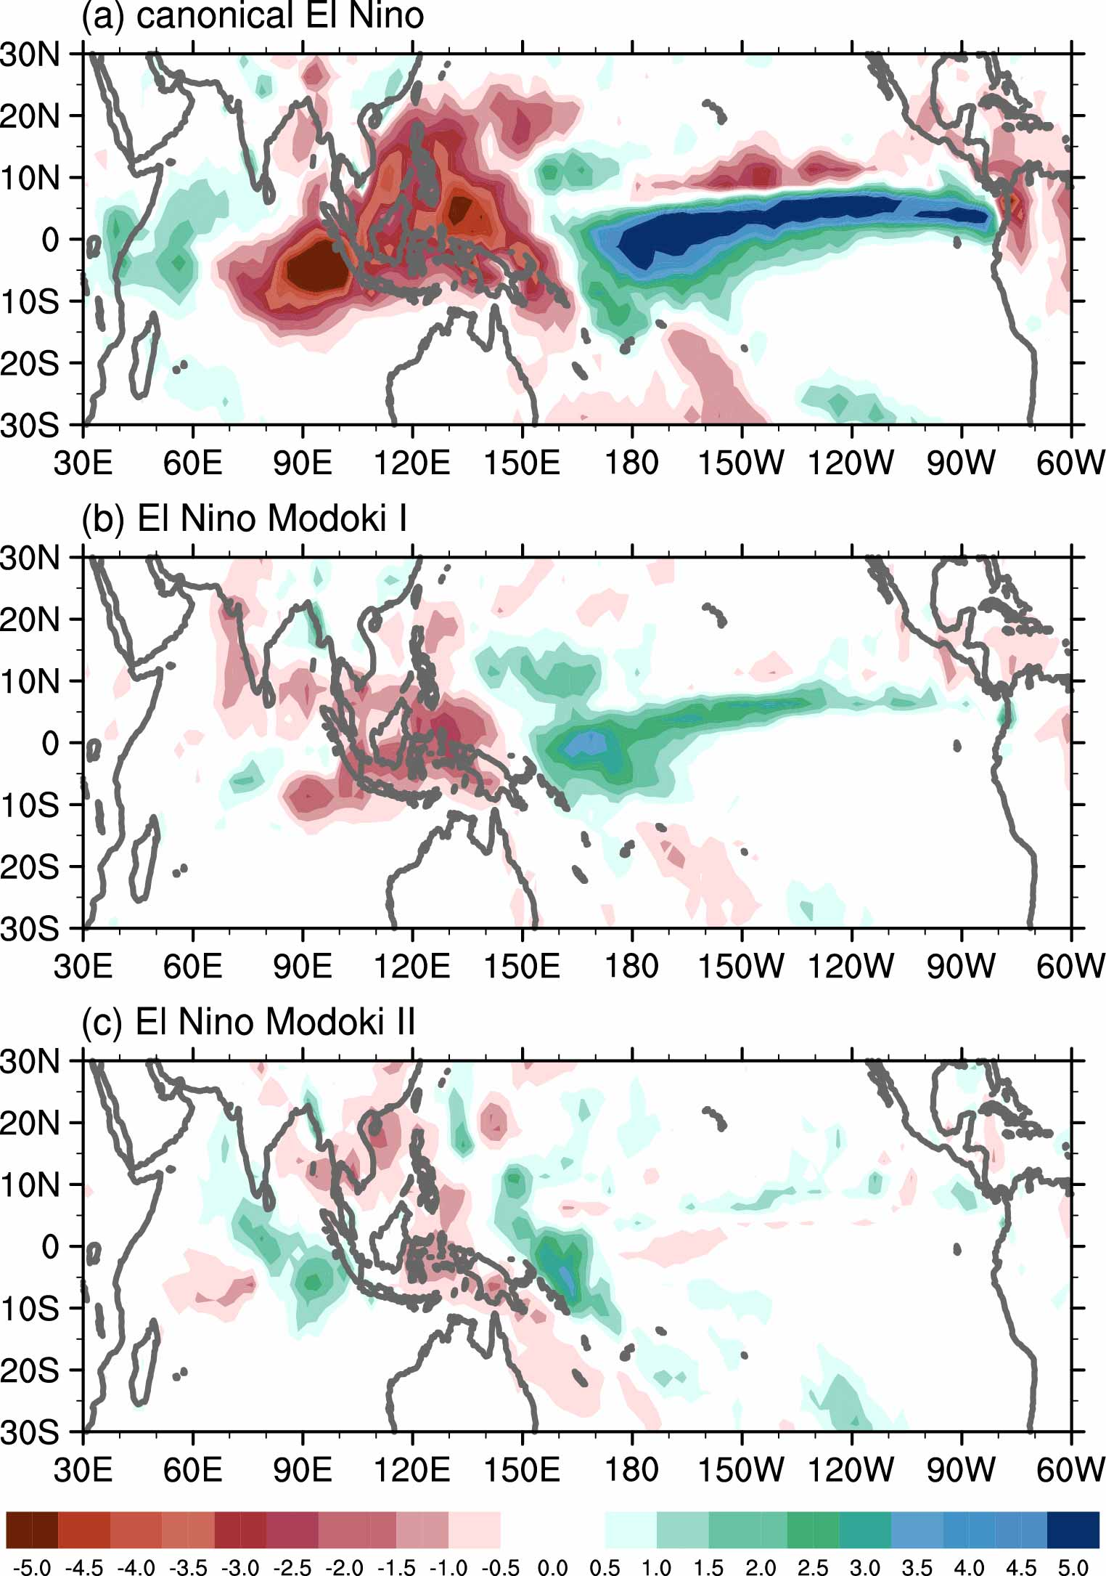
A New Classification of El Nino Events: Modoki I and II
El Nino Modoki I and II are named and identified, based on their opposite impacts on rainfall in China and typhoon landfall activity.
For canonical El Nino and El Nino Modoki I, the eastern Indian Ocean has negative rainfall anomalies (top two panels); however, for El Nino Modoki II it shows positive rainfall anomalies (low panel).

Slide 21
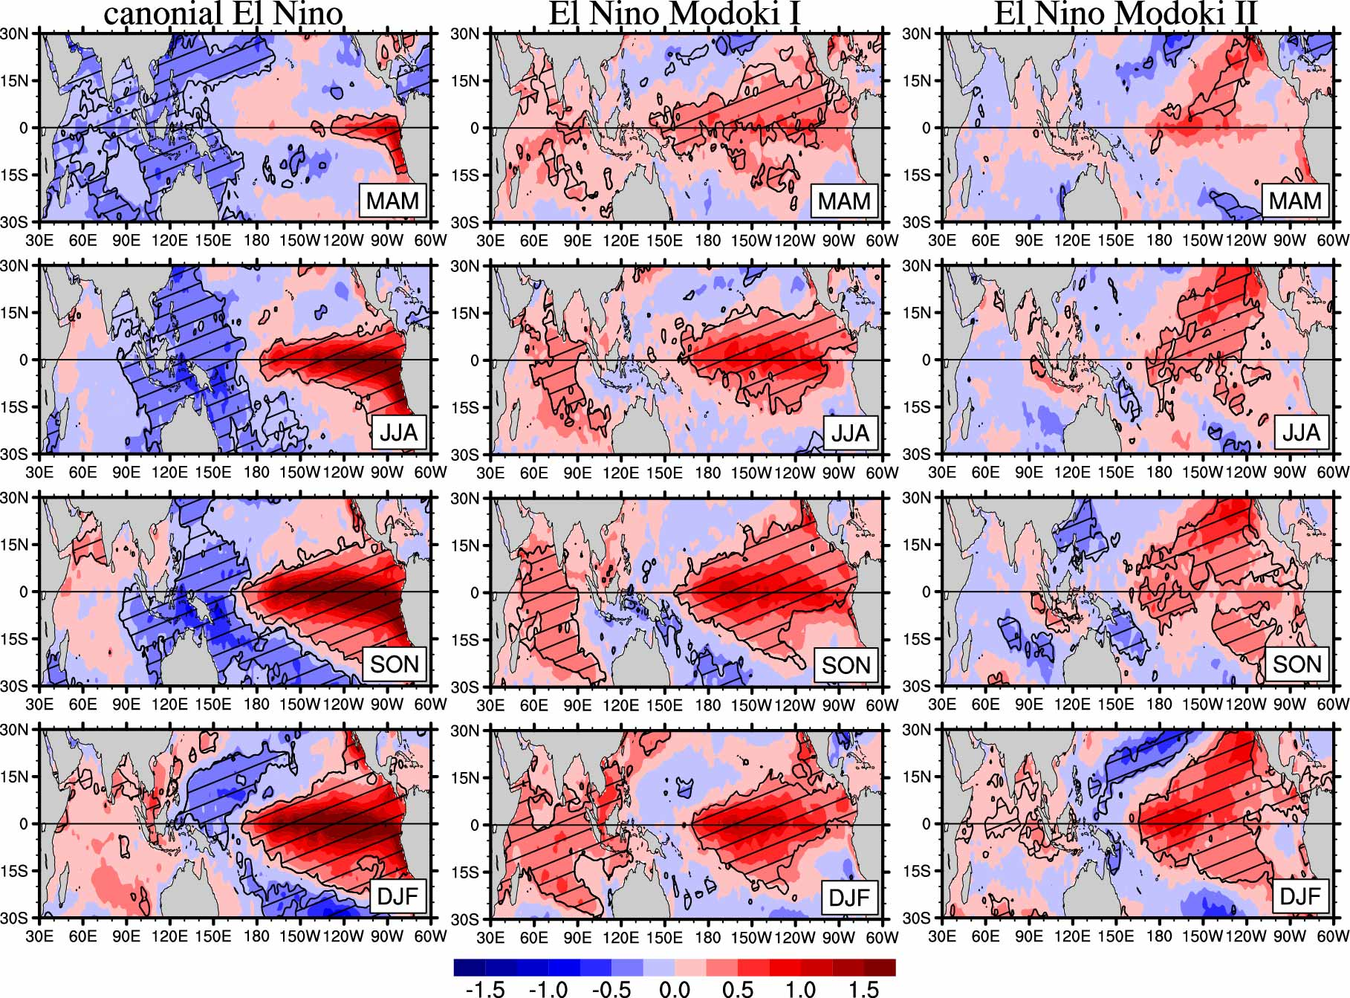
Different Impacts of Various El Nino Events on the Indian Ocean Dipole (IOD)
SST anomalies
Canonical El Nino and El Nino Modoki I are associated with a positive Indian Ocean Dipole (IOD), whereas El Nino Modoki II is favorable for a negative IOD.
The mechanism is that El Nino Modoki I (and canonical El Nino) and El Nino Modoki II induce an opposite Walker circulation which produces an opposite variation in the Indian Ocean.
Canonical El Nino
El Nino Modoki I
El Nino Modoki II

Slide 22
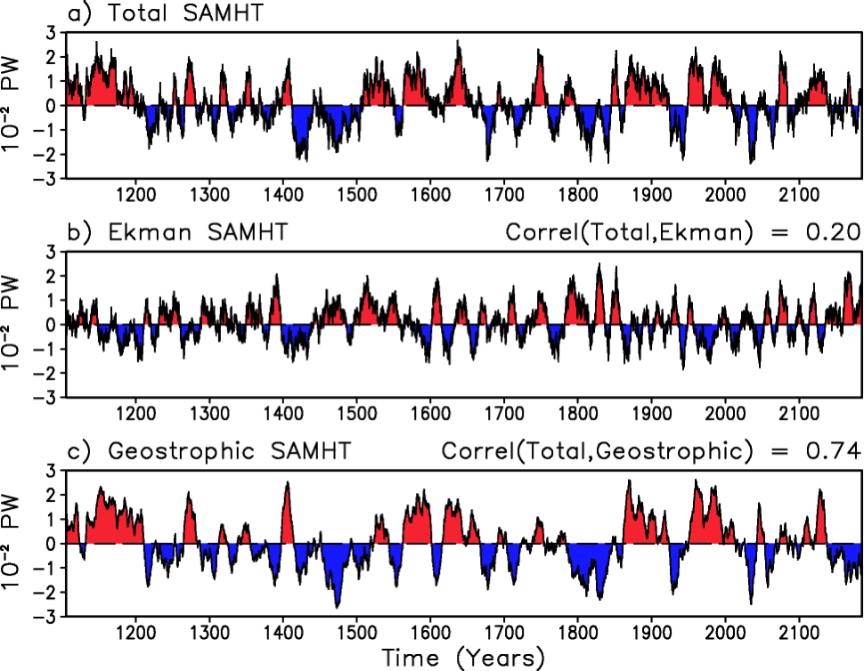
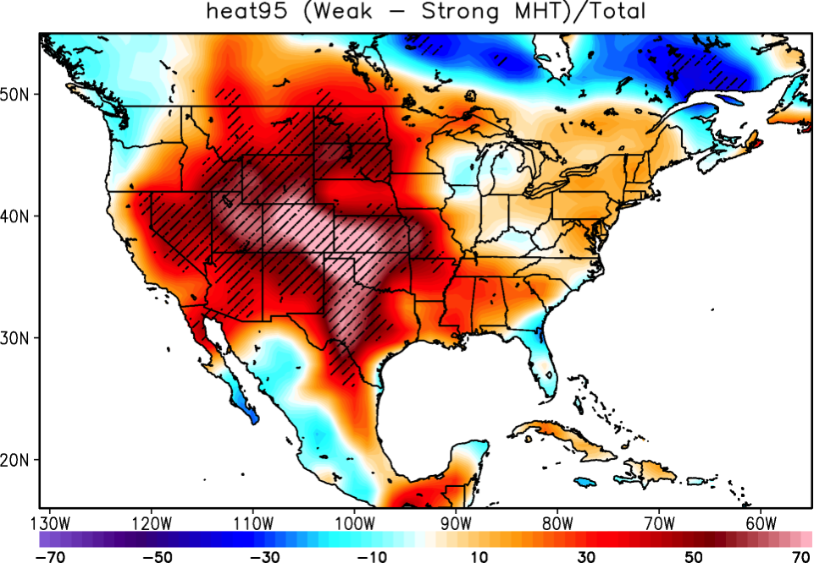
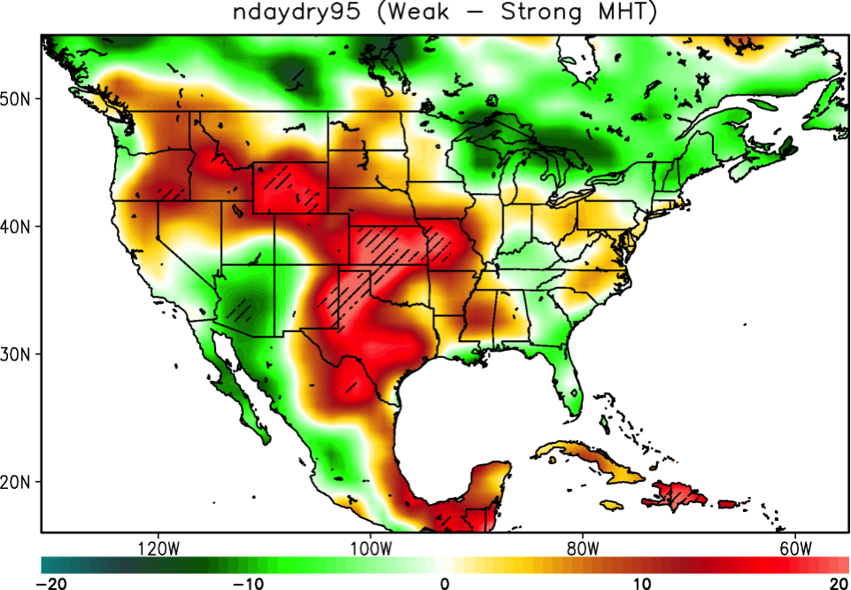
Multi-decadal South Atlantic Meridional Overturning Circulation variability and its slow modulations of extreme weather events.
CESM1 meridional heat transport (MHT) at 30S (11-years running average)
Composite difference of number of days with heat wave conditions during weak minus strong MHT at 30S.
More heat waves over the US during weak MHT at 30S.
Due to northward shift of the jet stream from anomalous Hadley circulation and less eddies “storms” activity.
Composite difference of number of days with drought conditions during weak minus strong MHT at 30S.
Stronger North American summer monsoon during weak MHT at 30S
Due to northward shift of ITCZ from anomalous Hadley circulation.
Hatched contour show 95% confidence level by a Kendall-τ test.

Slide 23
How are we helping to improve forecasts?

Slide 24
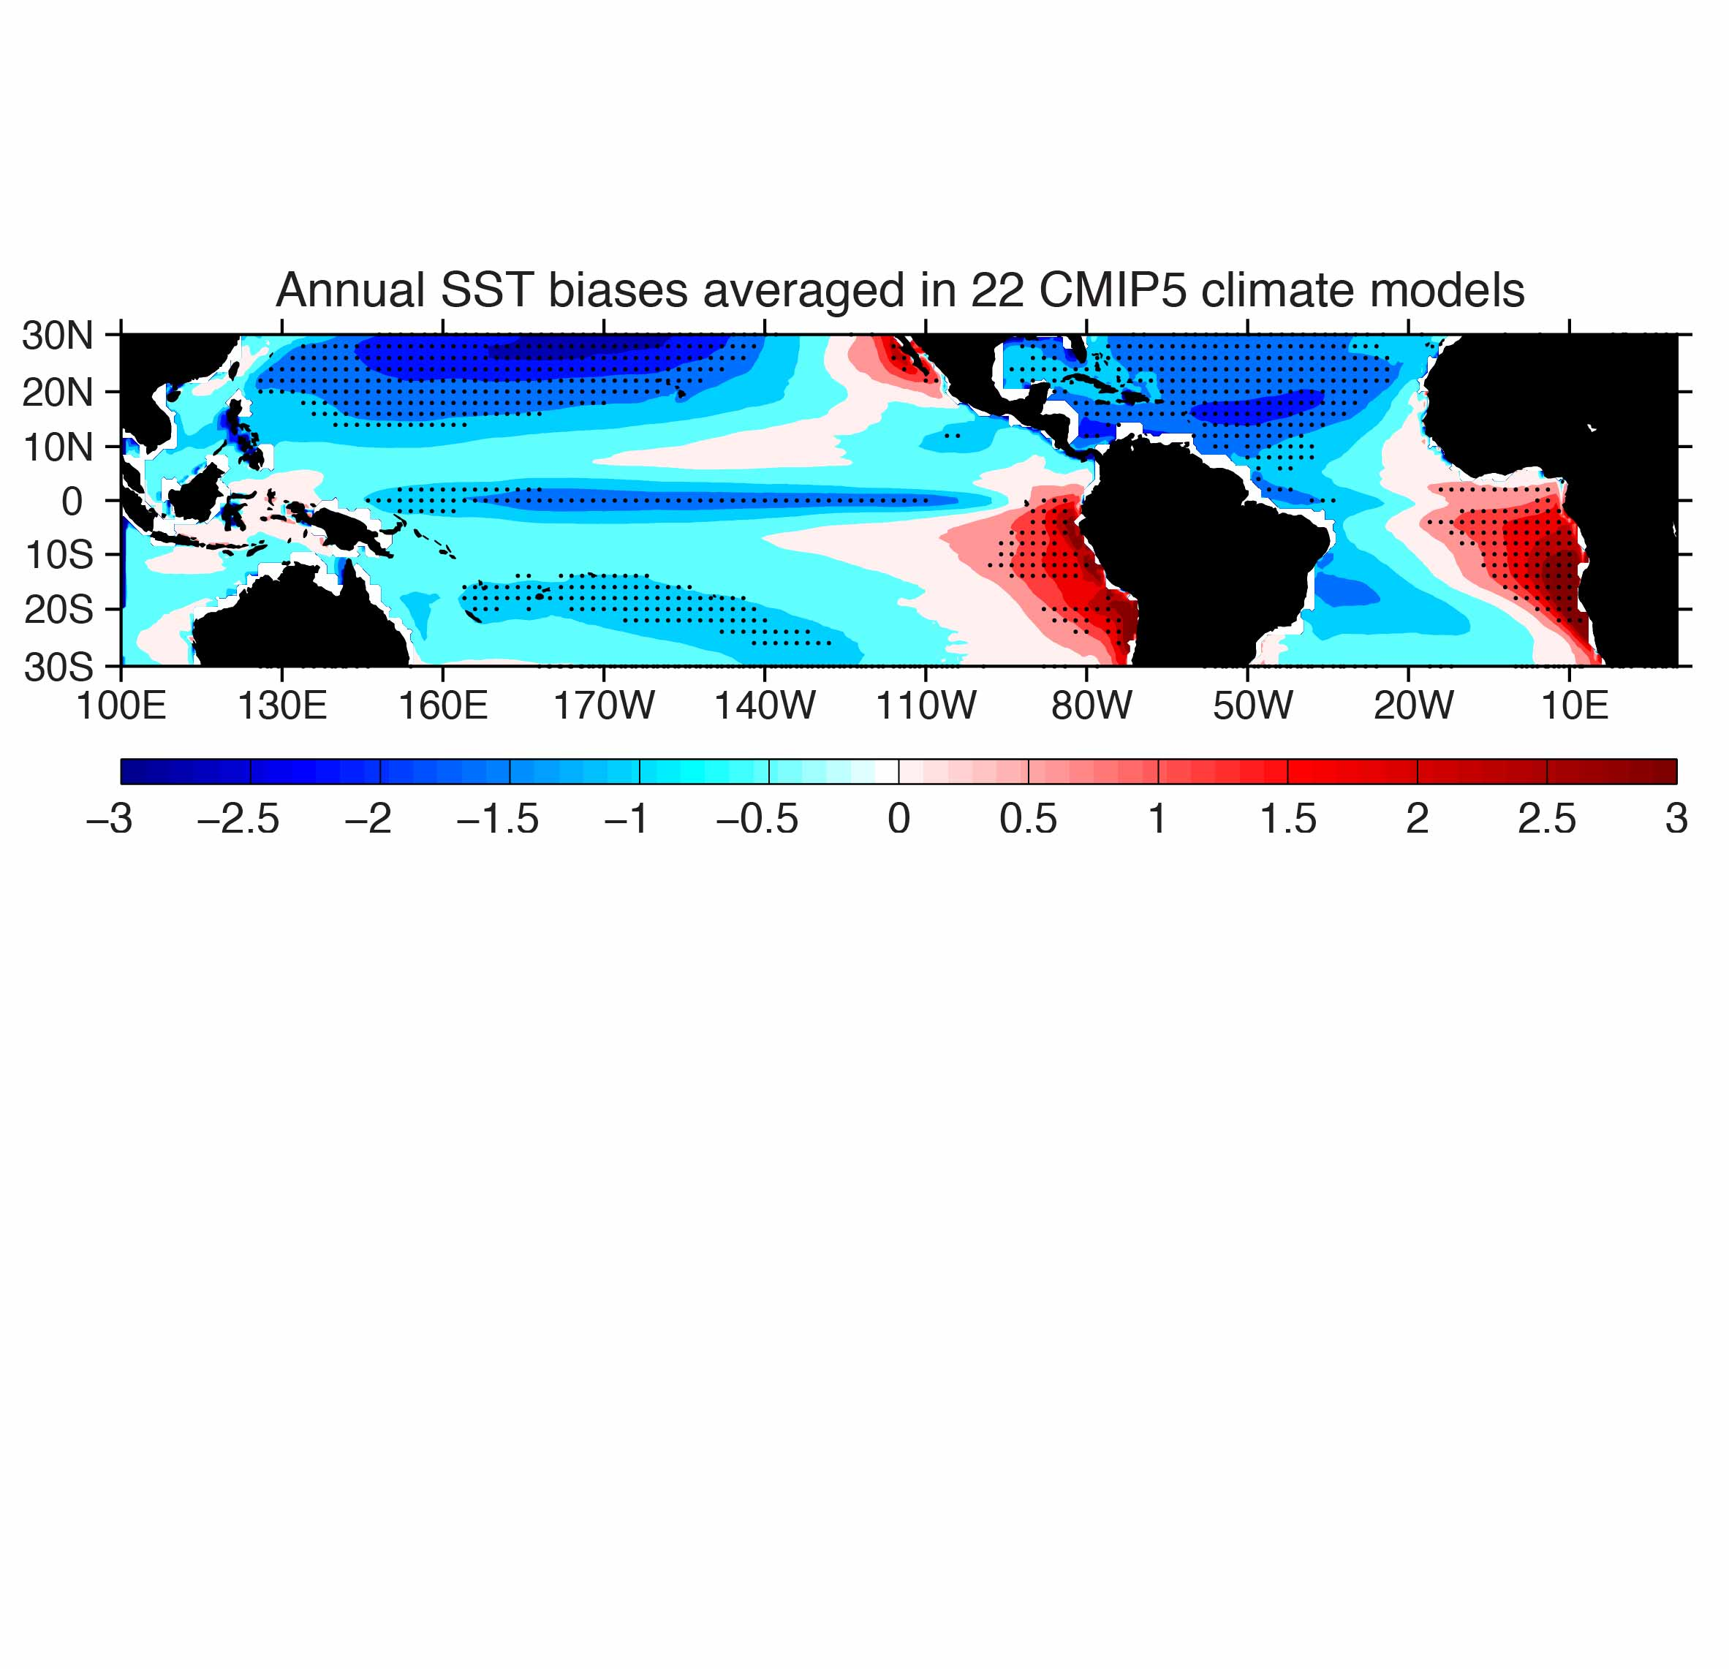
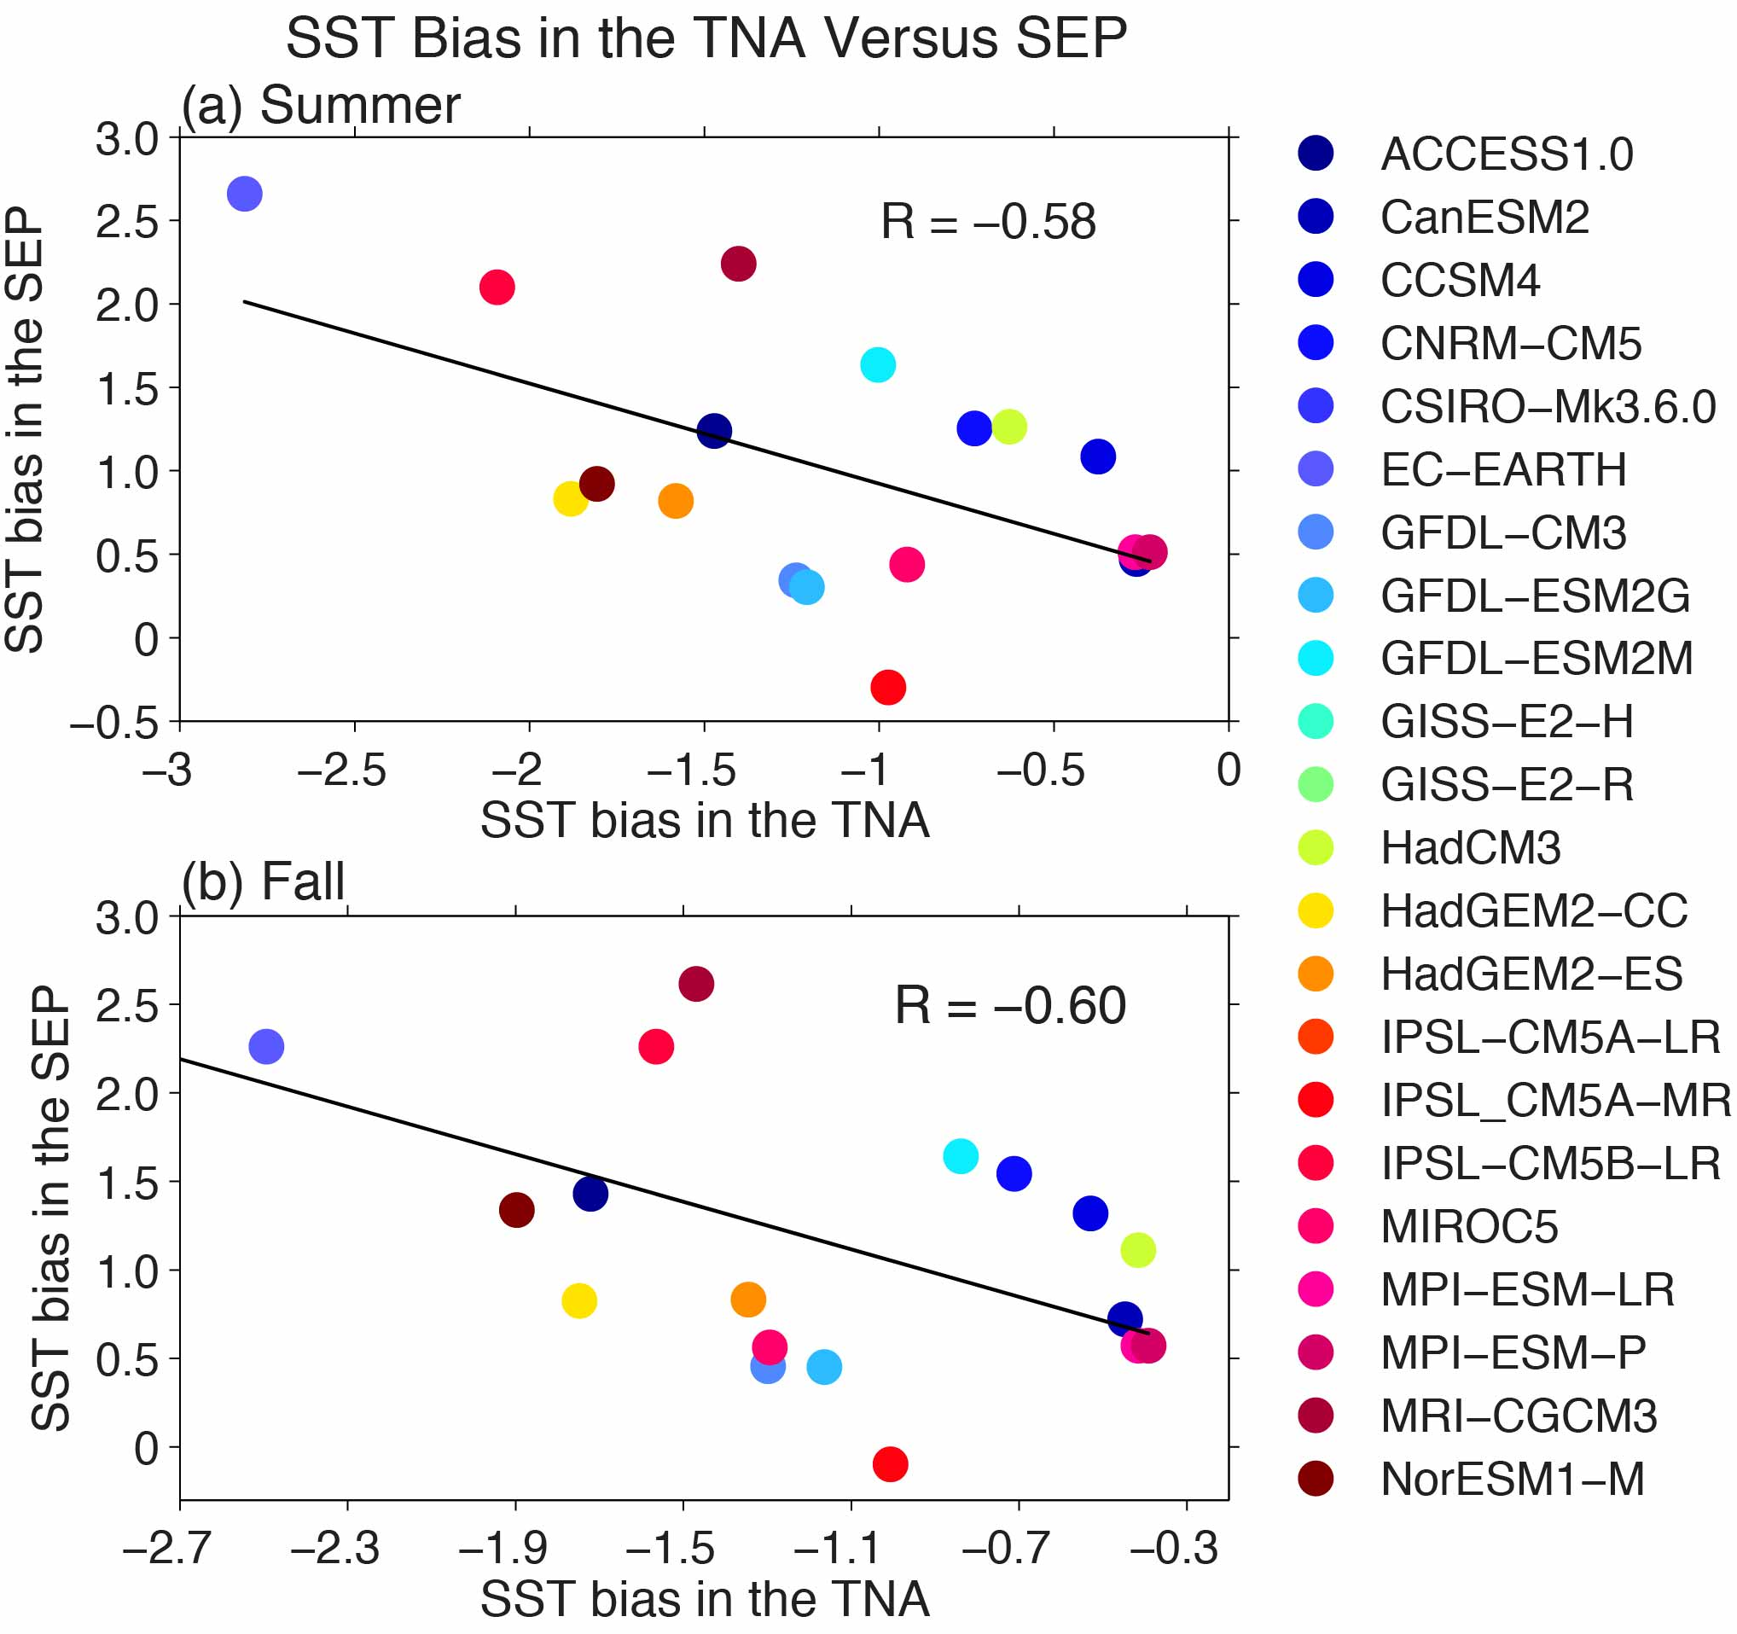
Interhemispheric influence of the AWP or TNA on the southeastern Pacific
Shown are the spatial patterns of SST biases and the relationship between the SST biases in the TNA and tropical southeastern Pacific (SEP).
The cold SST bias in the TNA is related to the warm SST bias in the SEP in the boreal summer and fall.
The mechanism for the remote influence is through the Hadley circulation induced by the AWP heating.
Wang

Slide 25
MOC seasonal cycle in observations not reproduced in models
Models do not reproduce seasonal cycle at 35°S, regardless of resolution
Amplitude of geostrophic heat transport is too weak in models
Observations show opposing Ekman and geostrophic components
Model heat transport is dominated by Ekman heat transport
Perez et al. (2014)
Notes:
Figure Caption: Seasonal cycle of MOC along 34.5°S for (a) XBT observations 2002-2008 and three GFDL simulations: (b) CM2.1, (c) CM2.5, and (d) CM2.5 CORE. Shading corresponds to standard errors of total MOC and components. Note, XBT standard errors computed as the standard deviation of the seasonal cycle residuals computed over a sliding 3-month window divided the square root of the (N_{3months}-1) sampled. Model standard errors computed as the standard deviation of monthly values divided by the square root of the (N_{years}-1) sampled.
Take home message:
The amplitude of the geostrophic component of the seasonal cycle at 34.5S is still weak in the ¼ degree NOAA/GFDL coupled climate model (CM2.5) and CORE-forced ocean only simulation (CM2.5 CORE).
Partners:
This work is being done by researchers at AOML in collaboration with Rym Msadek at NOAA/GFDL and Bill Johns and Jian Zha at UM/RSMAS. XBT data collected in partnership with South Africa, Argentina and Brazil (Garzoli et al. 2013).

Slide 26
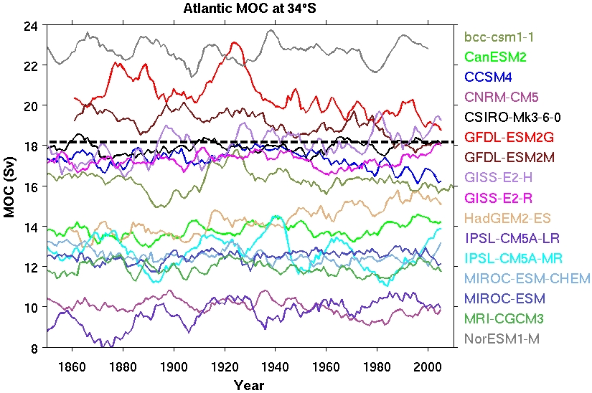
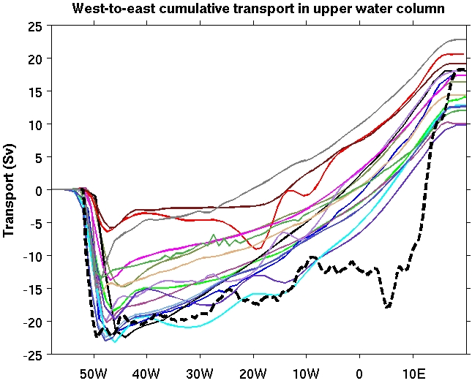
Model Evaluation: MOC from CMIP5 Models

Slide 27
Influence of the Atlantic Ocean on Pacific climate
It is well-known that ENSO affects the tropical North Atlantic (TNA).
We also show that warming/cooling in the TNA can affect tropical Pacific SST.
The coupled model experiments show that a cold TNA in summer/fall can initiate a warm El Nino event next spring in the tropical Pacific (above figure).
Wang

Slide 28
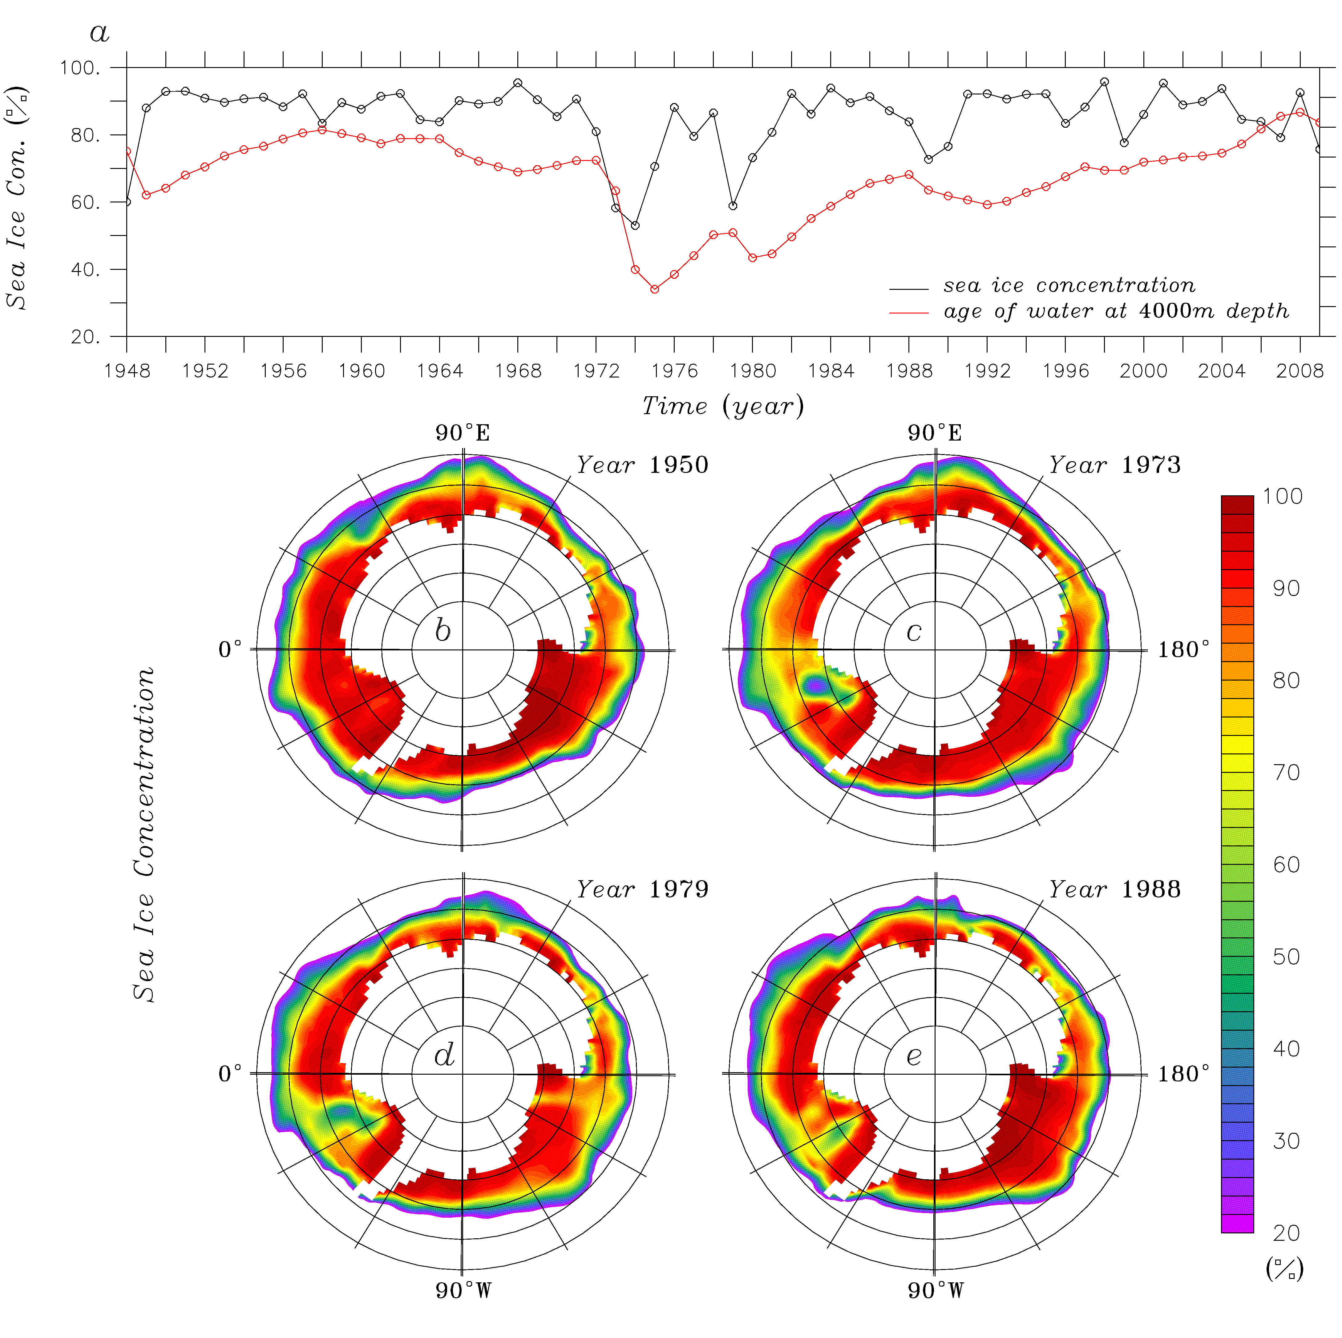
Replicating the 1970s’ Weddell Polynya using a global ocean-sea ice model
Simulated Sea ice concentration in the Weddell Sea
Funding: AOML (internal)
Personnel: S.-K. Lee & Y. Liu
Collaborations: ADD (South Korea) & LDEO
Highlights (Cheon & Lee et al., submitted):
The so-called “Weddell Polynya” was observed only from 1974-1976.
A global ocean-sea ice model reproduced the Weddell Polynya (this is the first time).
A chain of key processes identified: a sudden shift of the westerlies  intensification of the Weddell gyre  upwelling of warm and salty Weddell Sea Deep Water (WDW)  melting of the sea ice.
Sufficiently high heat content of the WDW built up to the mid-1970s was a necessary condition to establish the Weddell Polynya.

Slide 29
New advances

Slide 30
Simulating SAMOC Water Mass Pathways:
Vitoria-Trindade Ridge ROMS Experiment
Average tracer distribution after 20-years of ROMS benchmark simulation
After 10-years of ROMS benchmark simulation and simulation without VT Ridge
NOAA project: Perez, Garzoli, Matano, Msadek (Figure by R. Matano and V. Combes)
Notes:
The objective of this project is to improve our understanding of the pathways of the upper and lower limbs of the MOC in the SA.
Our research is focused on the analysis of state-of-the-art high-resolution NOAA/GFDL coupled climate model and ocean-only simulations, non-eddying CMIP and IPCC AR5 models including the NOAA/GFDL coarse resolution models, process-oriented numerical experiments using a regional ocean models, and observations.
As an example of one of the pathways we are studying with one of the models:
We are studying NADW pathway in a series of ROMS simulations. Passive tracers were released between NADW levels (1500-3000m) in the northwest corner to examine how the “realistic” pathway of NADW differs from the pathway when the Vitoria-Trindade Ridge is removed.
In the “realistic” pathway (large image) after 20-years there are three offshore intrusions of NADW near 10S, 20S, and 45S. The most remarkable is the one observed near 20S, which is the approximate location of the VT Ridge, because there is no clearly defined offshore mean flow in this location. The offshore detrainment of the deep waters in this location appears to be a largely eddy-driven process. The question, therefore, is whether these eddies driving this outflow are produced locally (e.g., through interaction between the western boundary current and the VT Ridge) or are the deep-ocean expression of surface eddies.
Preliminary analysis with the V-T seamount removed shows a reduced offshore spreading pattern of NADW near 20S although a substantial portion of the NADW is still detrained in the offshore direction at this particular location. Note, these simulations are being re-run by V. Combes and R. Matano because a spurious diffusion detected due to sigma-coordinates – so these results may change.

Slide 31
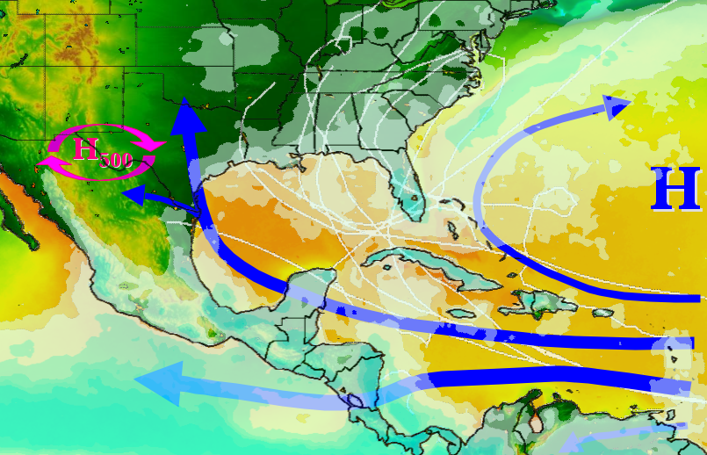
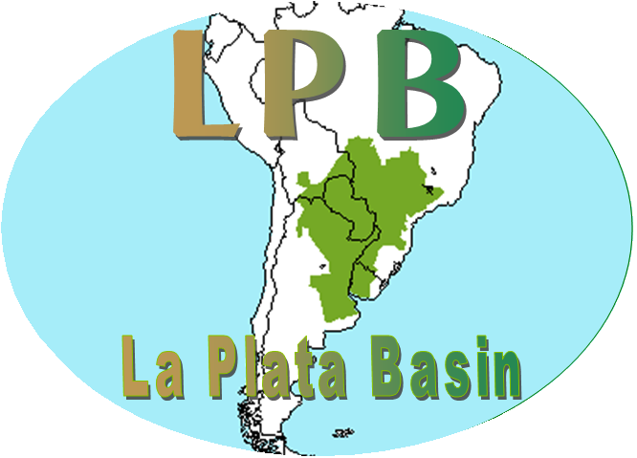
IASCLIP = Intra Americas Study of Climate Processes
An International CLIVAR Program
Atlantic Warm Pool is the centerpiece of the IASCLIP Science/Implementation Plan
Wang

Slide 32
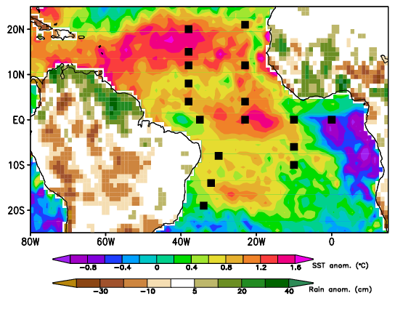
Creating an enhanced Tropical Atlantic data set for diagnosing climate events
17 PIRATA (Prediction and Research Moored Array in the Tropical Atlantic) buoys
are maintained, many with records extending back to 1998.
The records have vertical and temporal gaps and occasional biases that
complicate their use for studies of tropical Atlantic variability.
SST and rainfall anomalies during JAS 2010
and locations of PIRATA moorings
We are developing a data set consisting of continuous, daily-averaged, bias-corrected time series of the mixed layer heat budget components at each PIRATA mooring location for diagnosing the causes of short-term climate events and longer timescale climate changes.
Funded CPO proposal (2014-2016), PIs:
Foltz, Schmid, Lumpkin

Slide 33
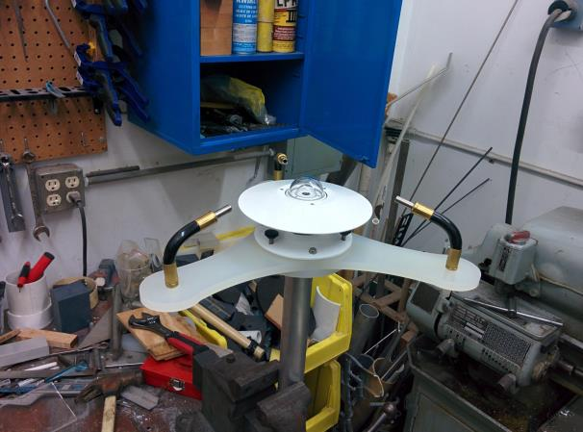
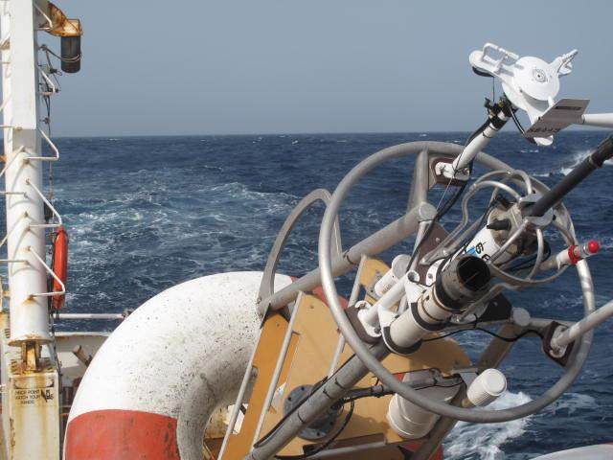
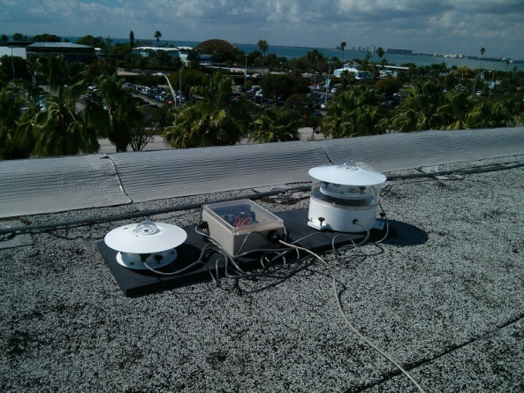
African dust collects on the shortwave radiometers of several PIRATA
(Prediction and Research Moored Array in the Tropical Atlantic) buoys,
leading to significant biases.
An automated radiometer rinser was developed and deployed on the
11.5°N, 23°W buoy earlier this year in an attempt to prevent aerosol buildup
and biased measurements. In a separate project, a radiometer will be
mounted to AOML’s roof to acquire a long time series of surface solar radiation.
Radiometer rinser in the lab during development
and mounted prior to deployment
Roof-mounted system under development

Slide 34
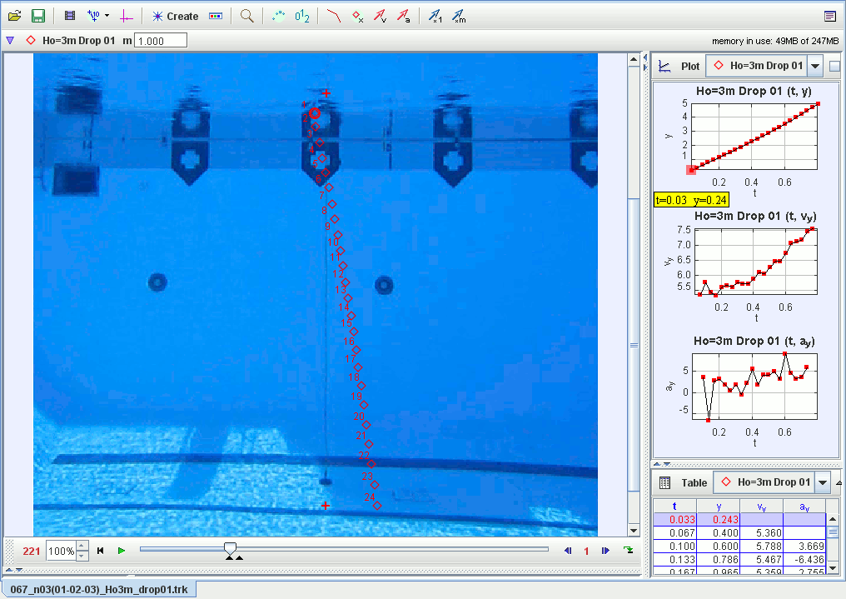
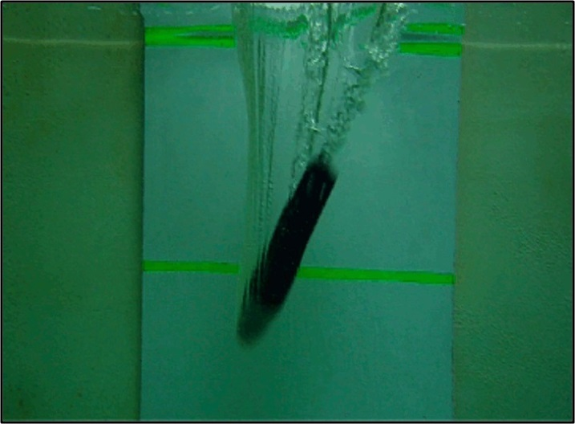
New XBT Fall Rate Equation Coefficients
  Hanawa et al (1995): z(t) = at – bt²
  XBT profiles obtained from this FRE contain : depth bias, depth offset, temp. bias
  AOML, CSIRO, NODC, UH (Germany), CAS (China), ENEA (Italy), partner to investigate errors.
  AOML led efforts to assess the depth offsets linked to deployment heights.
  z(t) = at – bt² + D(t)
  • In Beijing 2014, the community agreed on new correction scheme (Cheng et al, 2015, submitted to BAMS)
  • New correction scheme will improve historical data-set and current data.
Bringas, F, and G. Goni: 2015. Early dynamics of Deep Blue XBT probes, JTECH (submitted)
Notes:
The slide is of the joint work that we did with the XBT science team on obtaining the depth offset for the fall rate equation. AOML led this component of the XBT error assessment.
The paper on the offset was submitted to JTECH
The paper on the new coefficients was submitted to BAMS
The main result is that for launch height of 15m, typical of a cargo ship, the depth in the temperature profile has to be corrected by 2.5m.

Slide 35
DISCUSSION
Current proposals (with PIs) funding this topic
Personnel and months working on these proposals
Months for science, science support, engineering, etc.
Current open calls for proposals
Divisional support in personnel, equipment, etc.
Meetings attended, upcoming meetings
Days at sea in support of each project
Number of publications during last five years
Is current personnel sufficient? Do we need more postdocs, scientists, science support, engineering?
Future plans

Slide 36
END

Slide 37
Extra

Slide 38
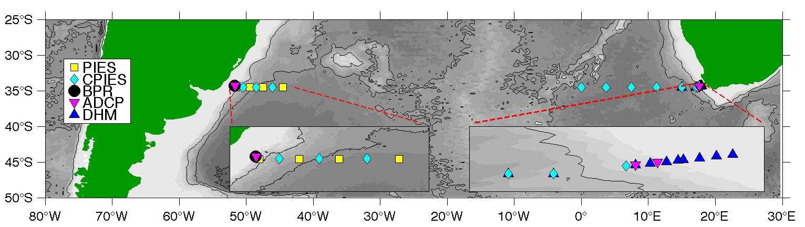
34.5°S
Array
Southwest Atlantic MOC (U.S. – NOAA, w/Argentina & Brazil) (“SAM”) project
Three PIES and one CPIES: March 2009 to July 2011
Four PIES: July 2011 to the present
South Atlantic MOC-Brazil (“SAMOC-Br”) project
Three CPIES: December 2012 to present
One ADCP & one BPR: December 2013 to present
South Atlantic MOC-France (“SAMOC-Fr”) project
Two CPIES: February 2008 to December 2010
Eight CPIES & two ADCP: September 2013 to present
South Atlantic MOC Basinwide Array – East (South Africa) project
~10 moorings: October 2014 to present
Concurrent time period for the pilot/initial arrays:
March 20, 2009 through December 2, 2010 (623 days total)
Notes:
Red arrows in the top map point approximately to the two PIES/CPIES used for the MOC calculation. Essentially it is just the instruments at roughly 1000 dbar on either side. Again, use or trim this info as you like.

Slide 39
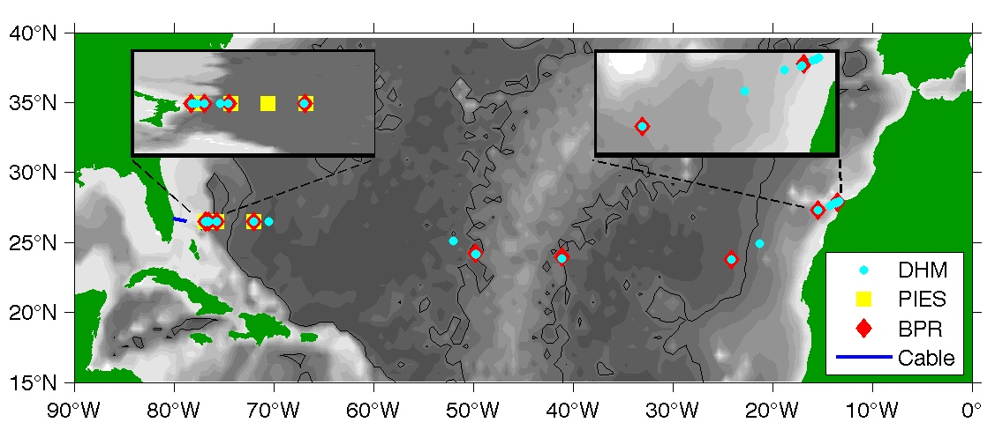
26.5°N
Array
RAPID-MOC (U. K. – NERC) (“RAPID”) project
~21 moorings (tall & short): April 2004 to present
~8 BPR: April 2004 to the present
Meridional Overturning Circulation Heat-flux Array (U. S. – NSF) (“MOCHA”) project
3 moorings (tall): April 2004 to present
2 BPR: April 2004 to the present
Western Boundary Time Series (U. S. – NOAA) (“WBTS”) project
Submarine cable: March 1982 to present
Five PIES/CPIES: September 2004 to present
Concurrent time period for the arrays:
April 2, 2004 through March 28, 2014 (3648 days total)
Notes:
I’m including both maps here along with info about the project start dates…but I doubt you’ll have room to show it all. Trim as you like.

Slide 40
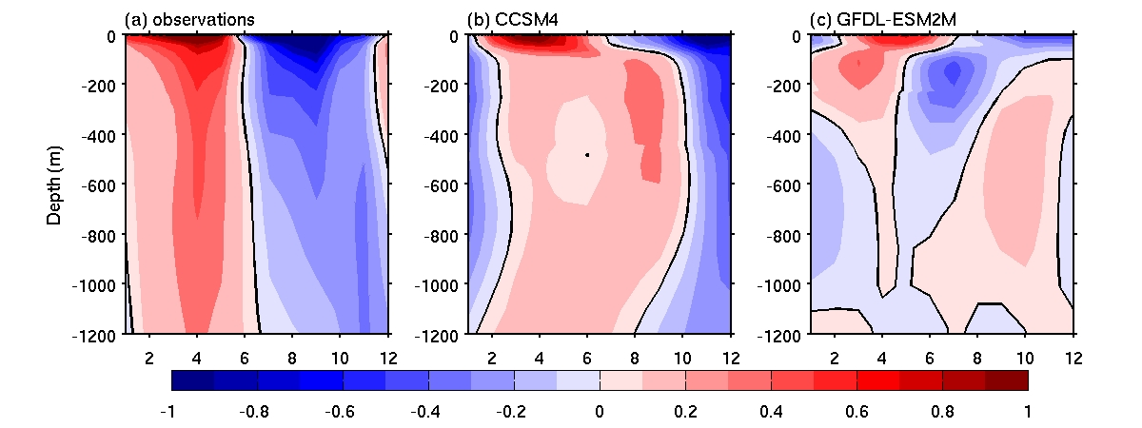
Models contain too much baroclinicity, reducing vertically coherent motions
South Atlantic XBT observations compared to models identifies deficiencies
Zonally-averaged Meridional Velocity Estimated from Observed and Modeled T/S Fields averaged by month (x axis) along 35°S
Observations (Argo) show vertically coherent seasonal changes in the meridional velocity, but not in the models. Both models show strong baroclinicity.
Dong et al. (2014)
Notes:
40

Slide 41
Move to Dynamics

Slide 42
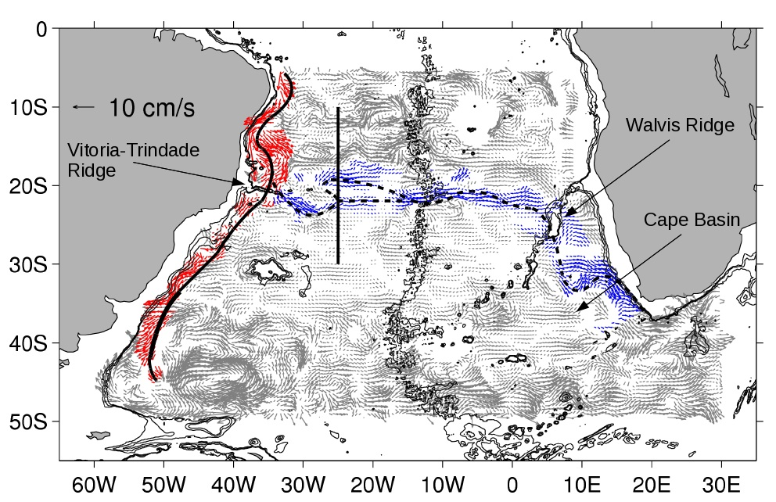
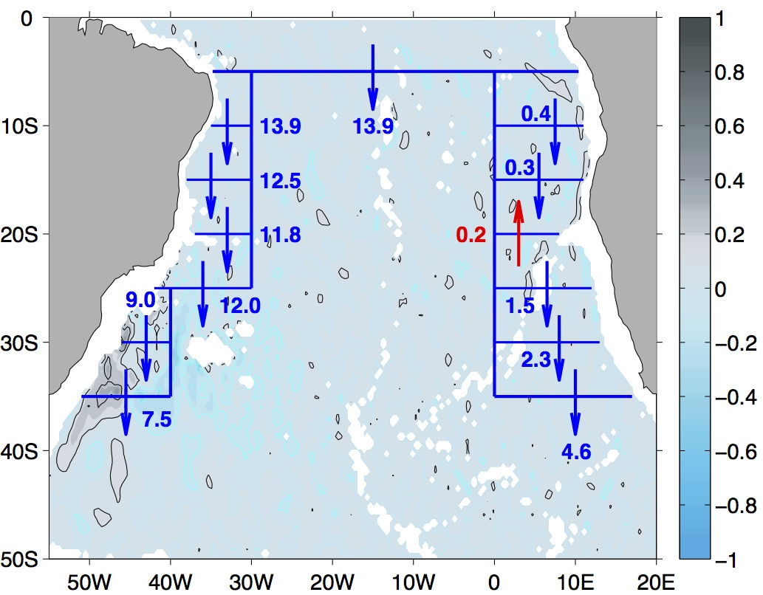
An analysis of historical and recent water mass observations, Argo float drift velocities (see figure at right), and both Lagrangian and Eulerian analysis of numerical model output has documented the key pathways of recently ventilated North Atlantic Deep Water (NADW) carried by the lower limb of the MOC as it passes through the South Atlantic.
Contrary to earlier analyses suggesting that an interior pathway eastward across the South Atlantic basin near 25°S was the dominant route for these waters, this analysis suggests that a much larger fraction of the recently ventilated NADW is carried southward in the Deep Western Boundary Current (DWBC) to nearly 40°S.
Model and observations suggest roughly 80% of the recently ventilated NADW is carried southward beyond 34.5°S by the DWBC. The DWBC reforms into a continuous boundary current near 25°S south of the Vitória-Trindade Ridge. Only about 20% of the recently ventilated NADW flows eastward near 20°S via the corridor described by van Sebille et al., (2012).
Modified from Garzoli et al. (2015)
Notes:
These are figures from Silvia’s recent paper that is presently under review and will likely be accepted soon we hope – it was ‘accepted pending minor revisions’ and Silvia just resubmitted it before she flew to DC.

Slide 43
Relationship between the elevations in the Mediterranean and Black Seas (D. Volkov)
Coupled EOF-1: regression maps of SLA (top) and SLP/wind (middle) and
Main results:
Altimetry and GRACE observations show that wind setup near the Strait of Gibraltar can lead to large, basin-wide, barotropic changes of sea level in the Mediterranean
The nonseasonal sea level records in the Black and the Aegean (eastern Mediterranean) Seas are correlated; the Black Sea SLA lags behind the Aegean Sea SLA by ~20 days
The NAO-related large-scale atmospheric forcing drives the sea level variability in the Black Sea by means of wind forcing near the Strait of Gibraltar and over the Aegean Sea and Turkish Straits, and by precipitation and evaporation over the Black Sea drainage basin
An increase/decrease of the Aegean SSH caused by winds over the Aegean Sea and/or near the Strait of Gibraltar reduces/increases the SSH gradient between the Black and Aegean Seas
Coupled PC-1 of SLA (black) and SLP (red) and, monthly NAO index (shading)
The Black Sea outflow reduces and sea level rises until the SSH gradient is re-established
The 20-day time lag between the Black and the Aegean Seas SSH is the time required for the Black Sea SSH to respond

Slide 44


The total transport per unit depth at 34.5°S is highly variable with time, with large changes occurring over periods as short as a few days.
The transition point between the northward and southward flowing layers is also highly variable, ranging from 1630 dbar to as shallow as 762 dbar. (The 10-day lowpass filtered data range from 801 to 1449 dbar.)
If you want to badly enough you can see some hint of an annual cycle in the transition depth, with deeper values in austral spring, but with less than two years of data, its very premature to put too much weight on this.
Statistics – Daily data
Maximum = 42 Sv
Mean = 21 Sv
Minimum = -3 Sv
STD = 9 Sv
Statistics – 10-day low pass filtered data
Maximum = 37 Sv
Mean = 20 Sv
Minimum = 0 Sv
STD = 8 Sv
For comparison, at 26°N the peak-to-peak range after a 10-day low pass filter is 36 Sv (see also table at right). In general the observed 34.5°S variability is similar to, or slightly larger than, the variability that is observed at the northern latitudes.

Slide 45
Move to Ecosystems

Slide 46

Public Health
Some facts about Vibrio species
Pathogenic vibrios present in marine environment
Proliferate in warm and low salinity seawater
Clinical manifestations: Wound infections, gastroenteritis, septicaemia (100 fatalities /year USA)
Other factors: aging population, shellfish consumption, contact with water, etc.
1982-1989 vs 2004-2011
Notes:
This work started as a result of multiple vibrio infections in the Baltic Sea (a perfect testbed because of the low salinity). We found a close relationship between infections and SST, and a model was developed to apply it at global scale. These results were published in Nature Climate Change
Difference in the number of days above 18C between 2004-2011 and 1982-1989. Indicates potential areas of Vibrio expansion in response to ocean warming. We see that many temperate regions around ~ 40N/S are potential affected areas, including large areas in the NE&NW USA. Last year and for first time, infections reached the southern part of the artic circle. The paper will be soon submitted for publication. We are working on long-term projections based on different ocean warming scenarios.
A model has been developed to estimate the risk index at global scale. The figure shows how the Cheasepeake Bay and the Mississippi Delta areas are affected. These fields are estimated retrospectively, operationaly and also as short-term forecast. Daily and cumulative fields are generated and distributed at NOAA/AOML.

