Slide 1
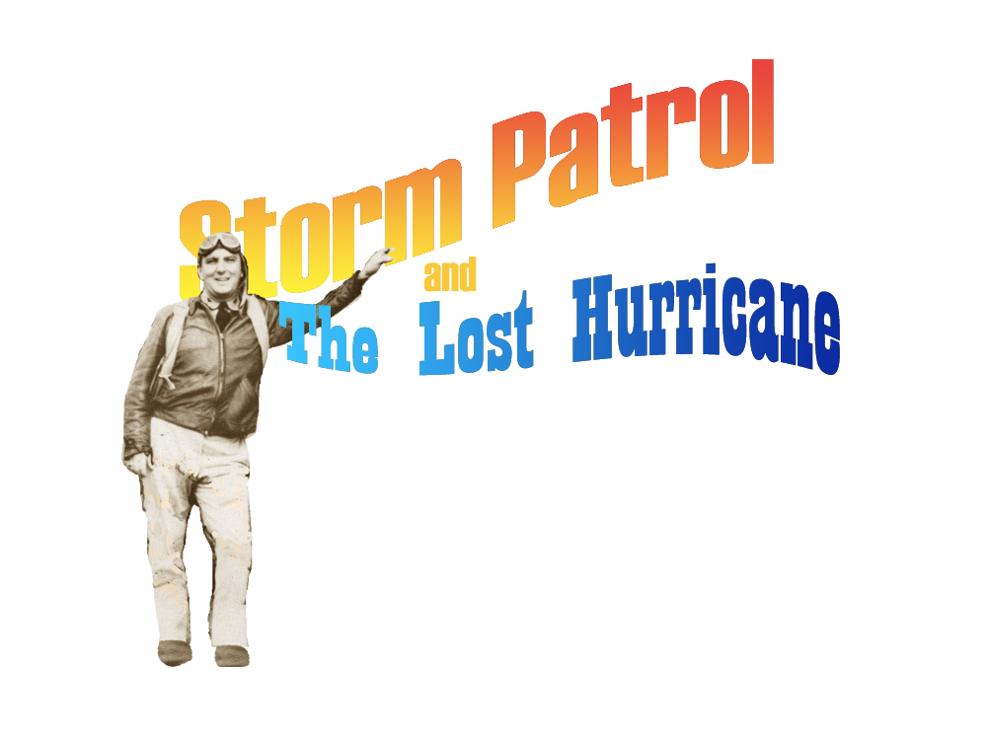
Neal M. Dorst
Atlantic Oceanographic and Meteorological Laboratory
Hurricane Research Division
May 19, 2010

Slide 2
Hurricanes are creatures of the sea
They spend the early and mature parts of their life cycles over the water.
They come ashore to ravage and to die.

Slide 3
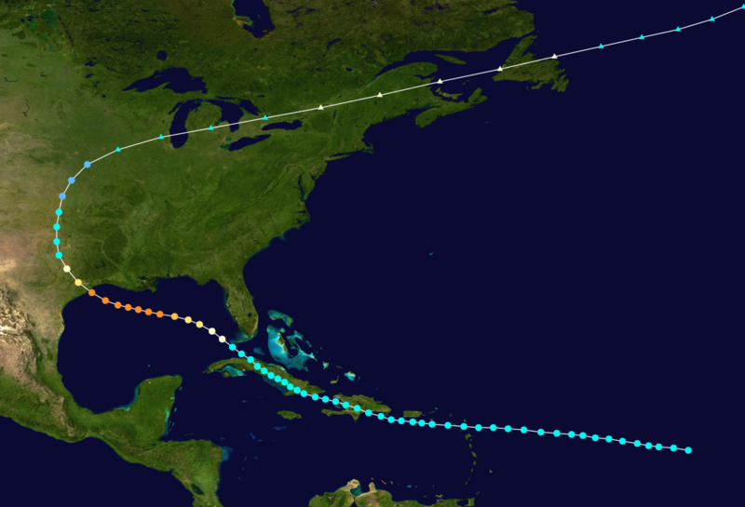
This proved a great difficulty for 19th Century forecasters.
1900 Galveston hurricane
Notes:
Estimate 6000 to 12,000 deaths

Slide 4
Wireless Telegraph introduced 1905
Did for tropical meteorology what telegraph did for mid-latitude weather
Allowed timely ship reports of storms at sea
Notes:
Guglielmo Marconi (1874-1937) Nobel prize physics 1909

Slide 5
The “Lost Hurricane” Problem
Ship reports allowed earlier discovery of tropical disturbances while still at sea
Shore-side weather services able to warn ships on the ocean

Slide 6
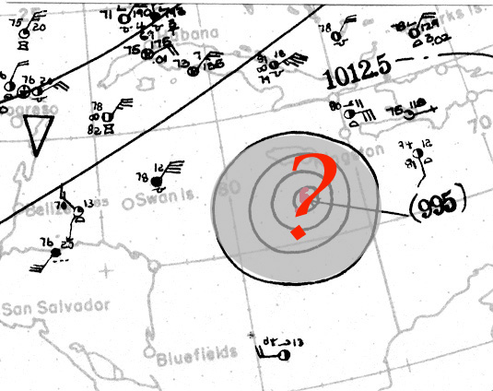
The “Lost Hurricane” Problem
Ships’ captains prudently avoid tropical disturbances.
Data gaps occur just where information is most needed.
‘Lost Hurricane’ problem plagues hurricane forecasters into the 1930s.

Slide 7
August 1932
Galveston had only 4 hours warning before a Major Hurricane struck. City fathers gravely concerned over future surprises.

Slide 8
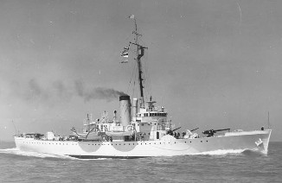
Storm Patrols recommended
USCG Saranac
Captain W. L. Farnsworth of the Galveston Commercial Association asks local Coast Guard command to institute ‘storm patrols’ into the Gulf of Mexico whenever storms threatened.
Cmd. L. Bennett dismisses request as ‘not feasible.’
Board of USCG and USWB experts reject request as dangerous and impractical.
Captain Farnsworth seeks Congressional support.

Slide 9
Notion of ‘Storm Patrols’ spreads
Miami Daily News editorial promotes ‘storm patrols’
Urges that Coast Guard ice patrols be sent south during the summer to hunt for tropical cyclones off the East Coast and in the Caribbean Sea.
Recommendation taken up by Florida Governor David Sholtz

Slide 10
August 1934
Galveston is again threatened by a hurricane. When storm fails to arrive city fathers telegraph senior forecaster in Washington DC for latest storm position. They receive a reply “Forecaster on golf course – unable to contact.” The fact that the hurricane had turned and only side-swiped their town did not mollify them.

Slide 11
U. S. Weather Bureau circa. 1934
Observations are collected from around the nation twice a day (00 Z and 12 Z.)

Slide 12
U. S. Weather Bureau circa. 1934
Observations are collected from around the nation twice a day (00 Z and 12 Z.)
Information is telegraphed to Washington, DC and checked.

Slide 13
U. S. Weather Bureau circa. 1934
Observations are collected from around the nation twice a day (00 Z and 12 Z.)
Information is telegraphed to Washington, DC and checked.
Station data is then plotted.

Slide 14
U. S. Weather Bureau circa. 1934
Observations are collected from around the nation twice a day (00 Z and 12 Z.)
Information is telegraphed to Washington, DC and checked.
Station data is then plotted.
Map is analyzed, isobars and isotherms are graphed.

Slide 15
U. S. Weather Bureau circa. 1934
Observations are collected from around the nation twice a day (00 Z and 12 Z.)
Information is telegraphed to Washington, DC and checked.
Station data is then plotted.
Map is analyzed, isobars and isotherms are graphed.
Senior forecaster (on 24-hour shift) then uses his experience and intuition to formulate a forecast.

Slide 16
U. S. Weather Bureau circa. 1934
Observations are collected from around the nation twice a day (00 Z and 12 Z.)
Information is telegraphed to Washington, DC and checked.
Station data is then plotted.
Map is analyzed, isobars and isotherms are graphed.
Senior forecaster (on 24-hour shift) then uses his experience and intuition to formulate a forecast.
Method better suited to large, slowly-evolving synoptic-scale mid-latitude weather than small, violent, rapidly-moving storms such as hurricanes.

Slide 17
Willis Gregg appointed new Chief of the Weather Bureau
Undertakes reform of the hurricane warning service
Using $80,000 supplement to Agriculture budget.

Slide 18
pre-1935 Hurricane Warning Service
Washington DC as only hurricane warning center

Slide 19
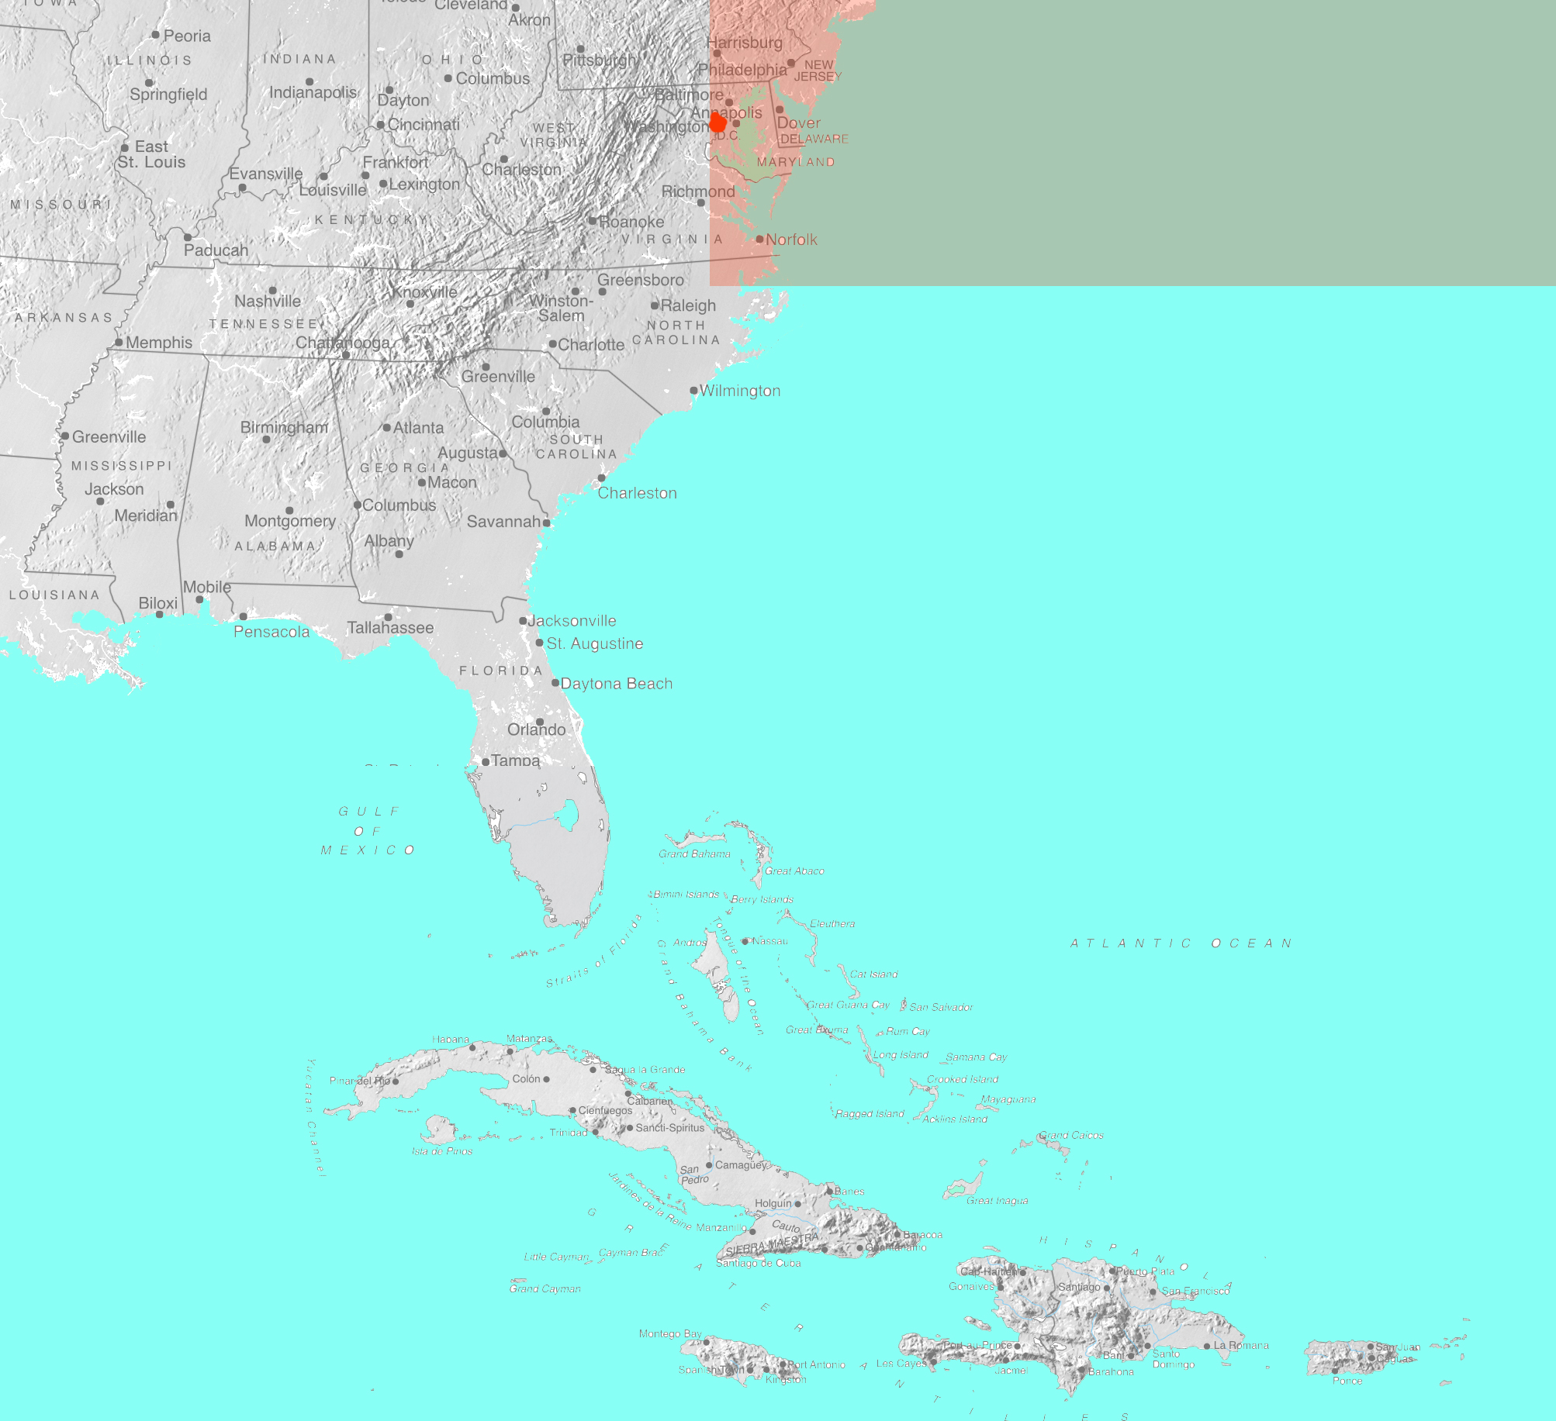
1935 changes to the Hurricane Warning Service
Washington DC only responsible for hurricanes north of 35 North

Slide 20
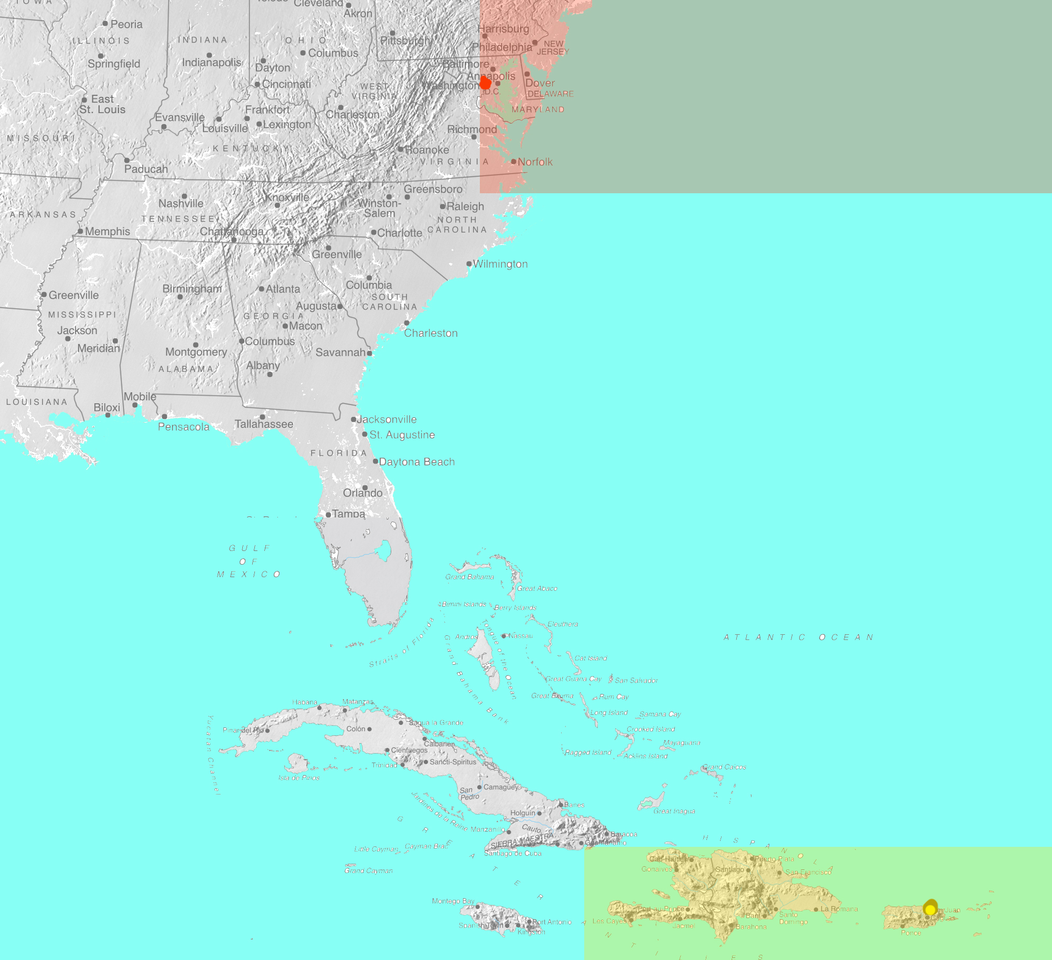
1935 changes to the Hurricane Warning Service
Washington DC only responsible for hurricanes north of 35 North
San Juan responsible for eastern Caribbean and tropical Atlantic

Slide 21
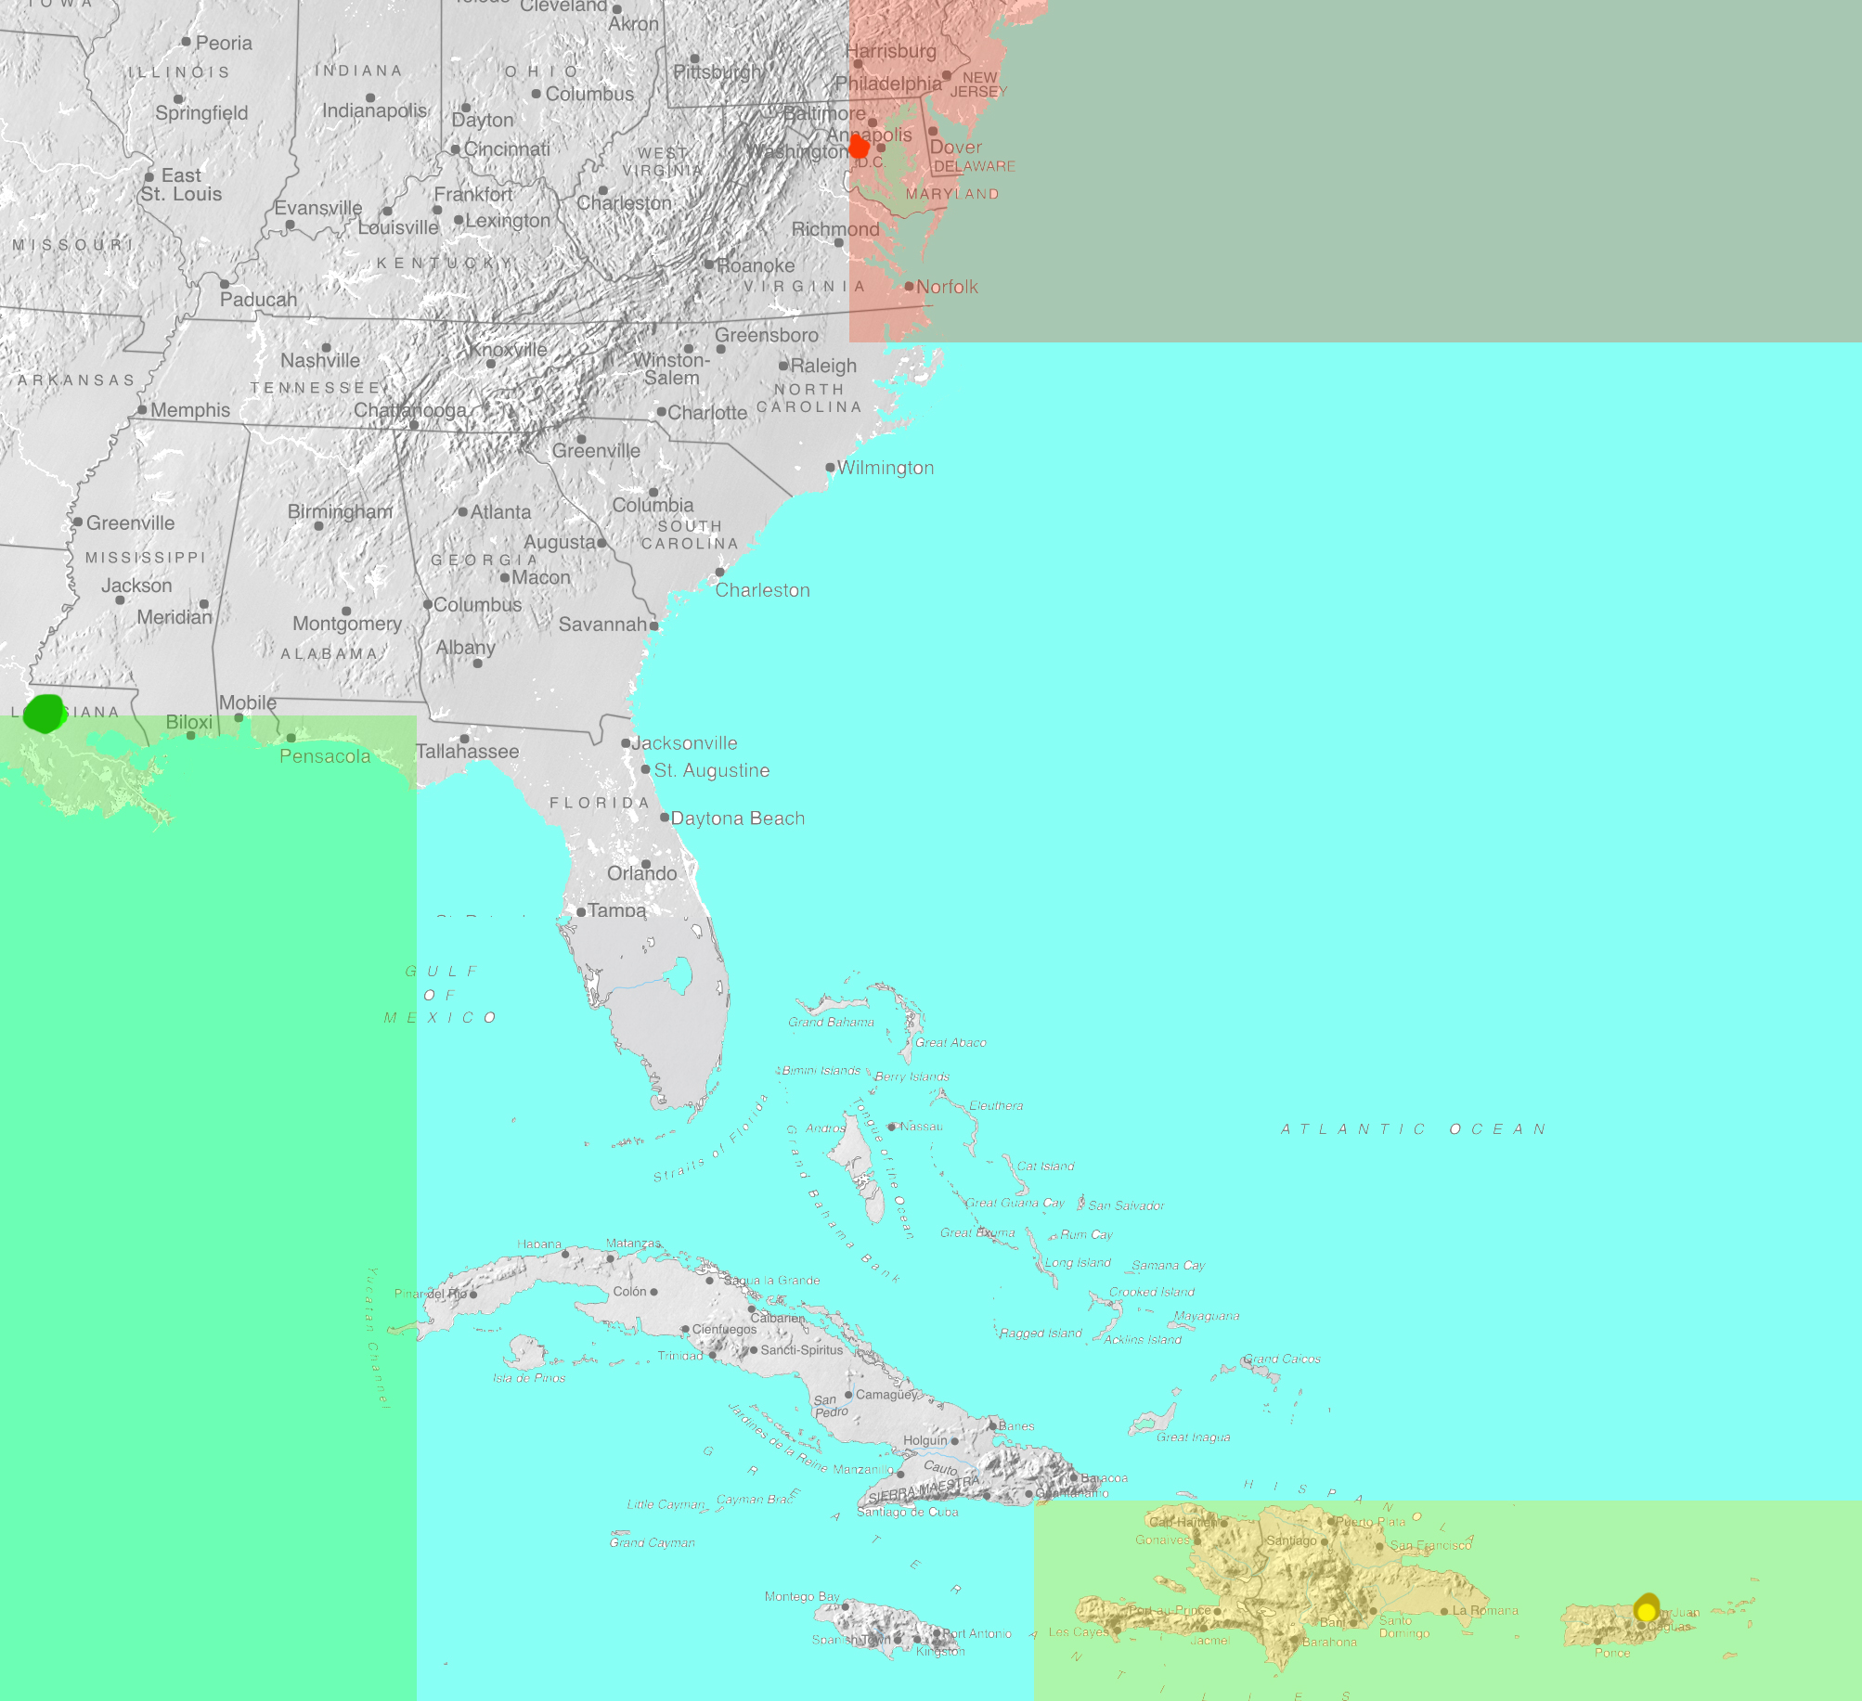
1935 changes to the Hurricane Warning Service
Washington DC only responsible for hurricanes north of 35 North
San Juan responsible for eastern Caribbean and tropical Atlantic
New Orleans responsible for western Gulf of Mexico to 85 West

Slide 22
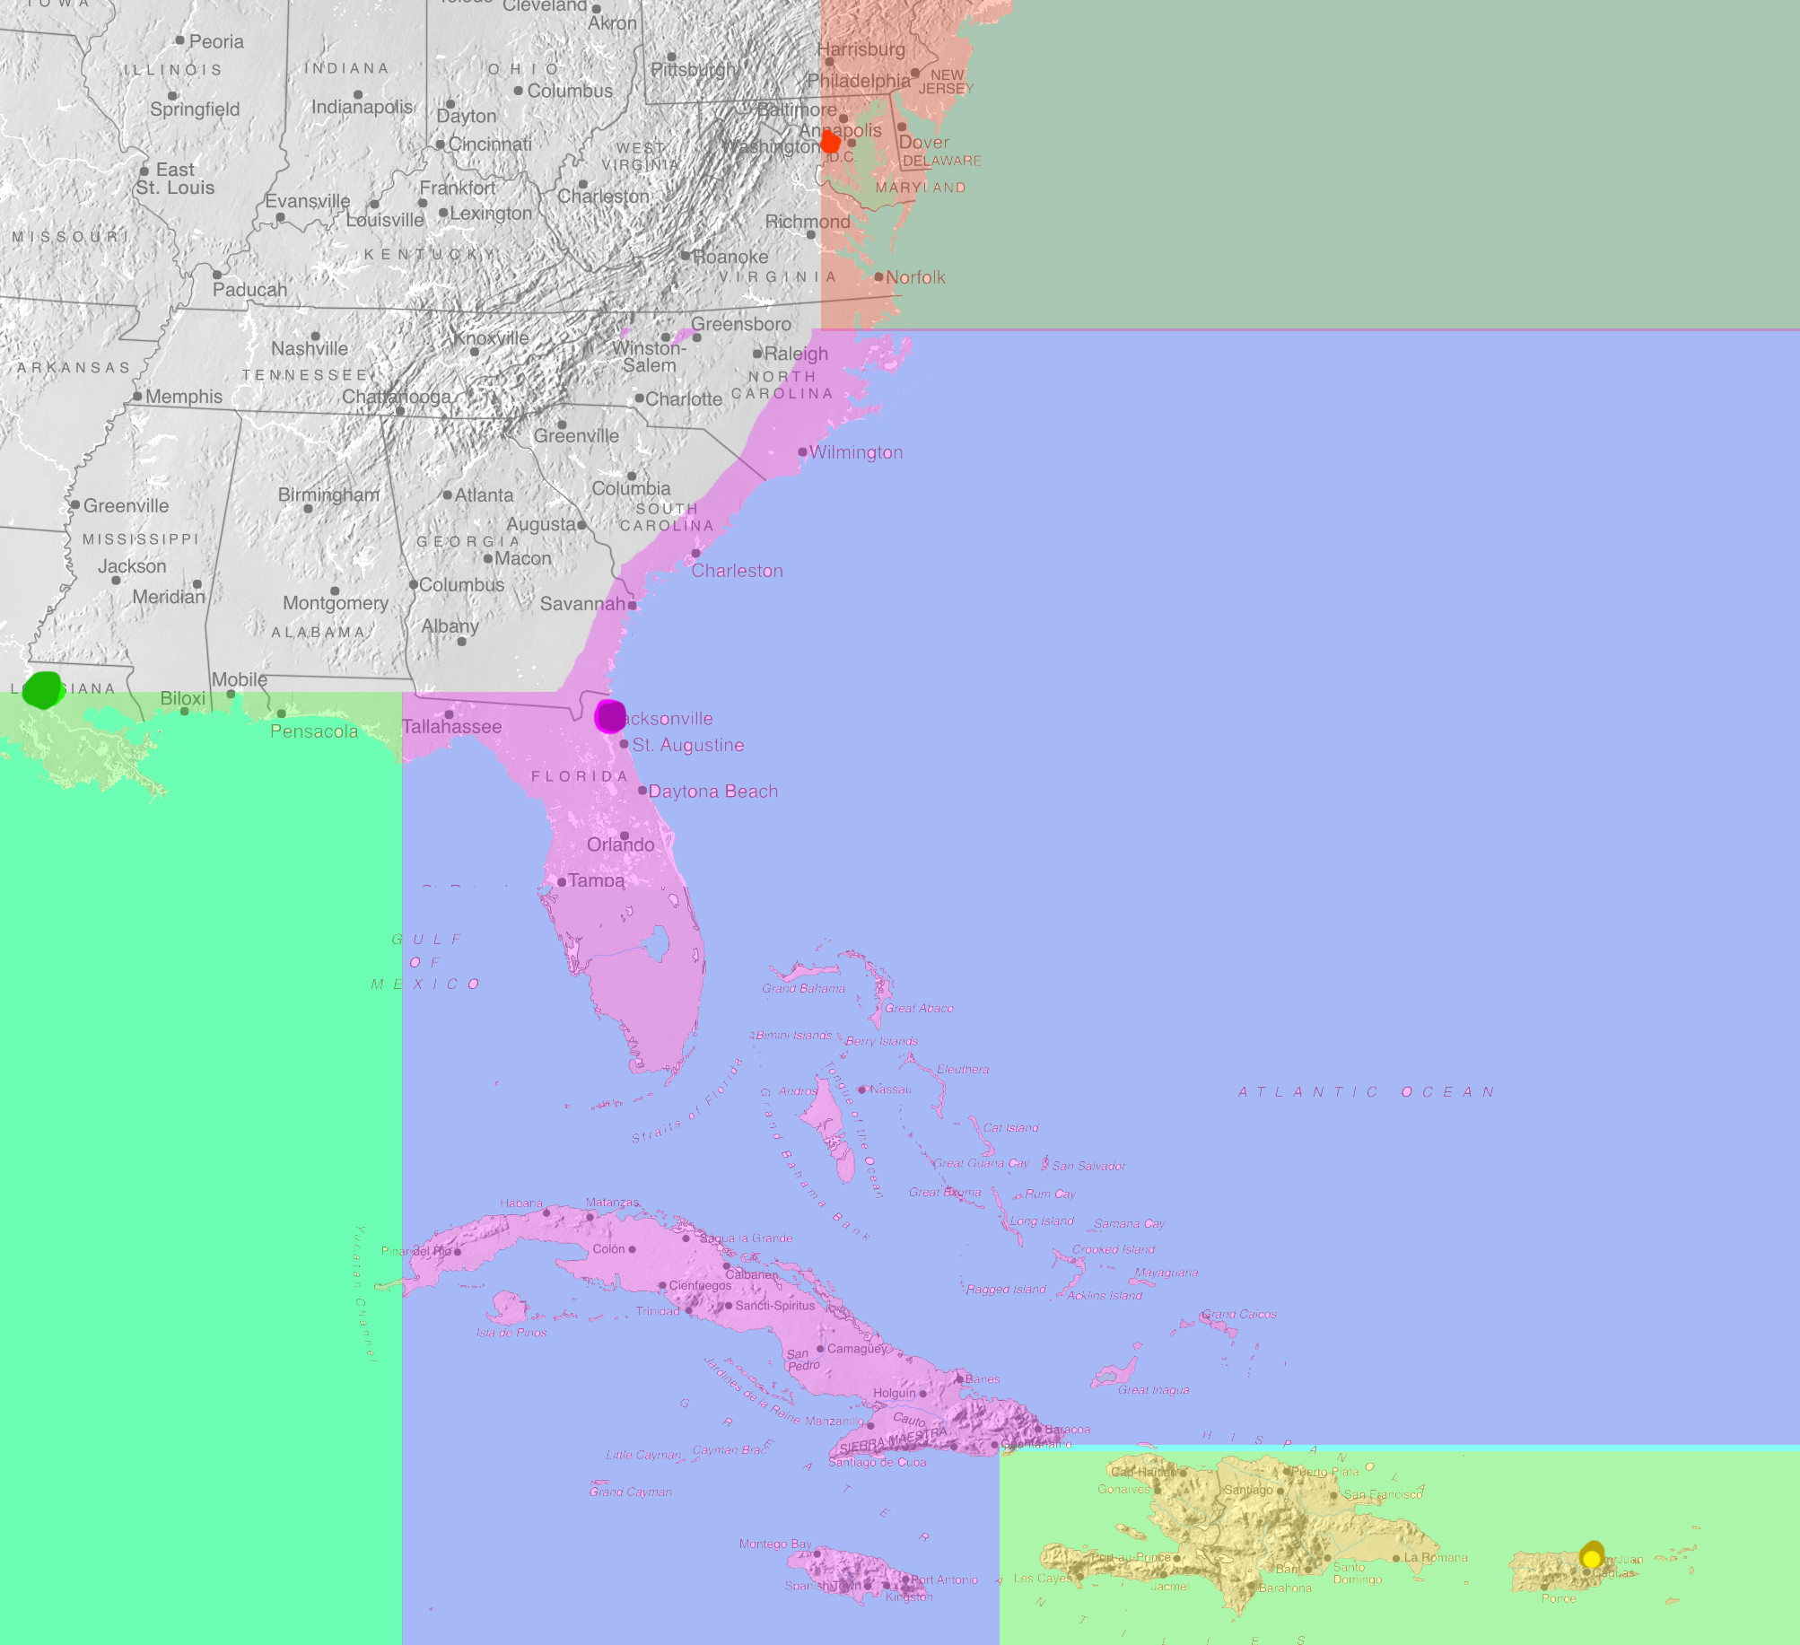
1935 changes to the Hurricane Warning Service
Washington DC only responsible for hurricanes north of 35 North
San Juan responsible for eastern Caribbean and tropical Atlantic
New Orleans responsible for western Gulf of Mexico to 85 West
Jacksonville responsible for the rest of the Atlantic and Caribbean Sea.

Slide 23
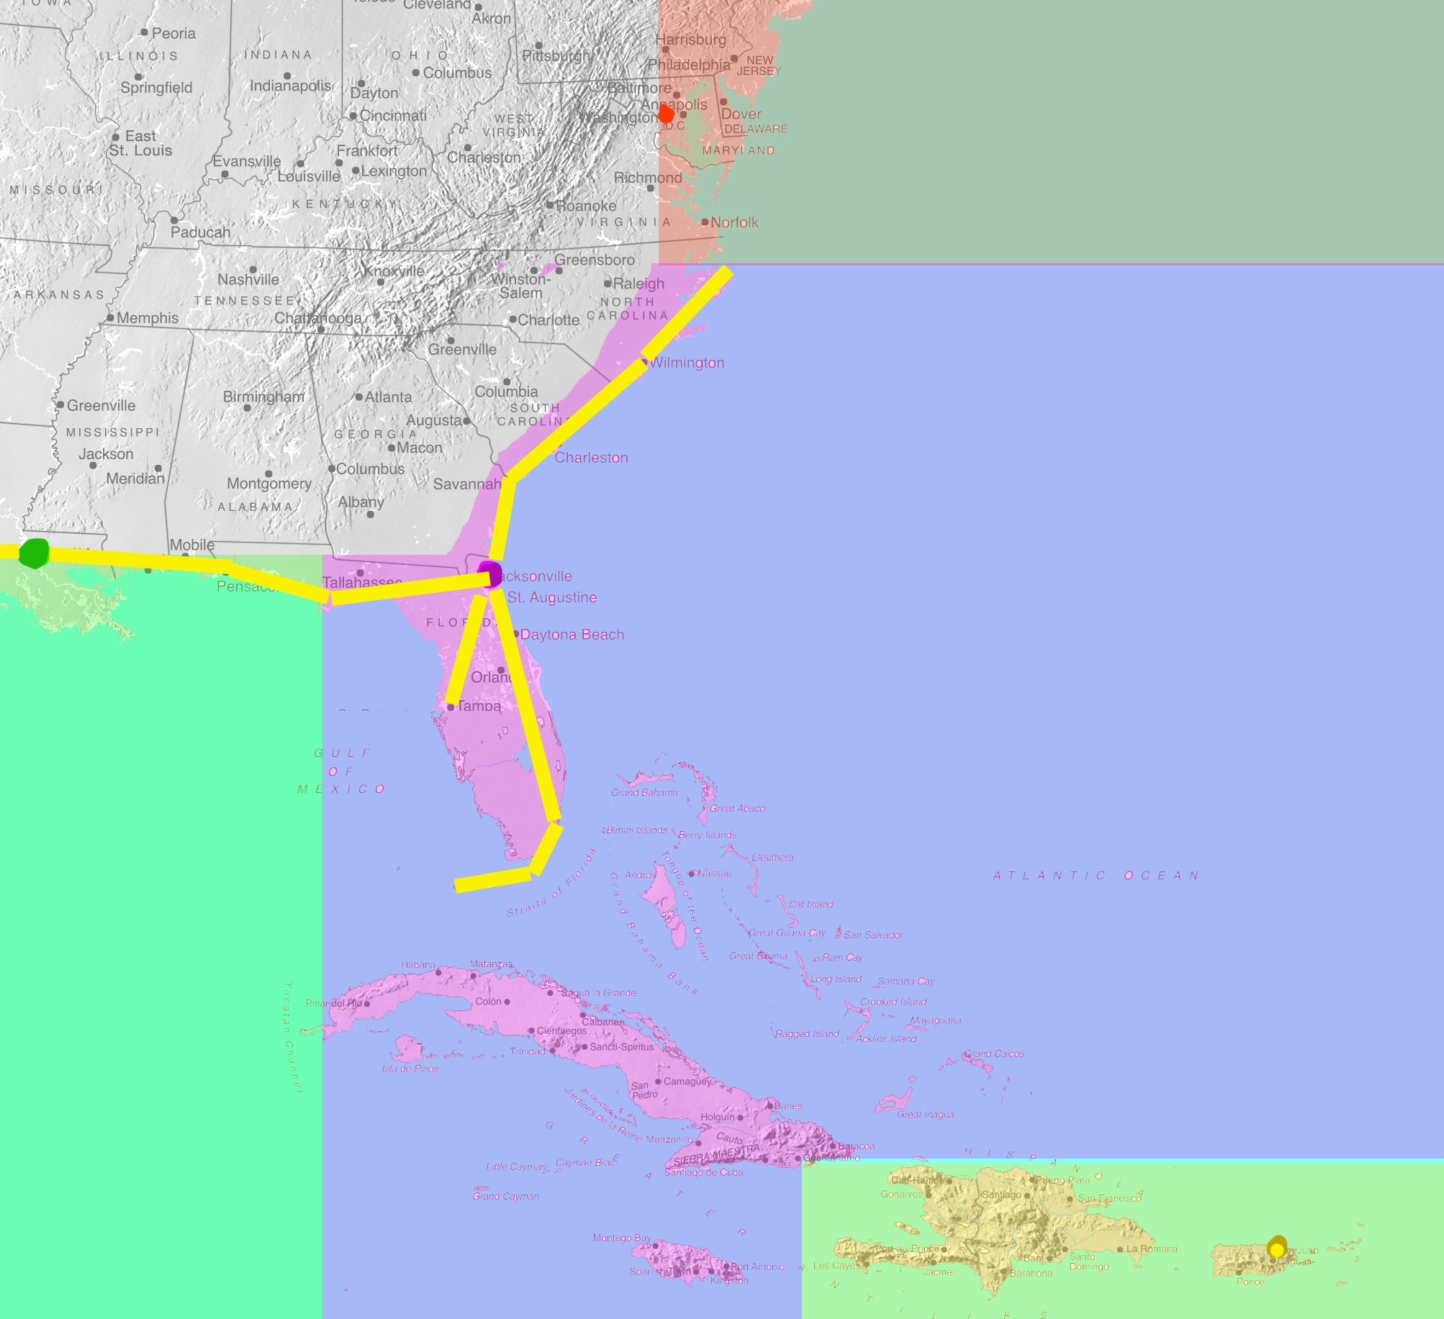
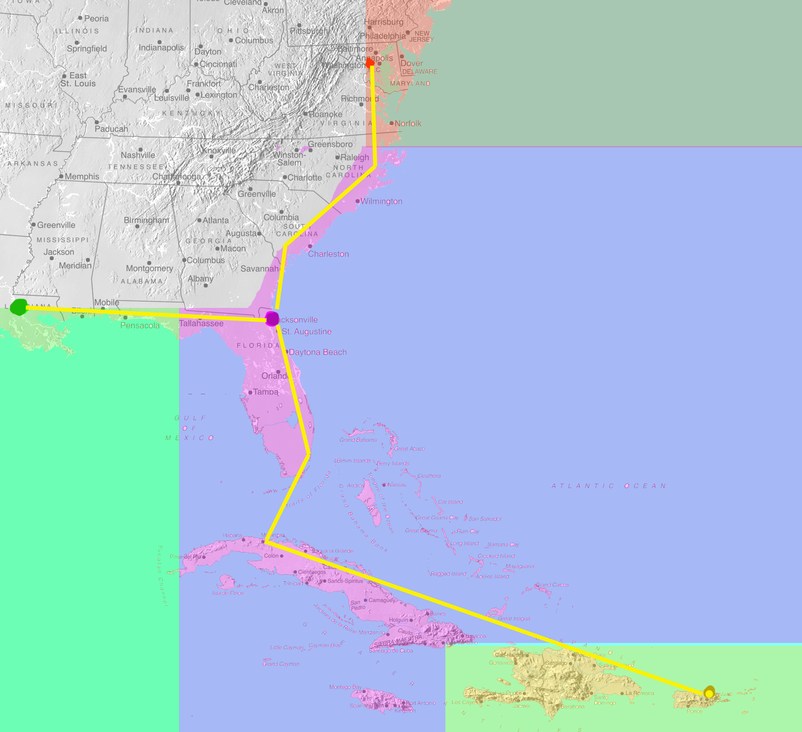
1935 changes to the Hurricane Warning Service
Washington DC only responsible for hurricanes north of 35 North
San Juan responsible for eastern Caribbean and tropical Atlantic
New Orleans responsible for western Gulf of Mexico to 85 West
Jacksonville responsible for the rest of the Atlantic and Caribbean Sea.
Dedicated telegraph cable just for hurricane reporting stations to avoid cable message congestion.

Slide 24
1935 changes to the Hurricane Warning Service
Washington DC only responsible for hurricanes north of 35 North
San Juan responsible for eastern Caribbean and tropical Atlantic
New Orleans responsible for western Gulf of Mexico to 85 West
Jacksonville responsible for the rest of the Atlantic and Caribbean Sea.
Dedicated telegraph cable just for hurricane reporting stations to avoid cable message congestion.
Observations increased to four times a day with even more frequent possible when hurricanes threaten

Slide 25
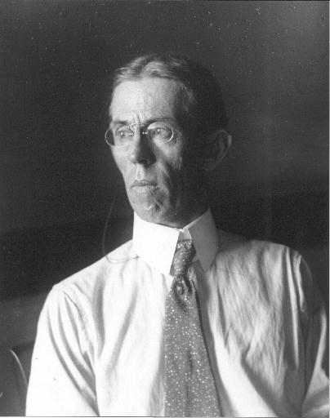
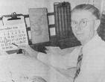
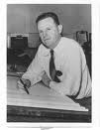
1935 changes to the Hurricane Warning Service
Richard Gray transferred from Miami to San Juan
Grady Norton transferred from New Orleans to Jacksonville
Gordon Dunn transferred from Washington DC to Jacksonville

Slide 26
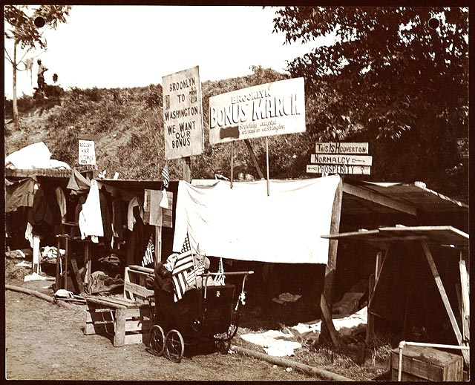
The Great Depression
Library of Congress
The eviction of the Bonus Army from their Washington DC camps in April 1932 leads, in part, to the eviction of the Hoover Administration from the White House the following November.
Roosevelt Administration’s Federal Emergency Relief Administration seeks to place veterans in work camps scattered around the nation to provide them with employment AND remove them from Washington DC and national attention.

Slide 27
The Great Depression
There were few areas as economically depressed as the Florida Keys in 1935. Tourism and the cigar industry depended on large numbers of people with considerable discretionary income. The Keys’ population was in serious decline.
Harry Hopkins proposed FERA fund work camps in the Keys to aid in building bridges to span the last of the ferry routes and connect Key West and Miami by automobile.
Three camps were established on Upper and Lower Matacumbe Keys, housing more than 750 workers. This nearly doubled the population of the Upper Keys.
Notes:
Population Key West 12,500 other Keys 865

Slide 28
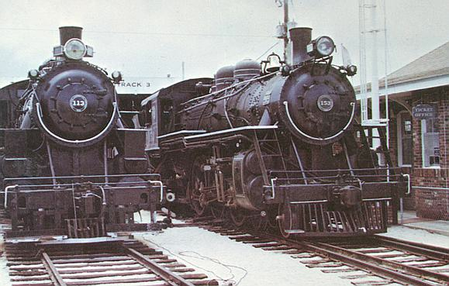
The Great Depression
Florida East Coast RR
FERA officials hurricane plan is to request an evacuation train be sent by the Florida East Coast Railroad from Miami in case a hurricane threatened the Keys.
Since it would be costly to keep a train and crew on stand-by, they would only request the train once hurricane warnings were issued.
Notes:
Population Key West 12,500 other Keys 865

Slide 29
Storm detected Aug 31st and tracked over Long Island in the Bahamas.
Last report of central wind speed (~36 kt) before landfall in the Keys.

Slide 30
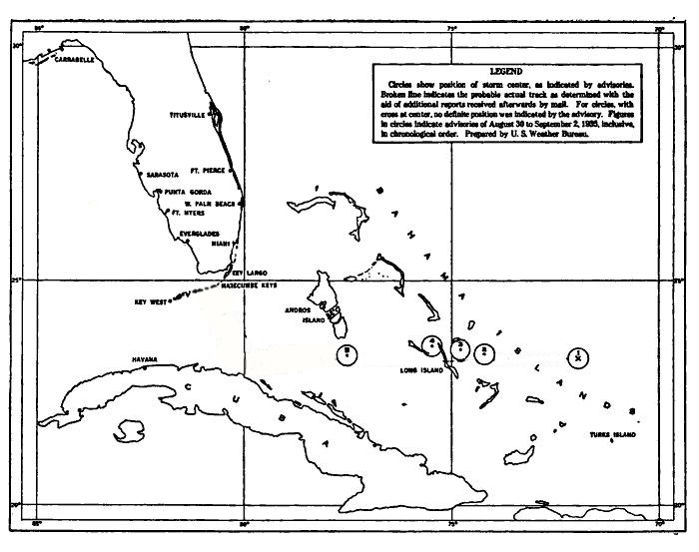
10 AM Sunday Sept. 1st Storm passes south of Andros Island in the Bahamas.

Slide 31
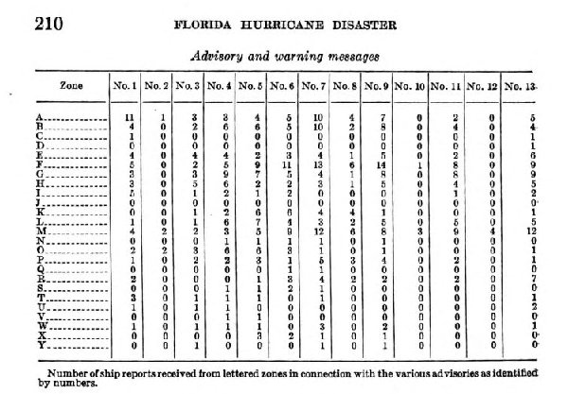

Slide 32
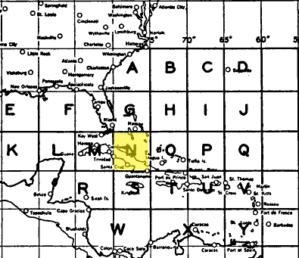

Slide 33
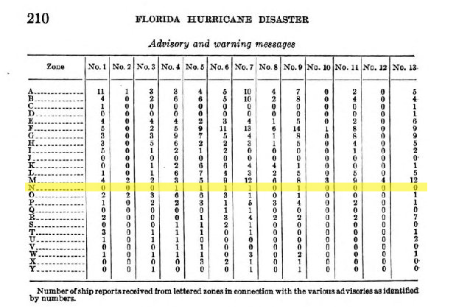

Slide 34
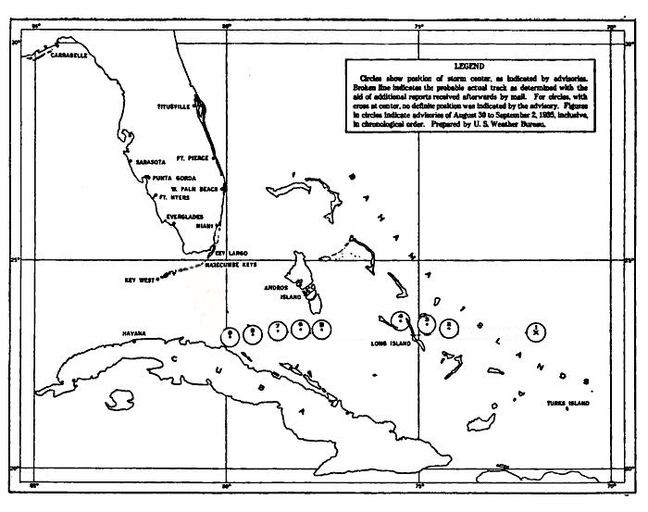
Jacksonville assumes a constant WSW course
…until 10 AM Monday Sept. 2nd
No ship reports or contrary observations.

Slide 35
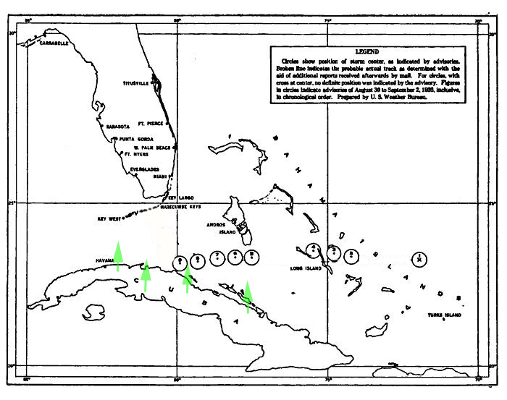
Cuban stations report rising barometers
No reports of deteriorating weather.
Confusion and rumors about storm location
Observatorio Nacional requests CAEC locate the hurricane

Slide 36
Capt. Leonard Povey CAEC
Early afternoon of Sept. 2nd, took off from Havana to find storm
Flew east along Cuba’s northern coast
Was not at location given by Jacksonville
Notes:
Cuerpo de Aviación del Ejército de Cuba (CAEC), Povey was an American WWI fighter pilot and barnstormer recruited by Cuban government to train their pilots and reorganize CAEC after overthrow of Gerardo “3 fingers” Machado.

Slide 37
Povey’s flight
Found cloud mass to “some miles” north of the expected location.
Curtiss Hawk II open cockpit
Did NOT penetrate storm, rather flew up to it and reconnoitered its position
Described it as “a cone-shaped body of clouds, inverted, rising to an altitude of 12,000 feet.”

Slide 38
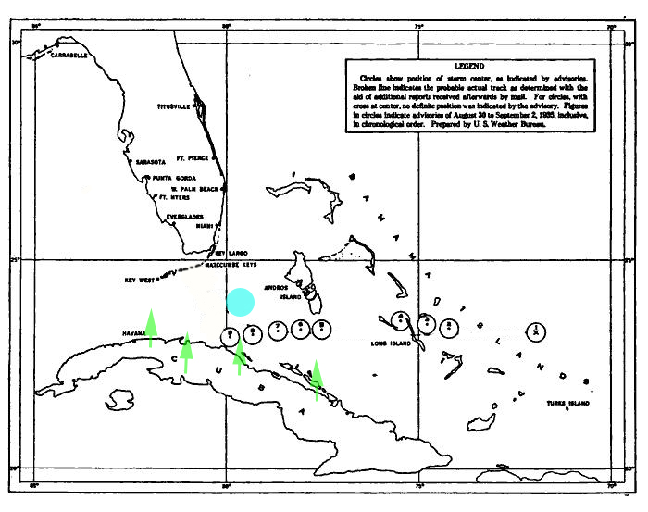
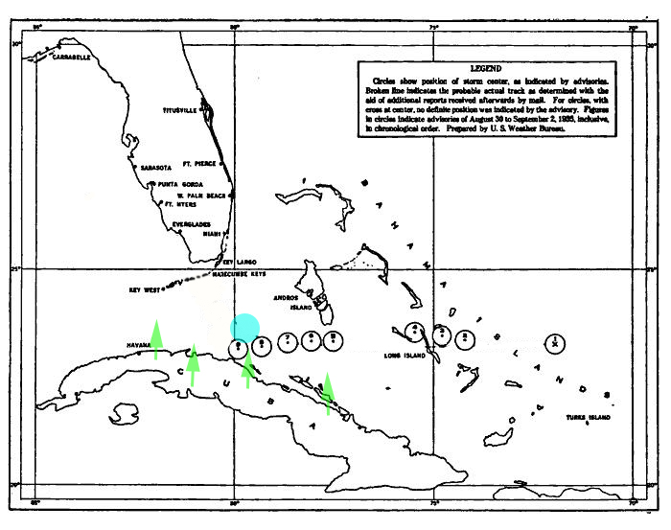
Povey’s position further north of expected location.

Slide 39
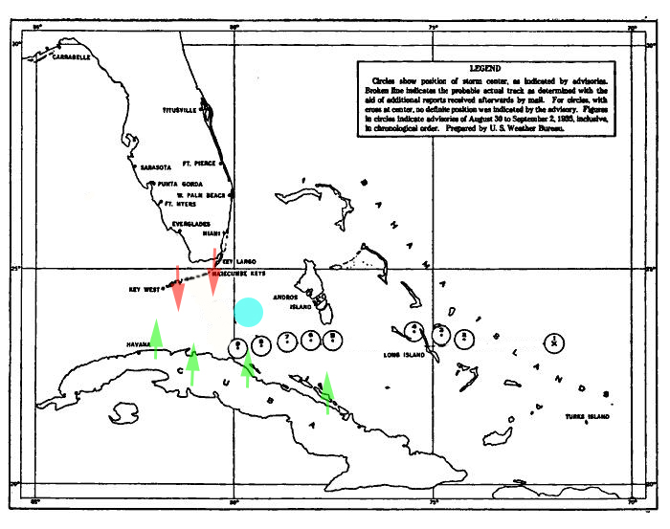
Sharp pressure drops reported in Keys
Squalls observed coming in from the Straits.

Slide 40
1:30 PM Advisory raises Hurricane Warning for the Keys

Slide 41
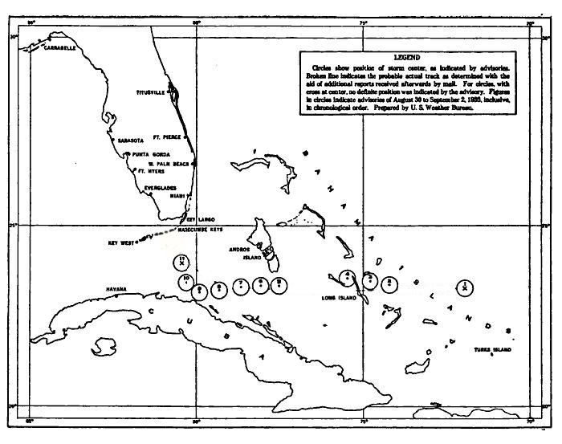
4:30 PM Advisory radically changes storm motion to northwesterly

Slide 42
Evacuation train
Florida East Coast RR
FERA officials request Florida East Coast Railroad send an evacuation train to their camps the Keys at ~1:45 PM.
Due to holiday, there is a delay in rounding up train crew. Train leaves Miami at ~5 PM.
Delays due to debris and storm result in train’s arrival at FERA Camp No. 1 at same time as the storm surge.
Notes:
FERA camp supervisor Ray Sheldon

Slide 43
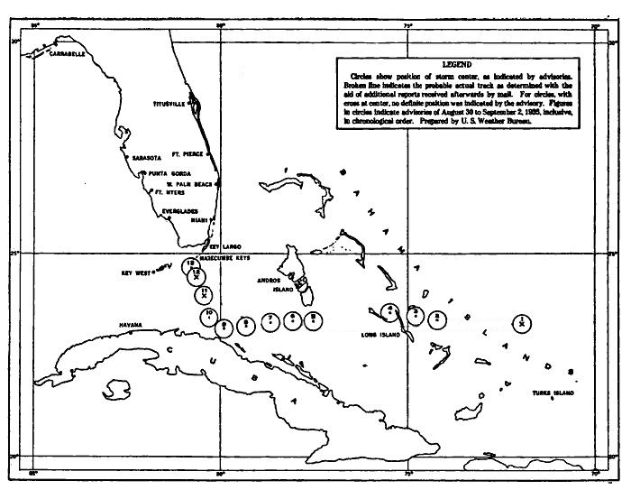
8:00 PM Monday, Sept. 2nd hurricane passes over Keys and labor camps
Notes:
Rail cars swept from tracks, vegetation stripped from the land, few structures left standing, men and automobiles pushed into Florida Bay, men sought refuge from wind in rock pit were drown

Slide 44
423 perish in the storm
164 ‘Conchs’ die.
But it is the 259 veterans would draw national attention to the tragedy.
A day passes before word reaches outside world of the disaster.
Notes:
19% of local population

Slide 45
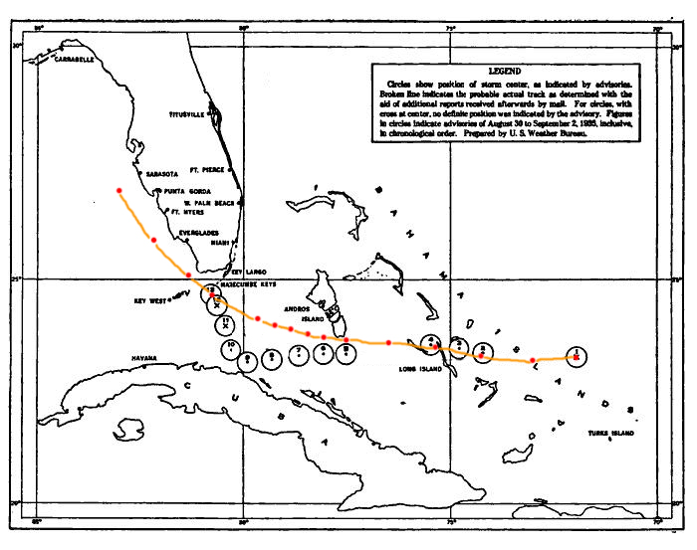
Comparison of operational fixes with HURDAT positions.

Slide 46
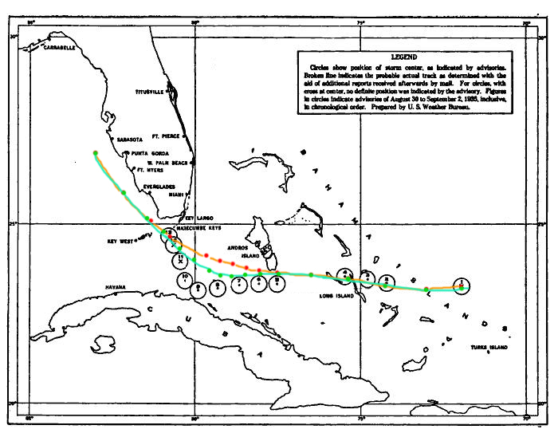
Comparison of operational fixes and HURDAT with proposed Reanalysis positions.

Slide 47
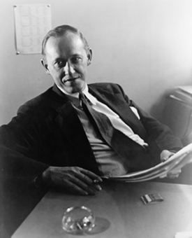
FERA’s Harry Hopkins sends aide to investigate
Aubrey Williams overflies scene, conducts a dozen interviews, has his report ready by Sept. 8, 1935 less than a week after the hurricane.
Exonerates FERA officials of negligence or mistaken judgment
VFW and State of Florida conduct their own investigations.

Slide 48
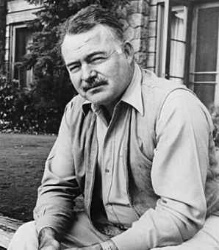
Ernest Hemingway
Key West resident
Knew many of the veterans from the FERA camps
Took his boat Pilar to middle Keys to help
Horrified by the destruction and death
Writes devastating critique “Who Murdered the Vets?” in New Masses

Slide 49
Congressional hearings March 1936

Slide 50
Republicans on the committee, led by Edith Rogers (R – MA), sharply question Roosevelt Administration officials.
Focus on poor living conditions in the camps and lack of planning for hurricane evacuation
Roosevelt Administration given a ‘black eye’

Slide 51
Willis Gregg asked about marine storm patrols

Slide 52
Cubans promote Aerial Hurricane Patrols
Use planes to track storm positions
Seek compensation from USWB
CAEC only has 8 planes, 3 of which are out of commission.

Slide 53
Willis Gregg promotes aerial patrols
USWB upgrades several coastal stations to 24/7
Gregg tours Gulf coast stations starting with Galveston
In June 16th Galveston Daily News he promotes the idea of USWB hiring commercial aircraft to reconnoiter storms.

Slide 54
Stroke of incredibly bad luck
On the same day, on the front page of the same newspaper as Gregg’s announcement is an article about a fatal ‘storm patrol’
Although it is reported nationally as a ‘storm patrol’ the flight is actually a post-storm rescue mission

Slide 55
Storm Patrol legislation
Capt. Farnsworth persuades Congressman Joseph Mansfield
(D –TX) to sponsor legislation mandating USCG carry out marine ‘storm patrols’ in Gulf of Mexico
Bill passed with strong southern support
Roosevelt vetoes bill.

Slide 56
White House convenes conference on hurricane patrols
To resolve conflicts over various proposals and polish Roosevelt Administration’s image
August 10, 1937
Presided over by James Roosevelt, the President’s private secretary and son
Invited representatives of USWB, USCG, Navy, and Army as well as Captain Farnsworth and Texas Senators and Congressman

Slide 57
Administration fails to brief newly appointed USCG Commandant, Adm. Russell Waesche
Texas delegation buttonholes Waesche before conference
In his opening remarks, Waesche endorses ‘storm patrols’
Other government officials have not choice but to accede
USWB brings up aerial patrols but receives no endorsement

Slide 58
Several sorties carried out in 1937 and 1938
One attempt to fix tropical storm before it strikes Cameron, LA. Tannehill’s evaluations is that these ‘storm patrols’ are useless.

Slide 59
Great New England hurricane 1938
No marine nor aerial storm patrols along East Coast
Handoff from Jacksonville to Washington warning centers
No use of the word ‘hurricane’ in Washington warnings
Missed acceleration and no recurvature.

Slide 60
> 680 deaths directly attributed to storm
Many people caught commuting home
People still at summer vacation homes along the shore at Long Island, Connecticut, Rhode Island, and Martha’s Vineyard
Notes:
“Flight of the Thielens” by Thomas Hart Benton (1938)

Slide 61
‘Surprise’ hurricane 1943
Marine storm patrols fall into disuse as war concerns loom.
Aerial storm patrols never implemented
Lost Hurricane problem continues into 1940s
Little warning due to wartime restrictions on broadcasting weather data
Major Duckworth flies into eye of hurricane over Texas.

Slide 62
What could’ve been?
Would marine or aerial storm patrols saved any of the 600+ lives lost in the Great New England hurricane?
Could aerial storm patrols have been instituted in the 1930s?
Innovations are often not realized because of lack of technology, money, or initiative.

