Slide 1
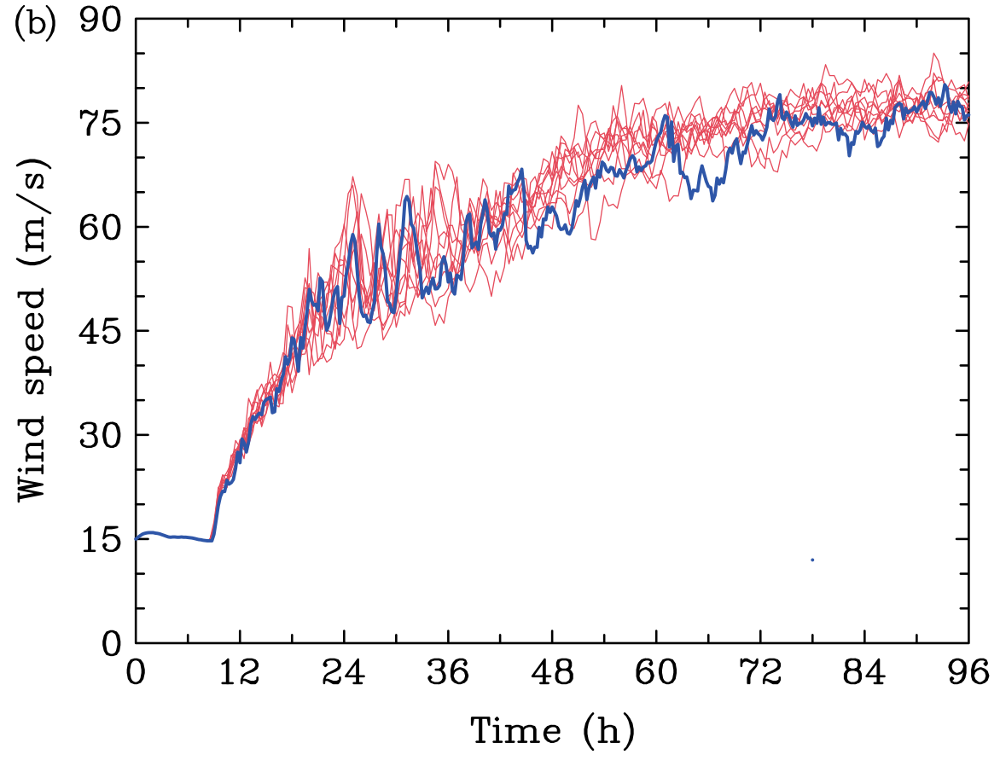
Ensemble Sensitivity of Hurricanes: WRF vs. MM5
MM5 version 3.6
45km, 15km, 5km
SST = 27 °C
f = 20 °N
Vmax = 15 m/s
Rmax = 135 m/s
random moisture perturbation: ± 0.5 g/kg
WRF version 3.1.1
18km, 6km, 2km
SST = 27 °C
f = 20 °N
Vmax = 15 m/s
Rmax = 135 m/s
random moisture perturbation: ± 0.5 g/kg
Nguyen, V. S., R. K. Smith, and M. T. Montgomery, 2008:

Slide 2
Hurricane Predictability Under Different Shear
NoShear
3m/s
1m/s
NoShear
5m/s
Shear 1m/s
Shear 3m/s
NoShear
1m/s
3m/s
5m/s
Shear 5m/s
(Zhang & Tao 2012, JAS, in review)
Notes:
The left panels show the hurricane intensity forecasts by ensembles under different environmental flow with and without shear. We can see increasingly larger forecast uncertainties of intensity occurs with increasingly stronger vertical wind shear. This panel shows the standard deviation of these four sets. It indicates that the larger the vertical shear, the larger the ensemble spread. And the largest standard deviation can be as much as 14m/s in the set of 5m/s shear during the rapid intensification stage.

Slide 3
Hurricane Predictability Under Moderate Shear
10m Maximum Total Wind for Shear 5 m/s
EN15
EN26
EN20
(Zhang & Tao 2012, JAS, in press)
Notes:
We can see that the small initial moisture perturbation under the sheared environment actually alters the onset of tropical cyclone rapid intensification stage.

Slide 4
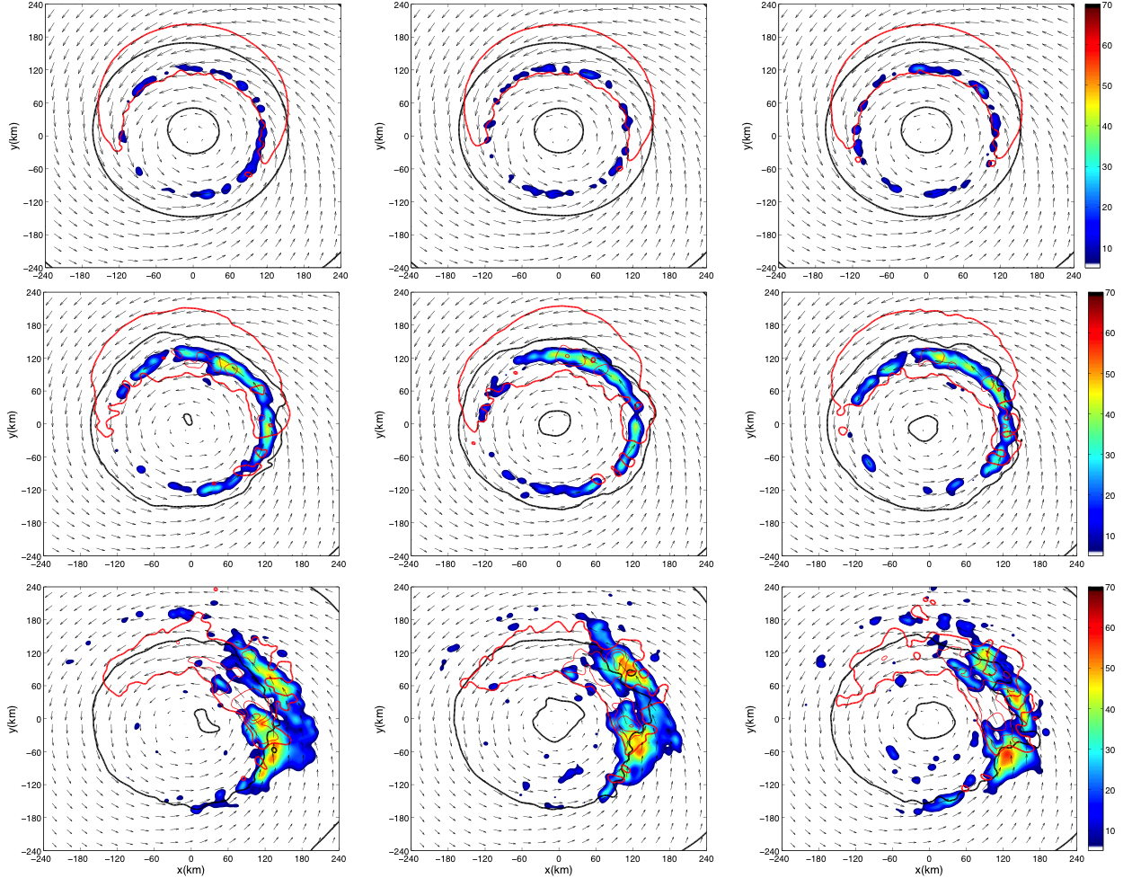
Surface Wind (red contour and vector), SLP, Max_dbz
EN15
EN20
EN26
8h
12h
24h
(Zhang & Tao 2012, JAS, in press)
Notes:
Then let’s have a look at surface wind, slp, max_dbz at different times. The red contours are the 10 m wind magnitude and black contours are slp. At 8 hour, The convection starts around the the center, they are quite symmetric. 4hous later, convection on the downhear side intensifies and convection on the uppershear side vanishes. At 24 hour simulation, the convections are all occurring on the downshear side.

Slide 5
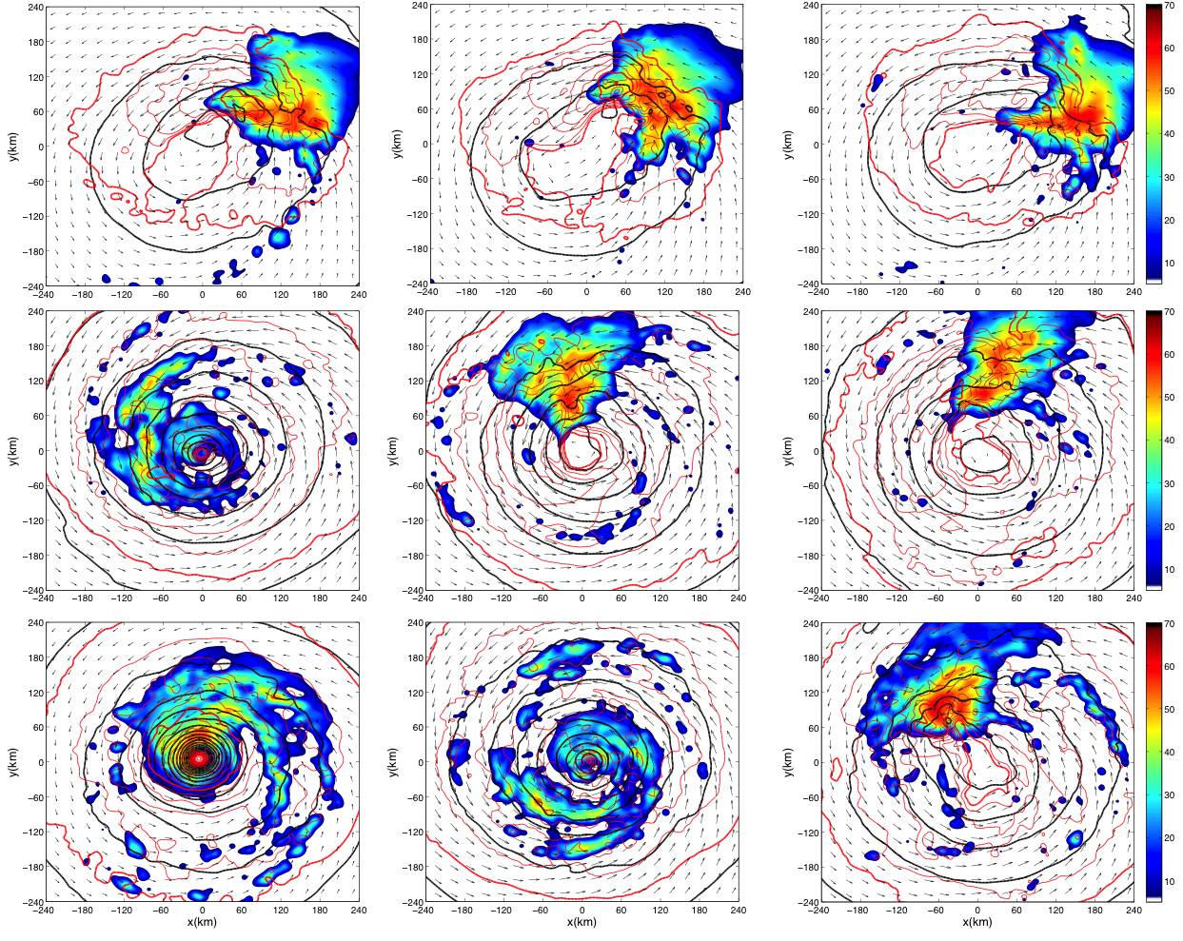
Surface Wind (red contour and vector), SLP, Max_dbz
EN15
EN20
EN26
44h
85h
106h
(Zhang & Tao 2012, JAS, in press)
Notes:
At 44 hour, the convections have moved cyclonically to the upper right quadrant as a whole, and EN15 has a little lower pressure center. At 85 hour, the convections in EN15 form around the center while EN20 has just moved to the upper shear left side and EN26 still in the down shear left side. Another 21 hours later, EN15 is fully developed while EN20 is repeating EN15’s procedure but more than 10 hours delayed. As for EN26, convection is still located at the upper shear left side.

Slide 6
Tilt and Shear Evolution
Increasing of tilt and shear magnitude at the beginning
Start the decrease of tilt and shear magnitude
After tilting angle reaches 90° (N), the tilt vector swirls faster
When tilt and shear magnitude reach their minima, TC rapid intensification stage starts
99h
133h
(Zhang & Tao 2012, JAS, in press)
Notes:
The process for EN20 and EN26 are the same, except for the timing. Now let’s have a look at the difference among these three members.

Slide 7
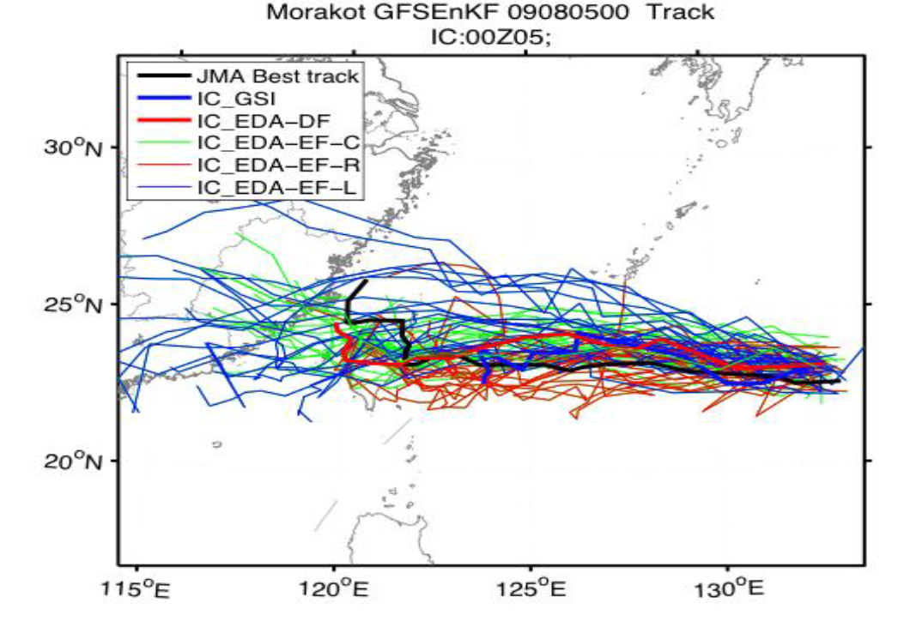
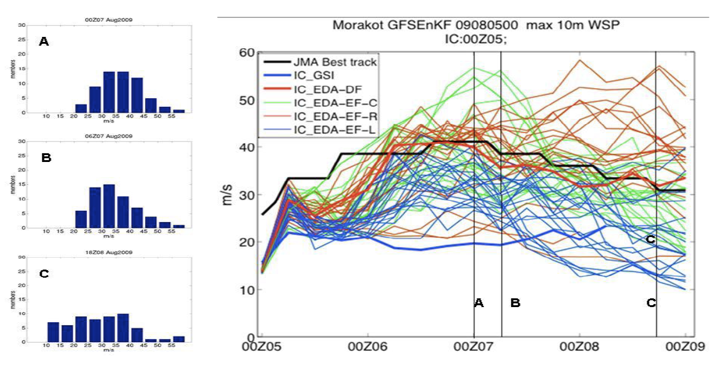
TC Track/Intensity Ensembles

Slide 8
HFIP Appropriation History
(2009-2013)
 | FY09 | FY10 | FY11 | FY12 | FY13 PB
WCOSS PAC | 6.000M | 3.000M | 3.000M | 4.000M (OMB increase) | 2.000M* (OMB 1yr reduction)
NWS ORF | 15.040M | 14.040M | 14.040M | 14.040M (pending $6.5M NWS reduction) | 13.644M* (OMB restored less $400K)
OAR ORF | 6.100M | 6.100M | 6.100M | 6.000M | 5.800M
TOTAL | $27.140M | $23.140M | $23.144M | $24.040M | $21.500M
*Anticipate Restoration in FY14
*Senate proposed full restoration of $400K

