Slide 1
2019-09-02_0400Z
Lin
SBM
Pmin_obs=914 hPa
Vmax_obs=74m/s
G4I
Tomp

Slide 2
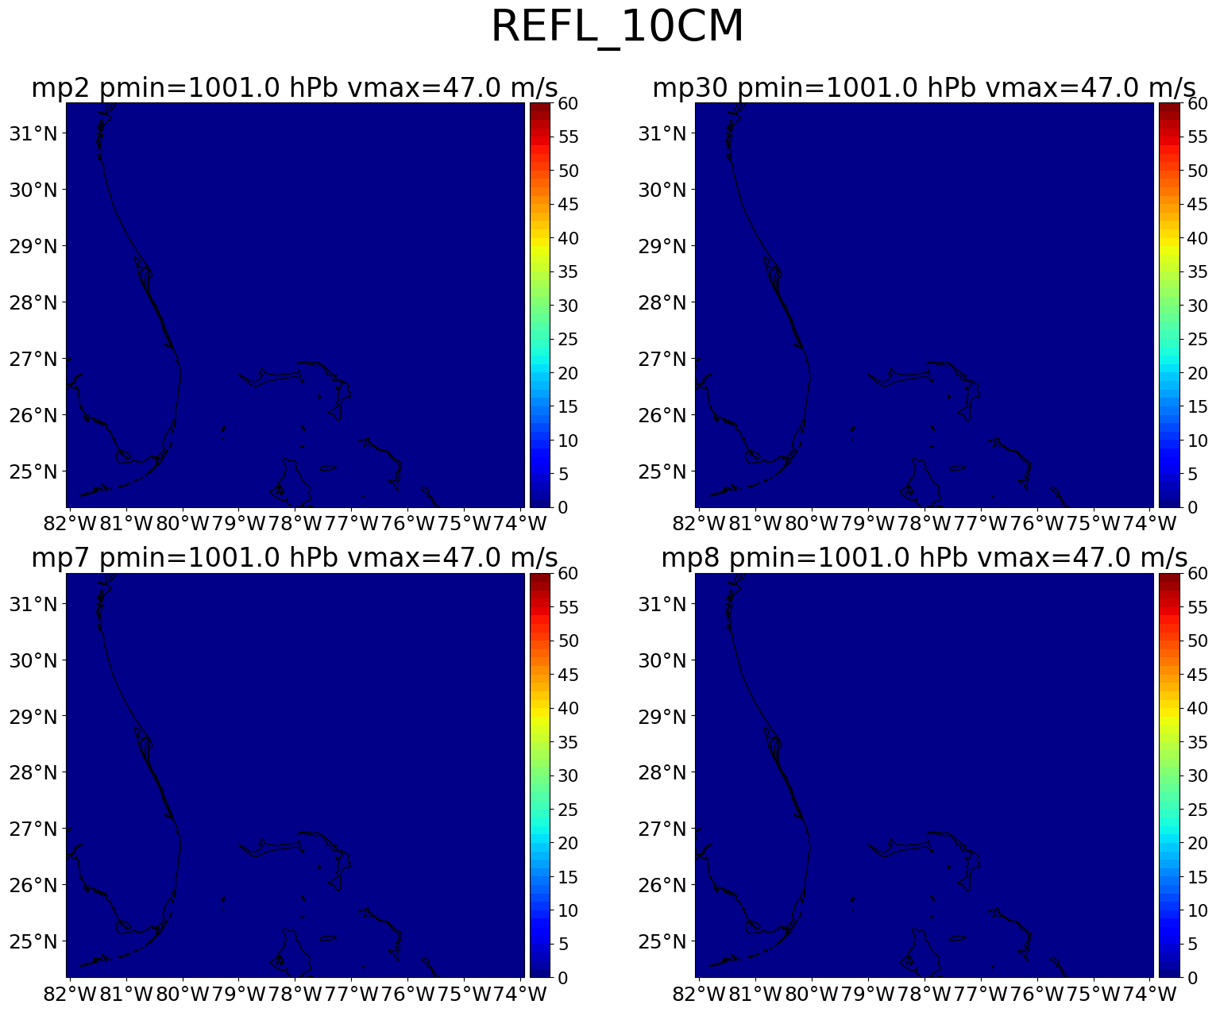
Lin
SBM
G4I
Tomp

