Slide 1
HMON (HNMMB): Development of a new Hurricane model for NWS/NCEP operations
Avichal Mehra, EMC Hurricane and Mesoscale Teams
Environmental Modeling Center
NOAA / NWS / NCEP

Slide 2
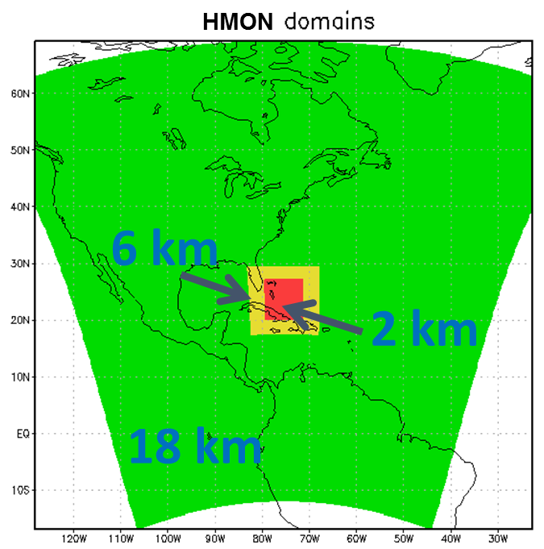
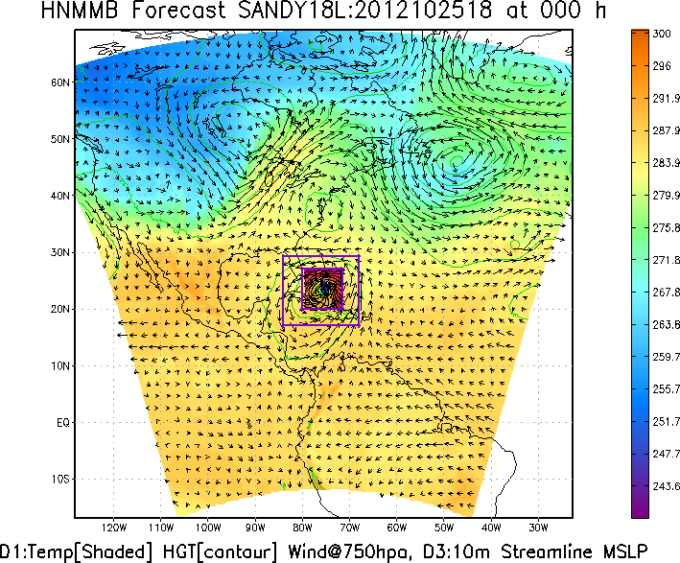
HMON: A New Operational Hurricane Model at NCEP
HMON
HMON: Hurricanes in a Multi-scale
Ocean coupled
Non-hydrostatic model
HMON: Implements a long-term strategy at NCEP/EMC for multiple static and moving nests globally, with one- and two-way interaction and coupled to other (ocean, wave, sea ice, surge, inundation, etc.) models using NEMS-NUOPC infrastructure.

Slide 3
Long-Term Strategies for Operational Hurricane Modeling at NCEP
Strategies for unified regional (meso-scale) models in the NEMS framework
Be able to meet the performance of current operational HWRF
Accommodate future development strategies including coupling to ocean, waves, land, surge and hydrology
Retain and expand community interactions fostered by HFIP
Flexible options for inner-core data assimilation
Enable future ensemble strategies and potential genesis and 7-day intensity forecasts
Strategies for unified global model with multiple moveable nests
Take advantage of NGGPS/FV3 supported development of non-hydrostatic global model in NEMS with high resolution nests for hurricanes
Leverage NMMB and GFS physics unification
Transition regional hurricane model components to global system for seamless prediction of hurricanes and severe weather
Strategies for serving the next-generation needs of operational tropical cyclone forecasters
Expand the products to include deterministic and probabilistic forecast guidance on genesis, rapid intensity changes, size, structure, storm-surge, rainfall, flooding and inundation and warn on forecasts

Slide 4
What is NEMS?
NEMS stands for: NOAA’s Environmental Modeling System
A shared, portable, high performance software superstructure and infrastructure
For use in operational prediction models at the National Centers for Environmental Prediction (NCEP)
Leveraging NUOPC related community developments
* slide courtesy Cecelia DeLuca

Slide 5
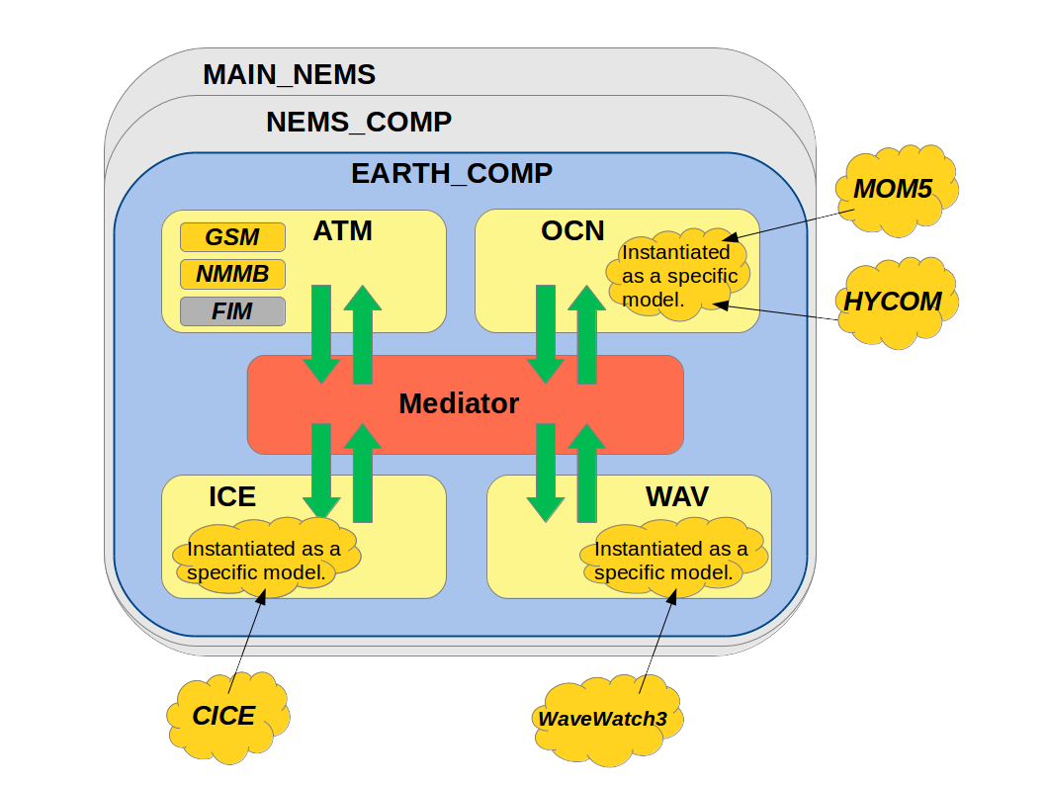
NEMS Architecture
Main Program
ESMF Component
NUOPC
Driver
NUOPC
Mediator
NUOPC
Models
NUOPC
Connector
* slide courtesy Cecelia DeLuca

Slide 6
FY17 HMON Configuration
Features
Current status
Flowchart
Physics options

Slide 7
HMON: Hurricanes in a Multi-scale Ocean coupled Non-hydrostatic model
HMON: Advanced Hurricane Model using NMMB (Non-hydrostatic Multi-scale Model on a B grid) dynamic core which is currently being used in NCEP’s operational NAM and SREF systems.
Shared infrastructure with unified model development in NEMS. A step closer towards NEMS/FV3 Unified Modeling System for hurricanes
Much faster, scalable and uses CCPP style physics package
Development supported by NGGPS, HFIP and HIWPP programs
Provides high-resolution intensity forecast guidance to NHC along with HWRF (replacing the legacy GFDL hurricane model)

Slide 8
Status of HMON at EMC (March 2017)
HWRF physics package and storm motion algorithm have been added to NMMB dy-core.
HMON vortex initialization has been developed.
HMON restart capability has been implemented.
(1) , (2), and (3) via active collaboration between EMC-HRD funded by HIWPP
Post and tracker scripts are working.
Python workflow has been built.
HMON ran in real-time on Theia for 2016 Hurricane season (using 1-5)
Retrospectives (2014-2016) completed using 2016 GFS.
Redo retrospectives using 2017 GFS (uncoupled and coupled)

Slide 9
Status of HMON at EMC (March 2017)
Two options for earth-system component coupling:
1. EMC legacy coupler (leverage HWRF developments)
-- operationally ready
-- extensively tested, robust
-- configured for 3-way interactions (air-ocean-wave)
2. NEMS-NUOPC coupler
-- unified modeling (Future)
-- based on ESMF regridding/functionality/portability
-- extensible to multiple-storm/component configurations
-- extensible to FV3/NEMS based configurations
-- leverage other coupled systems (NWS, NRL, NASA)

Slide 10
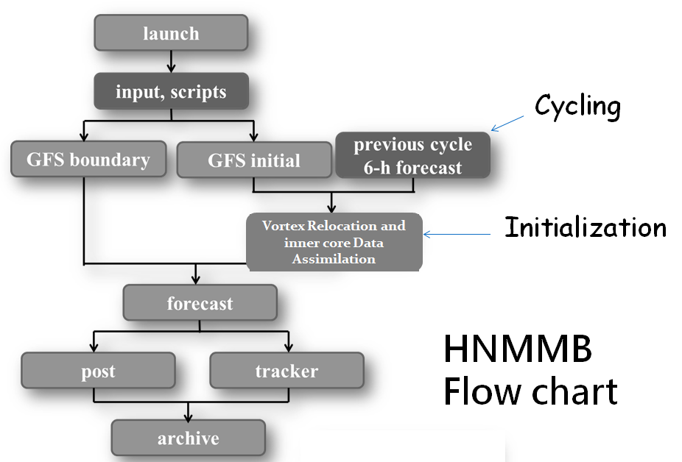
Design of HMON Workflow
HYCOM
Coupler

Slide 11
Detailed HMON Workflow
Ocean Component
Atmospheric Component
TC Vitals
Grid table
GDAS/GFS
Global RTOFS
Launch
Launch
TC Vitals
Storm message
Select domain
Configure domains
Forcing
(GDAS for 26 Hr)
BC
Forcing
(GFS for 132 Hr)
NPS
(Geo static for domains, GFS)
BC
IC
IC
24Hr
126 Hr
Vortex Relocation
(GFS tracker)
Previous
6 Hr forecast cycle
24 Hr nowcast
IC
Forecast
Post-processing
Vortex tracker
Archive

Slide 12
Physics options in HMON
Physics Package | Option
microphysics | Fer_hires
shortwave | RRTM
longwave | RRTM
turbulence | GFSHUR
convection | SASHUR
sfc_layer | GFDL
land_surface | noah

Slide 13
HWRF vs GFDL vs HMON
 | HWRF | GFDL | HMON
Dycore | Non-hydrostatic, NMM-E | Hydrostatic | Non-hydrostatic, NMM-B
Nesting | 18/6/2 kms; 75°/25°/8.3°, Full two-way moving | ½.°,1/6°,1/18°; 75°/11°/5°, Two-way moving with bc | 18/6/2 kms; 75°/12°/8°, Full two-way moving
Data Assimilation and Initialization | Self-cycled two-way HWRF EnKF-GSI with inner core DA (TDR); Vortex relocation & adjustment | Spin-up using idealized axisymmetric vortex | NDAS, NLDAS with partial cycling; Vortex relocation & adjustment
Physics | Updated surface (GFDL),GFS-EDMF PBL, Scale-aware SAS, NOAH LSM, RRTM, Ferrier | Surface (GFDL), GFS PBL(2014), SAS, GFDL LSM, RRTM, Ferrier | Surface (GFDL), GFS PBL (2015), SAS, NOAH LSM, RRTM, Ferrier
Coupling | MPIPOM, RTOFS/GDEM Wavewatch-III | MPIPOM, RTOFS/GDEM, No waves | HYCOM, RTOFS/NCODA, No waves
Post-processing | NHC interpolation method, GFDL tracker | NHC interpolation Method, In-line tracker | NHC interpolation method, GFDL tracker
NEMS/NUOPC | No | No | Yes with moving nests

Slide 14
2014-2016 Retrospective Statistics for HMON

Slide 15
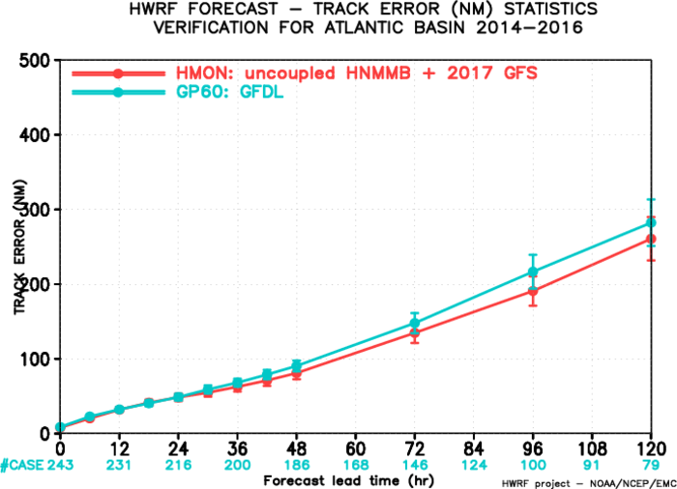
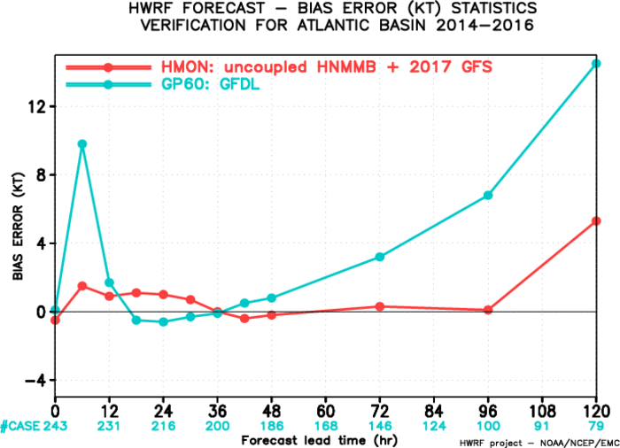
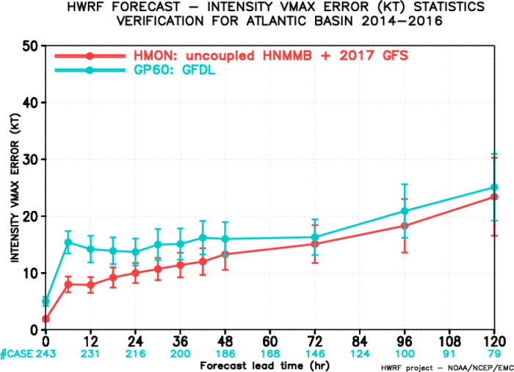
2017 HMON Performance: North Atlantic Basin
2017 HMON track errors shows significant improvement as compared to GFDL errors especially at long-lead times.
Intensity errors are also considerably less than GFDL with improved results for early lead-times (up to 48 hrs).
Preliminary results.

Slide 16
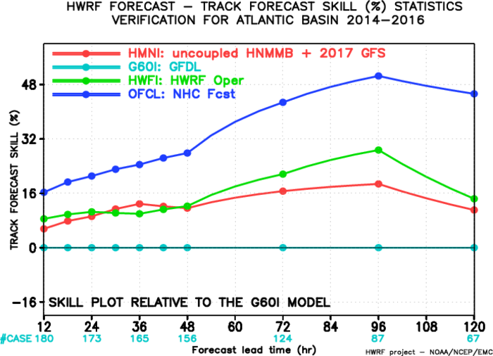
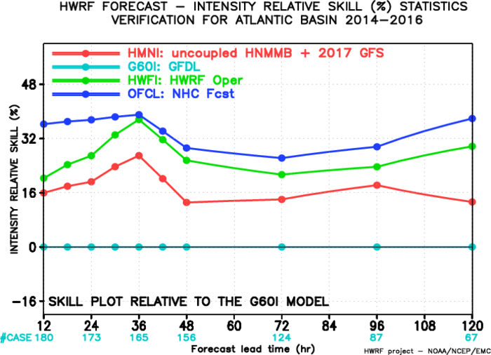
2014-16 Atlantic Basin: Relative to GFDL
(interpolated)
HMON has improved track skills as compared to GFDL with an average improvement of more than 8%. It also has improved intensity skills with a mean improvement of >15%.

Slide 17
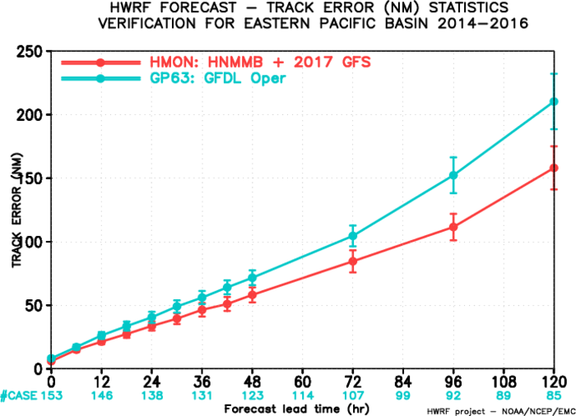
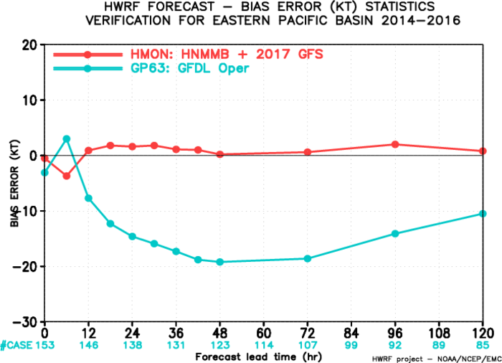
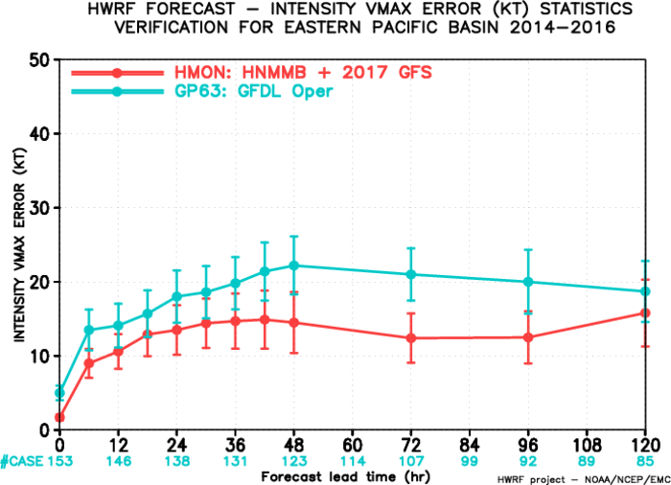
2017 HMON Performance: North East Pacific Basin
2017 HMON has much better results than GFDL for track error in the East Pacific basin.
2017 HMON has much superior results than GFDL for intensity errors at all lead times in the East Pacific basin.
Intensity bias is also much improved as compared to GFDL.
Preliminary results.

Slide 18
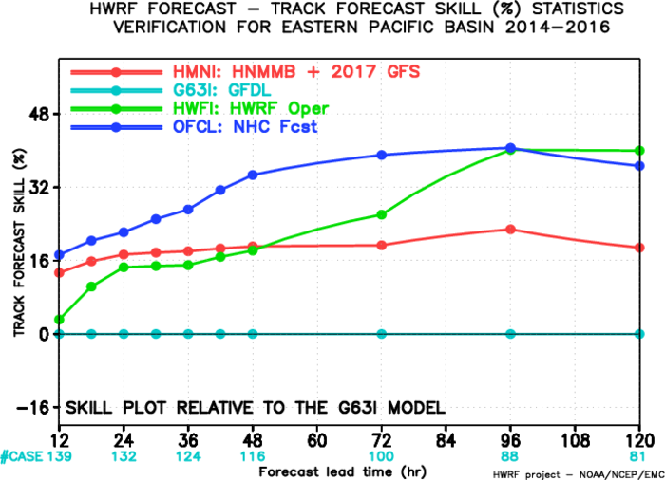
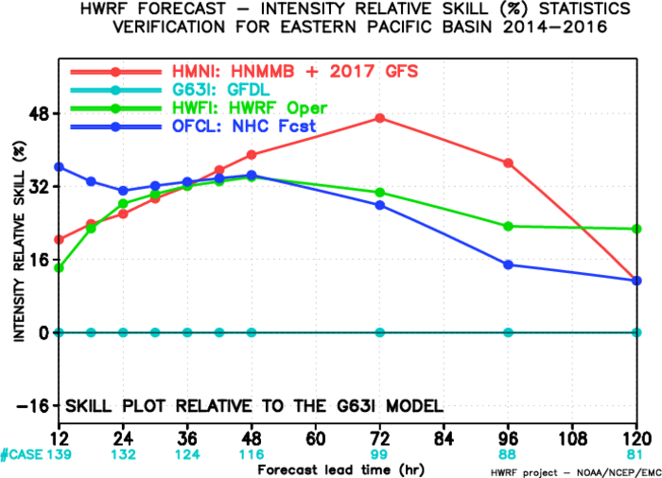
2014-16 East Pacific Basin: Relative to GFDL
(interpolated)
HMON has improved track skills as compared to GFDL with an average improvement of more than 15%. It also has significantly improved intensity skills with a mean improvement of >20%.

Slide 19
HMON verification Statistics: Conclusions
Compared with GFDL, HMON consistently shows improved performance for track and intensity skill for the North Atlantic basin (based on 2014-16 seasons)
Compared with GFDL, it also consistently shows improved performance for track and intensity skill for the North East Pacific basin (based on 2014-16 seasons)
Results are different from HWRF and usually exhibit larger track errors in comparison especially at longer lead-times
Check impact on NHC consensus model tracks and intensity forecasts before operational implementation (NHC)

Slide 20
Targeted Resources for Hurricane Modeling
(maximum per storm)
Operational System | 2016 (nodes) | 2017 (nodes) | Comments
HWRF | 63 | 63 | No change
WW3-multi2 | 9 | 0 | WW3 subsumed in HWRF
GFDL | 3 | 0 | Discontinued
HMON | 0 | 26* | Uses much less resources than HWRF
TOTAL | 75 | 89 | 18.7% resource increase*
*Initial implementation is targeted for only 5 maximum storms serving NHC areas of responsibility (ATL, EPAC & CPAC)

Slide 21
HMON: Current and Future Tasks
Redo retrospectives with 2017 GFS data plus ocean coupling plus other upgrades
Data Assimilation developments (sync with HWRF)
Nesting under active development with NESII/ESRL/HRD/GFDL using NEMS/NUOPC
Extend HMON to all global Basins (incl. WPAC, NIO and SH)
Potential migration from NMMB to FV3-based NGGPS Dycore under NEMS

Slide 22
HWRF/HMON Long-Term Plans
2016
2017
2018
2019
2020
HWRF Operational Model Continues Followed by Ensembles
GFDL –—–— HMON
10-member HWRF/ HMON Ensembles
NEMS Global Nests (NGGPS)
Basin-Scale HWRF/NMMB/FV3—–— Global/Tropical Domains
Hurricane Models take over Hurricane Wave Forecasts
Development, T&E and Implementation Plans for HWRF & HMON
2016 Nov: Configuration ready
2016 Dec- 2017 March: Pre-implementation retrospective testing
2017 April: EMC CCB and code hand-off
2017 June: Operational Implementation

Slide 23
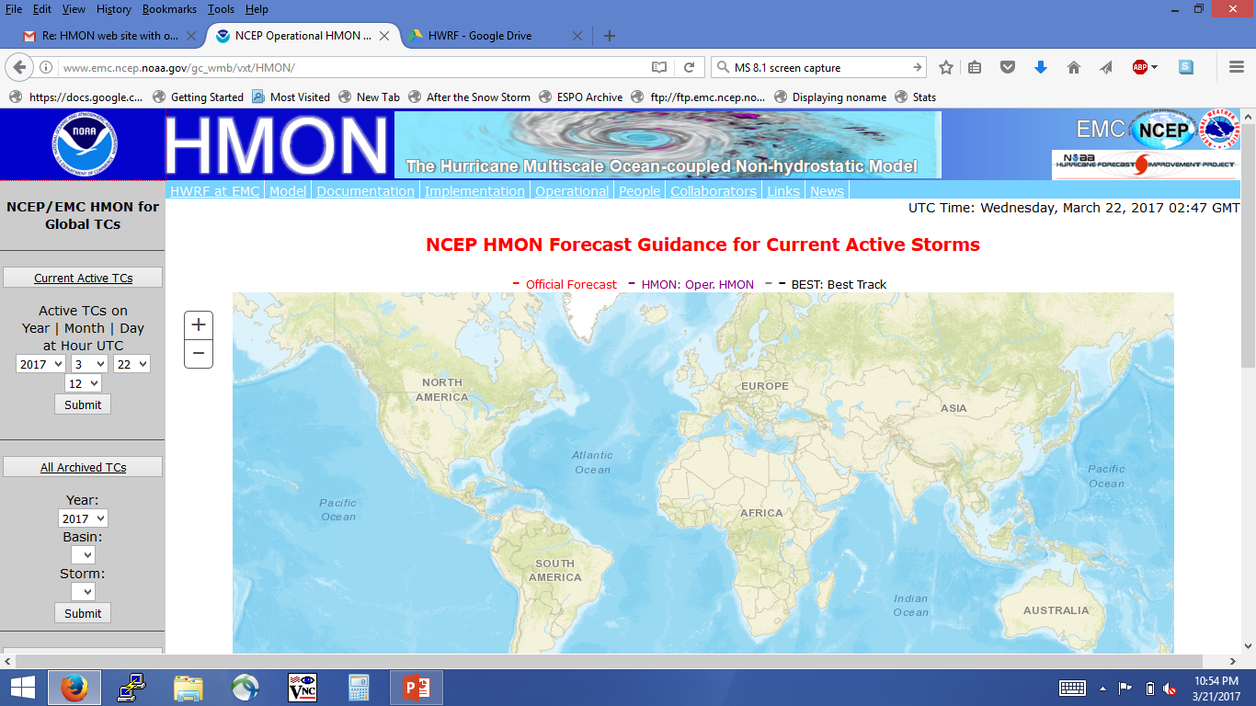
HMON Home Page
www.emc.ncep.noaa.gov/gc_wmb/vxt/HMON/

Slide 24
Thank You!

