Slide 1
Tropical Cyclone Observations from NOAA’s Hurricane Field Program
Jonathan Zawislak

Slide 2
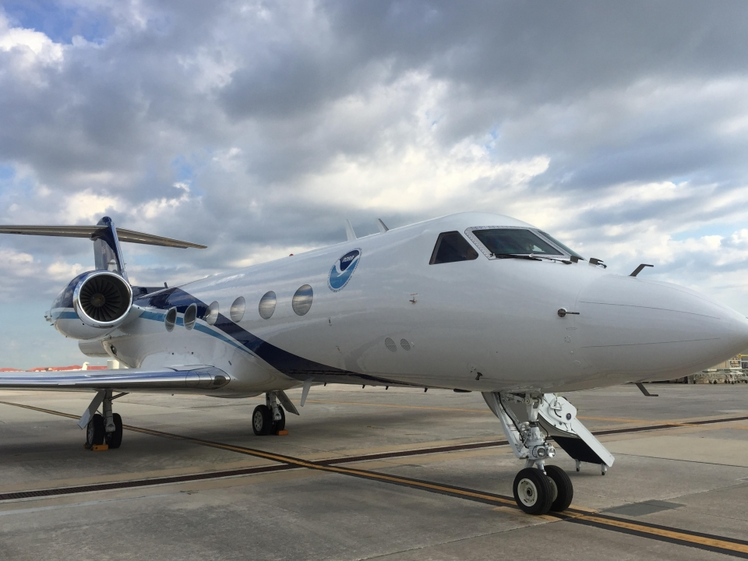
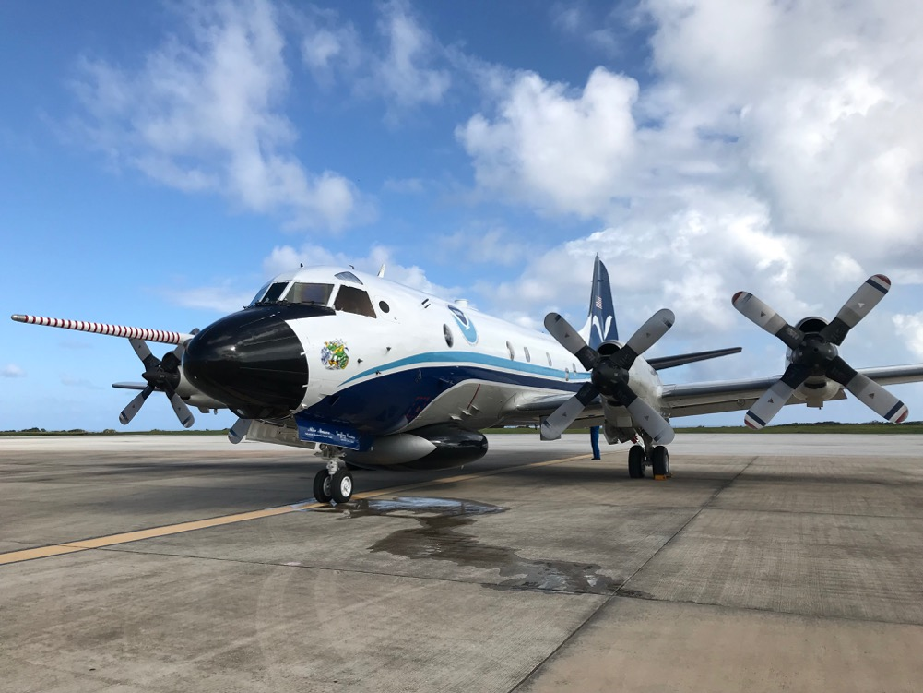
NOAA G-IV
NOAA WP-3D

Slide 3
Intensity Forecast Experiment (IFEX)
In Partnership with
NOAA/OMAO Aircraft Operations Center
Annual budget for flight hours on G-IV/P-3
Collecting observations in support of the Hurricane Forecast Improvement Project (HFIP)
RESEARCH
GOALS
BASIC
UNDERSTANDING
INTEGRATE OBSERVATIONS INTO MODELS
DEVELOP REAL-TIME MONITORING CAPABILITIES
Notes:
NOAA and other Agencies
NESDIS (Joint Polar Satellite System Proving Ground*) -Scientific, leveraging resources (*dropsondes)
National Center for Atmospheric Research Office of Naval Research
Academia

Slide 4
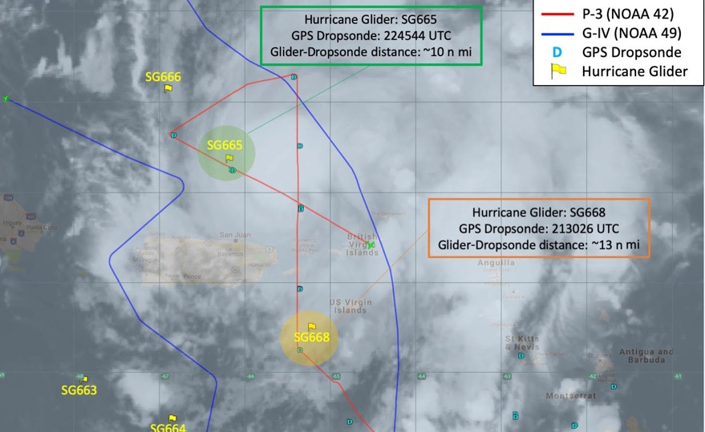
Intensity Forecast Experiment (IFEX)
Collecting observations in support of the Hurricane Forecast Improvement Project (HFIP)
Enhanced coordination with PhOD
RESEARCH
GOALS
BASIC
UNDERSTANDING
INTEGRATE OBSERVATIONS INTO MODELS
DEVELOP REAL-TIME MONITORING CAPABILITIES
Notes:
NOAA and other Agencies
NESDIS (Joint Polar Satellite System Proving Ground*) -Scientific, leveraging resources (*dropsondes)
National Center for Atmospheric Research Office of Naval Research
Academia

Slide 5
NOAA’s Hurricane Field Program
RESEARCH
Research
to
Operations
Operations
to
Research
Supporting observational data collection for research and operations
OPERATIONS
National Centers for Environmental Prediction (NCEP) / Environmental Modeling Center (EMC)
National Weather Service / National Hurricane Center
NOAA National Environmental Satellite, Data, and Information Service (NESDIS)

Slide 6
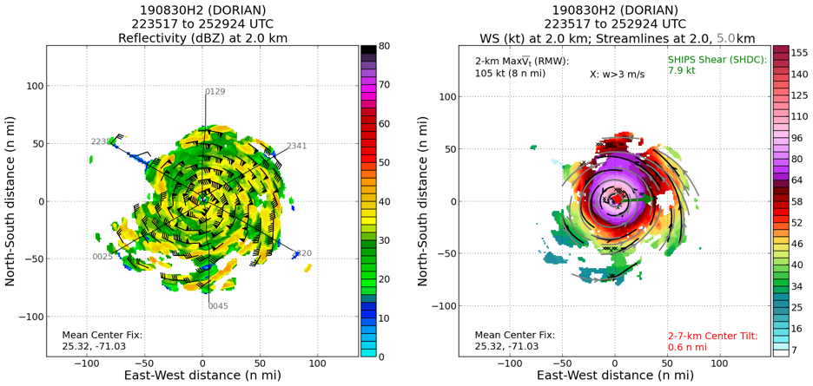
Near real-time monitoring and data transmission
Hurricane Dorian
OPERATIONS
Assimilation of radar data into HWRF
P-3 / G-IV
Visualize in AWIPS-II
Inner core (90 n mi) circumnavigation for G-IV NHC missions
Tail-Doppler Radar

Slide 7
2019 HFP-IFEX by the Numbers
Research Hours
Operational Hours
EMC-Tasked Missions
196
283
64%
OAR + NESDIS
on P-3s and G-IV
on P-3s and G-IV
Out of 36 P-3 storm missions

